Slide 1
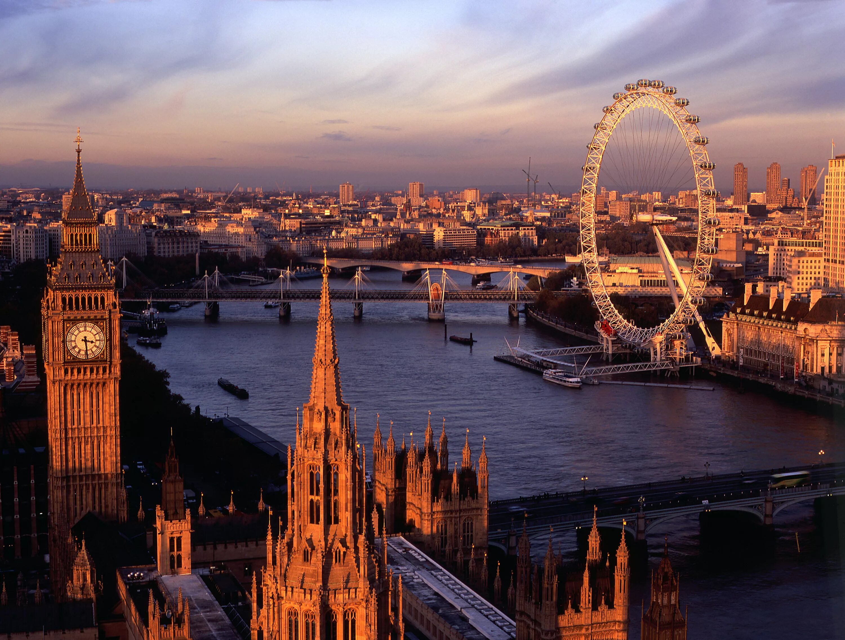
Around London
Калитиевская Екатерина Дмитриевна

Slide 2
London is a brilliant city for tourists with many interesting places.
London museums
Royal London
London for Harry Potter fans
Spooky places
Shopping in London

Slide 3
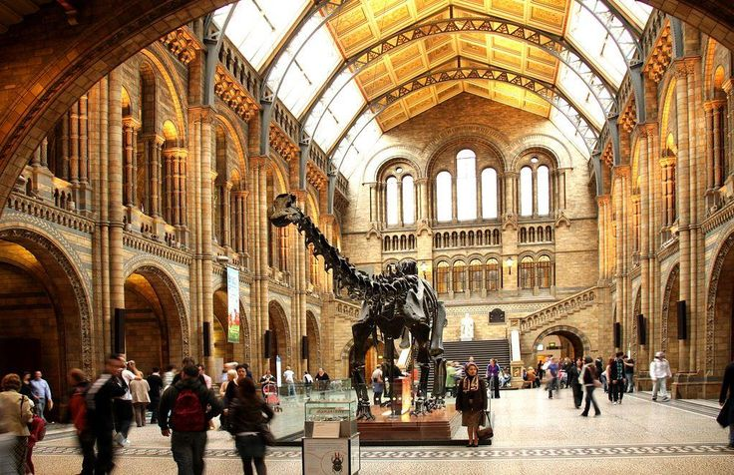
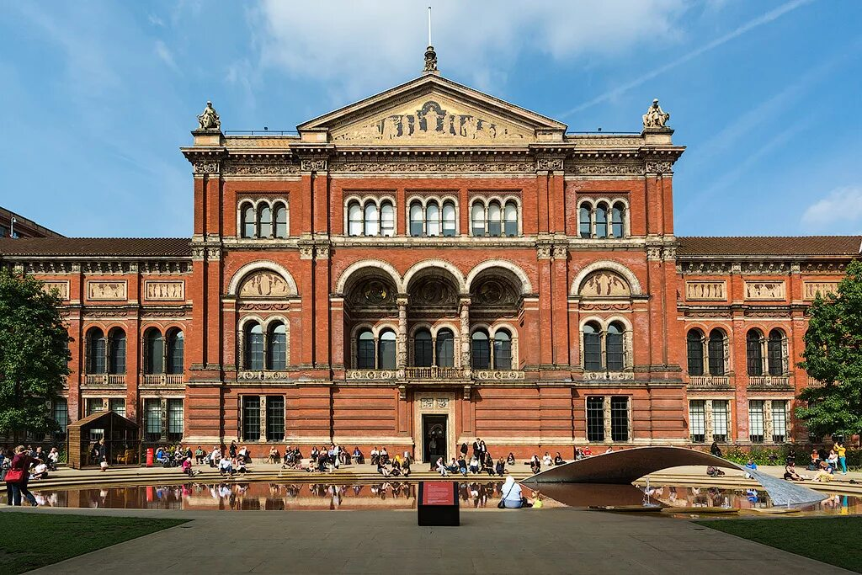
London museums
London is home to nearly 200 museums but the following are the ones that teens will enjoy best.
The Natural History Museum
Victoria and Albert Museum

Slide 4
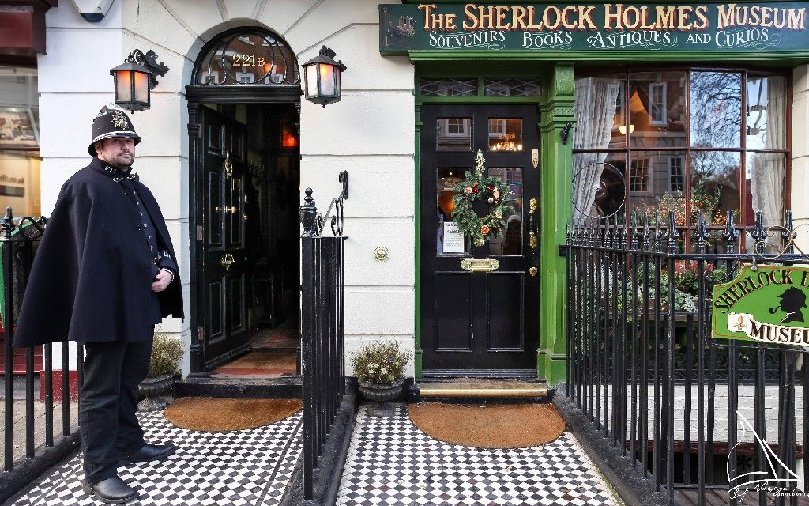
Sherlock Holmes Museum
Located on Baker Street, one of the most famous streets in London, the Sherlock Holmes Museum is in the home of the legendary detective Sherlock Holmes (author Sir Arthur Conan Doyle made this address the detective’s residence).
Today you can walk around the rooms, which are filled with real Victorian furniture and knick knacks belonging to the iconic detective and his enemies.

Slide 5
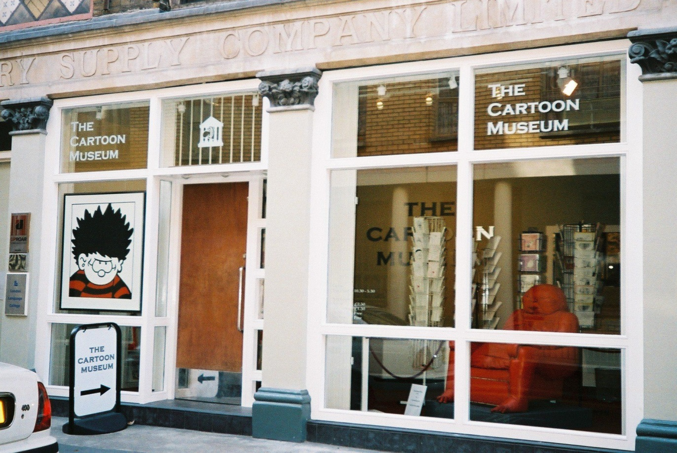
Cartoon Museum
It is a great option for teens with an interest in current affairs because it focuses more on the history of political cartoons and social commentary than on comics for kids.
Located in Fitzrovia, the museum houses over 6,000 original cartoon and comic artwork and a library of over 8,000 books and comics.

Slide 6
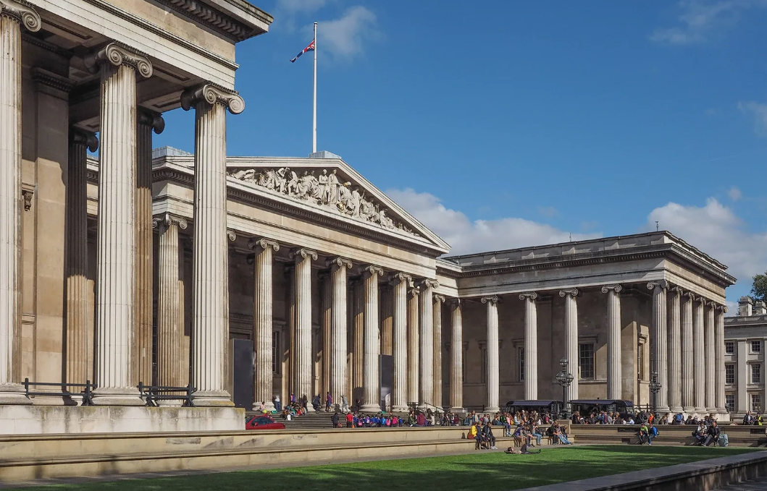
British Museum
The doors to the British Museum, the world’s oldest national public museum, first opened in 1759 .
The museum is a real Aladdin’s Cave of artefacts from around the world and is a fascinating place to visit in London with teens. Among its treasures, you’ve got bits of the Greek Acropolis, the Rosetta Stone, a burial helmet from Sutton Hoo and an Easter Island statute.
In addition to the permanent exhibitions there are regular temporary exhibitions. Plus, they host sleepovers at the museum too.

Slide 7
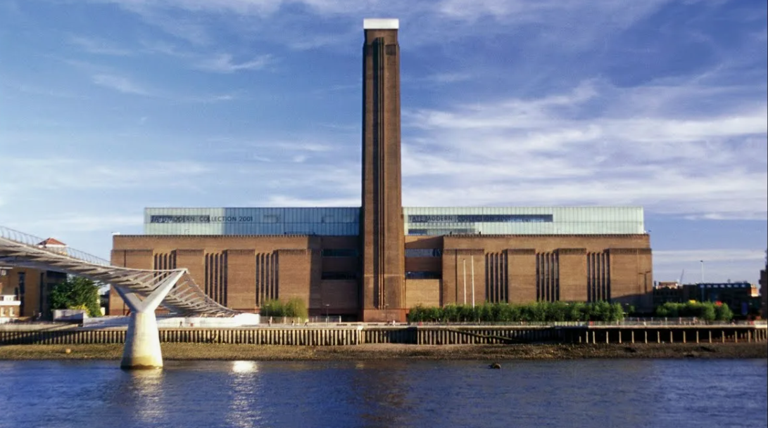
Tate Modern
Tate Modern is one of the largest museums of modern and contemporary art in the world. It is located in the former Bankside Power Station.

Slide 8
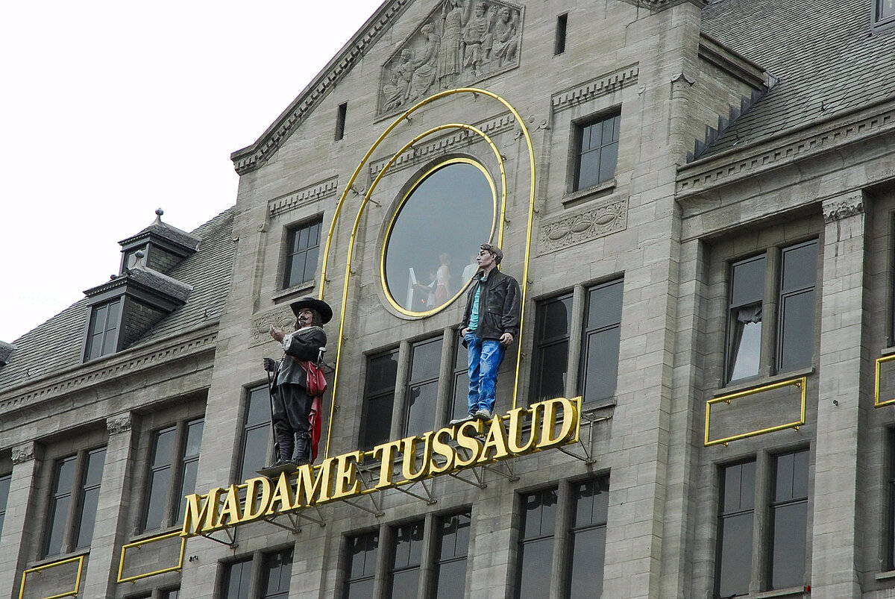
Madame Tussauds
Madame Tussauds is a wax museum in London.
A major tousrist attraction in London since the Victorian era, Madame Tussauds displays the waxworks of famous and historical figures, as well as popular film and television characters played by famous actors.

Slide 9
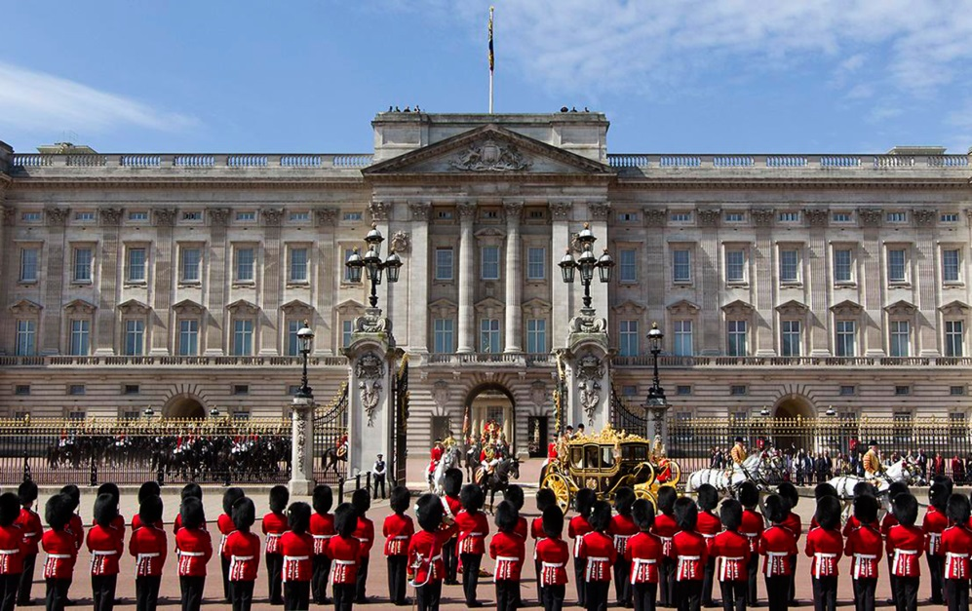
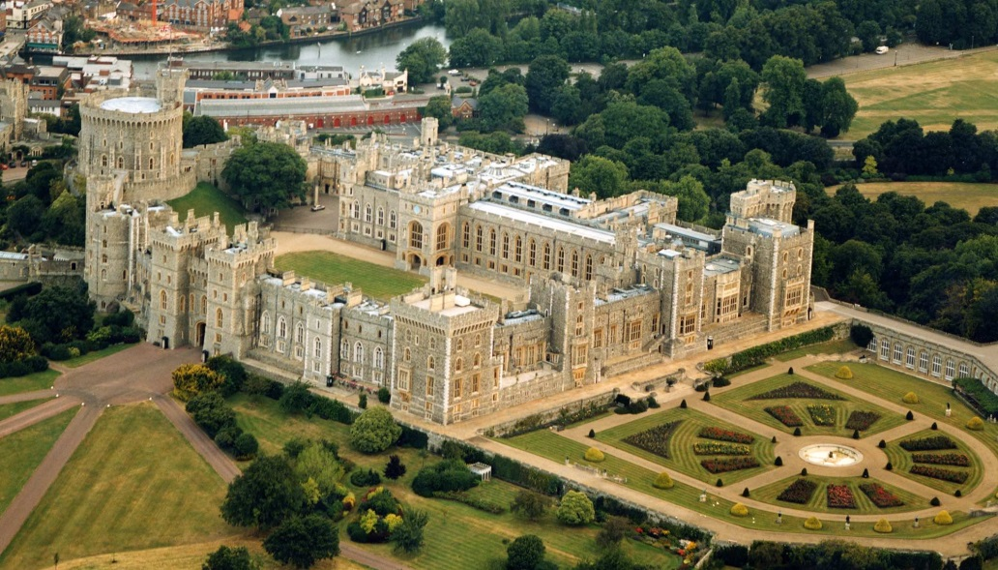
Royal London for teenagers
Whether you love Kate and Wills or are fascinated by Megan and Harry, it’s easy to plan a royal-themed day out in London.
Buckingham Palace
Windsor Castle

Slide 10
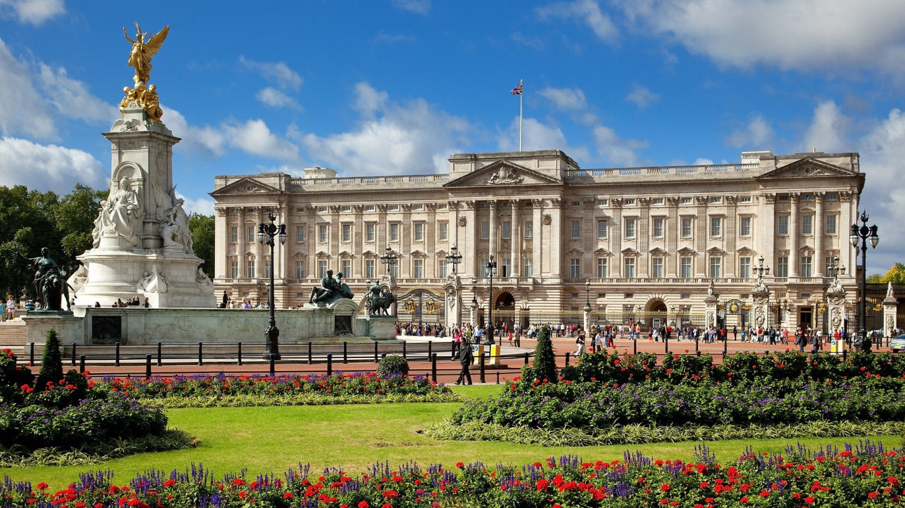
Buckingham Palace
Buckingham Palace is the official residence of the King and Queen. Located in the City of Westminster , the palace is often at the centre of state occasions and royal hospitality.

Slide 11
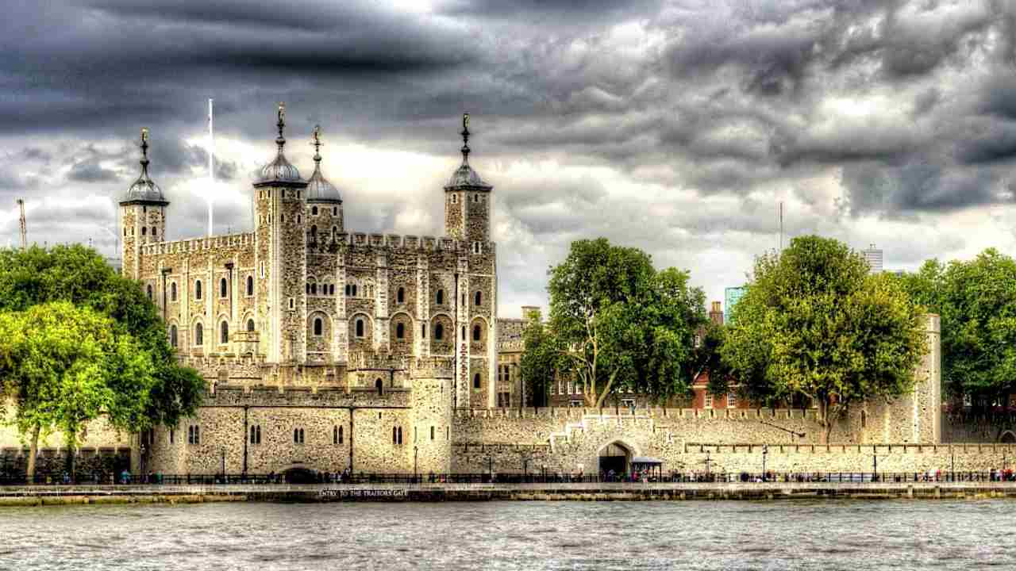
Tower of London
The Tower of London is a historical castle. William the Conqueror built the Tower of London as a fortress to stay safe. Later it used to be a prison, Royal Zoo, and jewel house.
You can see big black ravens there. They are well-kept. The legend says that if the ravens ever leave, the Tower and the kingdom will fall.

Slide 12
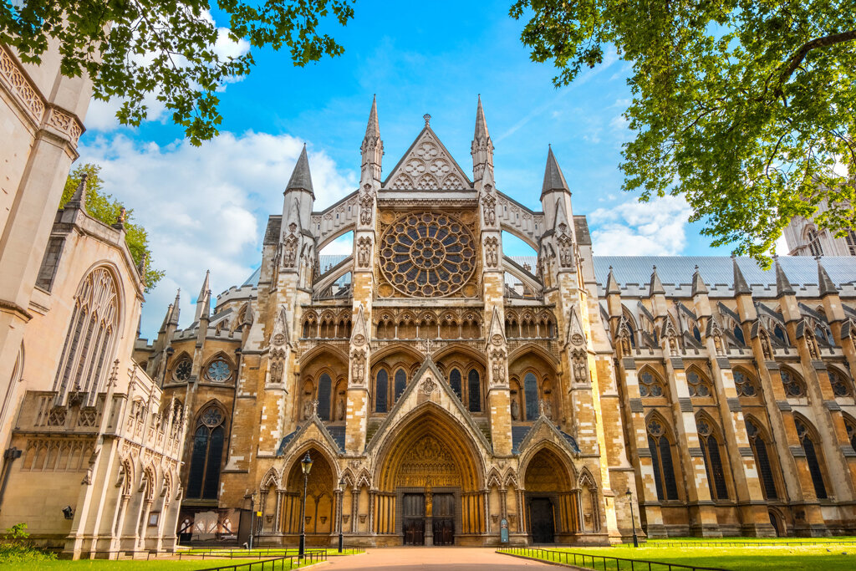
Westminster Abbey
Westminster Abbey is the magnificent coronation church that sits in the heart of central London. It was built in the 13th century. Many royal weddings have taken place there. Also many famous Englishmen men and kings were buried there.

Slide 13
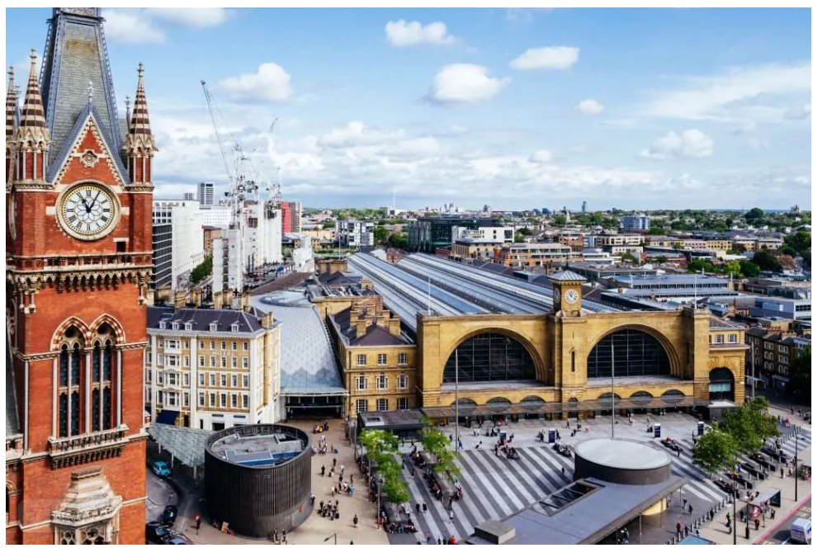
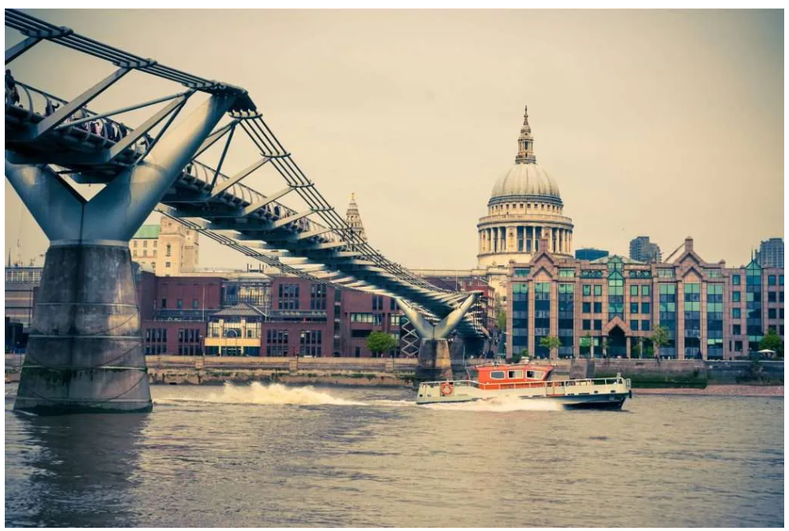
London for Harry Potter fans
There are many teenagers all over the world who are crazy about the world of Harry Potter. In London you can find some places that are connected with it in some way.
Platform 9 ¾ at King’s Cross Station
Millennium Bridge

Slide 14
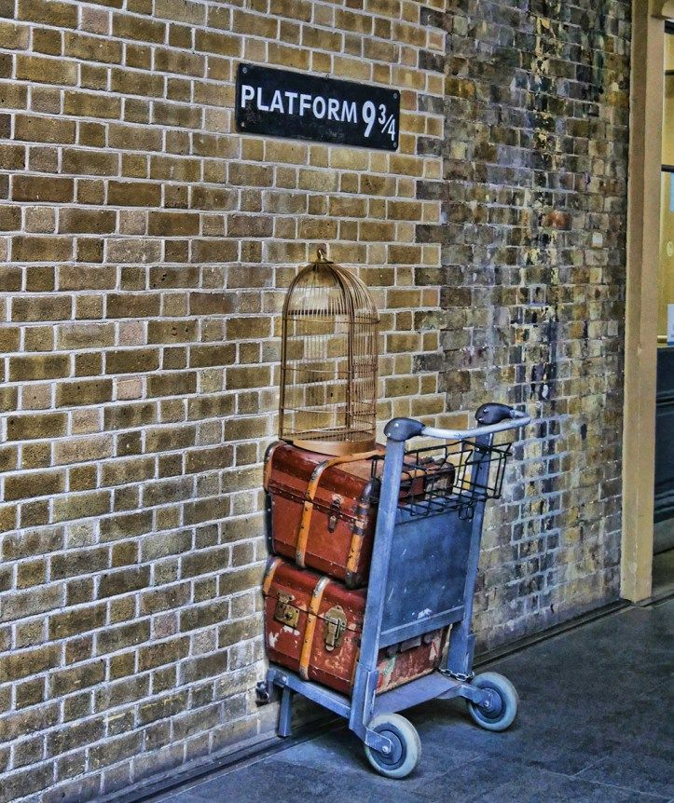
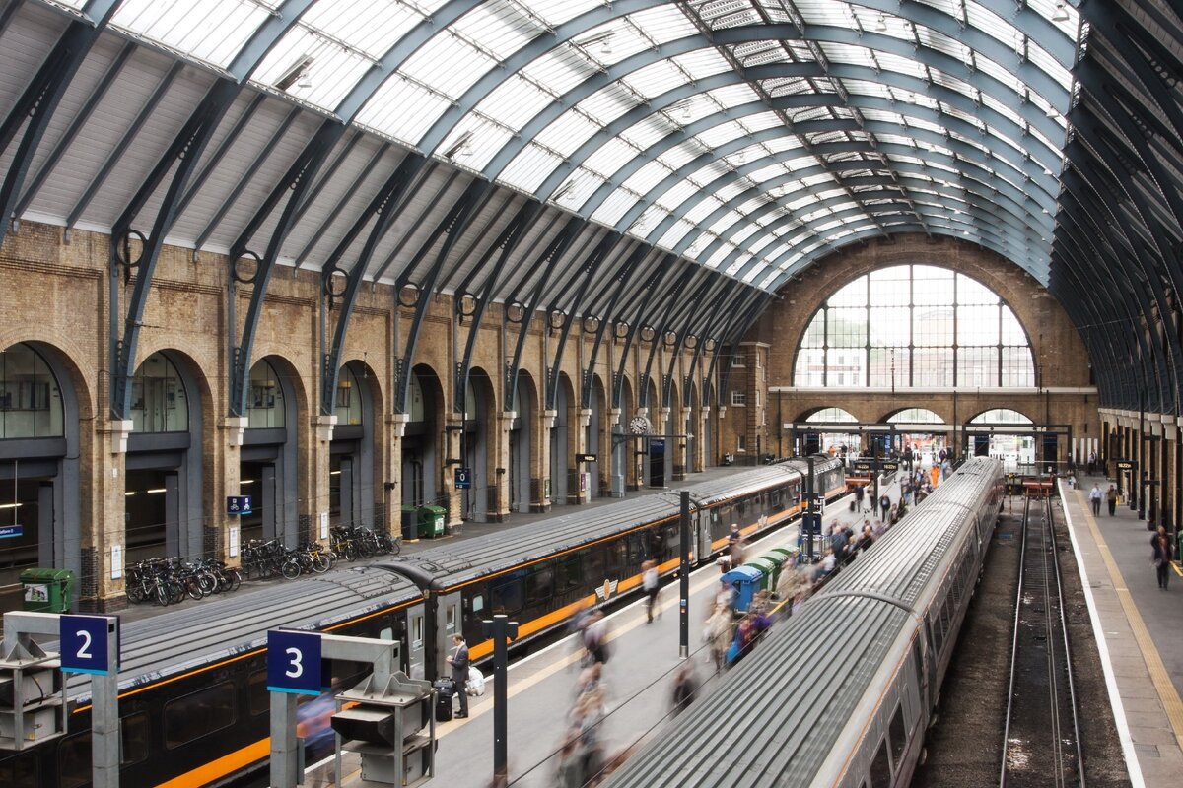
Platform 9 ¾, King’s Cross
Platform 9 ¾ at King’s Cross is an iconic location in J.K. Rowling’s Harry Potter series, serving as the magical gateway for students to embark on their journey to Hogwarts School of Witchcraft and Wizardry. This enchanted platform holds a special place in the hearts of fans worldwide, offering a glimpse into the enchanting world of wizards and witches.

Slide 15
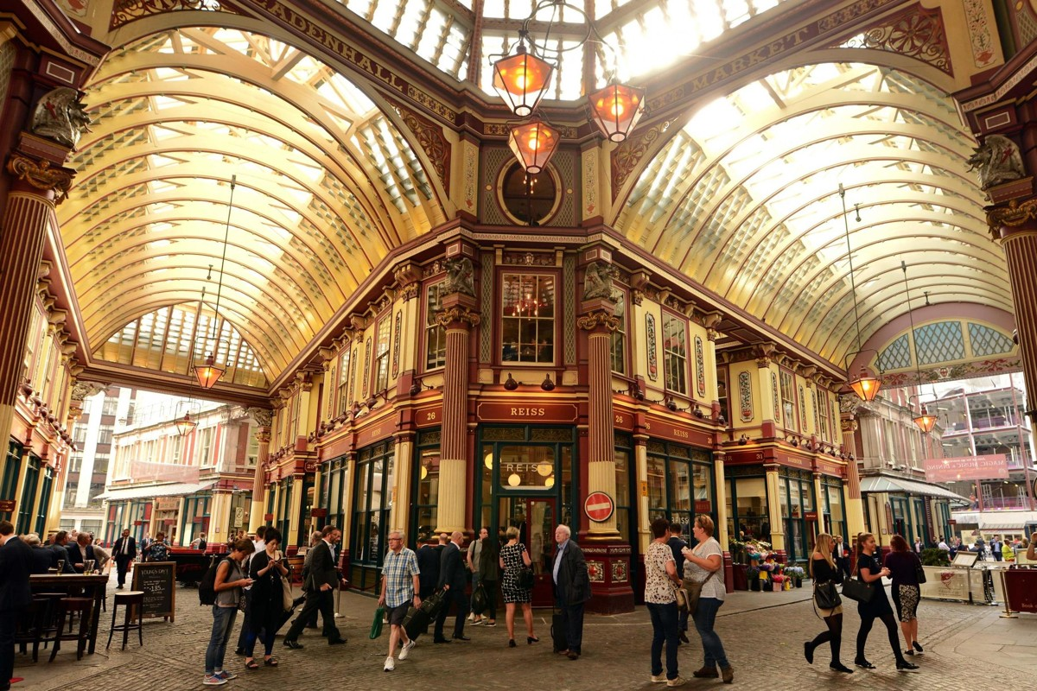
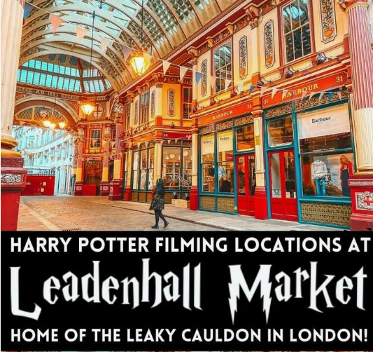
Leadenhall Market
Leadenhall Market and its amazing Victorian architecture will transport you straight to Diagon Alley—understandable, since this is where exterior shots of the wizard shopping district were filmed. While you won’t find Ollivander's Wand Shop, you will be able to visit some unique stores, restaurants, and bars here. In Bull’s Head Passage, the door to what is now an optician (The Glass House) was used as the entrance to The Leaky Cauldron pub in The Sorcerer's Stone.

Slide 16
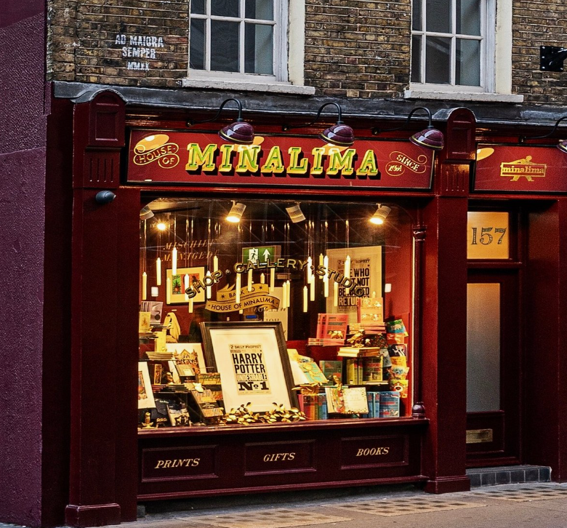
House of MinaLima
Harry Potter fans should pay a visit to MinaLima in London’s Soho. The store is filled with graphic art of the Harry Potter and Fantastic Beasts films as well as limited edition art prints designed by MinaLima. You’ll also see props from the films on display.

Slide 17
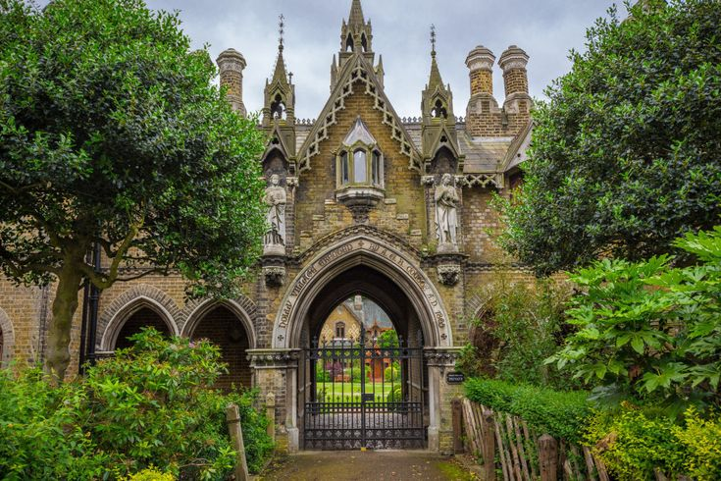
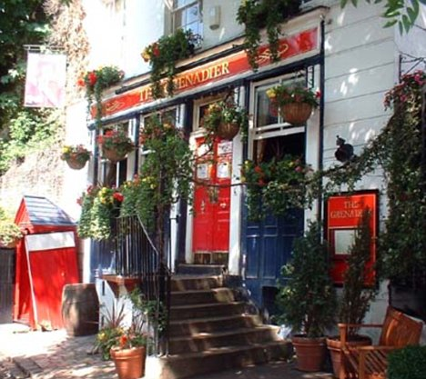
Spooky places
If you like things that go bump in the night then London’s a great place to explore. There are lots of spooky sights and plenty of gruesome stories!
Highgate Cemetry
The Grenadier Pub

Slide 18
Tower of London
Many people believe that the Tower of London is haunted. With the gruesome and often tragic history of its prisoners, this is not very surprising.

Slide 19
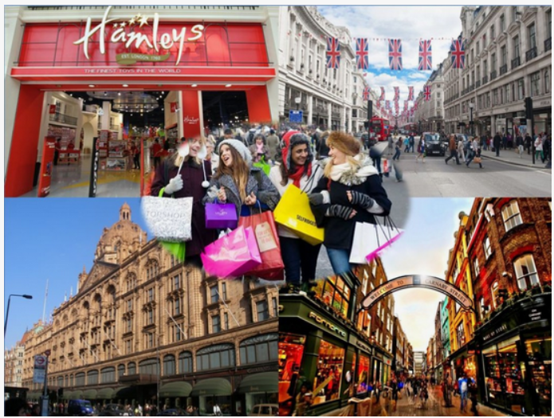
Shopping in London
Whether you like high street shopping or prefer rummaging for vintage bargains, teens and tweens will love shopping in London.

Slide 20
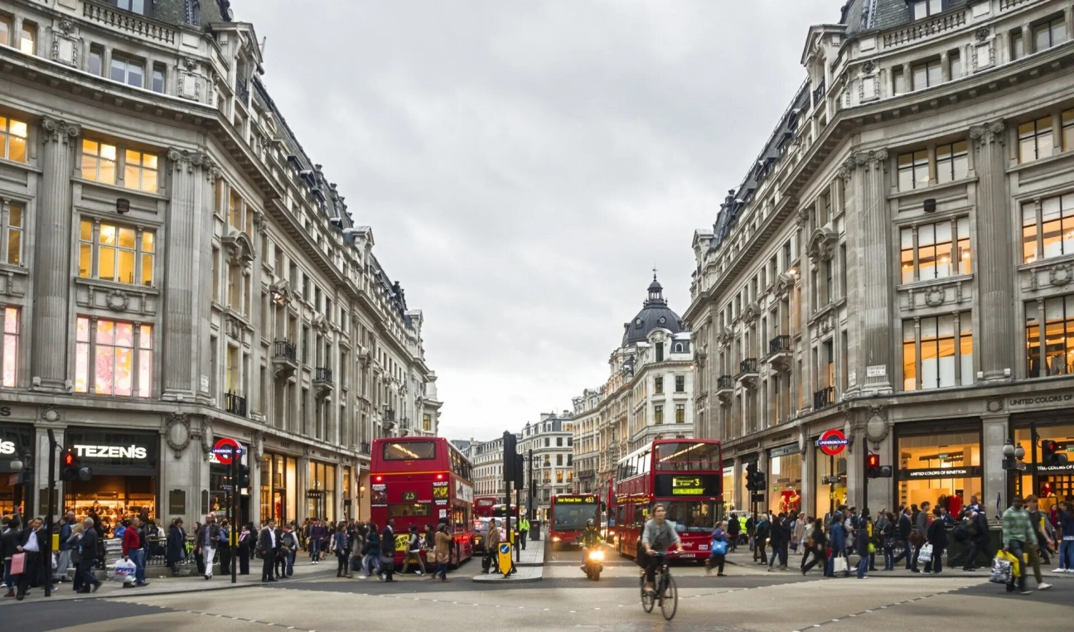
Oxford Street
Oxford Street is home to high-end brands as well as some of the UK’s most iconic department stores including Selfridges and John Lewis.

Slide 21
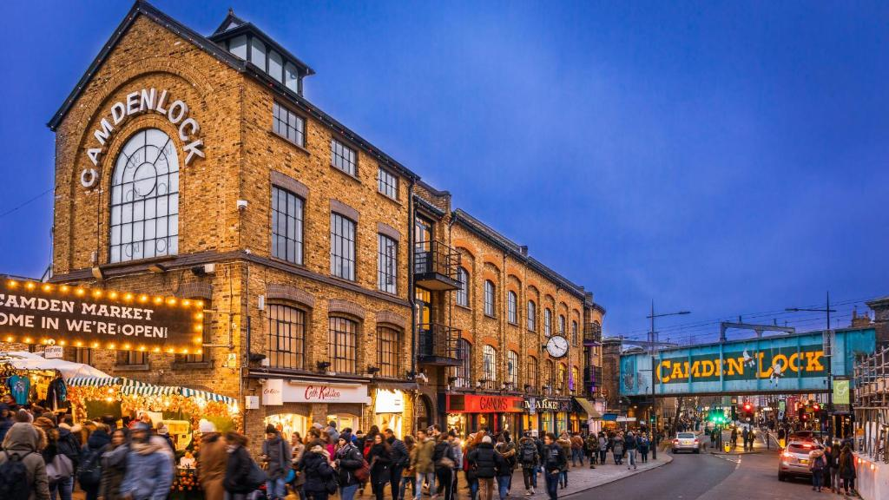
Camden Market
The lively neighbourhood of Camden in north London is fun to discover with teens. The highlight is Camden Market, located next to Regent’s Canal. Home to over 1,000 places to shop, eat and drink you’ll find everything from vintage clothing and jewellery to vinyl records and photography. The food options are fantastic too with street eats from around the world.

Slide 22
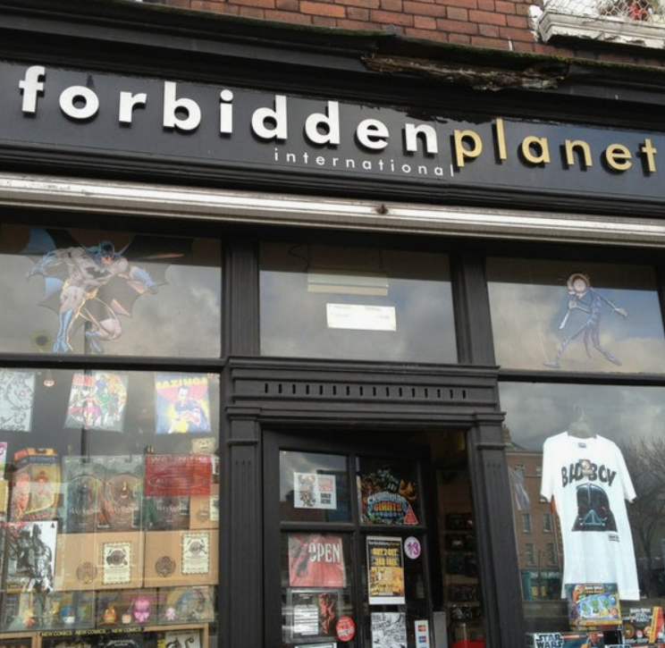
Forbidden Planet
Forbidden Planet is a great place for anime fans. This two-storey store stocks a huge range of books covering science fiction, animation, graphic design, superheroes, computer games and much more. You’ll also find lots of DVDs, collectible figures, clothing and posters.

Slide 23
Quiz
London is the capital of …
You can go shopping … in London.
In London you can visit many places where scenes from … (film) took place.
In the picture we can see…
… lived in Baker Street. Now his home is a ….

