Slide 1
Herbal medicine
Bagiyan Karina

Slide 2
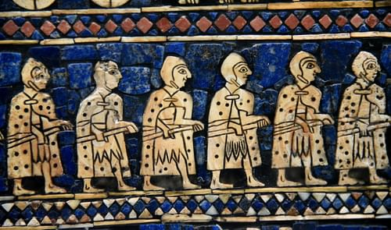
History
Archaeological evidence indicates that the use of medicinal plants dates back to the Paleolithic age, approximately 60,000 years ago.
Written evidence of herbal remedies dates back over 5,000 years to the Sumerians, who compiled lists of plants.

Slide 3
review
It is estimated that 80% of world population rely on traditional herbal medicine for primary health care.
A wide variety of herbal medicines are readily available in the market all over the world.

Slide 4
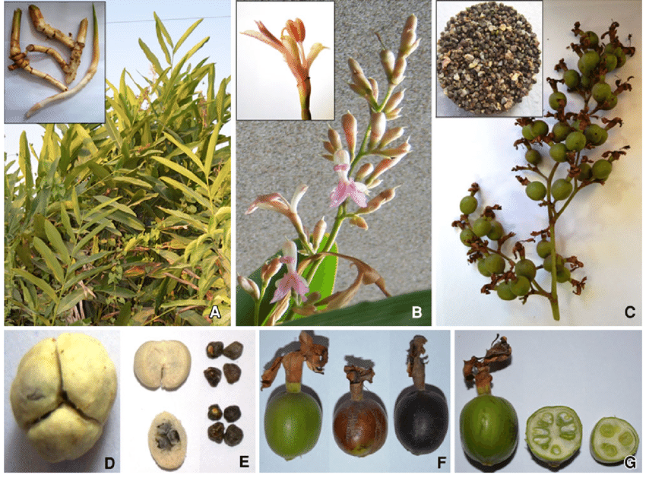
Beliefs
Herbalists tend to use extracts from parts of plants, such as the roots or leaves, believing that plants are subject to environmental pressures and therefore develop resistance to threats such as radiation, reactive oxygen species and microbial attack to survive, providing defensive phytochemicals of use in herbalism.

Slide 5
An example of a herbal medicine resource:
the bark of the cinchona tree contains quinine, which today is a widely prescribed treatment for malaria. The unpurified bark is still used by some who can not afford to purchase more expensive antimalarial drugs.

Slide 6
The main effect of herbal medicine or herbal treatment is the mobilization of the body's own defenses aimed at healing.
herbs do not have the toxicity of many pharmacological drugs;
side effects and allergic reactions to herbs occur 8-10 times less frequently than to derivatives of chemical synthesis;
herbal supplements can be taken for a long time, unlike traditional medicines;
the gifts of nature act milder, because they are biologically closer to the human body than medications;
with prolonged use of herbs, the body rebuilds and begins to work in a different, healthier mode, which persists even after the course of phytotherapy.

Slide 7
Herbal Medicine Is Drug, Not Food.

Slide 8
Safety
We should clearly recognize that herbal medicinal products are widely considered to be of lower risk compared with synthetic drugs; they are not completely free from the possibility of toxicity or adverse effects
Toxicology constitutes an essential role in the development of herbal medicines. With the advancements of analytical techniques and molecular technology, coupling with the conventional test systems, the ‘-omic-’ technology makes a significant contribution to the predictive and preclinical toxicology of herbal medicine

Slide 9
The Relative Property of Herbal Medicine Safety
As the Chinese saying goes, “all medicines have their own side effects”; that is, medicine is a double-blade sword: it can cure disease or maintain health, while it may also cause damage to human body.

Slide 10
Xi'an, China.
Ready to drink macerated medicinal liquor with goji berry, tokay gecko, and ginseng, for sale at a traditional medicine market in Xi'an, China

Slide 11
Goa, India
A platter of herbal medicines at Goa, India

Slide 12
An antique selection of herbal medicines

Slide 13
A physician preparing an elixir, from an Arabic version of Dioscorides's pharmacopoeia, 1224

