Slide 1
English riddles
Угадай-ка

Slide 2
English riddles
When I eat, I live; but when I drink, I die.
WHAT am I ?

Slide 3
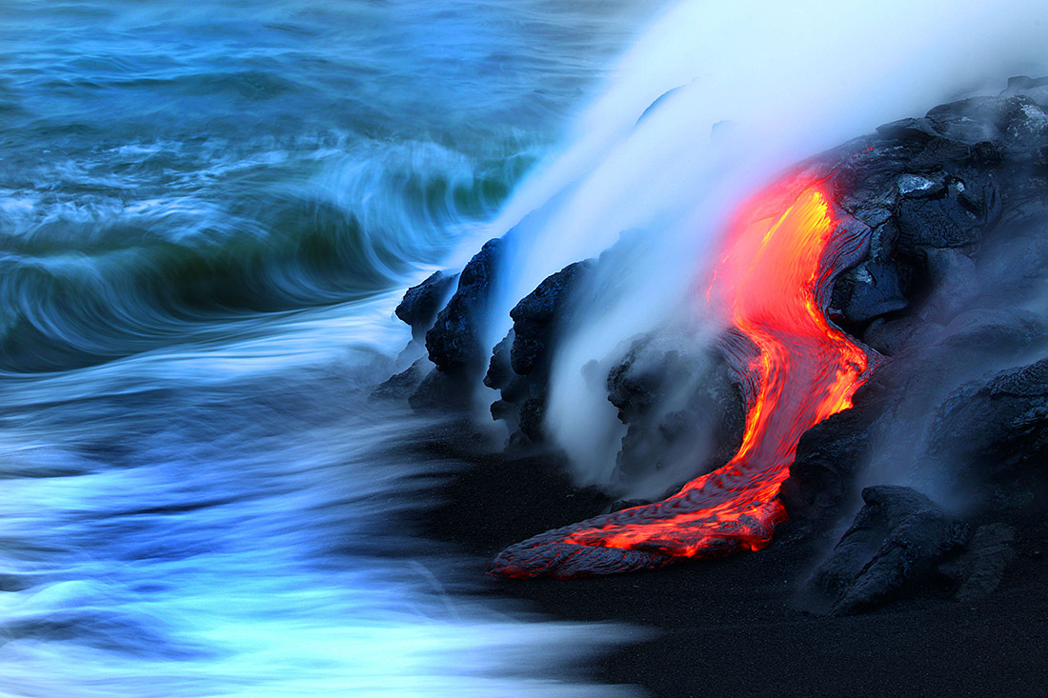
When I eat, I live; but when I drink, I die. WHAT am I ?

Slide 4
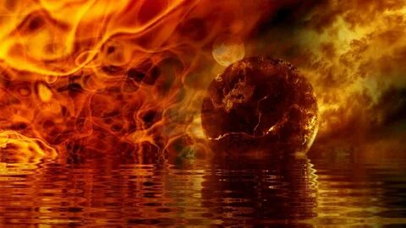
When I eat, I live; but when I drink, I die. WHAT am I ?
fire
water

Slide 5
FIRE

Slide 6
English riddles
Which ALPHABET letter is
a hot drink?

Slide 7
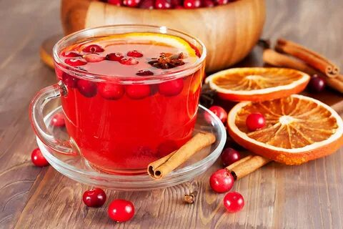
Which ALPHABET letter is a hot drink?

Slide 8
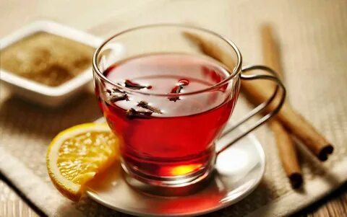
Which ALPHABET letter is a hot drink?
TEA
tea

Slide 9
English riddles
What asks no question but demands an answer?

Slide 10
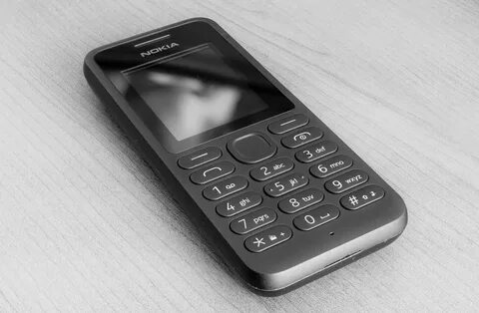
What asks no question but demands an answer?

Slide 11
What asks no question but demands an answer?
mobile phone doorbell

Slide 12
What asks no question but demands an answer?
DOORBELL

Slide 13
English riddles
Which letter sounds like an insect?

Slide 14
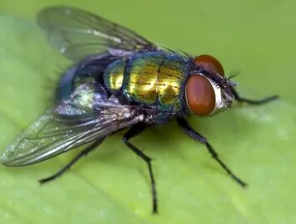
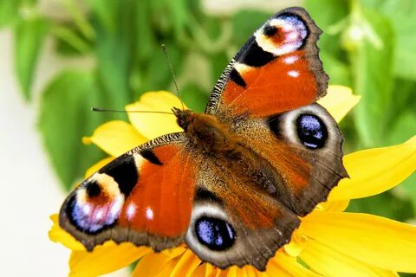
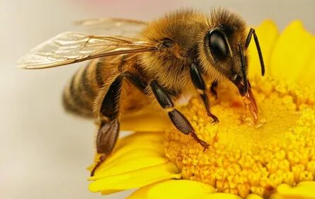
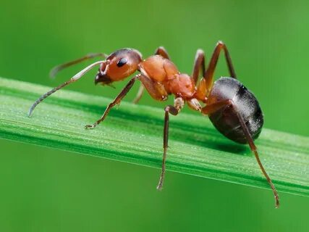
Which letter sounds like an insect?
ant bee butterfly fly

Slide 15
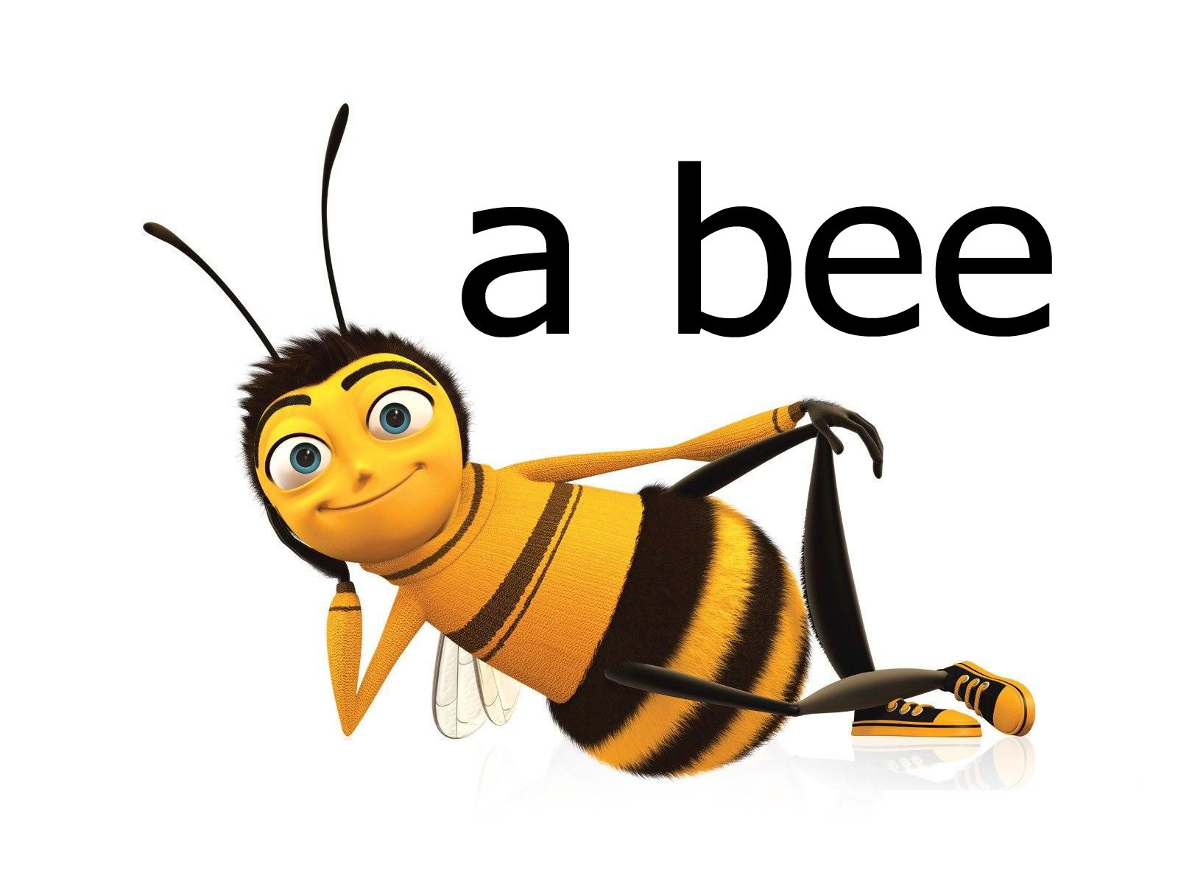

Slide 16
English riddles
What goes up when the rain
comes down?

Slide 17
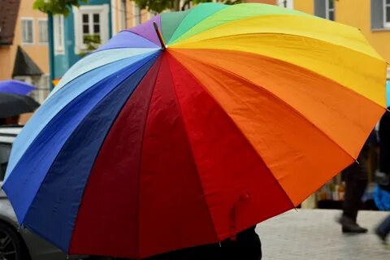
What goes up when the rain comes down?

Slide 18
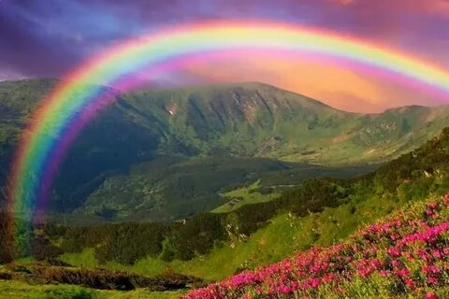
What goes up when the rain comes down?
rainbow umbrella

Slide 19
UMBRELLA

Slide 20
English riddles
What in our lives is always increasing but never decreasing?

Slide 21
What in our lives is always increasing but never decreasing?
hair age

Slide 22
AGE

Slide 23
English riddles
Two sisters fair and bright.
Always running, never meet.

Slide 24
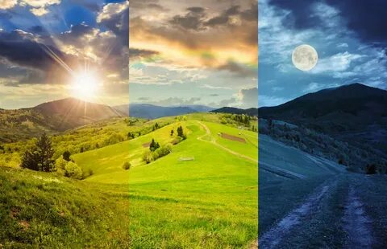
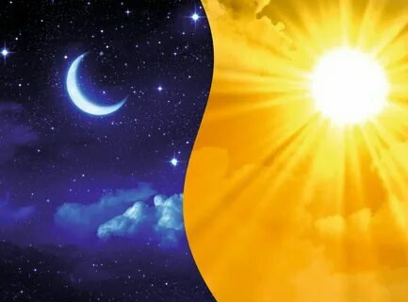
Two sisters fair and bright Always running, never meet.
Sun and Moon day and night

Slide 25
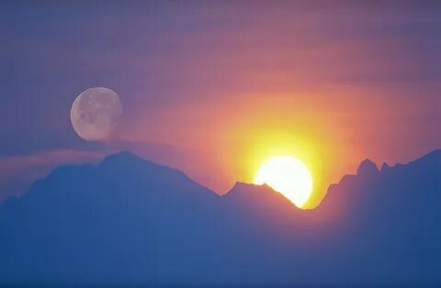
MOON and SUN

Slide 26
English riddles
Two geese before a goose, and two geese behind a goose, and one goose in the middle. How many geese in all?

Slide 27
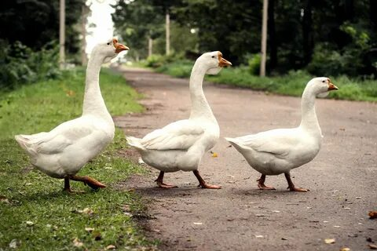
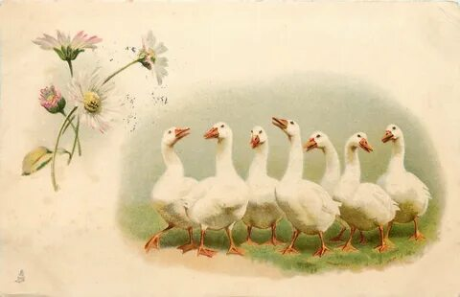
Two geese before a goose, and two geese behind a goose, and one goose in the middle. How many geese in all?
7 GEESE
3 GEESE

Slide 28
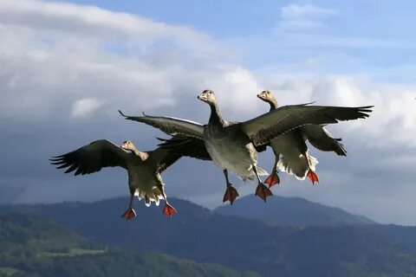

Slide 29
English riddles
What is that can speak any language but never went to school?

Slide 30
What is that can speak any language but never went to school?

Slide 31
What is that can speak any language but never went to school?
dictionary
echo

Slide 32
