Slide 3
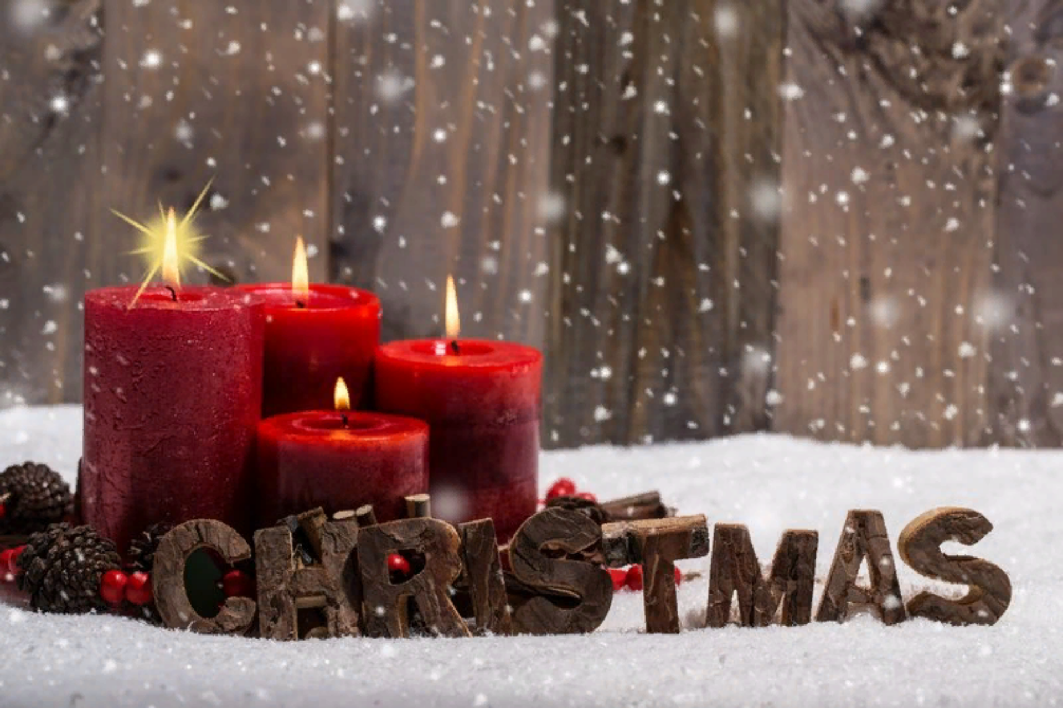

Slide 4
Celebrate Christmas

Slide 5
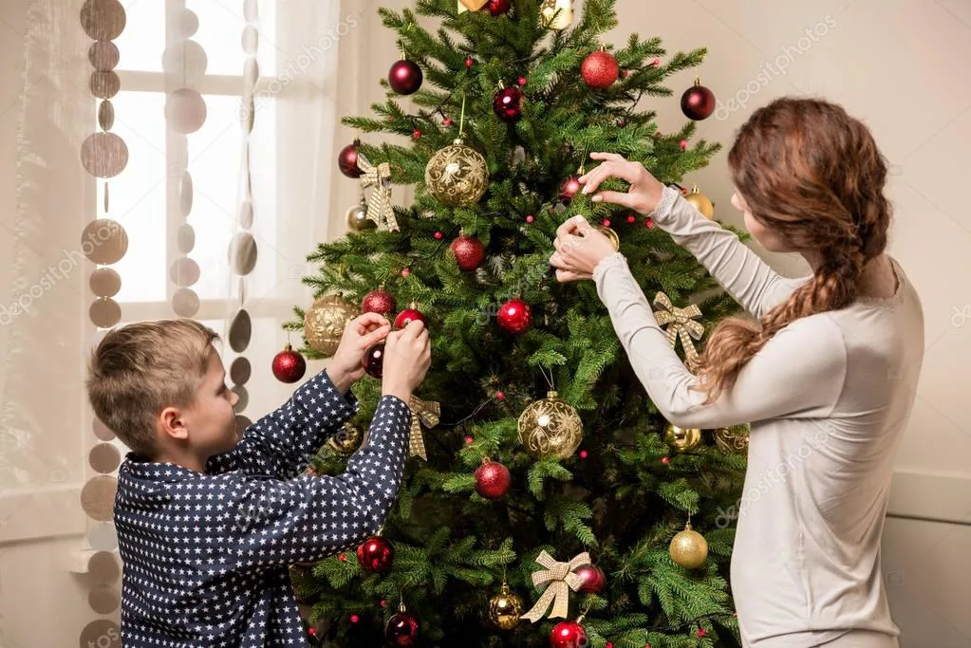
Decorate homes

Slide 6
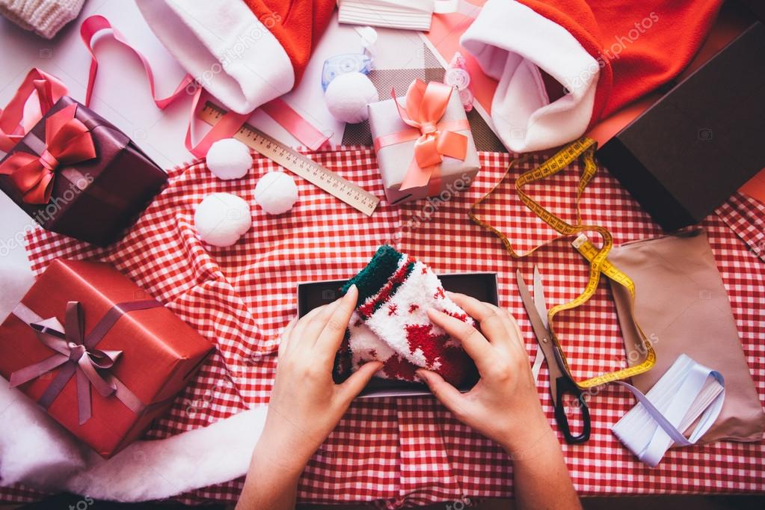
Prepare gifts

Slide 7
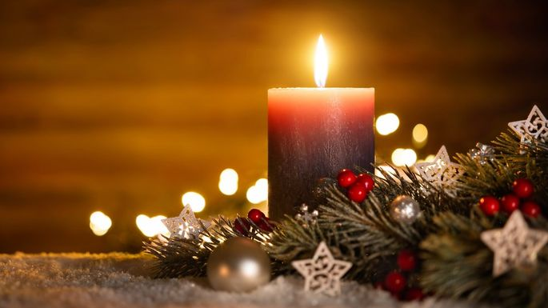
Candle

Slide 8
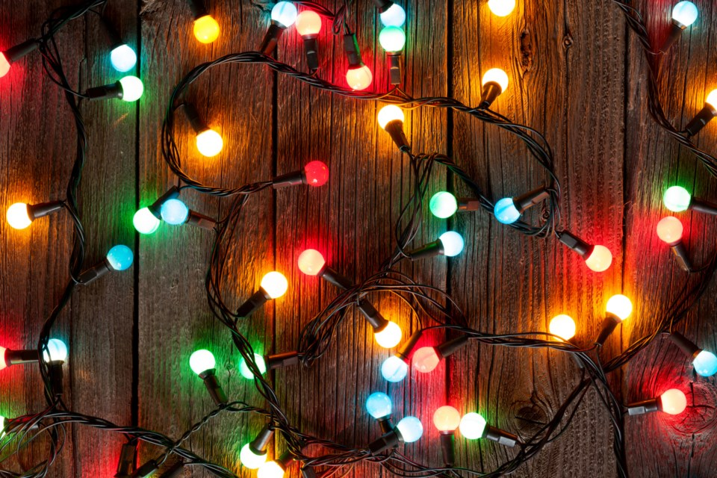
Lights

Slide 9
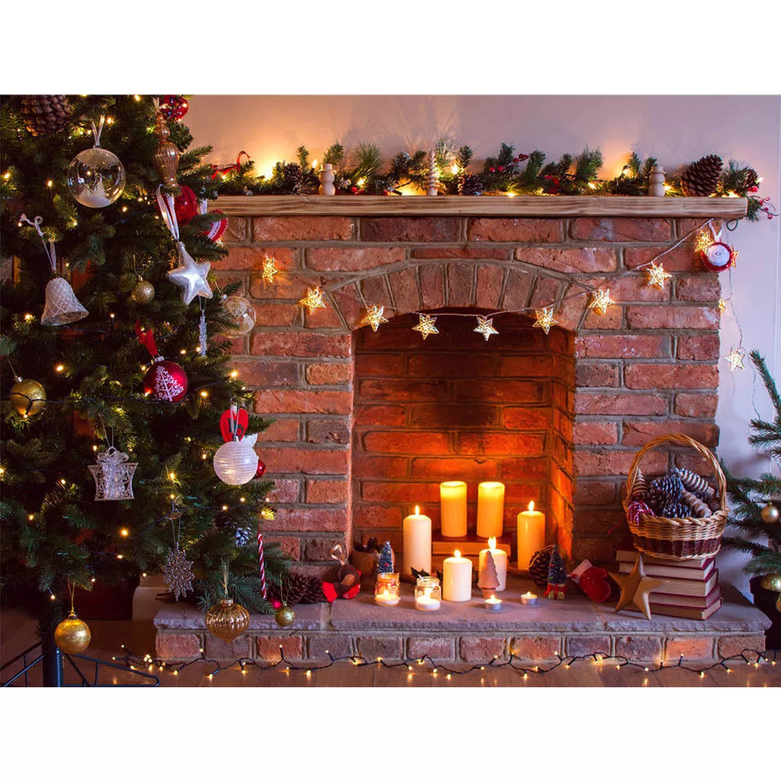
Fireplace

Slide 10
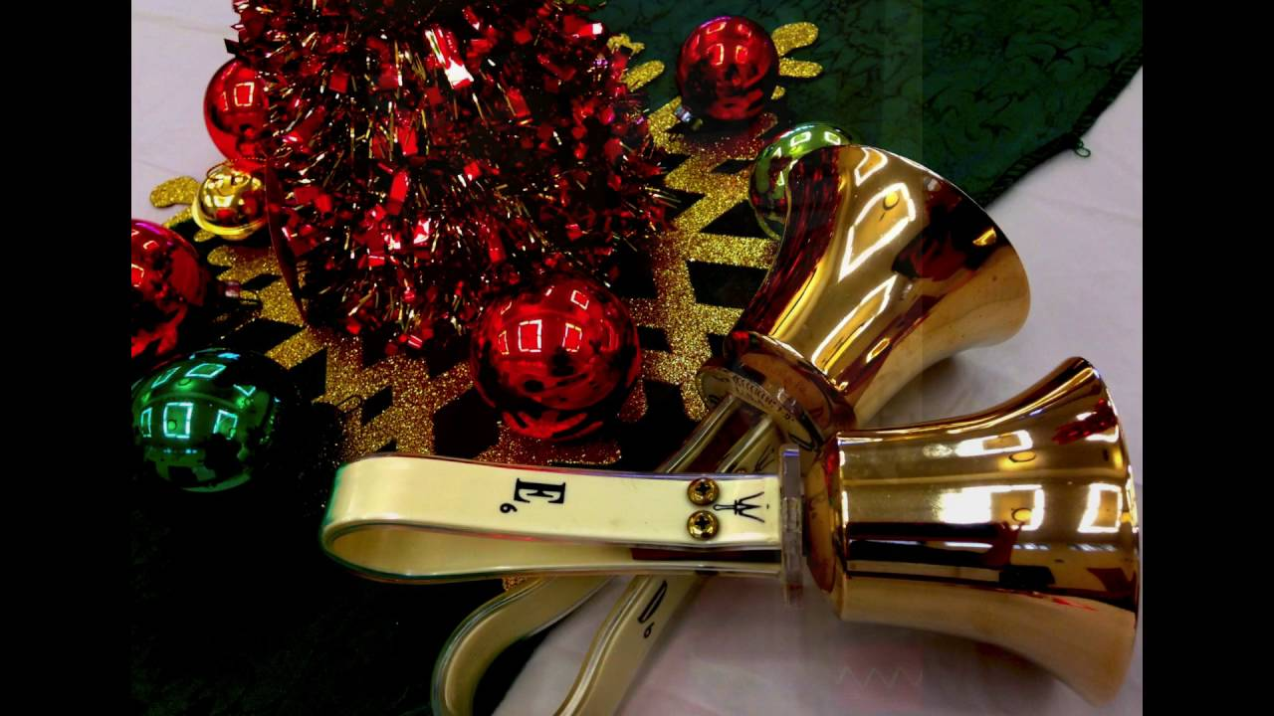
Handbell

Slide 11
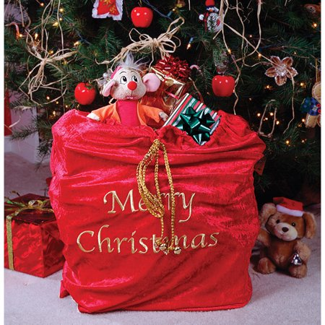
Sack

Slide 12
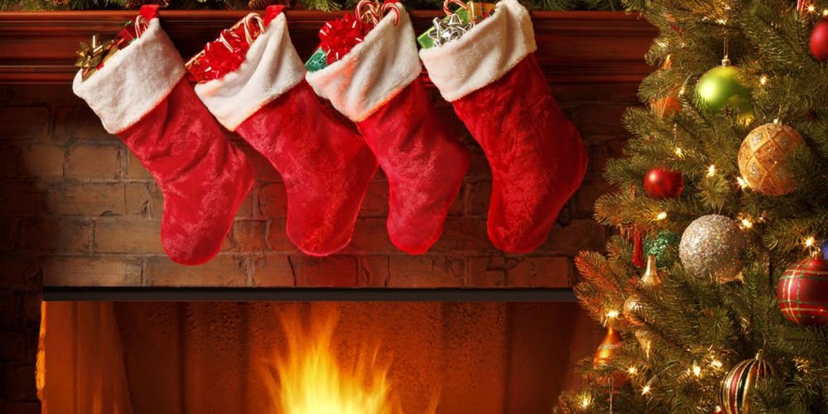
Christmas stockings

Slide 13
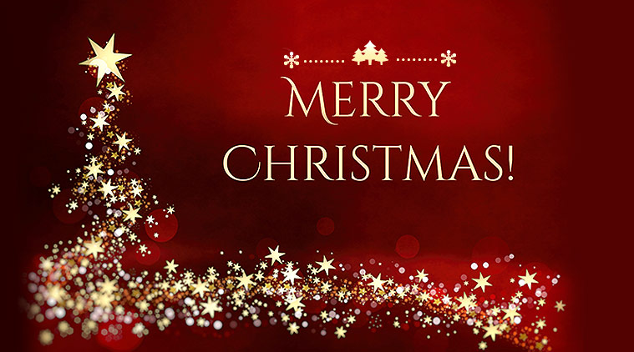
Wishes

Slide 14
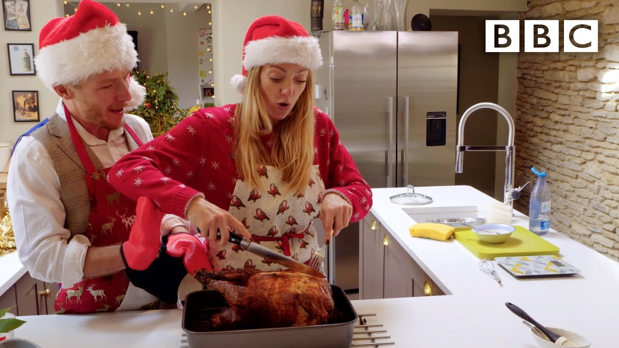
Cook turkey

Slide 15
Eat pudding

Slide 16
Exchange gifts

Slide 17
Father Christmas

Slide 18
Christmas tree

Slide 19
Check up
People celebrate Christmas on the 30th of December. __F__
People celebrate Christmas on the 25th of December.
British people like to decorate their homes. _T_
Children write letters to the Queen. _F___
Children write letters to Father Christmas or Santa.
On Christmas Eve everybody exchange their gifts. __F__
On Christmas Day everybody exchange their gifts.

Slide 20
Stand up when you see the correct answer
They celebrate Christmas on the 1st of September.
They celebrate Christmas on the 25th of November
They celebrate Christmas on the 25th of December .

Slide 21
Clap your hands when you see the correct answer
They believe in Father Frost
They believe in Santa Claus
They believe in Father Christmas.

Slide 22
Sit down when you see the correct answer
At teatime in the late afternoon they drink coffee with their birthday cake.
At teatime in the late afternoon they drink milk with their cookies.
Famillies usually cook turkey or goose with vegetables, eat pudding or Christmas cake , apples, some sweets and nuts.

Slide 23
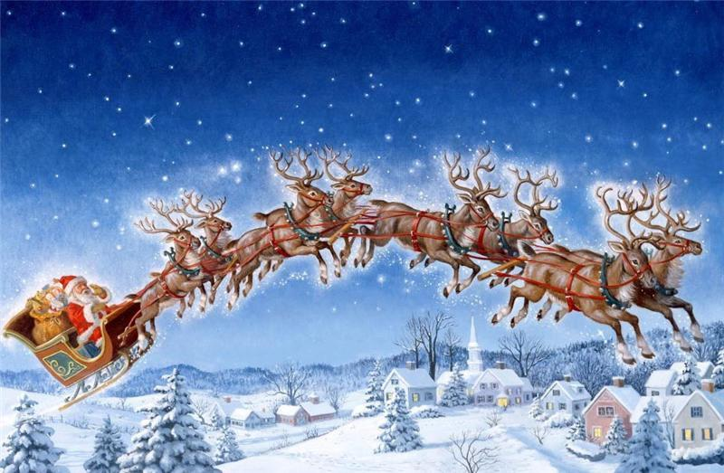
Merry Christmas!!!

