Slide 1
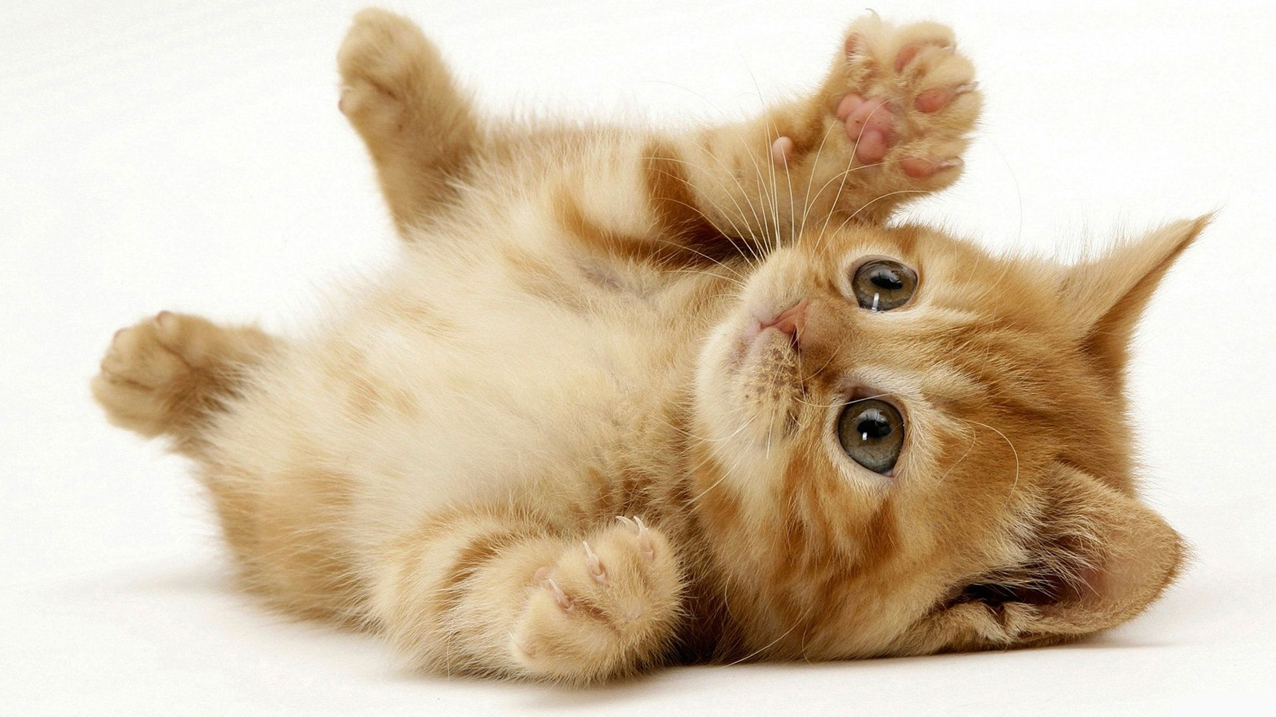
cute

Slide 2
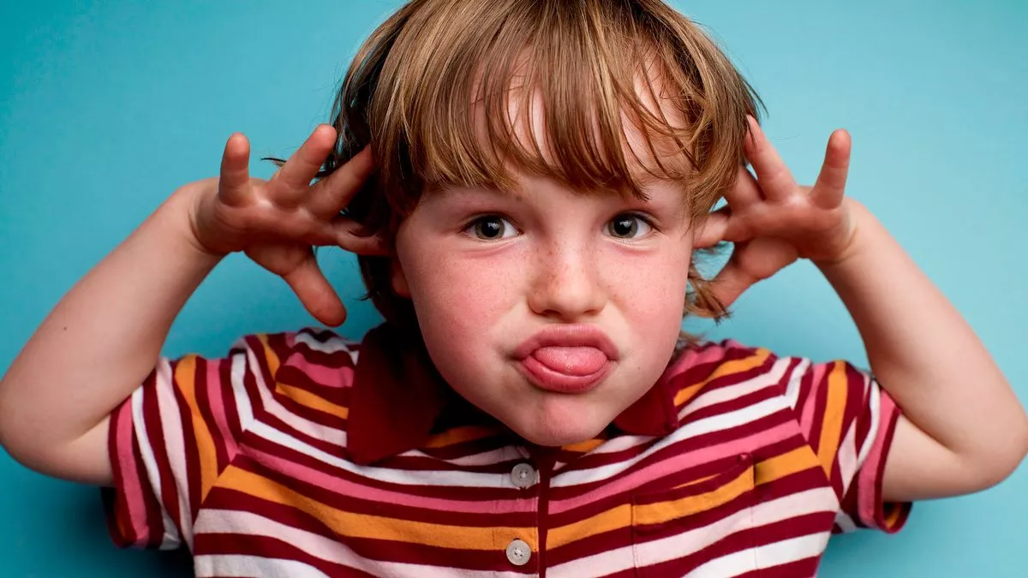
naughty

Slide 3
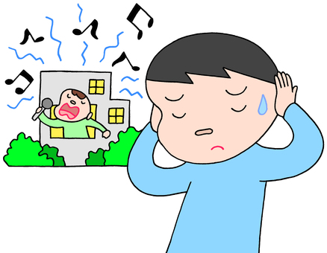
noisy

Slide 4
quiet

Slide 5
happy

Slide 6
good

Slide 7
clever

Slide 8
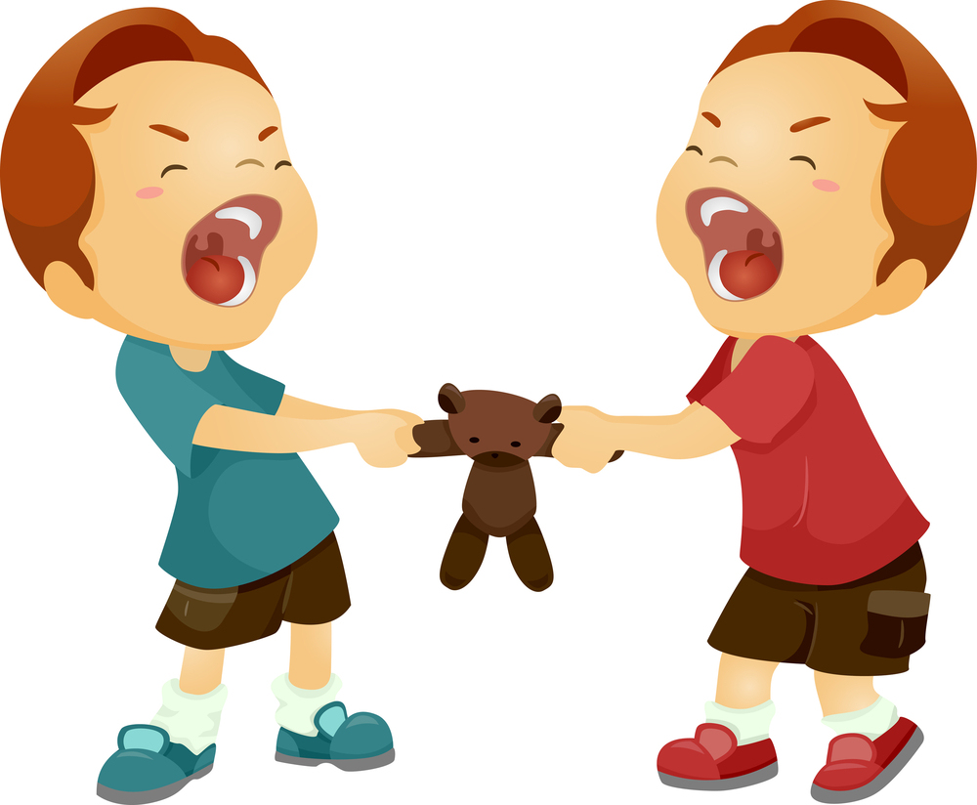
naughty

Slide 9
good

Slide 10
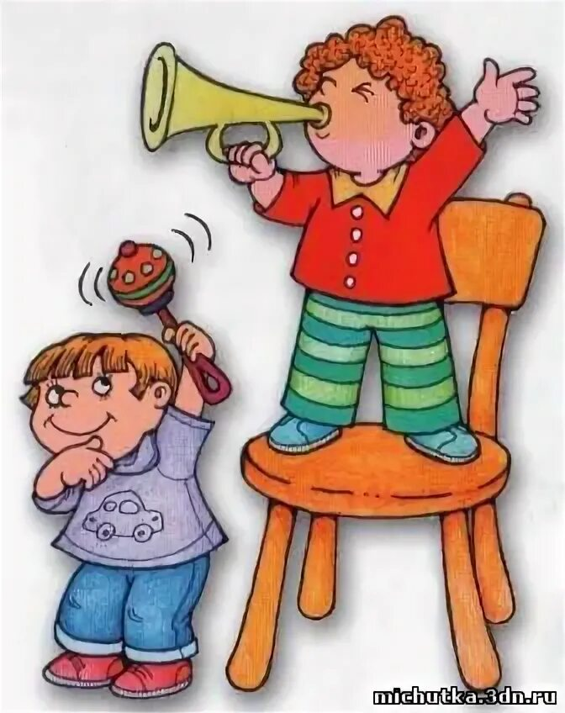
noisy

Slide 11
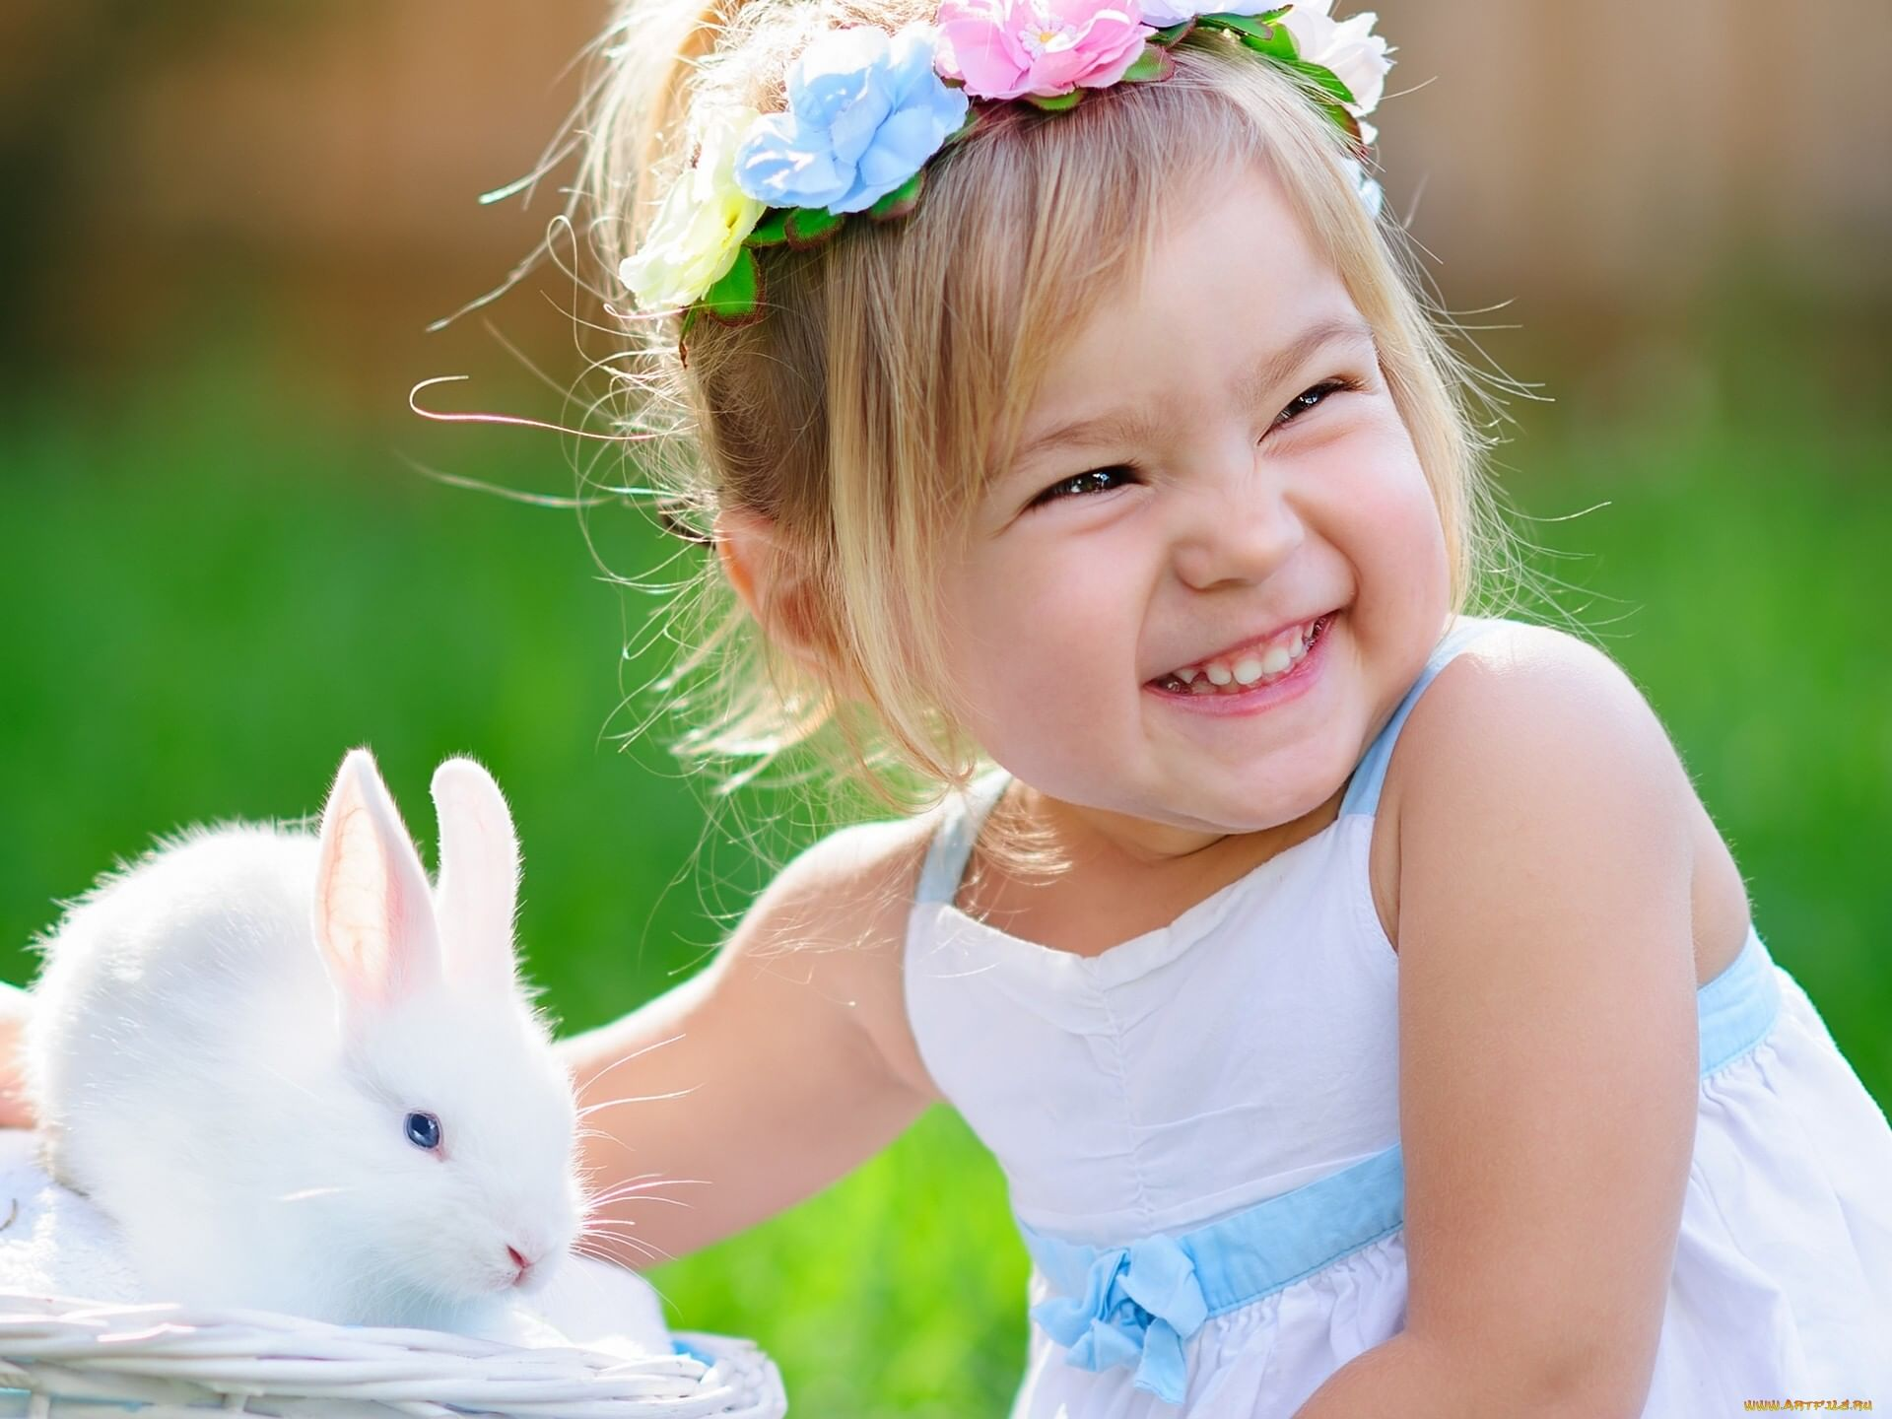
cute

Slide 12
happy

Slide 13
clever

Slide 14
quiet

