Slide 1
English General Knowledge Quiz

Slide 2
History 10
?
This object was made more than 100 years ago in France. It was made of Russian bronze and given to America as a present.

Slide 3
History 10
The Statue of Liberty

Slide 4
Geography 10
Look at these pairs of cities:
Washington DC – New York City
Brasilia – Sao Paulo
Canberra – Sydney
And what is in this pair?
Ankara - ?

Slide 5
Geography 10
Istanbul – the largest city of Turkey

Slide 6
Science 10
They were invented in China 2000 years ago. They were mostly used at religious ceremonies. We use them on holidays and festivals nowadays.
?

Slide 7
Fireworks

Slide 8
Languages 10
This international language was invented by a Polish man in 1887.
??

Slide 9
Languages 10
Esperanto

Slide 10
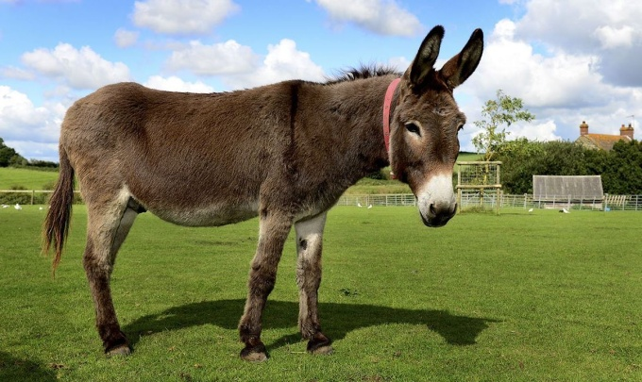
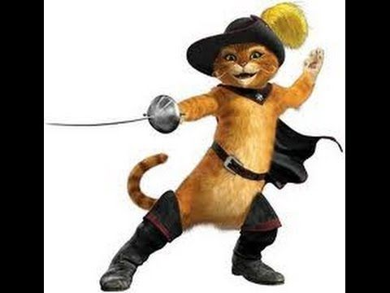
Children’s Books and Films 10
The third gift was the most profitable. What was it?
?

Slide 11
Children’s Books and Films 10
Puss in Boots

Slide 12
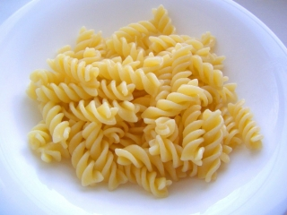
History 20
Many years ago the Italian traveler Marco Polo brought this food from China to Italy. It’s very popular all over the world now, but not if you’re on a diet!
?

Slide 13
History 20
Pasta

Slide 14
Geography 20
Which is the driest continent in the world?
?

Slide 15
Geography 20
Antarctica

Slide 16
Science 20
Baobab trees can change their form. They can become fatter or thinner. When do they become fatter?

Slide 17
Science 20
They become fatter in the rainy season

Slide 18
Languages 20
There are some synthetic words in English, for example: brunch = breakfast + lunch; smog = smoke + fog.
And what is “motel”?

Slide 19
Languages 20
Motel = motor + hotel

Slide 20
Children’s Books and Films 20
This Soviet cartoon character has become really popular in Japan for his cuteness.
?

Slide 21
Children’s Books and Films 20
Cheburashka (яп. チェブラーシカ Тебура:сика, рус. «Чебурашка»)

Slide 22
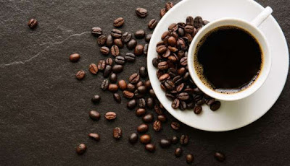
History 30
Once there was a shepherd in Ethiopia. His goats found a strange tree with red fruit. They ate the fruit, and after that they couldn’t sleep! The shepherd took the fruit and made a drink. It’s very popular now.
?

Slide 23
History 30
Coffee

Slide 24
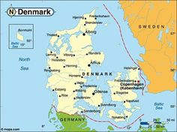
Geography 30
This largest island in the world belongs to this small European country. Name the country.
?

Slide 25
Geography 30
The largest island is Greenland and the country is Denmark.

Slide 26
Science 30
This object was invented in 1968, by Doug Englebart, and he called it an “x-y position indicator”. People who work in an office use it every day now.
?

Slide 27
Science 30
The computer mouse

Slide 28
Languages 30
Mechanic, character, chemistry. In all these words we read “ch” as [k]. What language did they come from into English?
?

Slide 29
Languages 30
They all come from Greek.

Slide 30
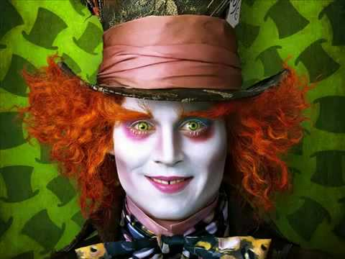
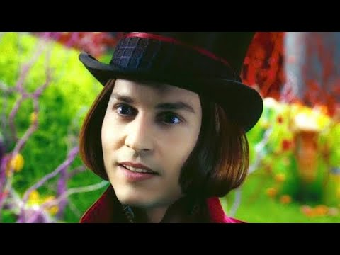
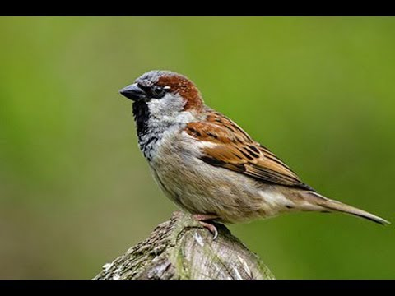
Children’s Books and Films 30
These are Johnny Depp’s famous film roles. Which role is next to the bird?
?

Slide 31
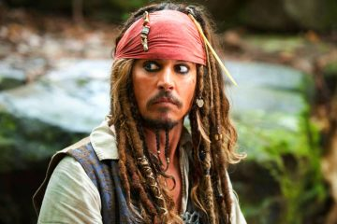
Children’s Books and Films 30
The characters are Edward Scissorhands, The Mad Hatter, Willy Wonka. Next to the sparrow is Jack Sparrow, of course!

Slide 32
History 40
These large non-flying mammals arrived in New Zealand in the 12th century and still live there. What are they?
?

Slide 33
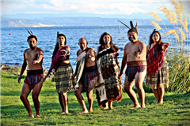
History 40
They are human beings or people.

Slide 34
Geography 40
This region of the UK has the longest name of a place in this country. Name the region.

Slide 35
Geography 40
Wales

Slide 36
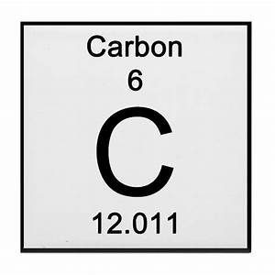
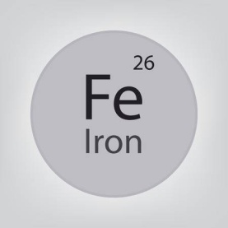
Science 40
Every doctor knows that this object has enough carbon to make 9000 pencils, enough iron to make a nail, and phosphorus for 2000 matches. What is it?
?

Slide 37
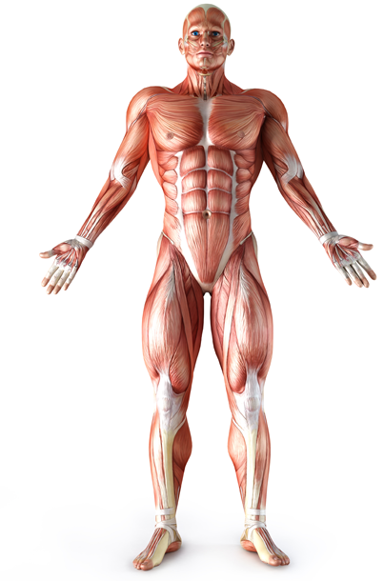
Science 40
The human body

Slide 38
Languages 40
?
A famous English writer once combined two words: “homo” (man) and “rabbit”. He invented a new word which consisted of the two. What is the word and who is the author?
?

Slide 39
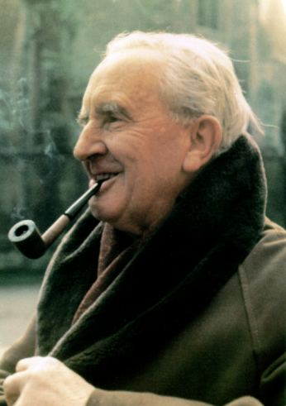
Languages 40
The word is “hobbit” and the author is John Ronald Reuel Tolkien

Slide 40
Children’s Books and Films 40
This man (1856-1943) lived in Austria-Hungary and the USA. He was said to have “invented the 20th century”. Who was he?
?

Slide 41
Children’s Books and Films 40
Nikola Tesla, a Serbian-American inventor and engineer. The characters next to him are Tofslan and Vifslan.

Slide 42
History 50
Laconia was part of Ancient Greece where Spartans lived. Macedonian king Philip wanted to invade Laconia. He sent them a letter saying: “If I invade your country, I will destroy it.” Lacons brought him an answer. There was only one word in it. What was the word?

Slide 43
History 50

Slide 44
Geography 50
The Irish writer George Moore said: “A man travels the world in search of what he needs and finds it…” Where?

Slide 45
Geography 50
The Irish writer George Moore said: “A man travels the world in search of what he needs and finds it at home.”

Slide 46
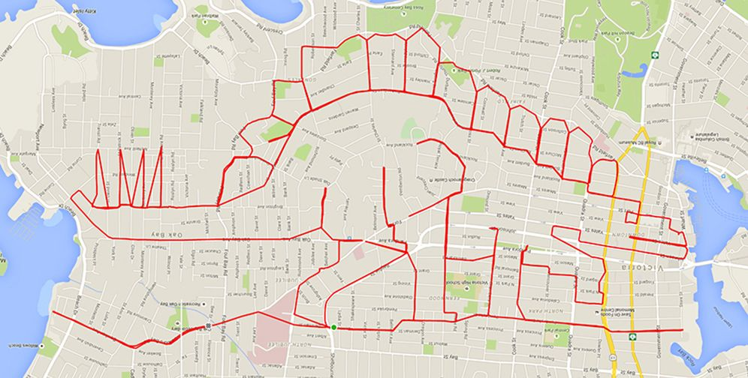
Science 50
How were these pictures drawn? Name the instrument in 3 letters.

Slide 47
Science 50
They were made using a GPS navigator and a special Strava app.

Slide 48
Languages 50
In English – red, in French – rouge, in German – rot. And what word of the same root do we have in Russian?

Slide 49
Languages 50
Рыжий

Slide 50
Children’s Books and Films 50
This picture of Pinocchio with the Crow and the Owl was made in the 19th century. What kind of doctor do the birds look like?

Slide 51
Children’s Books and Films 50
They look like the plague doctor.

