Slide 1
Features of metals in welding

Slide 2
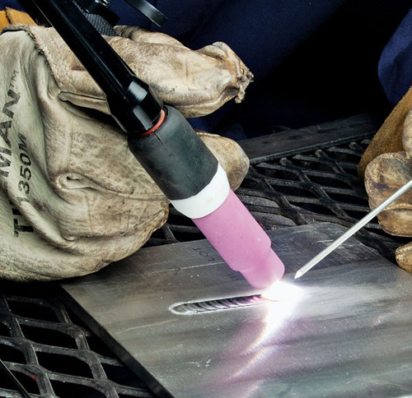
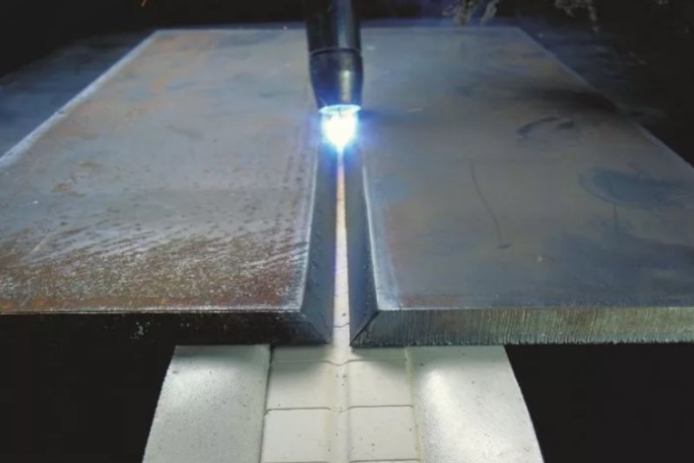
Aluminum
Aluminum has a high thermal conductivity, there is an oxide film on its surface, which has a high melting point of 2050 °C, and the melting point of aluminum itself is about 660 °C.
The refractory film on the molten metal droplets prevents the metal from melting, so protection from air exposure is necessary during welding. Such protection can be welding of aluminum in an argon environment.
The significant fluidity of aluminum makes it difficult to control the welding bath. To cool the metal as quickly as possible, it is necessary to use heat-trapping pads.

Slide 3
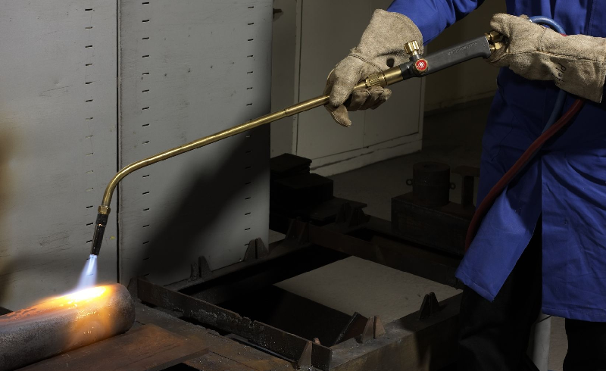
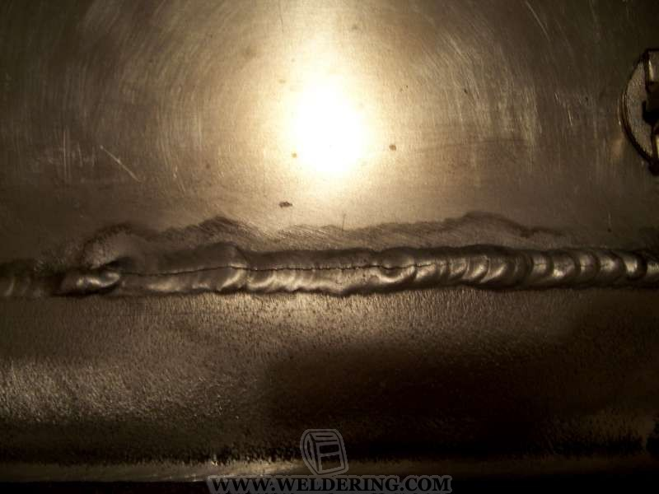
Steel
Steel is an alloy of iron with carbon, with a carbon content of 2.14 %.
The weldability of steel depends on the content of carbon and other alloying elements in it.
Before welding high-carbon steels, the products are preheated to 600-650 °C
One of the main difficulties in welding steels is to prevent the formation of hot cracks in the seams and near-seam area.

Slide 4
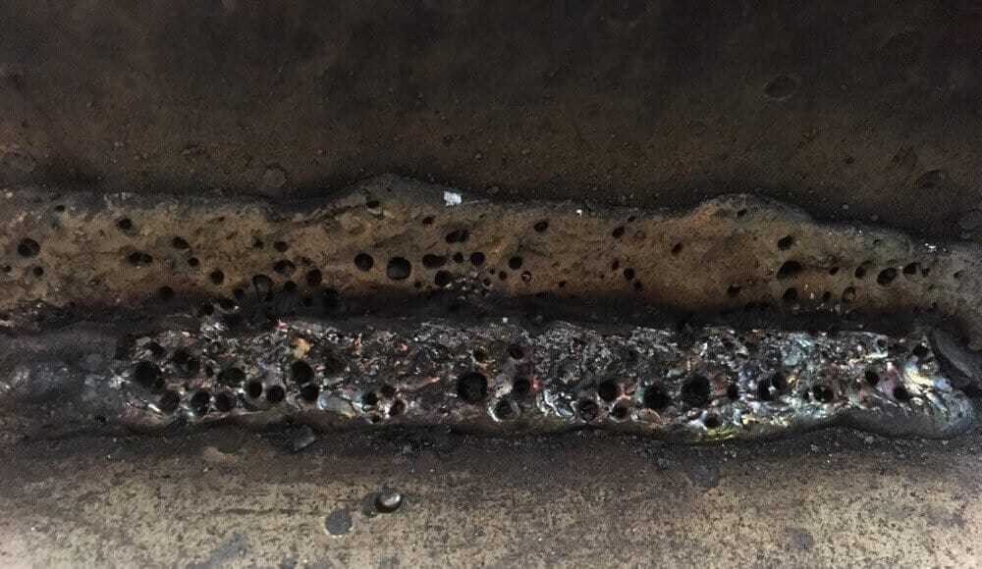
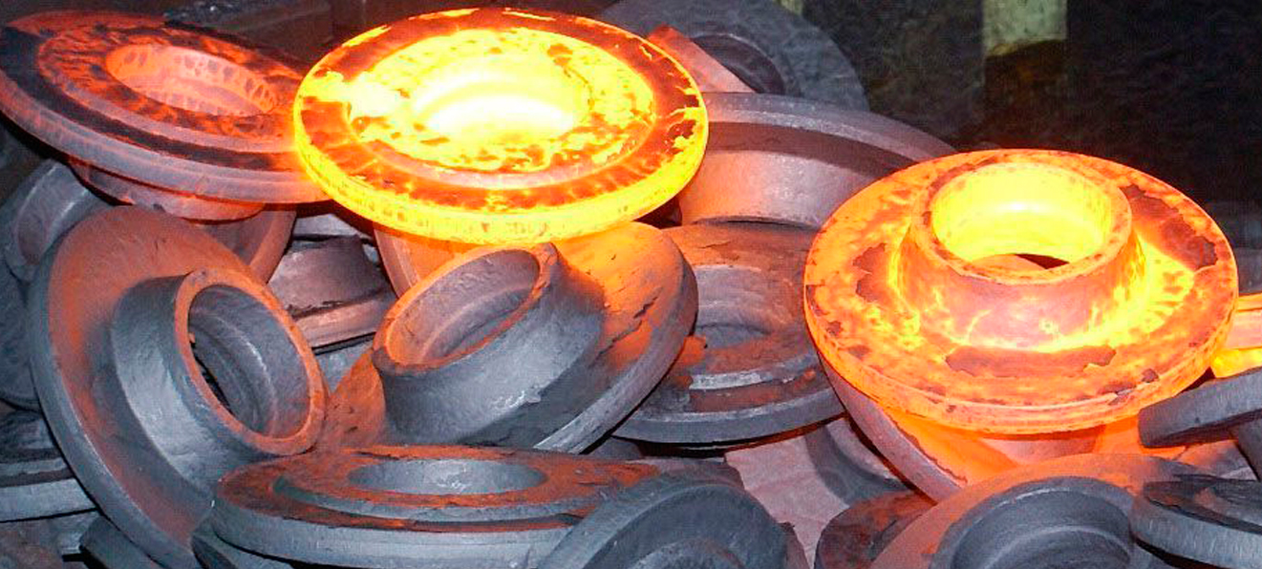
Cast iron
Cast iron is an alloy of iron with carbon. The carbon content in cast iron is from 2.14 %. The melting point of cast iron ranges from 1150 to 1200 °C, which is 300 °C lower than that of pure iron.
Difficulties in welding cast iron are caused by the formation of cracks due to graphite inclusions; carbon burnout and the formation of pores in the seam
Cast iron is welded by manual arc welding with melting or non-melting electrodes with or without heating.
To improve the seam quality when welding cast iron, the part is heated and slowly cooled after welding.

Slide 5
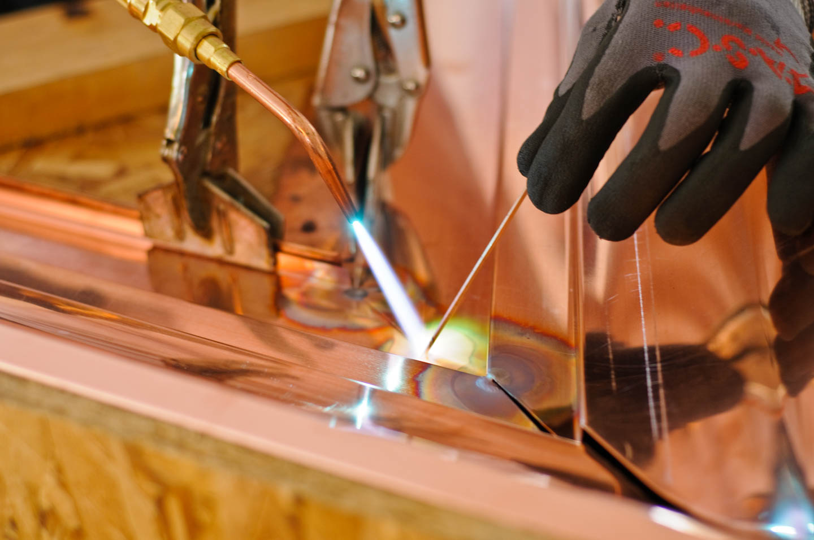
Copper
The peculiarities of welding copper are due to its physical and chemical properties. Copper has a melting point of 1080-1083 °C.
Welding of copper and alloys can be carried out by gas welding.
Since copper oxide is formed during welding, welding must be carried out quickly, at a speed of about 0.25 m/min. Preheating of workpieces is used for welding copper with a thickness of 6 mm or more.
Due to the high thermal conductivity of copper, a higher current must be applied during arc welding.

Slide 6
Conclusion
Always take into account the properties of metals when choosing the type of welding and filler materials! Understanding how to work with the material ensures high quality work in general

