Slide 1

Countries and nationalities

Slide 2


I’m from Portugal. I’m Portuguese.

Slide 3


I’m from Spain.
I’m Spanish.

Slide 4

I’m from France.
I’m French.

Slide 5


I’m from Italy.
I’m Italian.

Slide 6


I’m from Germany. I’m German.

Slide 7

I’m from Poland.
I’m Polish.

Slide 8


I’m from the UK.
I’m British.
The U.K. = England + Scotland + Wales + Northern Ireland

Slide 9

I’m from England. I’m English.

Slide 10


I’m from Scotland. I’m Scottish.

Slide 11

I’m from Wales.
I’m Welsh.

Slide 12

I’m from Ireland.
I’m Irish.

Slide 13
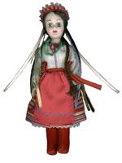
I’m from Ukraine. I’m Ukrainian.

Slide 14

I’m from Russia.
I’m Russian.

Slide 15

I’m from the USA. I’m American.

Slide 16

I’m from Mexico.
I’m Mexican.

Slide 17

I’m from Brazil.
I’m Brazilian.

Slide 18

I’m from Japan.
I’m Japanese.

Slide 19

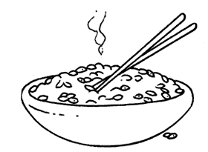
I’m from China.
I’m Chinese.

Slide 20

I’m from India.
I’m Indian.

Slide 21

I’m from Angola. I’m Angolan.

Slide 22

I’m from Mozambique. I’m Mozambican.

Slide 23

I’m from Cape Verde.
I’m Cape Verdean.

