Slide 1
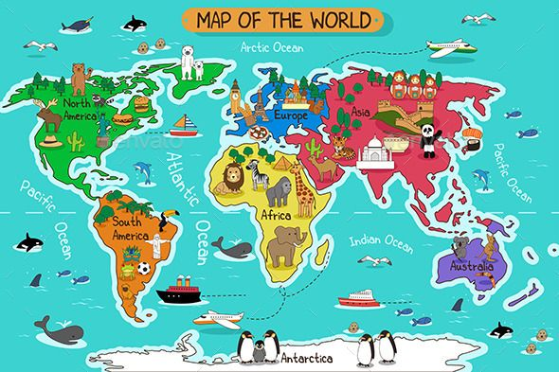
The English World

Slide 3
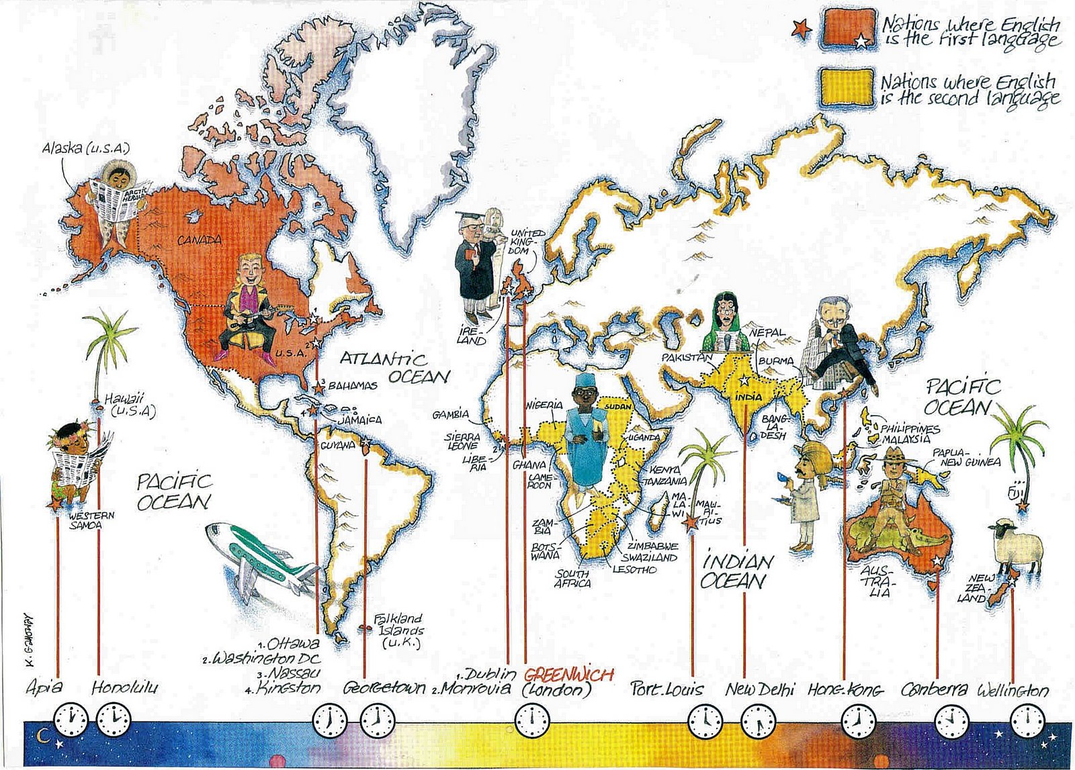
English Speaking Countries

Slide 5
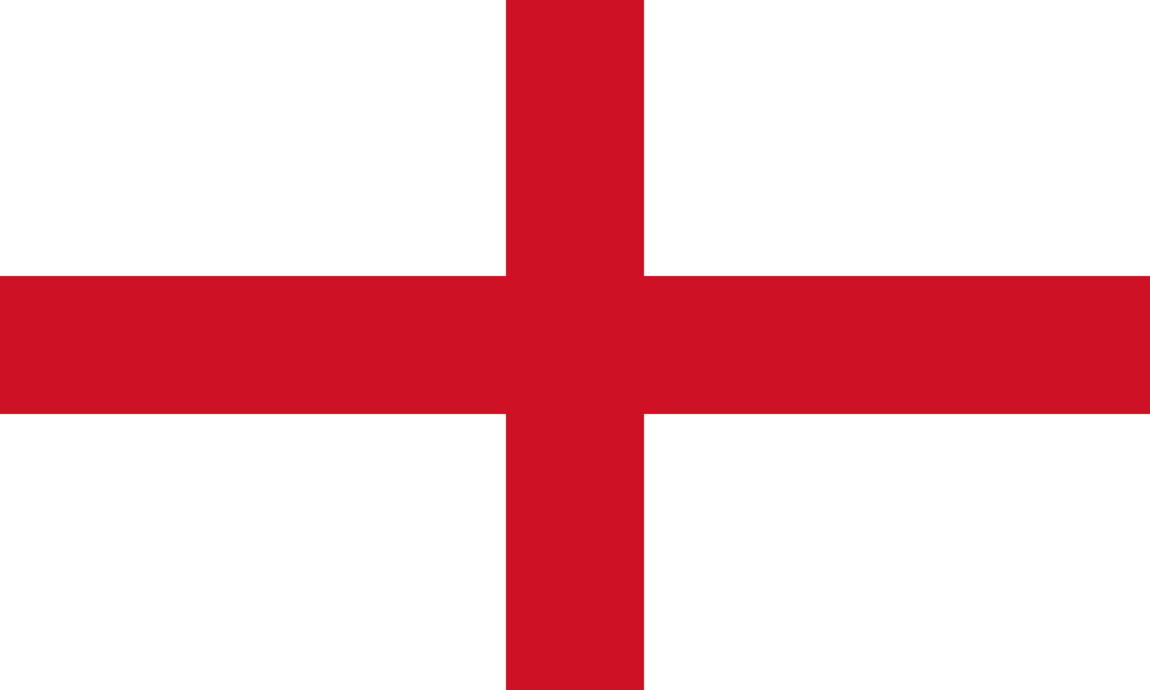
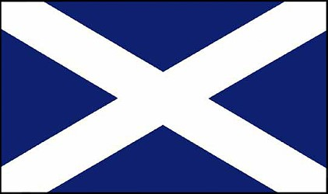
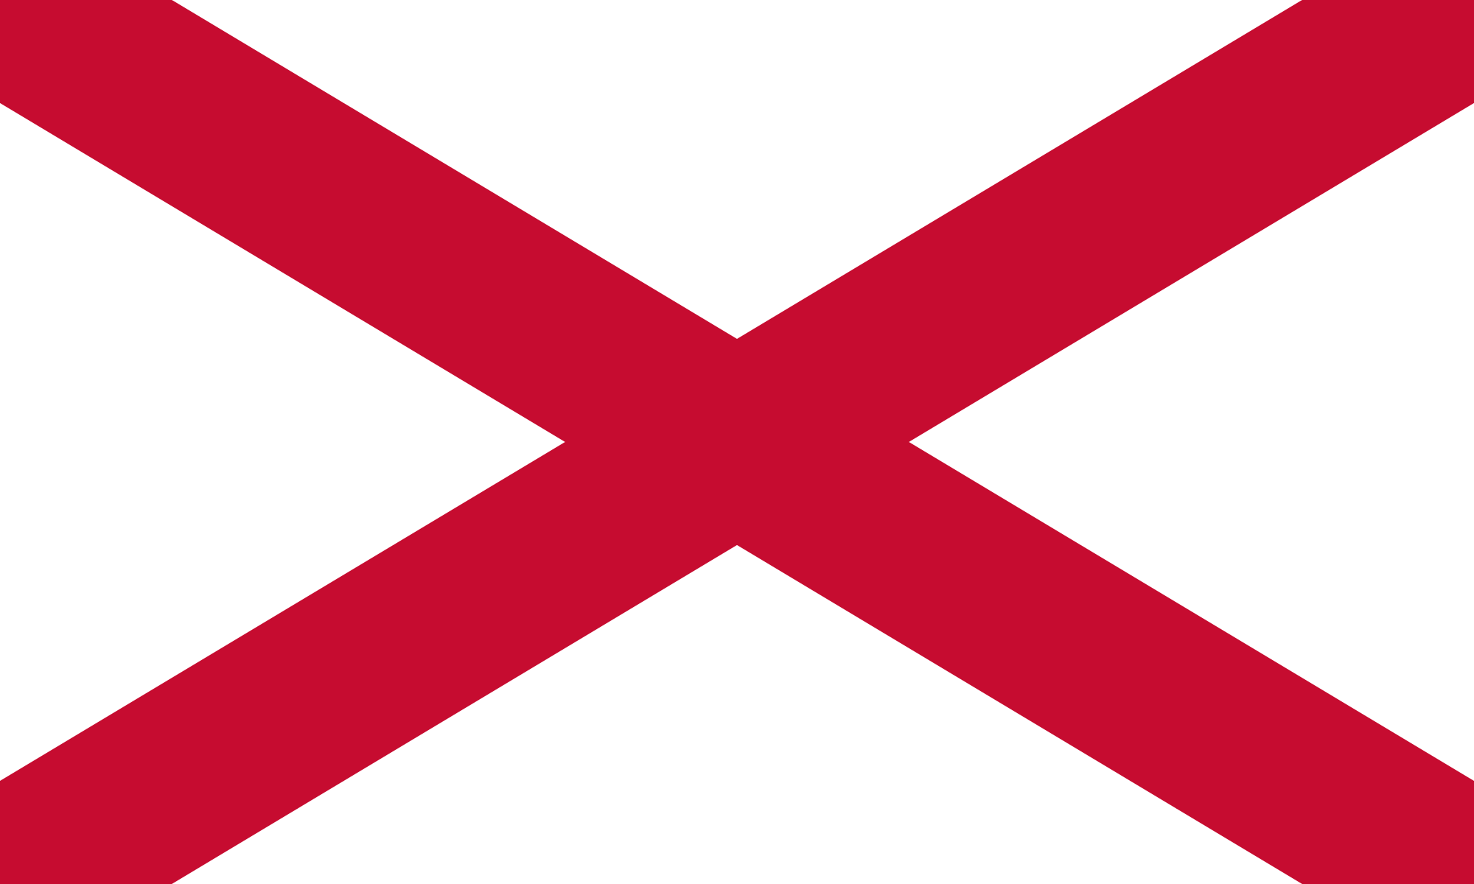
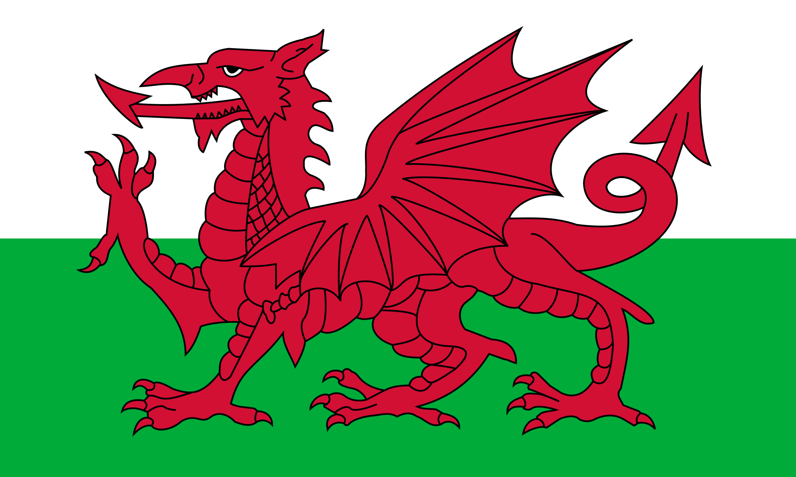
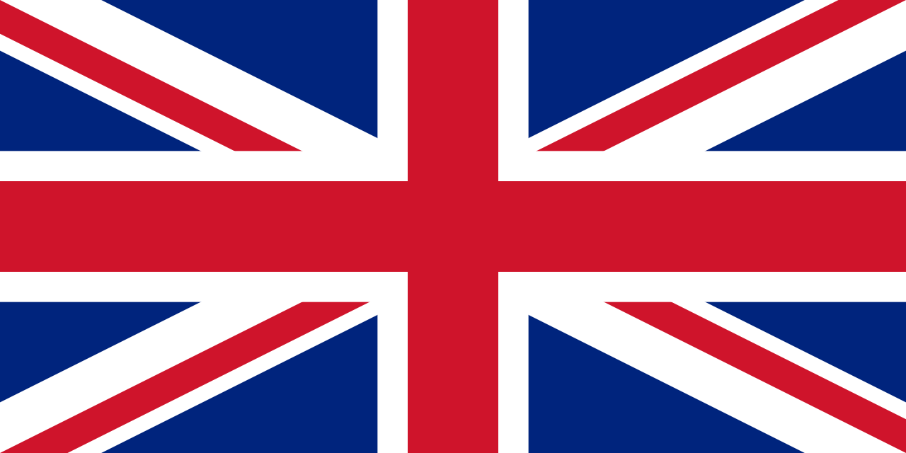
Some English Speaking Countries
England
The Cross of St. George
Scotland
The Cross of St Andrew
Northern Ireland
The Cross of St Patrick
Wales
The Red Dragon
The United Kingdom
The Union Jack

Slide 6
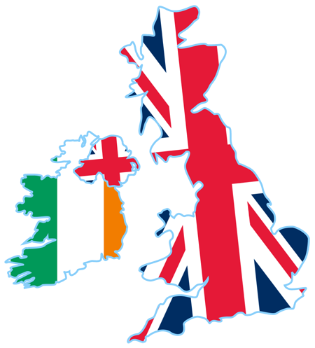
Great Britain and the UK

Slide 7
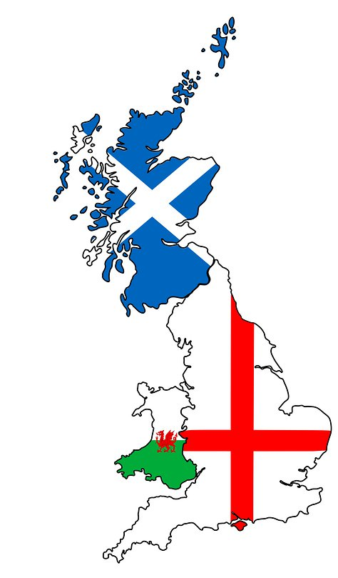
Scotland
Great Britain
Wales
The British Isles
England

Slide 8
Scotland
Northern Ireland
The United Kingdom (UK)
England
Wales

Slide 9
Scotland
Northern Ireland
The United Kingdom of Great Britain and Northern Ireland
England
Wales

Slide 10
What about Republic of Ireland?
Ireland is not part of the UK. It’s a fully independant country.

Slide 11
Scottish / British
The UK Nationalities
Irish
English / British
Welsh / British

Slide 12
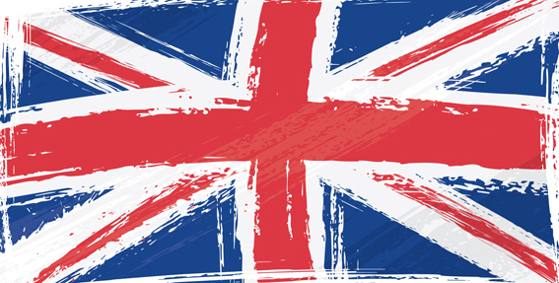
The UK’s National Anthem

Slide 13
Some English Speaking Countries

Slide 14
The Union Jack

Slide 15
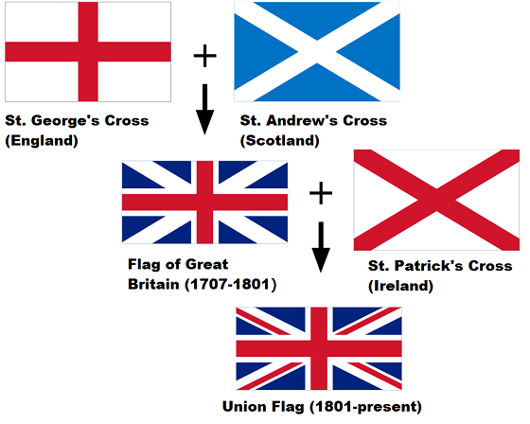
Scotland
The Great Britain Flag
Wales
England

Slide 16
Union Jack – The United
Kingdom’s Flag
The 1st Flag
1 red cross + 1 white cross + blue background

Slide 17

The UK Flags

Slide 18

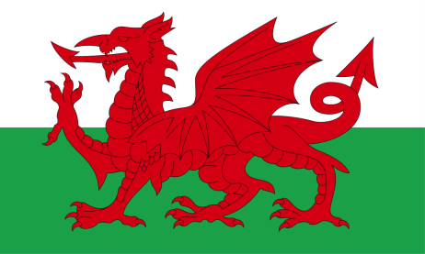
Union Jack – The United
Kingdom’s Flag
The Union Jack

Slide 19
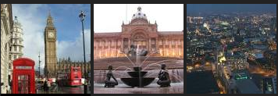
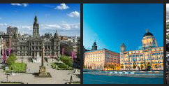
England
London
Birmingham
Manchester
UK cities
Glasgow
Liverpool
Scotland

Slide 20

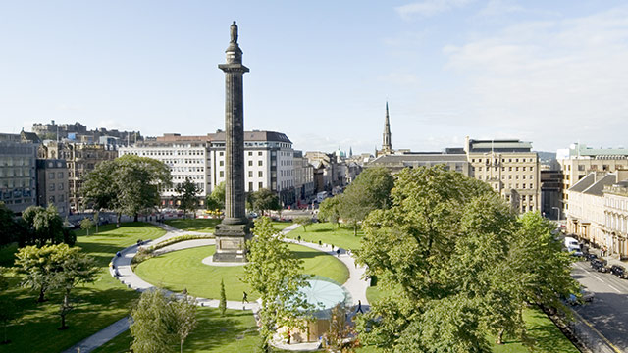

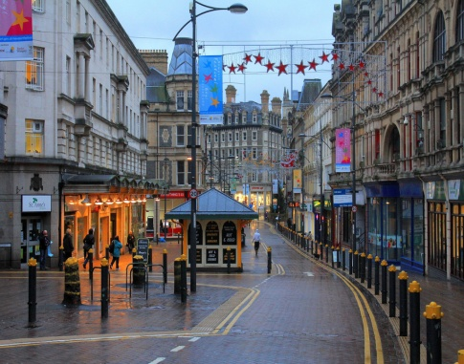
UK cities
Scotland
Edinburgh
Wales
Cardiff
Wales
Newport

Slide 21
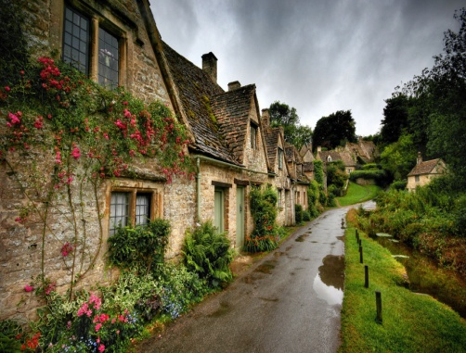
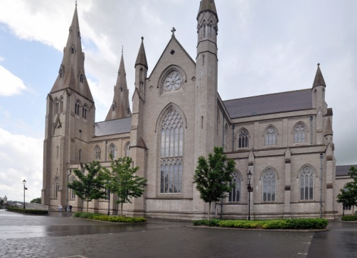
UK cities
Northern Ireland
Belfast
Armagh

Slide 22
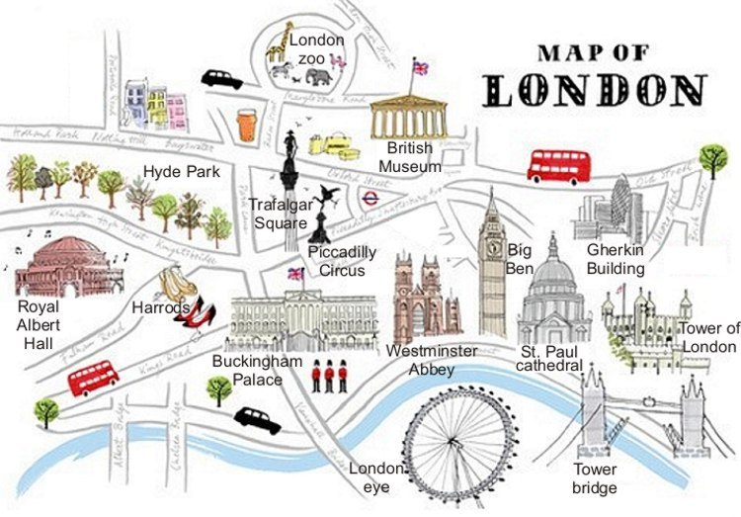
London’s famous monuments and places

Slide 23
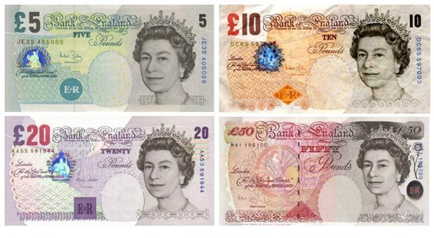

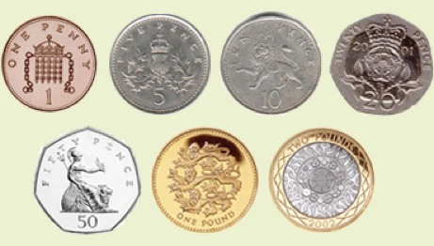
The UK Currency

Slide 24
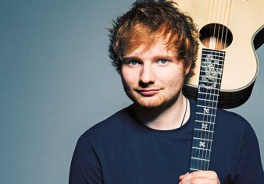
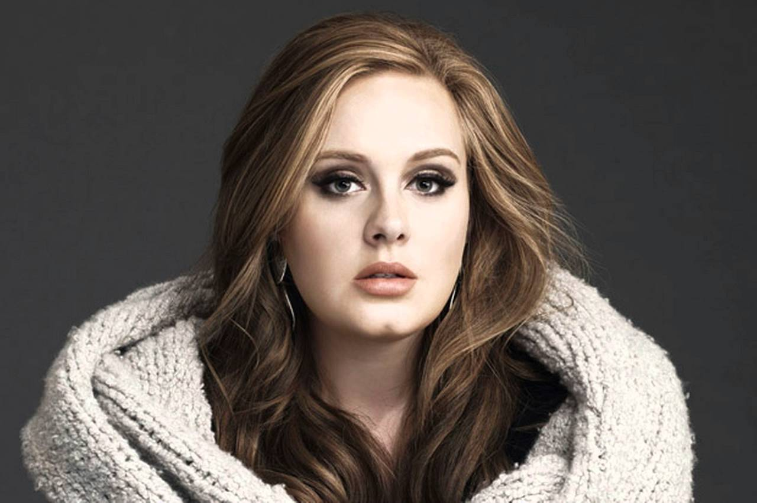
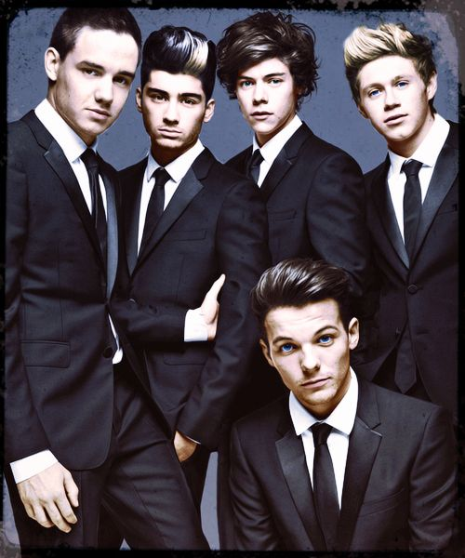
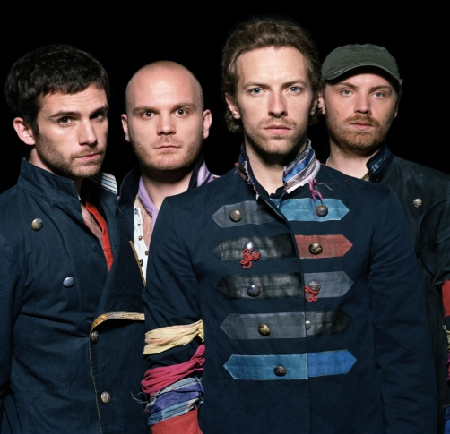
English Famous Singers
One Direction
Ed Sheeran
Adele
Coldplay

Slide 25
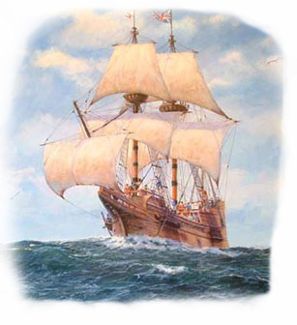
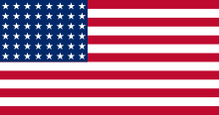
Another English Speaking Country
The USA
Stars and Stripes

Slide 26
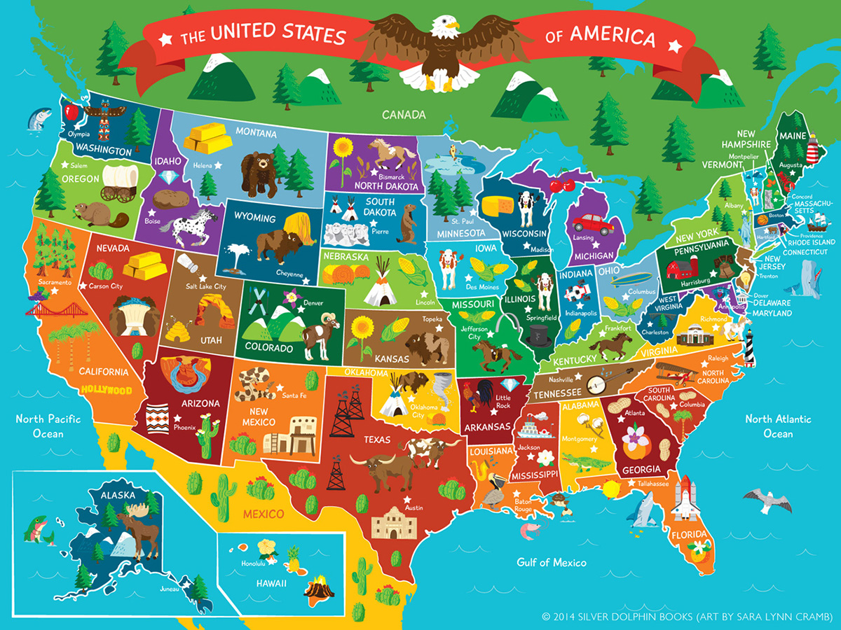
The USA

Slide 28
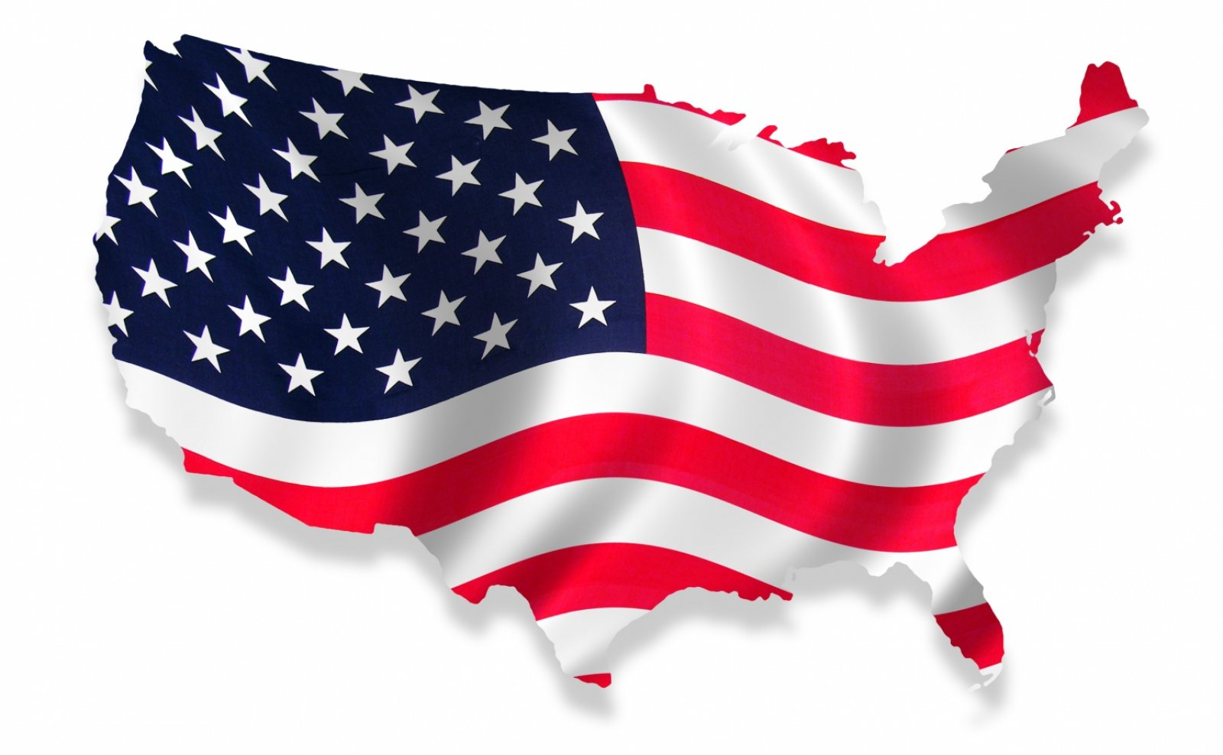
USA Flag

Slide 29
USA National Anthem

Slide 30
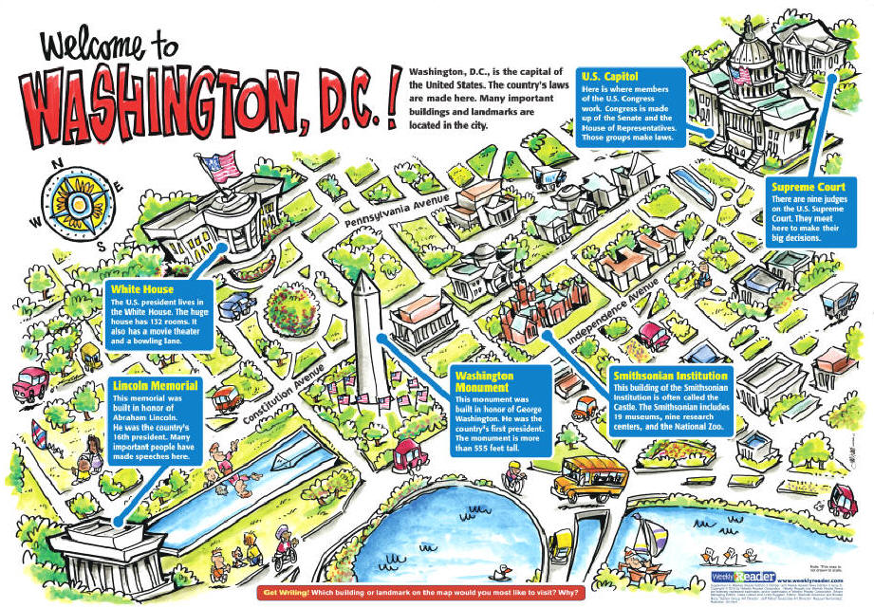
Washington DC Monuments

Slide 31

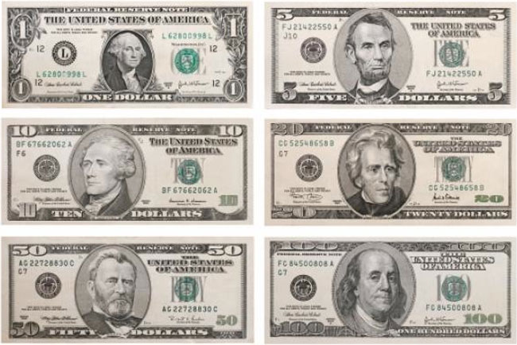
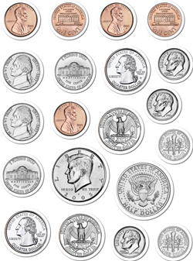
The USA Currency

Slide 32
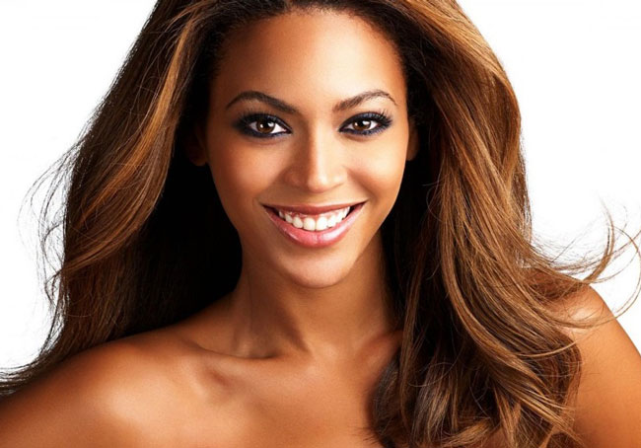
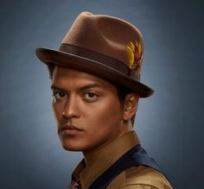
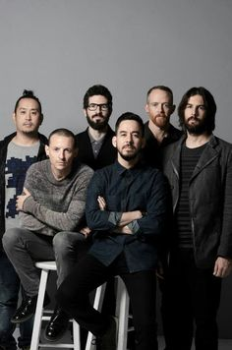
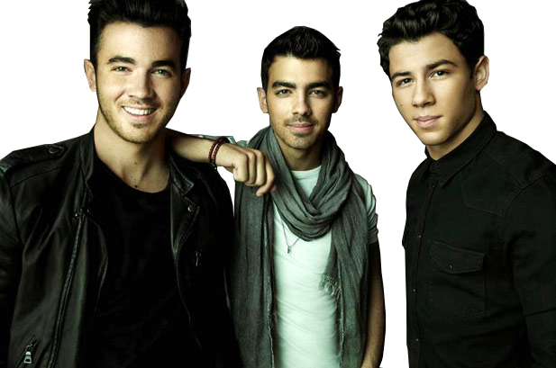
American Famous Singers
Beyoncé Knowles
Bruno Mars
Linkin Park
Jonas Brothers

Slide 33
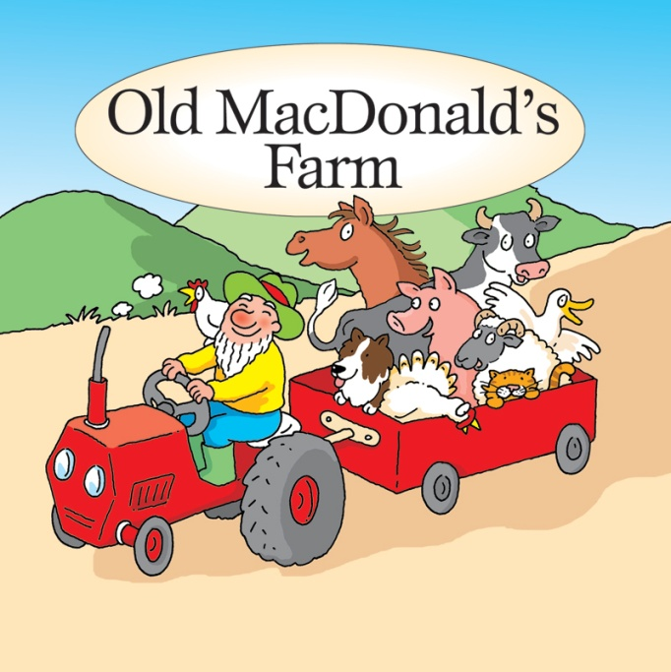
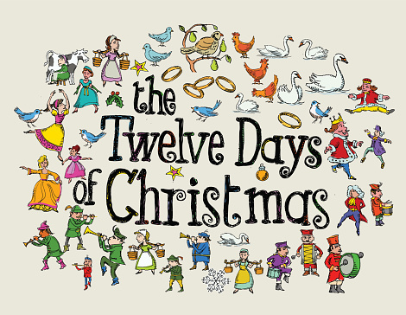
English Traditional Songs
Old MacDonald
The Twelve Days of Christmas

Slide 34


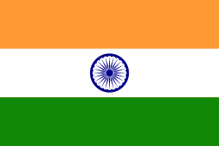
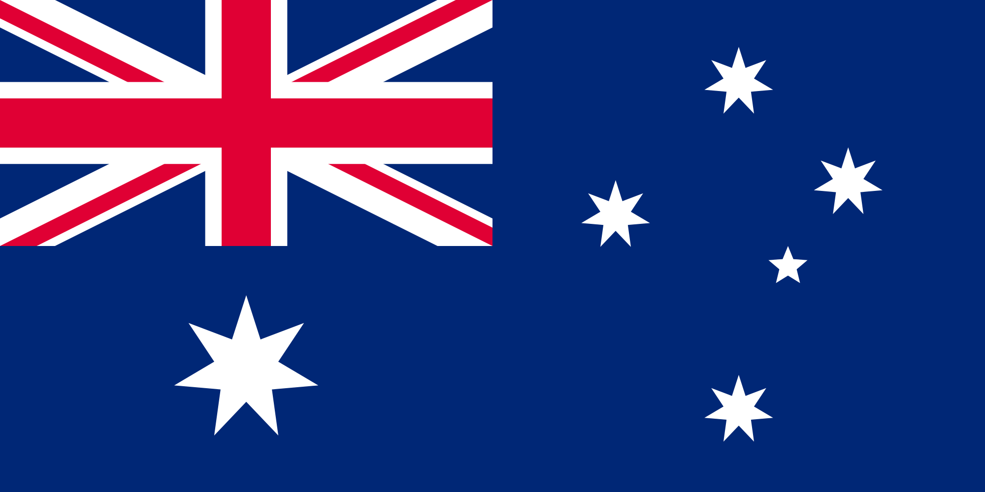
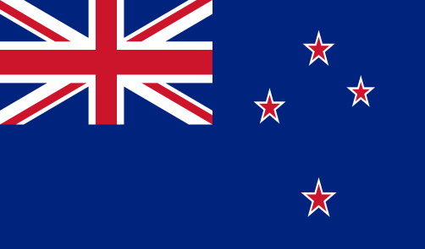
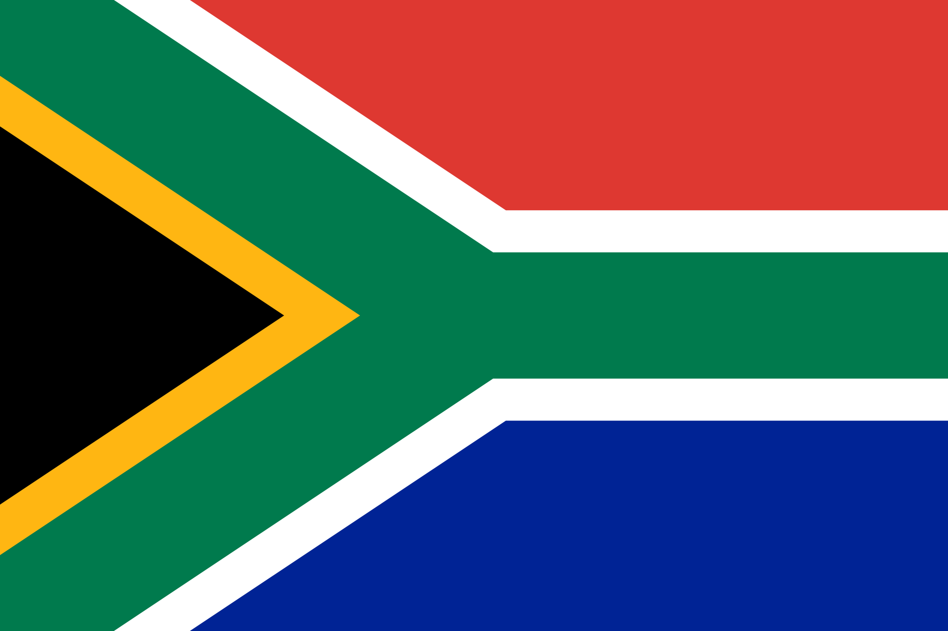
More English Speaking Countries
Ireland
Canada
India
Australia
South Africa
New Zealand

Slide 35
Some English Speaking Countries
England
The Cross of St. George
Scotland
The Cross of St Andrew
Northern Ireland
The Cross of St Patrick
Wales
The Red Dragon

