Slide 1
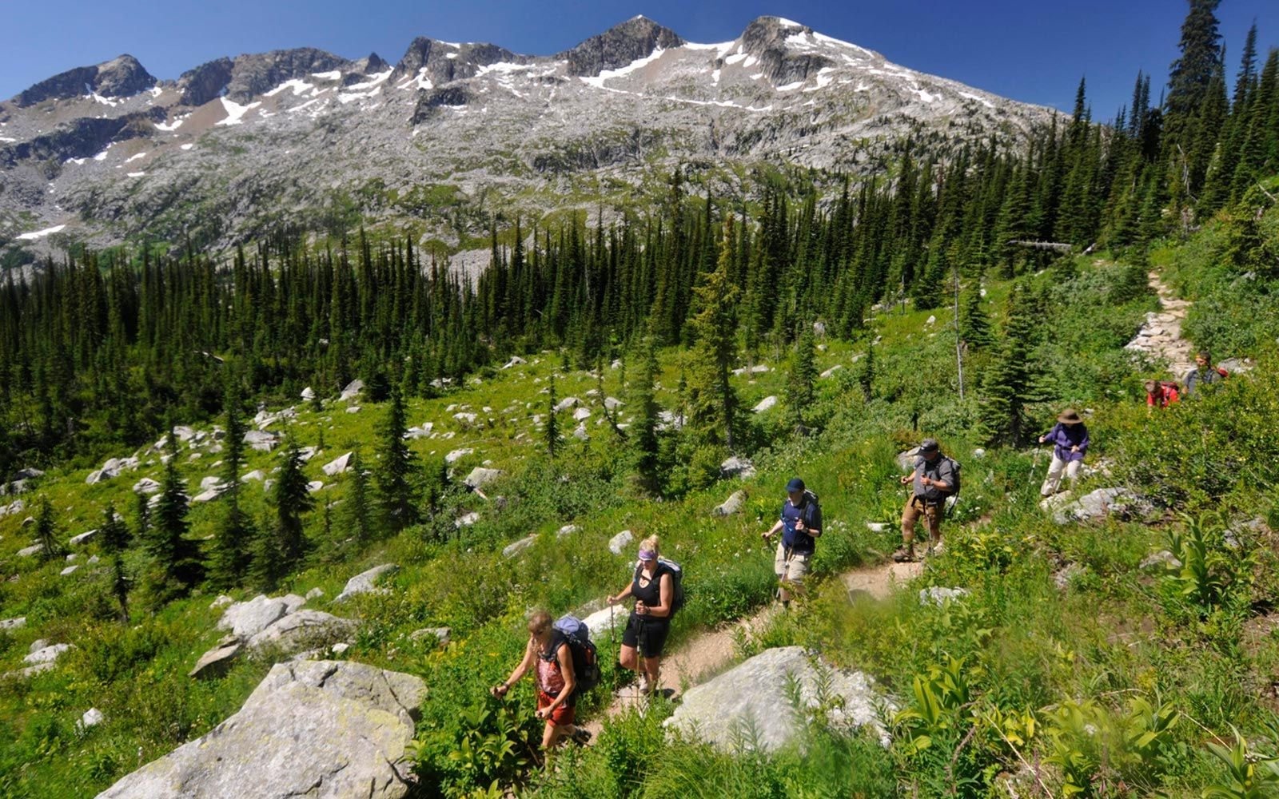
TIME TO TRAVEL

Slide 2
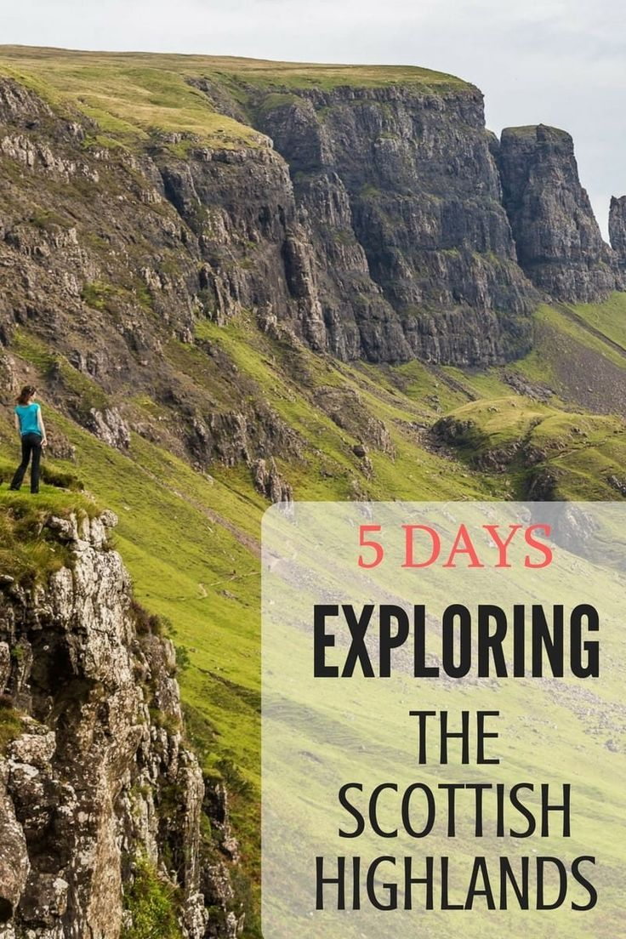
Read the text and do the tasks after it. Sightseeing Tour
This summer, I’m visiting my uncle. He lives in a small town in the Scottish Highlands. It's famous for its castle and ancient ruins. In the summer, there are a lot of tourists. They often arrive exhausted from hiking through the Highlands with their backpacks. Luckily, there are plenty of hotels and bed and breakfasts to stay in. There's also a campsite, although in Scotland people are also allowed to camp in the wild.
Most travellers stop in the town for a few days to relax and see the sights. The town is beautiful and there is so much to see and do. Usually, you can see the tourists wandering around with maps and cameras, eager to discover something exciting – or maybe they're just lost. It's funny because there are so many signposts in the town, it’s impossible to get lost.
My uncle is a tour guide, he takes groups on sightseeing tours of the town. They meet every morning at 9 am in front of the statue in the town square. There's a wonderful view of the hills and mountains nearby. With binoculars you can even see the people hiking and the wind blowing in the grass.

Slide 3
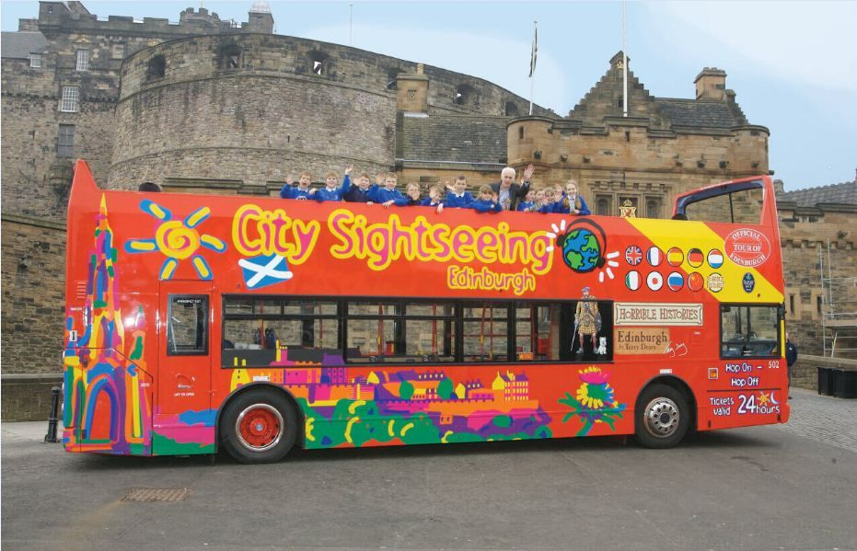
Sightseeing Tour Find the Russian equivalents
Древние развалины
Шотландское Высокогорье
Измученные походом
Место разбивки лагеря
Лагерь в дикой природе
Увидеть достопримечательности
Tуристы, бродящие по окрестностям
Стремящийся открыть
Указатели
Невозможно потеряться
Экскурсовод
Ветер, колыхающий траву

Slide 4
Sightseeing Tour Continue each line (после ключевого слова должно быть не менее 4-х слов или словосочетаний)
1. ruins: ancient, huge, … , …
2. tourists: exhausted, … , …
3. a tour guide: knowledgeable, … , … , …
4. a campsite: distant, … , …
5. to discover: a disease-curing properties, … , … , …
6. town: signposts, … , … , …
7. exciting: view, … , … , …
8. lost: tourist, … , … , …
9. to be allowed: to camp in the wild, … , … , …

Slide 5
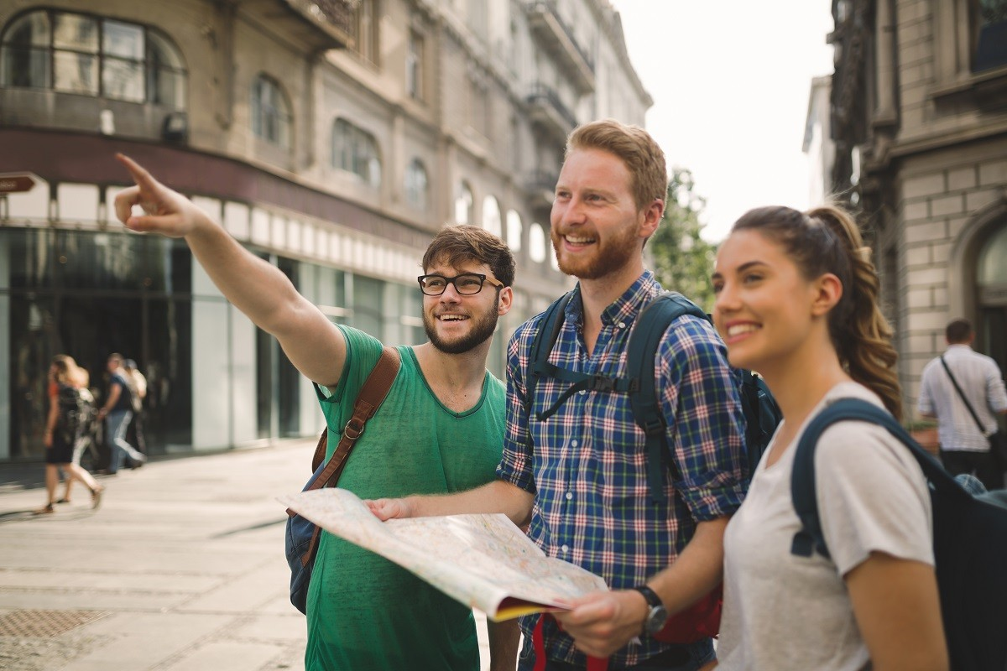
Answer the questions Sightseeing Tour
1. Why is the town well known?
a) There are a lot of tourists.
b) It has a castle and ancients ruins.
c) There are plenty of places to have breakfast.
2. How long do people stay in town?
two days
one day
c) some days
3. What is funny about the tourists?
a) They walk through the town with cameras and binculars.
b) It’s very difficult to get lost here, but the tourists do.
c) They think they will discover something new.
4. b) What can you see from the town square?
a) The beautiful landscape.
Tourists with their maps and cameras.
c) Tour groups leaving their hotels.

