Slide 1
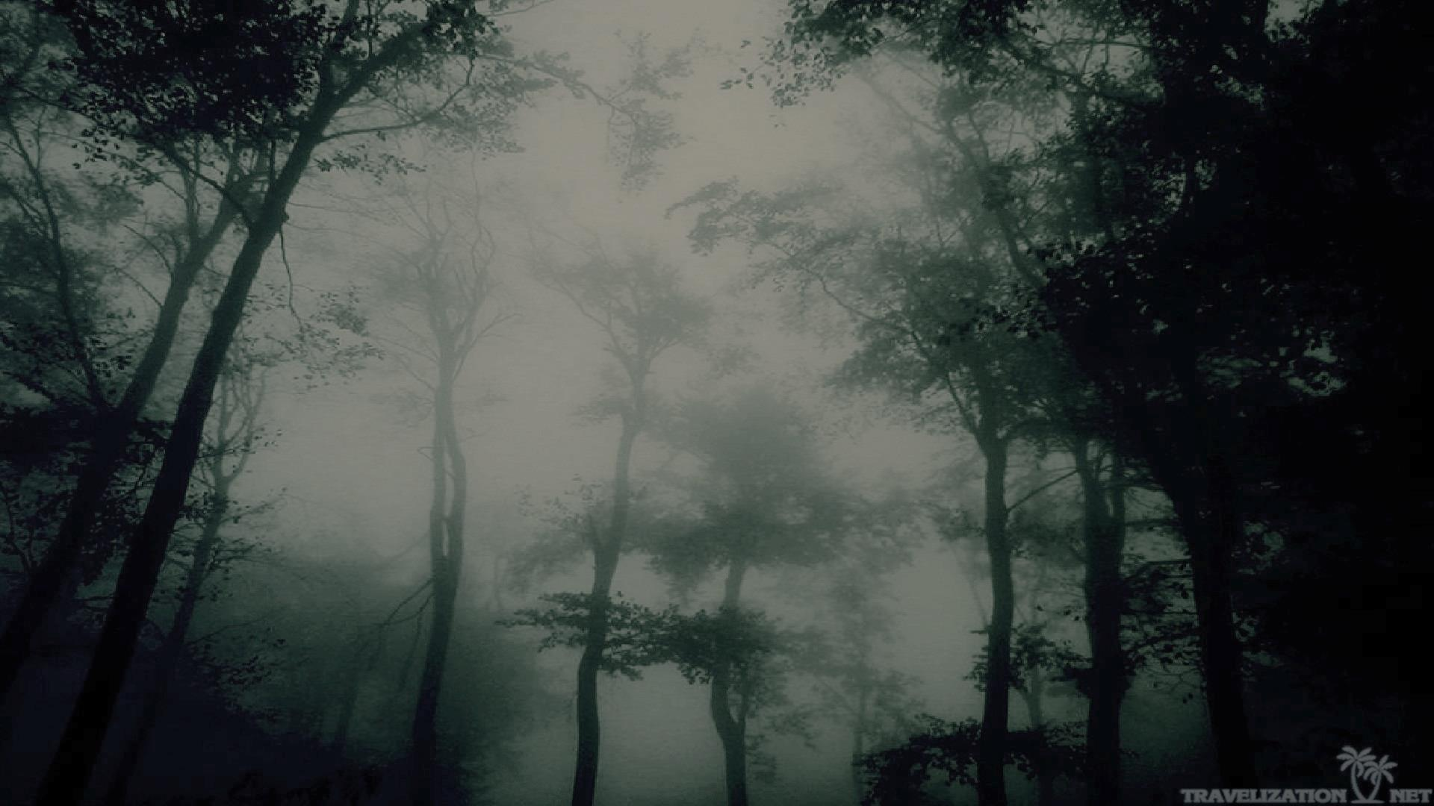
The main mystery of Scotland or the Overton Bridge
The work has been prepared by Marina Matsko

Slide 2
Before you get scared, practice your English
stone bridge – каменный мост
a sinister secret – зловещая тайна
gothic style – готический стиль
serious injuries – серьезные травмы
incomprehensible energy – непонятная энергия
dark forces – темные силы
ridiculous plot – нелепый сюжет
supernatural explanation - сверхъестественное объяснение
scientific explanation – научное объяснение
superstitious places – суеверные места

Slide 3
It will be better for you if you listen to this story…
The most superstitious region in the UK is Wales. (yes\no)
Some Scots have seen ghosts or talked to them. (yes\no)
The Scots explain the strange things that happen at home or on the street with magic. (yes\no)
The magic that happens in Scotland is always kind and good. (yes\no)

Slide 4
It will be better for you if you listen to this story…
The most superstitious region in the UK is Wales. NO
Some Scots have seen ghosts or talked to them. YES
The Scots explain the strange things that happen at home or on the street with magic. YES
The magic that happens in Scotland is always kind and good. NO

Slide 5
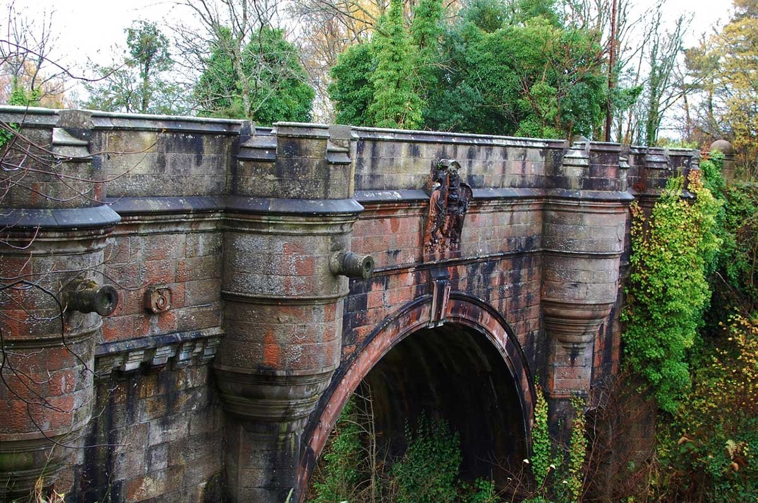
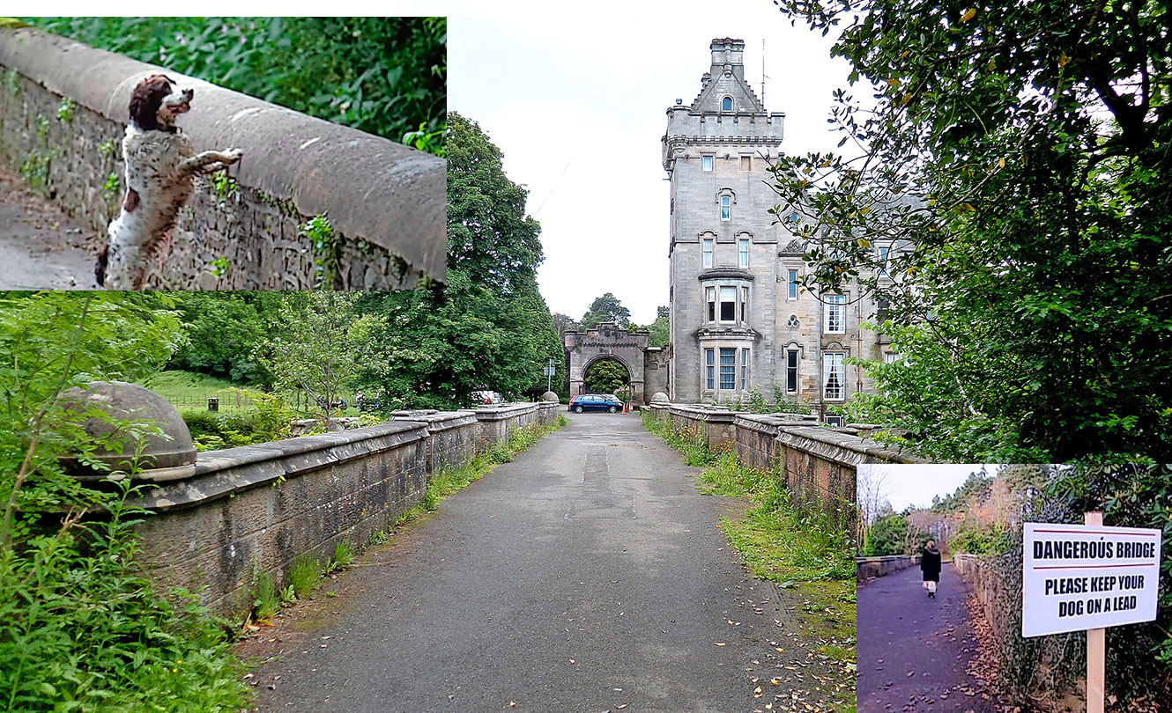
You never know around which corner a meeting with horror is waiting for you.

Slide 6
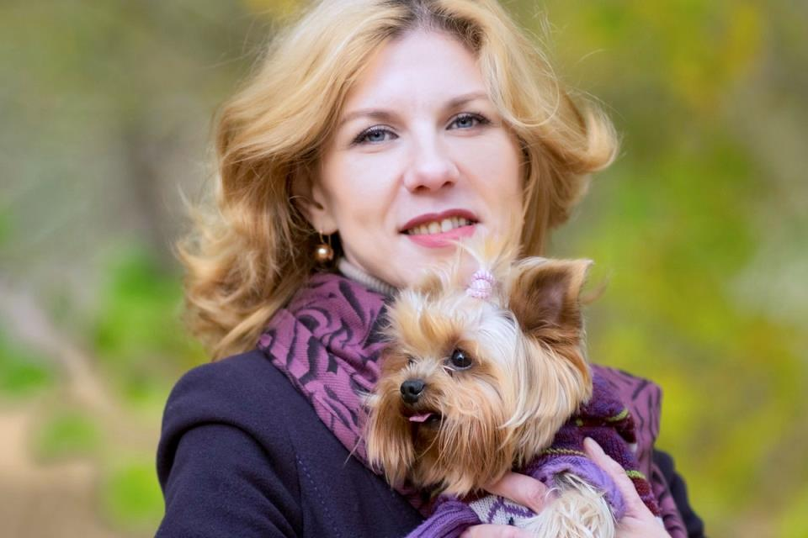
"I was sure she was dead," Lottie McKinnon said quietly.
"As soon as we got to the bridge, it was like something possessed Bonnie," Ms. McKinnon says. - At first she froze, but then some incomprehensible energy seized her, she rushed to the edge and jumped right off the bridge.

Slide 7
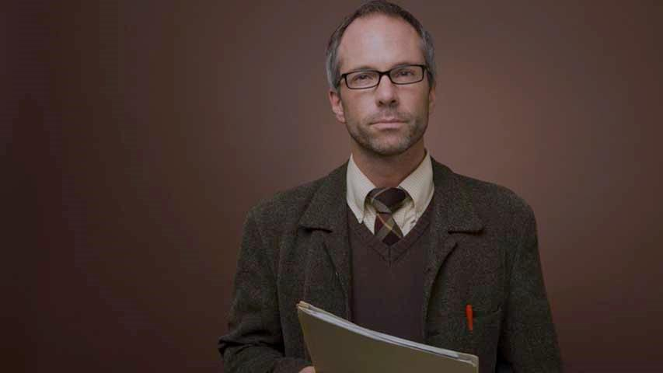
Attempts at scientific explanation
Paul Owens, a teacher of religion and philosophy from Glasgow, grew up in a town that is very close to this bridge. Not so long ago, he published a book about the mystery of Overton, where he stated that everything that happens has only a supernatural explanation.
"After 11 years of research, I am convinced that there is a ghost behind everything," Owens said.

Slide 8
A. gothic style | 1. bruises, abrasions or wounds that require medical treatment.
B. stone bridge | 2. rapidly going down.
C. serious injuries | 3. this is a structure that connects the two shores, made of stone.
D. seize | 4. it is based on a dark palette and specific symbolism, closely related to mysticism.
E. rush down | 5. someone is taking over you and your body.

Slide 9
The Overton Bridge was built in the middle of the 17th century.
All cats that pass over this bridge jump down.
Almost no one in Scotland believes in ghosts.
Paul Owens who tried to find out the secret of the bridge was a magician and a psychic.
In the end, scientists came to a logical, common-sense conclusion.

Slide 10
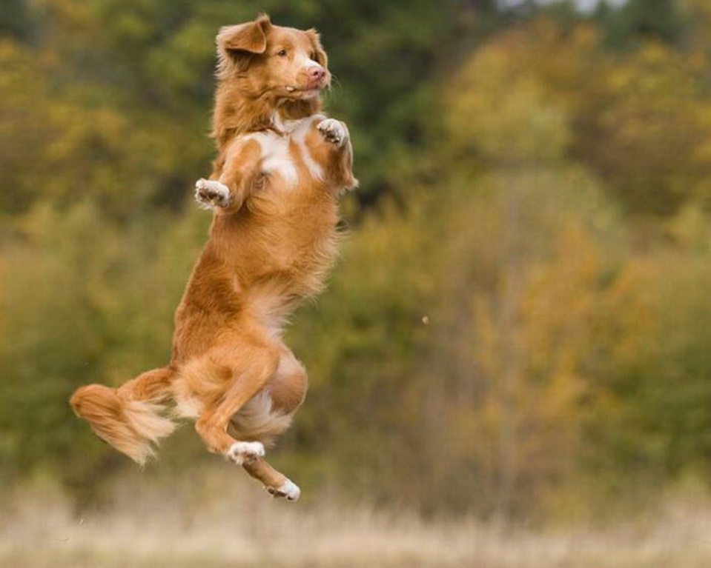
Be careful with your dog on the Overton Bridge.
Thanks for your attention!
………………………………………………………………………………………………………………………………………………………………………………………………………………………………………………………………………………………………………..
Nobody:
Absolutely nobody:
The dog on the Overton Bridge:

