Slide 1
Особенности письменной части ЕГЭ 2022 (задания 37 и 38)
Москаленко И. А.
Учитель английского языка МОУ СОШ №4
Бежецк
2023

Slide 2
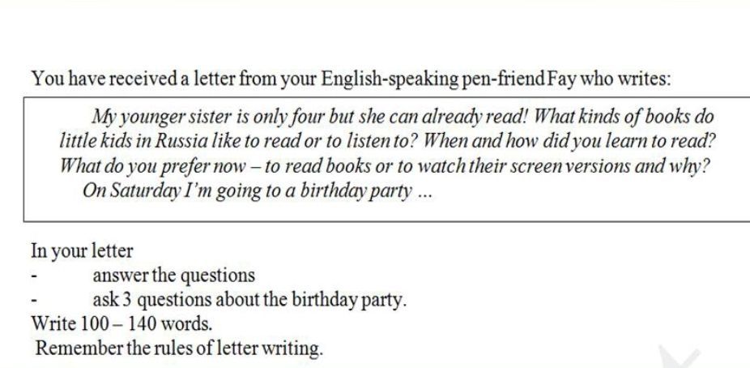
Личное письмо 2021

Slide 3
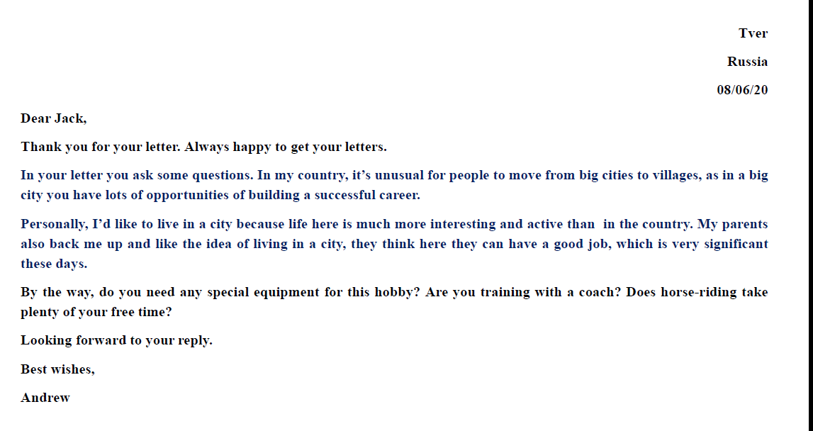
Личное письмо 2021

Slide 4
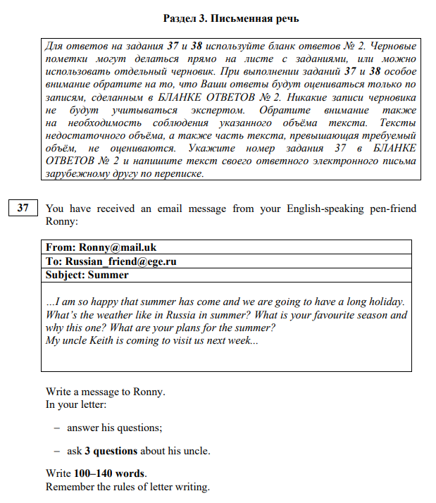
Электронное письмо 2022

Slide 5
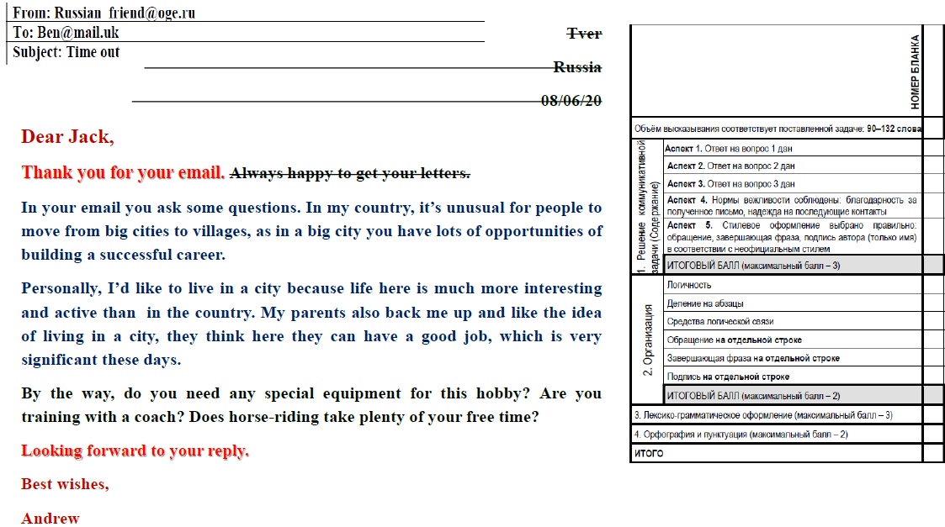
Электронное письмо 2022

Slide 6
3 Вопроса автору!!!
… My friend got an unusual present.
ask 3 questions about the present.
… My brother has won a tennis tournament.
ask 3 questions about his brother.
I became keen on listening to audiobooks …
- ask 3 questions about the audiobooks.
I wrote an article for our school magazine …
ask 3 questions about the article.
We’ve just moved to a new flat …
ask 3 questions about the flat.
I’ve started reading a new novel / a novel by Leo Tolstoy
ask 3 questions about the novel.
My grandma has come to visit us …
ask 3 questions about her grandma.

Slide 7
I’ve started reading a new novel / a novel by Leo Tolstoy. ask 3 questions about the novel.
Ошибки!!!
What is your favourite book? -
Have you read something else written by Leo
Tolstoy before? -
Have you ever read novels by Leo Tolstoy? -
Do you want to read other novels by Leo
Tolstoy? -
Is Leo Tolstoy your favourite writer? -

Slide 8
I became keen on listening to audiobooks.
- ask 3 questions about the audiobooks.
Your audiobook is good gadget, isn’t it?
Can you listen to songs on your audiobooks?
Do your friends enjoy audiobooks or not?
What is audiobook anyway?
What do you listen audiobooks?
How often do you listen to audiobooks?
Is it interesting? Is it expensive? Is it in Russian?
Is it a good audiobook? Do you like it? How
much does it cost?

Slide 9
My friend got an unusual present. ask 3 questions about the present.
Great news about your present! What is it?
Why is it unusual? Who presented you with it?
……. Do you like the present?
Is it a real gift or not?
Is it alive?
Who did give it to you?
You like playing with it, don’t you?
What are you going to do with your present?
Will your friend give this present to you?
Why is your friend unusual?
Will you use it together with your friend?
Where did your friend buy it?

Slide 10
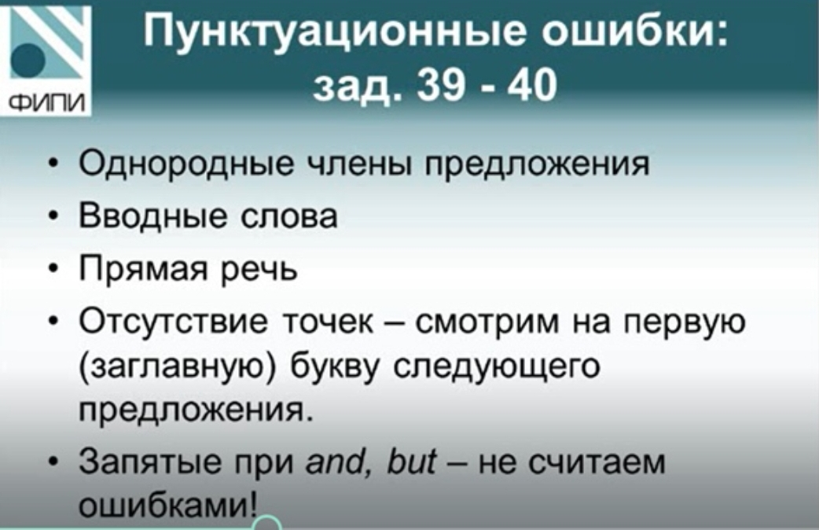
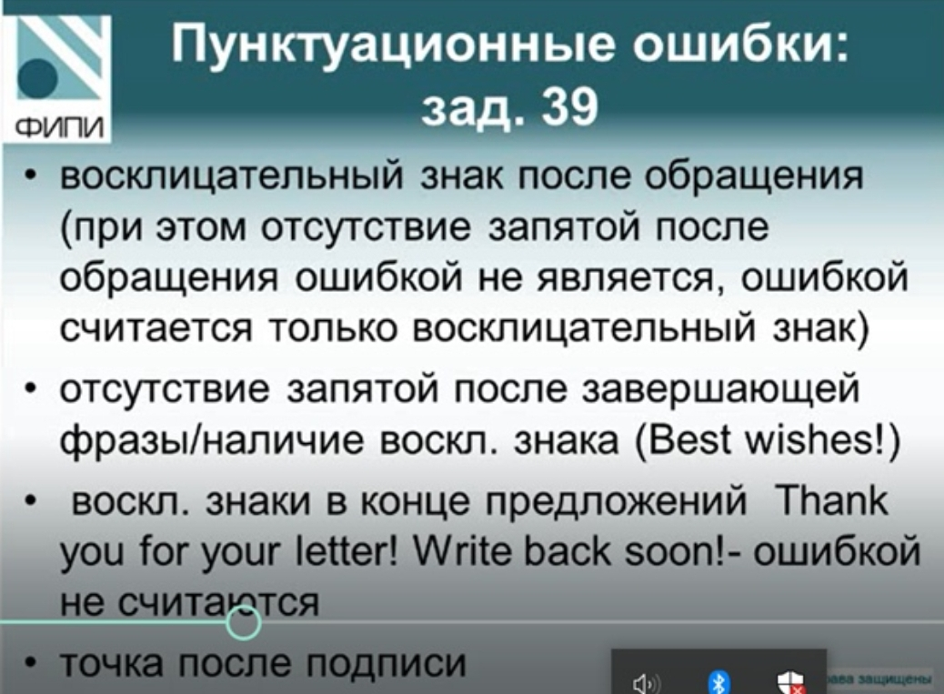

Slide 11
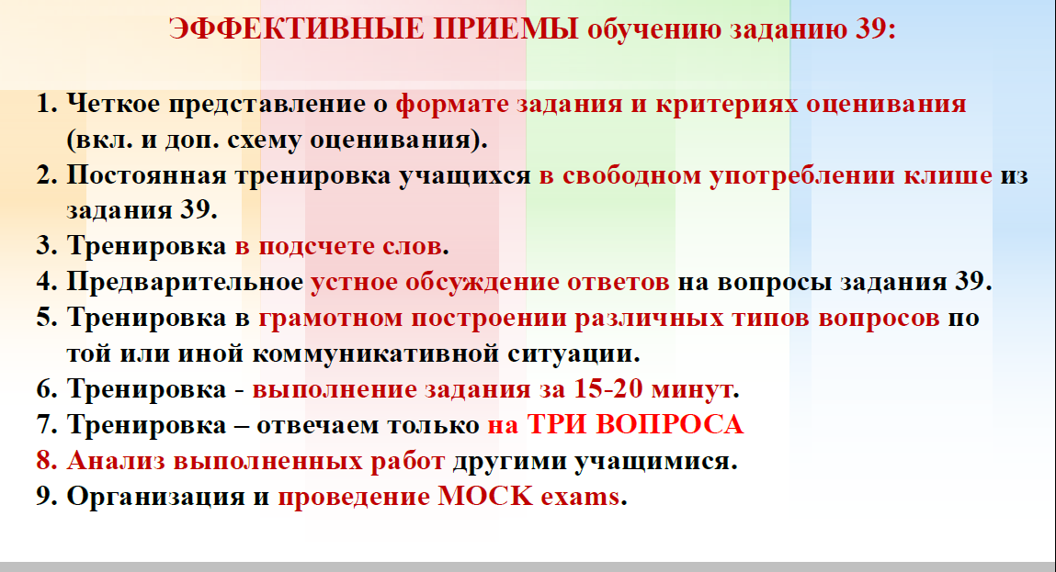

Slide 12
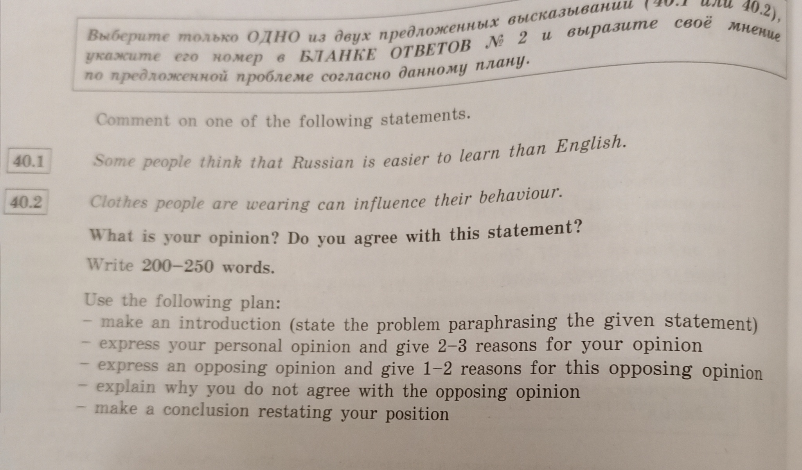
Личное высказывание с элементами рассуждения 2021

Slide 13
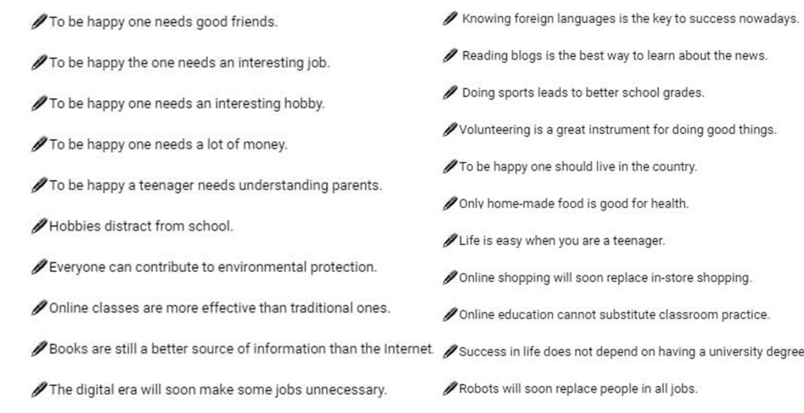
Тематика

Slide 14
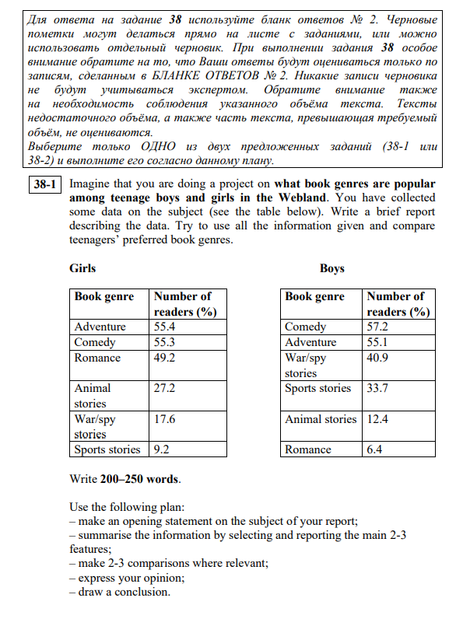
2022 (a brief report)

Slide 15
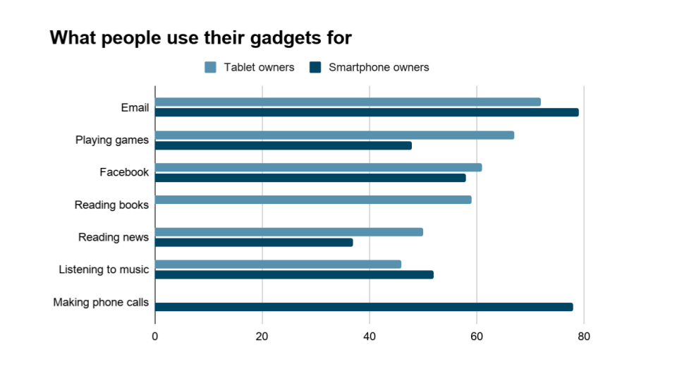
38-2 Imagine that you are doing a project on what people use their smartphones and tablet PC for. You have collected some data on the subject (see the diagrams below). Write a brief report describing the data. Try to use all the information given and compare smartphones and tablet PCs in terms of what they are used for.

Slide 16
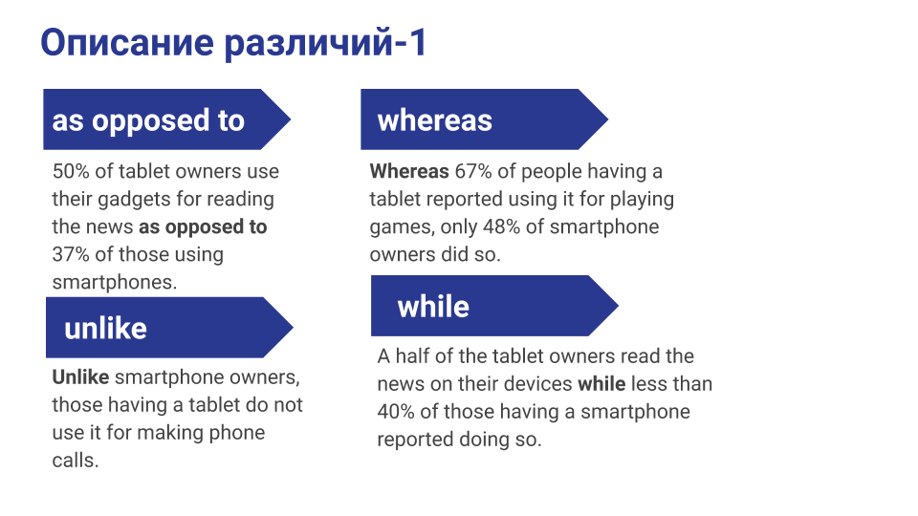
Полезные советы!!!

Slide 17
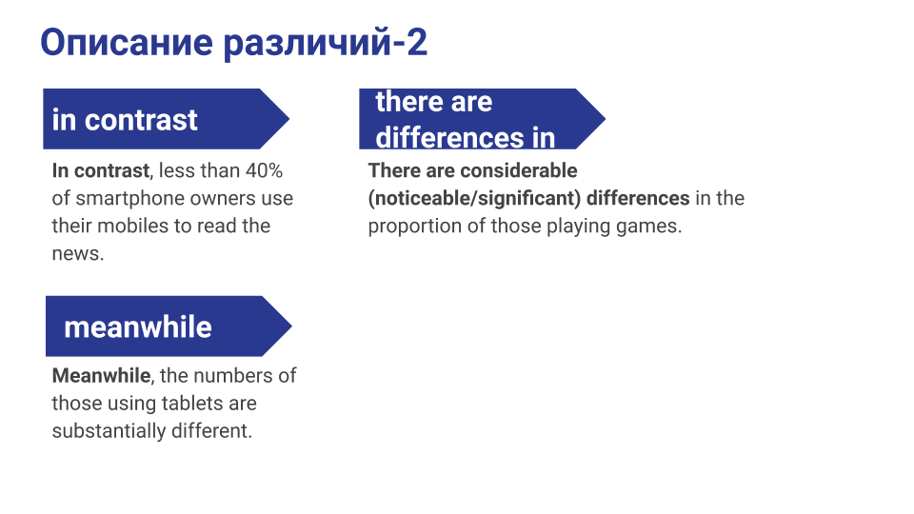

Slide 18
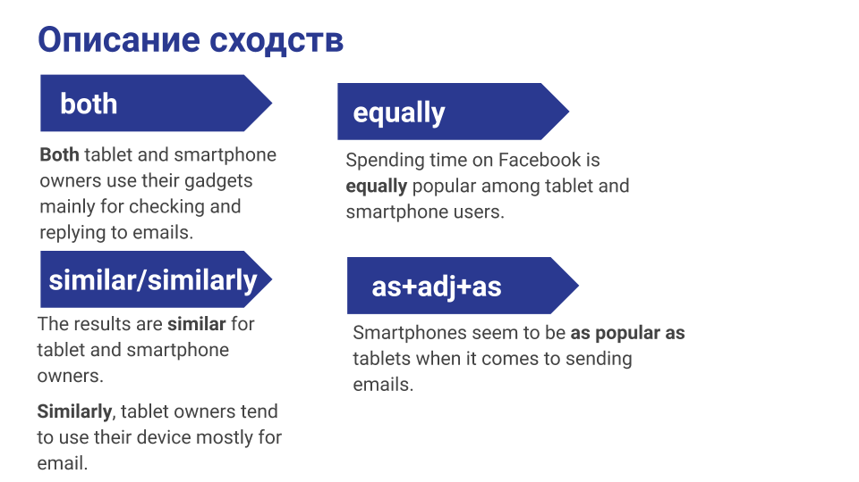

Slide 19
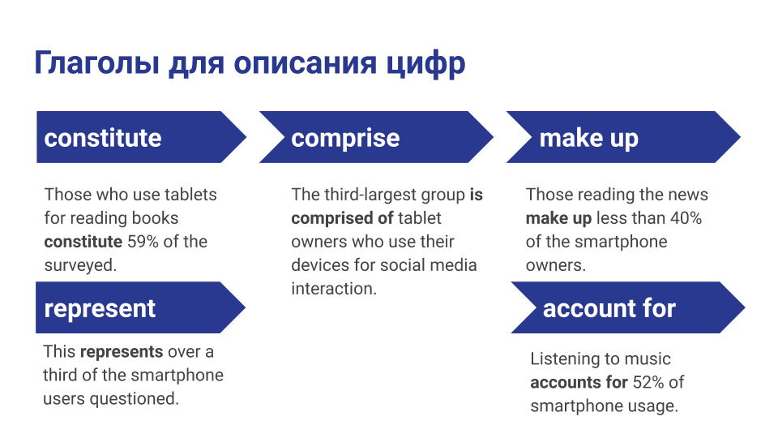

Slide 20
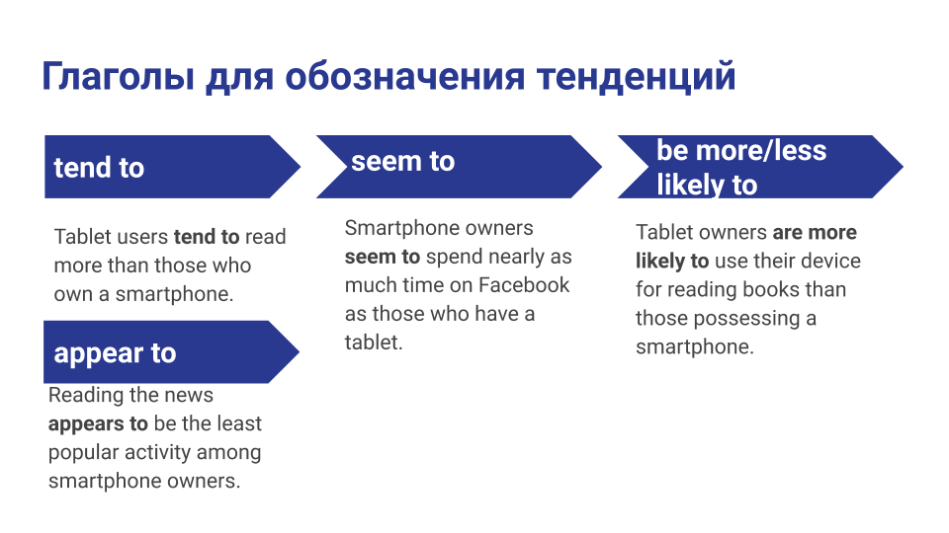

Slide 21
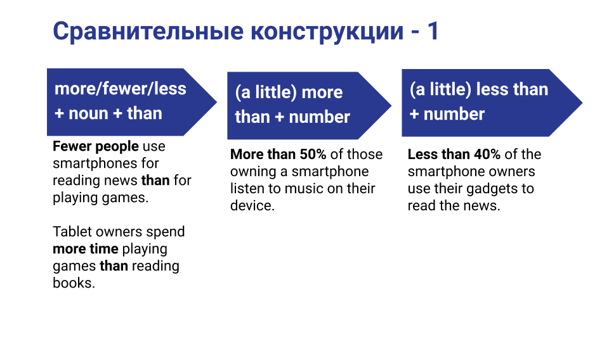

Slide 22
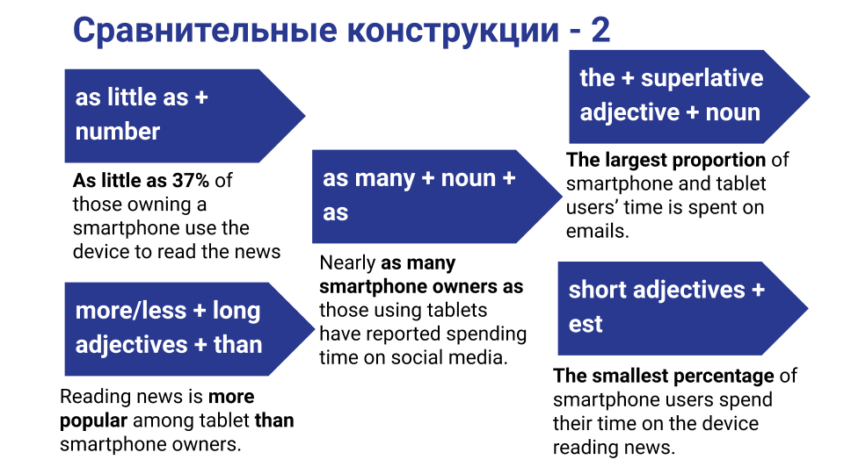

Slide 23
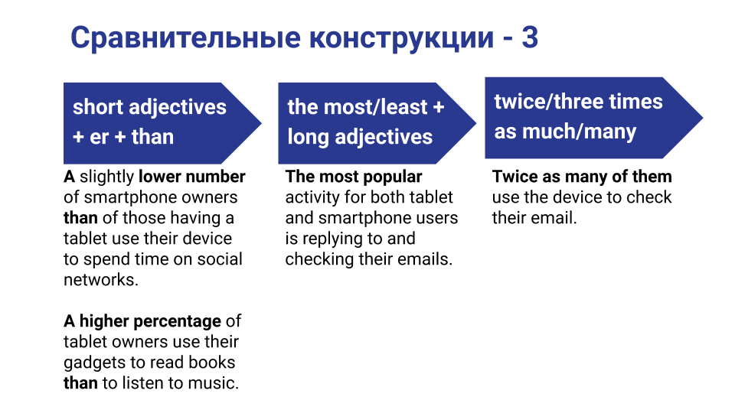

Slide 24
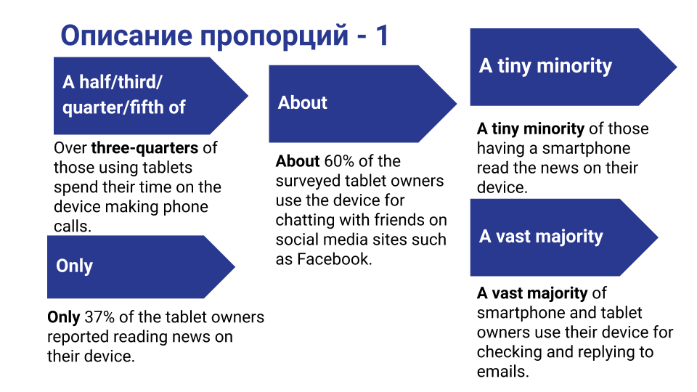

Slide 25
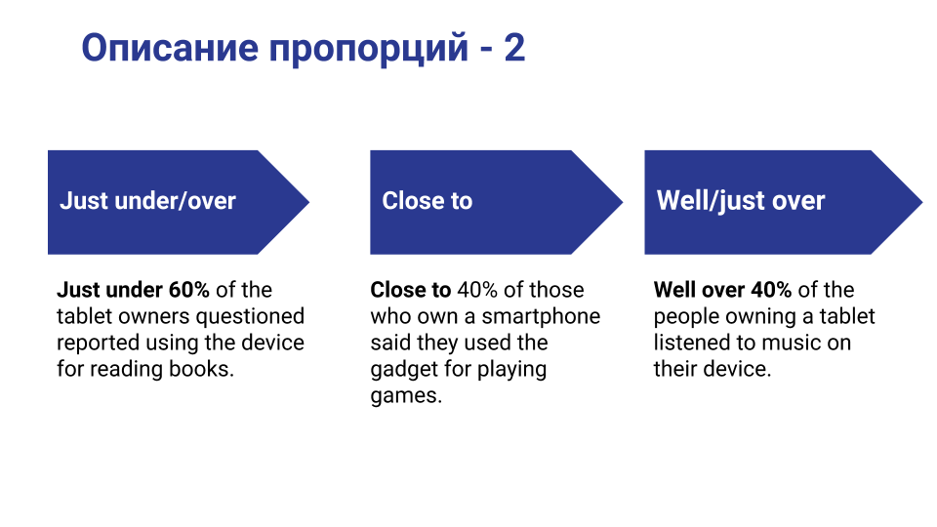

Slide 26
Готовить детей можно на основе пособий, разработанных для кембриджских экзаменов (Cambridge First, Cambridge Adnaced) и IELTS.

Slide 27
Спасибо за внимание!

