Slide 1
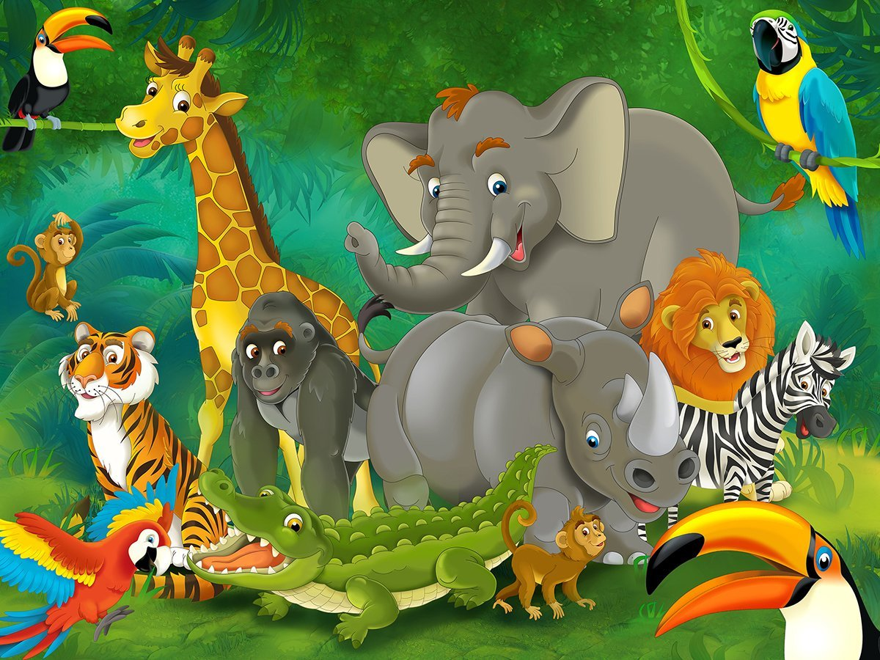
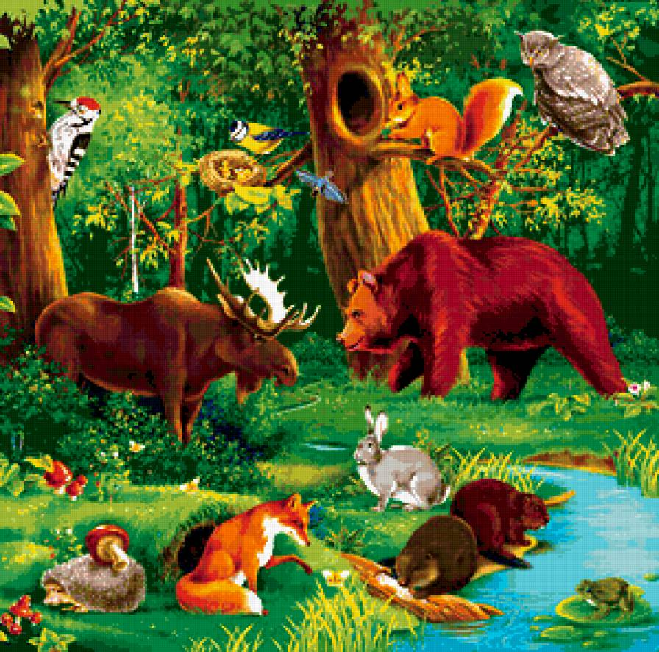
FURRY FRIENDS
Spotlight 3

Slide 2
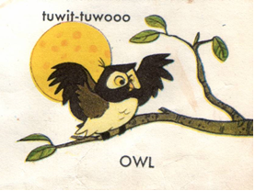
Let's warm-up, look at the tongue-twister and repeat after me
tuwit – tuwoo, tuwit – tuwoo.
[tu'wit – tuwu: - tu'wit – tuwu:]
An old owl sat in an oak,
The more he heard,
The less he spoke.

Slide 3










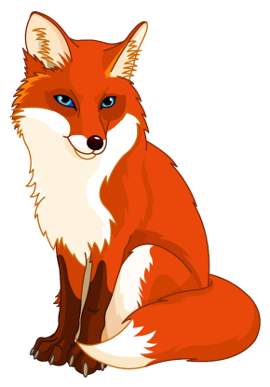




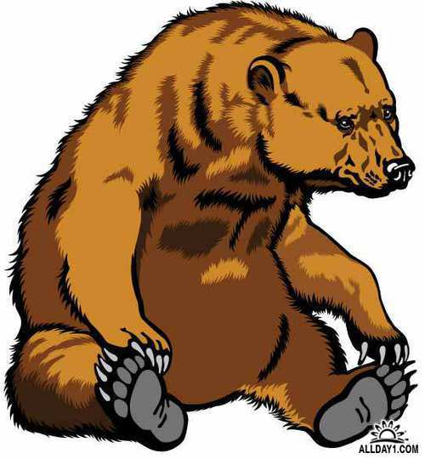




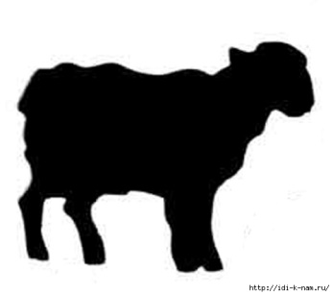


Find animals in the picture
?
?
fox
bear

Slide 4
Group I | Fill in a / an | Count , write and say
 | ____ sheep | 10 + 11 = ?
 | ____ elephant | 20 + 30 = ?
 | ____ tooth | 16 + 16 = ?
 | ____ man | 40 - 5 = ?
Group II | Fill in a/ an | Count ,write and say
 | ____ mouse | 11 + 15 = ?
 | ____ owl | 30 - 3 = ?
 | ____ foot | 1 + 1 = ?
 | ____ woman | 60 - 10 = ?
Group III | Fill in a/ an | Count , write and say
 | _____ fish | 50 + 10 = ?
 | _____ ox | 15 + 5 = ?
 | _____ spider | 30 - 20 = ?
 | _____ goose | 45 + 45 = ?

Slide 5
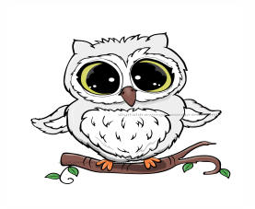
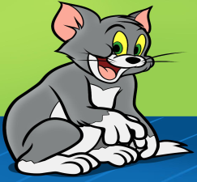
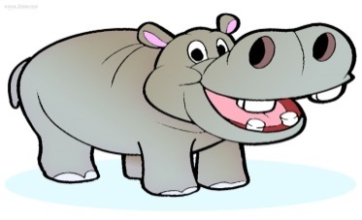
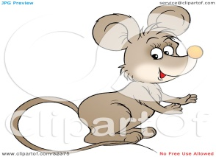
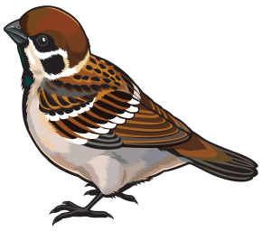
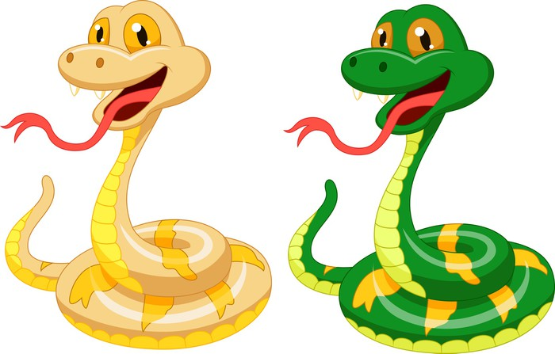
Choose this-these;that-those
1.This /That is an owl.
2.These/ Those are cats.
3.This / That is a hippo.
4. These /Those are mice.
5.This/These is a sparrow.
6.These/ Those are snakes.
1.This is an owl.
2.These are cats.
3. That is a hippo.
4. Those are mice.
5.This is a sparrow.
6. Those are snakes.

Slide 6
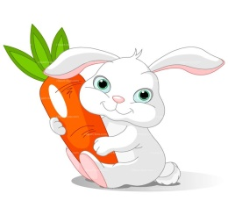
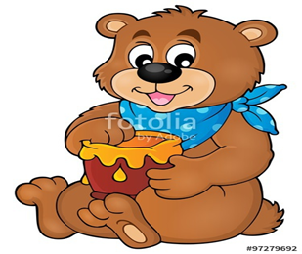
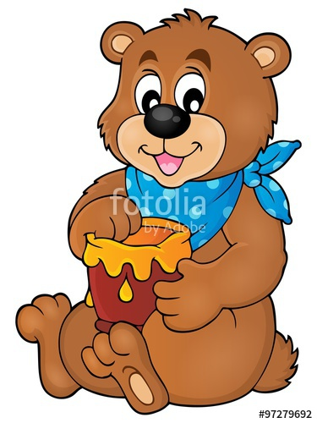
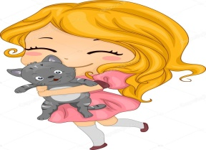
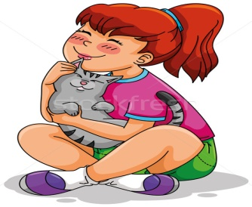
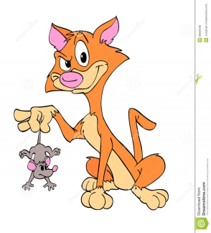

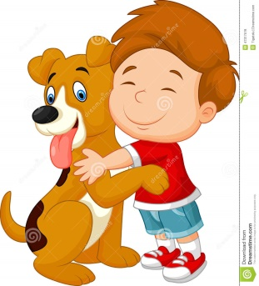

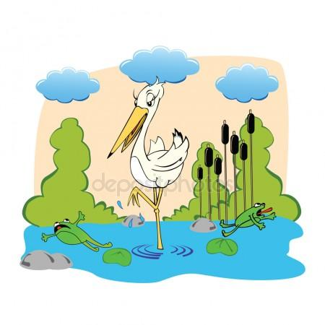
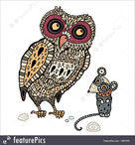

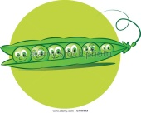



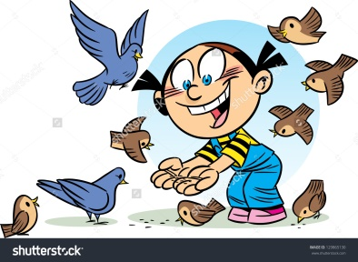
I like my Bunny.
Bears like honey.
Girls like cats.
Cats like rats.
Boys like dogs.
Storks like frogs.
Mice like cheese.
Sparrows like peas.
Owls like mice.
I like rice,
Birds like grain.
Say it again.
Let’s revise the poem

Slide 7
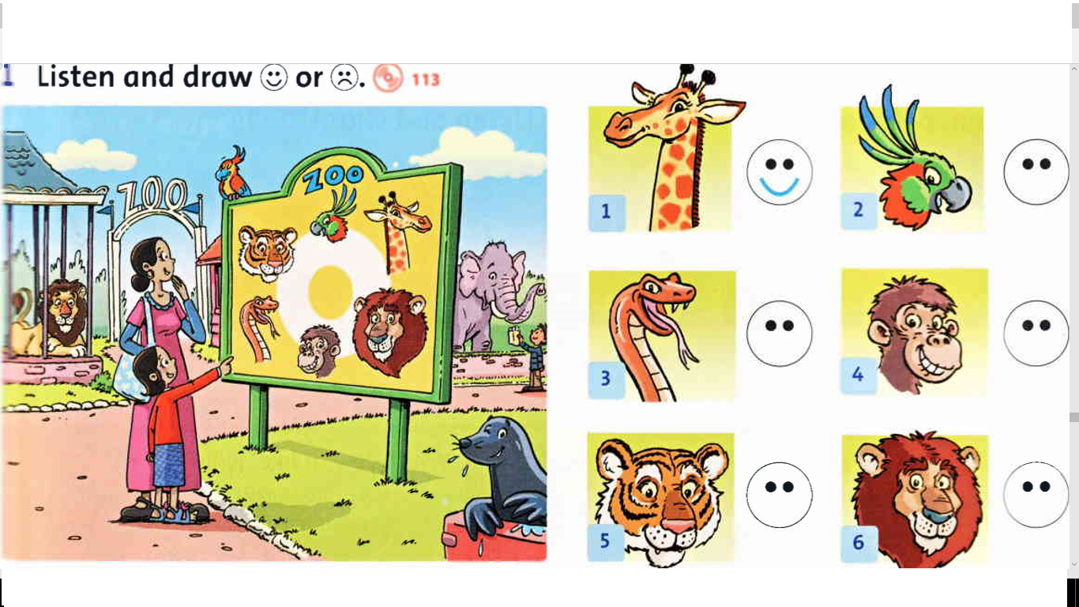



Slide 8
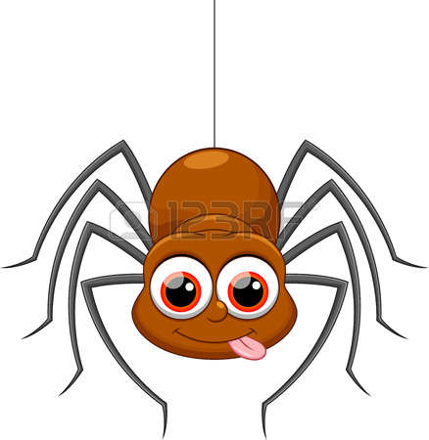
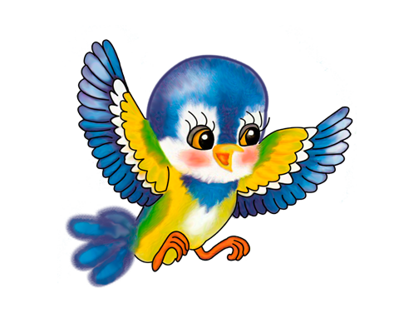

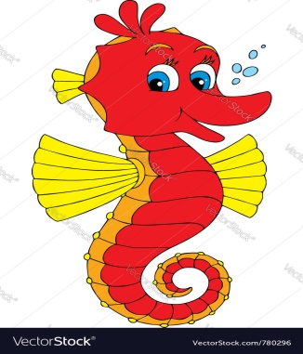
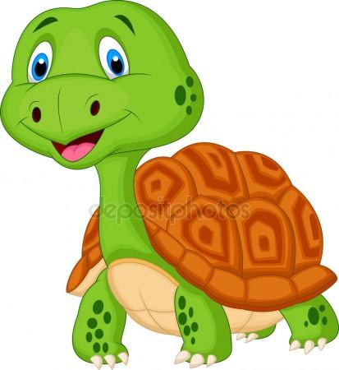
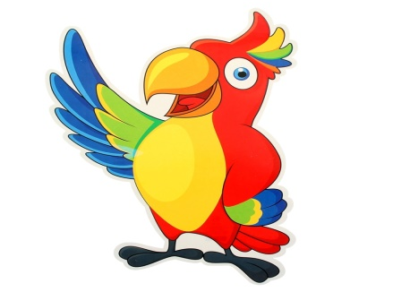
Let’s sing together
What can crawl?
A spider can !
Whan can fly?
A bird can!
What can jump?
A rabbit can !
What can swim?
A seahorse can!
What сan walk ?
A tortoise can!
What can talk ?
A parrot can!

Slide 9



Make can / can’t sentences
Example : An owl can fly , walk and jump but it can’t swim, talk,crawl,climb or sing.
Animal | Walk | Fly | Jump | Swim | Sing | Crawl | Climb | Talk
An owl
A bird
A tiger
A snake
A fish
A monkey
A parrot

Slide 10
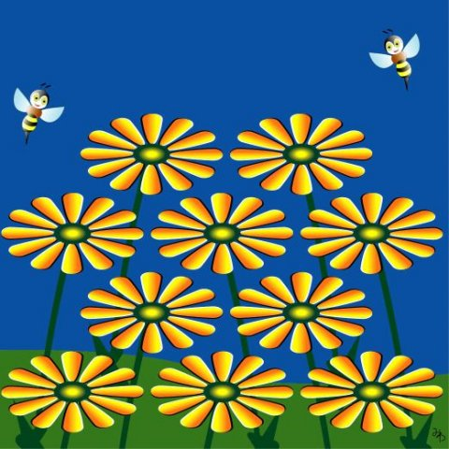

Let’s have a rest.

Slide 11
Put the letters in the correct order
samll deah
nogl sone
tihn gles
shtor tial
gib yese
aft doby
Small head
long nose
thin legs
short tail
big eyes
fat body

Slide 12
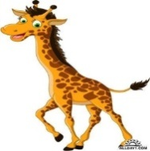
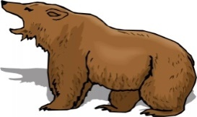

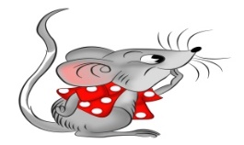
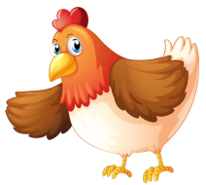

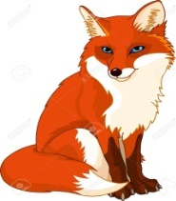

Choose and use .
The giraffe has got a short / long neck.
The bear has got a thin / fat body.
The mice have got short / long tails.
The hen has got a big / small head.
The frog has got a long / short neck.
The foxes have got a thin body.

Slide 13
Read the text , correct the mistakes
I name is Bob. I has got a pet. It is dog. His names is Rex. Rex is a ten. He is blak and white. Rex have got an fat body, big brown eye, a big nose, big paw and a long tails. He can to jump, run and swim but I can’t sing and climb. He like meat , vegetables but he doesn’t likes juice and pears.

Slide 14

Read the text again and write T (true) or F (false).
1. Rex is a cat ____________________
2.He is ten._______________________
3.The boy’s name is Bob.____________
4.Rex has got a thin body.____________
5.His paws are small._________________
6.He likes mice and rice.______________
7.He can’t sing and climb._____________

Slide 15

Pet
Can/can’t do
Name
age
Like(s) /doesn’t/don’t like to eat
colour
eyes

Slide 16
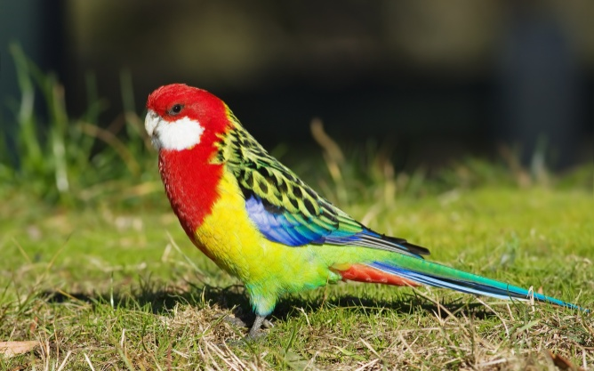
Match. Fill the table .Then act out a dialogue.
1.Hello!How are you? A. He likes grain and apples 2.Have you got a pet? C. He can fly, walk and talk but he can’t sing
3.What’s your pet’s name? D. Hi . I’m fine , thank you.
4.What colour is your parrot? E.Yes , I have . I’ve got a parrot
5.What can Kesha do? F. Bye.
6.What’s his favourite food? G. He is green, red ,blue and yellow.
7.Good bye. F. His name is Kesha.
1 | 2 | 3 | 4 | 5 | 6 | 7

Slide 17

Match. Fill the table .Then act out a dialogue.
1.Hello!How are you? A. Yes,she has. She’s got big eyes.
2. Have you got a pet? B. Bye.
3. What’s your pet’s name? C. No, She can walk but she can’t jump,run
4.Has she got big eyes? D. Hi. I’m fine. Thank you.
5.Has she got a fat body? E. She likes vegetables and apples.
6.Can your rabbit crawl? F. Her name is Sima.
7. What’s her favourite food? G.Yes, I have. I’ve got a tortoise.
8.Goodbye. H.Ye,She has . She’s got a fat body.
1 | 2 | 3 | 4 | 5 | 6 | 7 | 8

Slide 18
Match. Fill the table .Then act out a dialogue.
1.Do you like going to the zoo? A.They can’t sing. 2.What animals can you see at the zoo? B.Yes,I do. I like going to the zoo
3.What animals do you like? C.Their favourite food is bananas,apples.
4.What can they do? E. Bye.
5.What can’t they do? F. I can see elephants,monkeys,snakes, tigers, seals,lions,owls.
6.What’s their favourite food? G.I like monkeys. they are funny.
7.Goodbye. D. They can’t crawl and sing.
1 | 2 | 3 | 4 | 5 | 6 | 7

Slide 19

Dear _______,
Thank you for your letter. How are you?
I’ve got a pet. It’s______________________________________.
His/Her name is_______________________________________.
He’s got_______________________________________________.
His favourite food is_____________________________________.
He can_____________________but he can’t_________________.
What about ____________________________________________?
What __________________________________________________?
Write back soon.
Love,
___________
\
Almetyevsk
Russia
15/02/2018

Slide 20
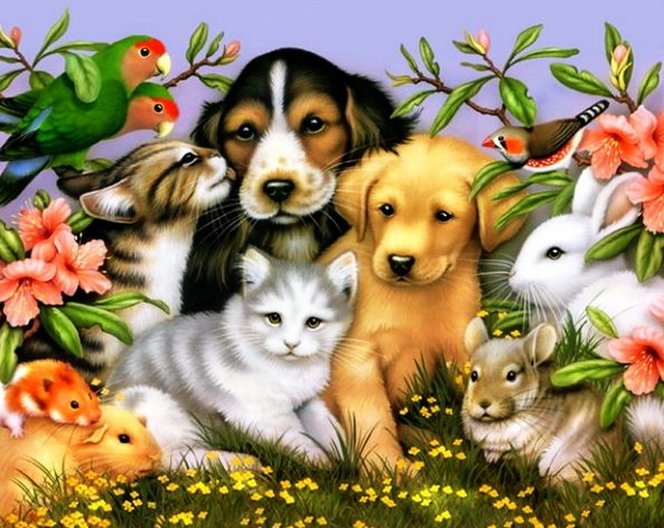
Thank you for your attention

