Slide 1
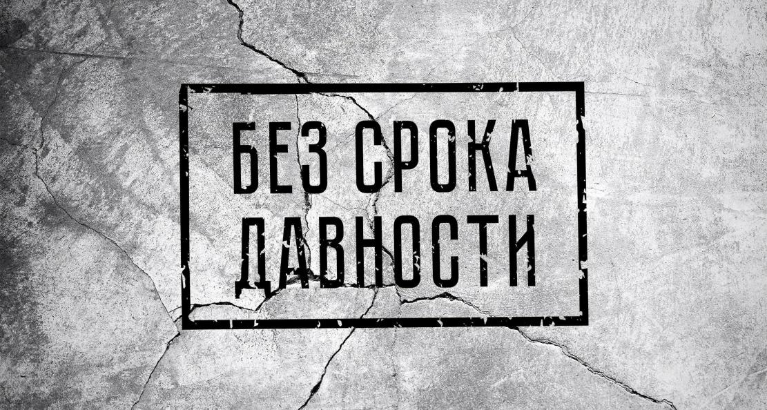
Remember to prevent… (Помнить, чтобы не допустить…)
“Lecturers Club.
No statute of limitations"
«Клуб Лекторов. Без срока давности»

Slide 2
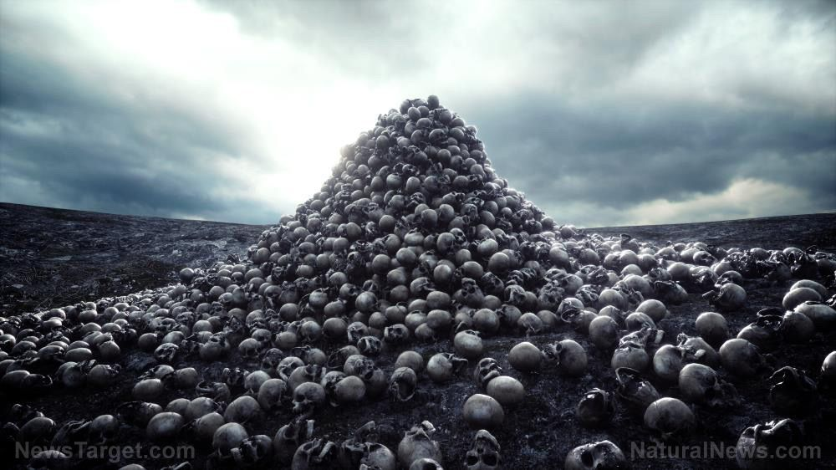
GENOCIDE is…
Killing members of the group
Causing serious bodily or mental harm to members of the group.
Deliberately inflicting on the group conditions of life calculated to bring about its physical destruction in whole or in part
Imposing measures intended to prevent births within the group
Forcibly transferring children of the group to another group

Slide 3
The Decree No. 39 of the Presidium of the Supreme Council on penalties for Nazi villains guilty of murder and torture of the Soviet civilian population and captured Red Army soldiers, for spies, traitors to the motherland from among Soviet citizens and for their accomplices was issued on April 19, 1943

Slide 4
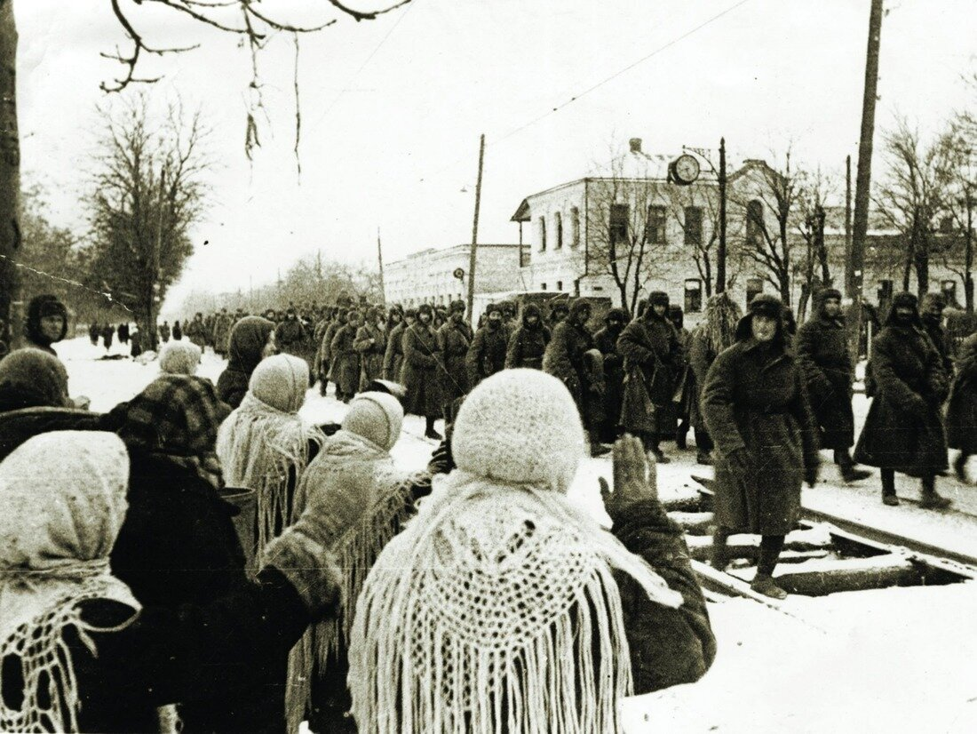
The city of Voroshilovsk (Stavropol) was occupied on August 3, 1942 by units of the German and Romanian armies and liberated on January 21, 1943 by the 347th Infantry Division of the Red Army.

Slide 5
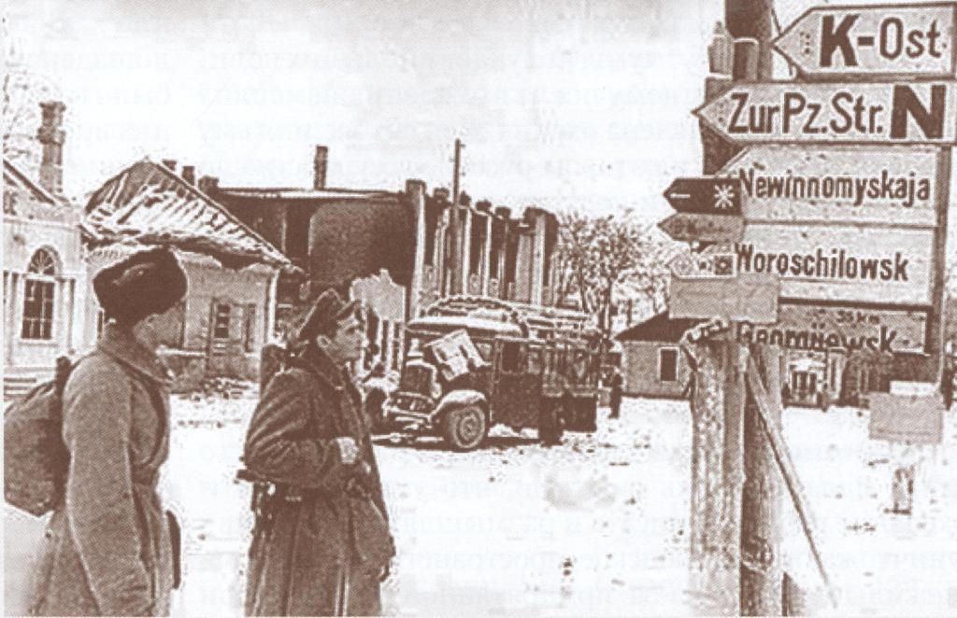
Our village of Staromaryevka in the Stavropol Region also experienced a hard time of occupation.

Slide 6
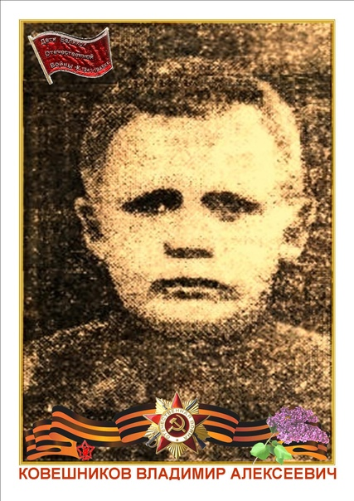
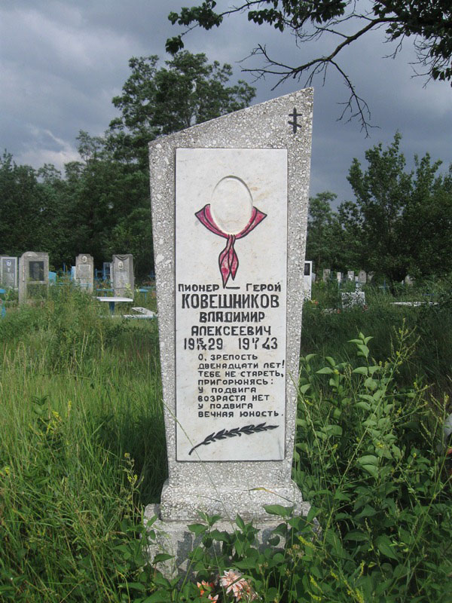
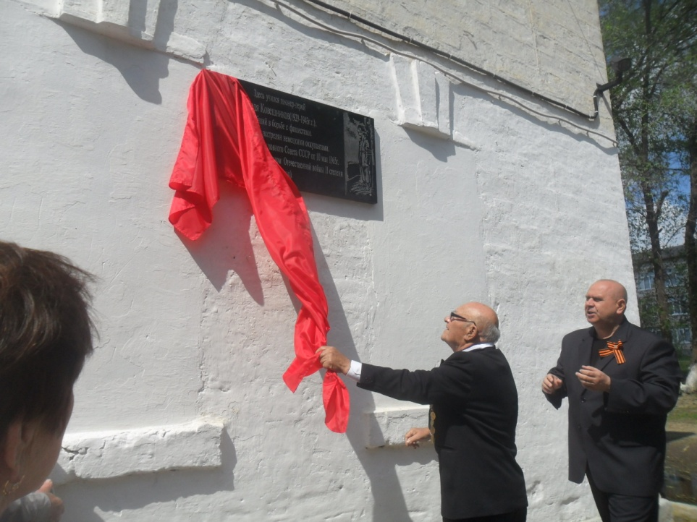
By decree of the Presidium of the Supreme Soviet of the USSR of May 10, 1965, Vladimir Alekseevich Koveshnikov was awarded the Order of the Patriotic War, II degree, posthumously.

Slide 7
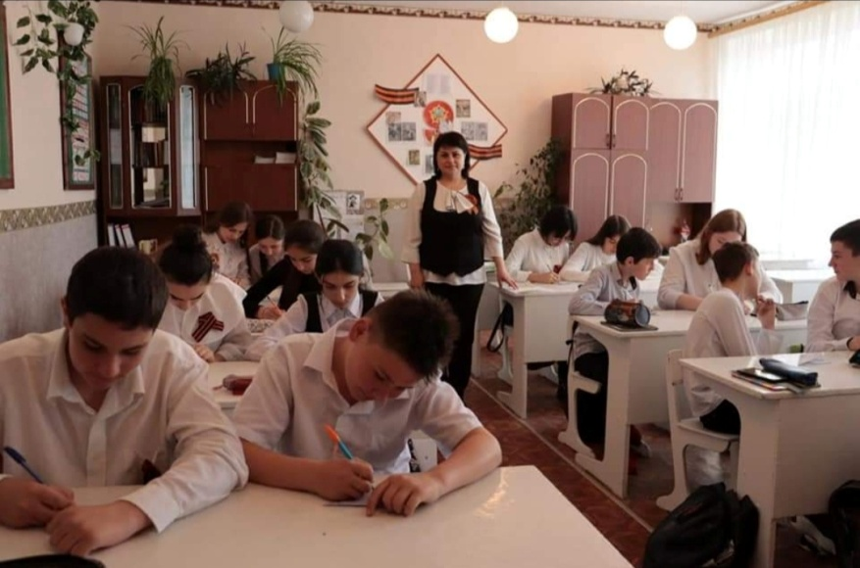
Every year on April 19th, United Action Day is held, lessons dedicated to the topic of genocide of the Soviet people by the Nazis and their accomplices during the Great Patriotic War.

Slide 8
By the decree of the President of the Russian Federation dated February 11, 2023, for courage and heroism shown in the performance of military duty, warrant officer Nikita Yuryevich Gusev was awarded the title of Hero of the Russian Federation (posthumously).

Slide 9
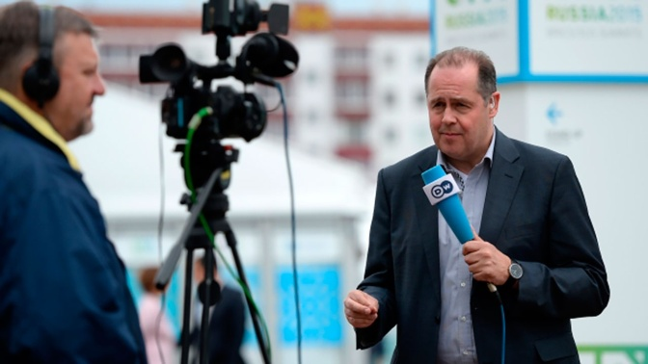
The United States and its allies spend a lot of money on providing information and psychological influence on Russia and its allies.

Slide 10
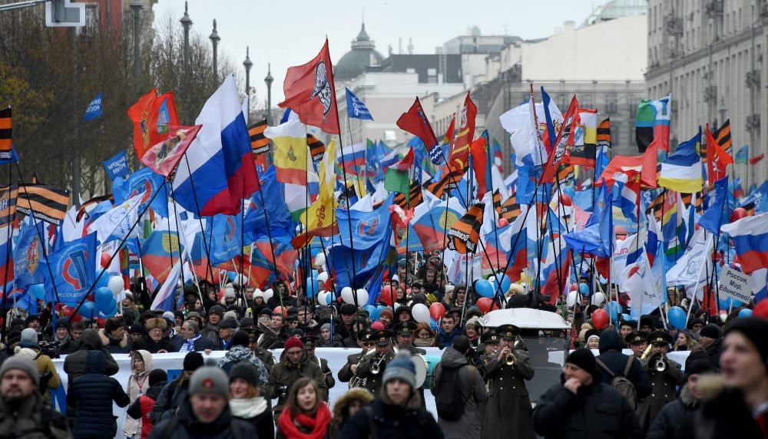
The power of Russia is in the unity of its peoples

