Slide 1
Look at the photo.
Read.
What is the topic of the lesson?

Slide 3
Answer these questions

Slide 4
Grammar

Slide 5
Birthday parties around the world

Slide 7
Check

Slide 8
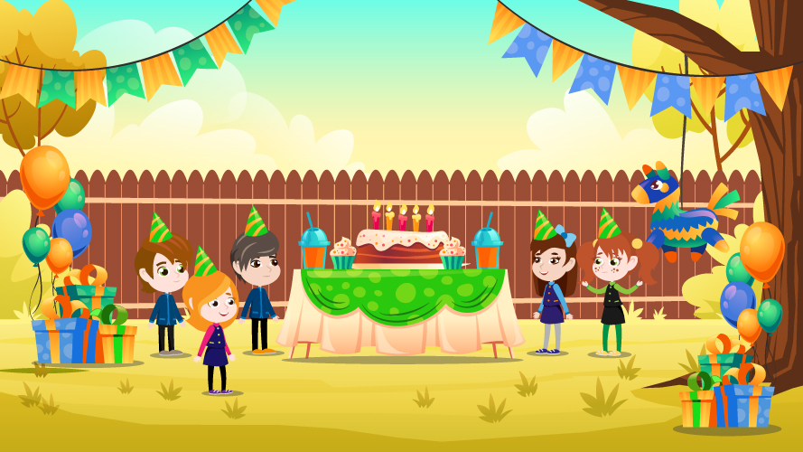
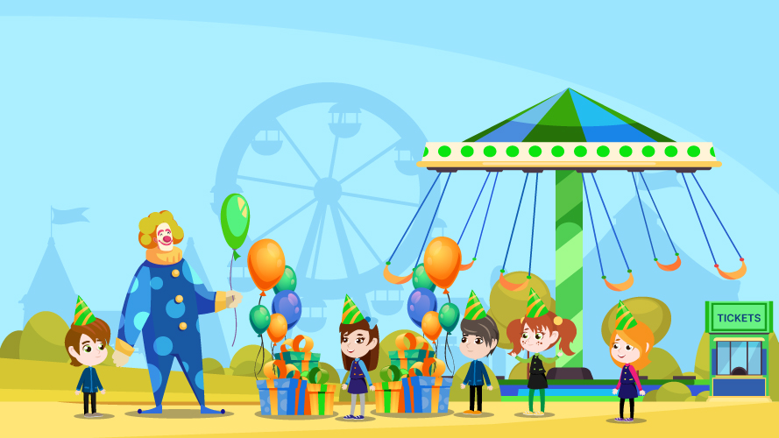
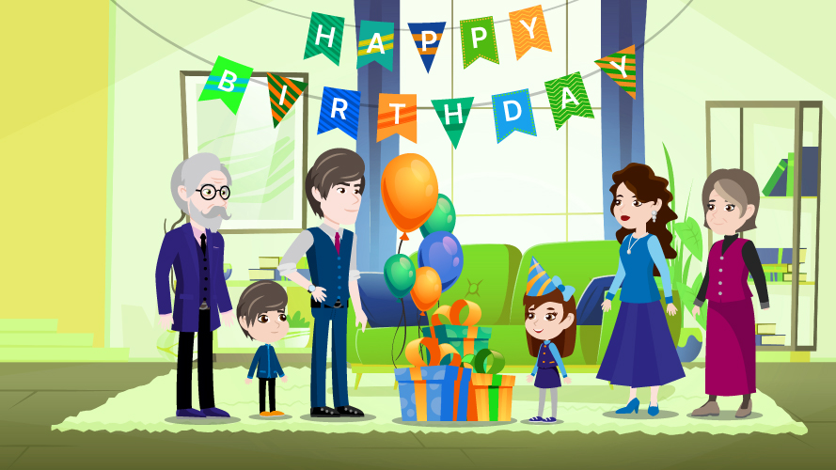
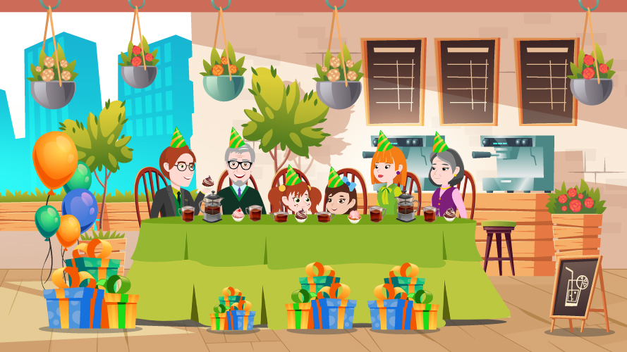
Look at the pictures and say.

Slide 9
Check your progress

Slide 10
Check list

Slide 11
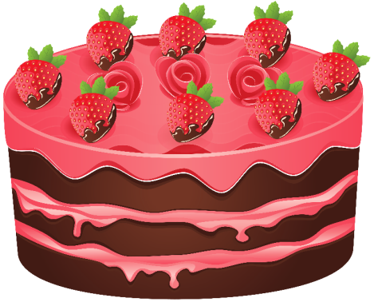
Excellent
Good
Not bad

