Slide 1
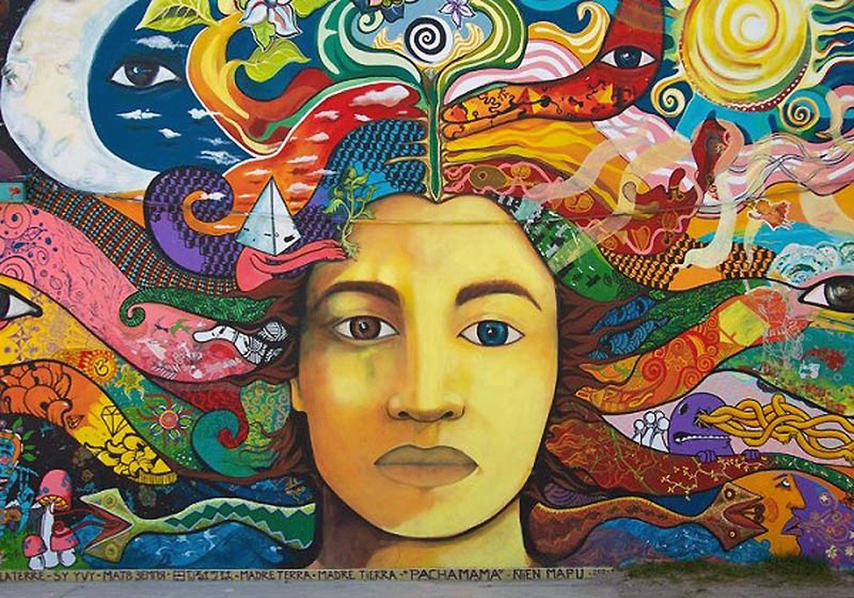
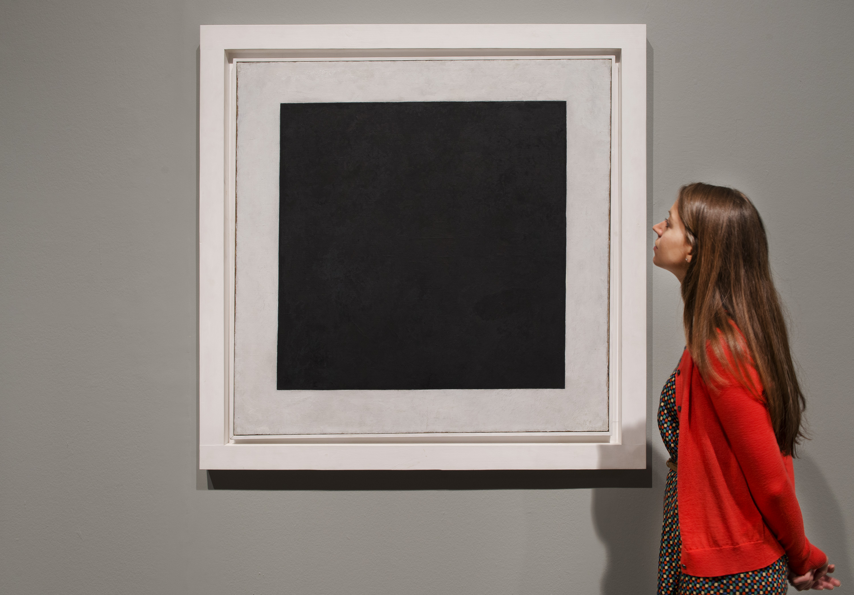
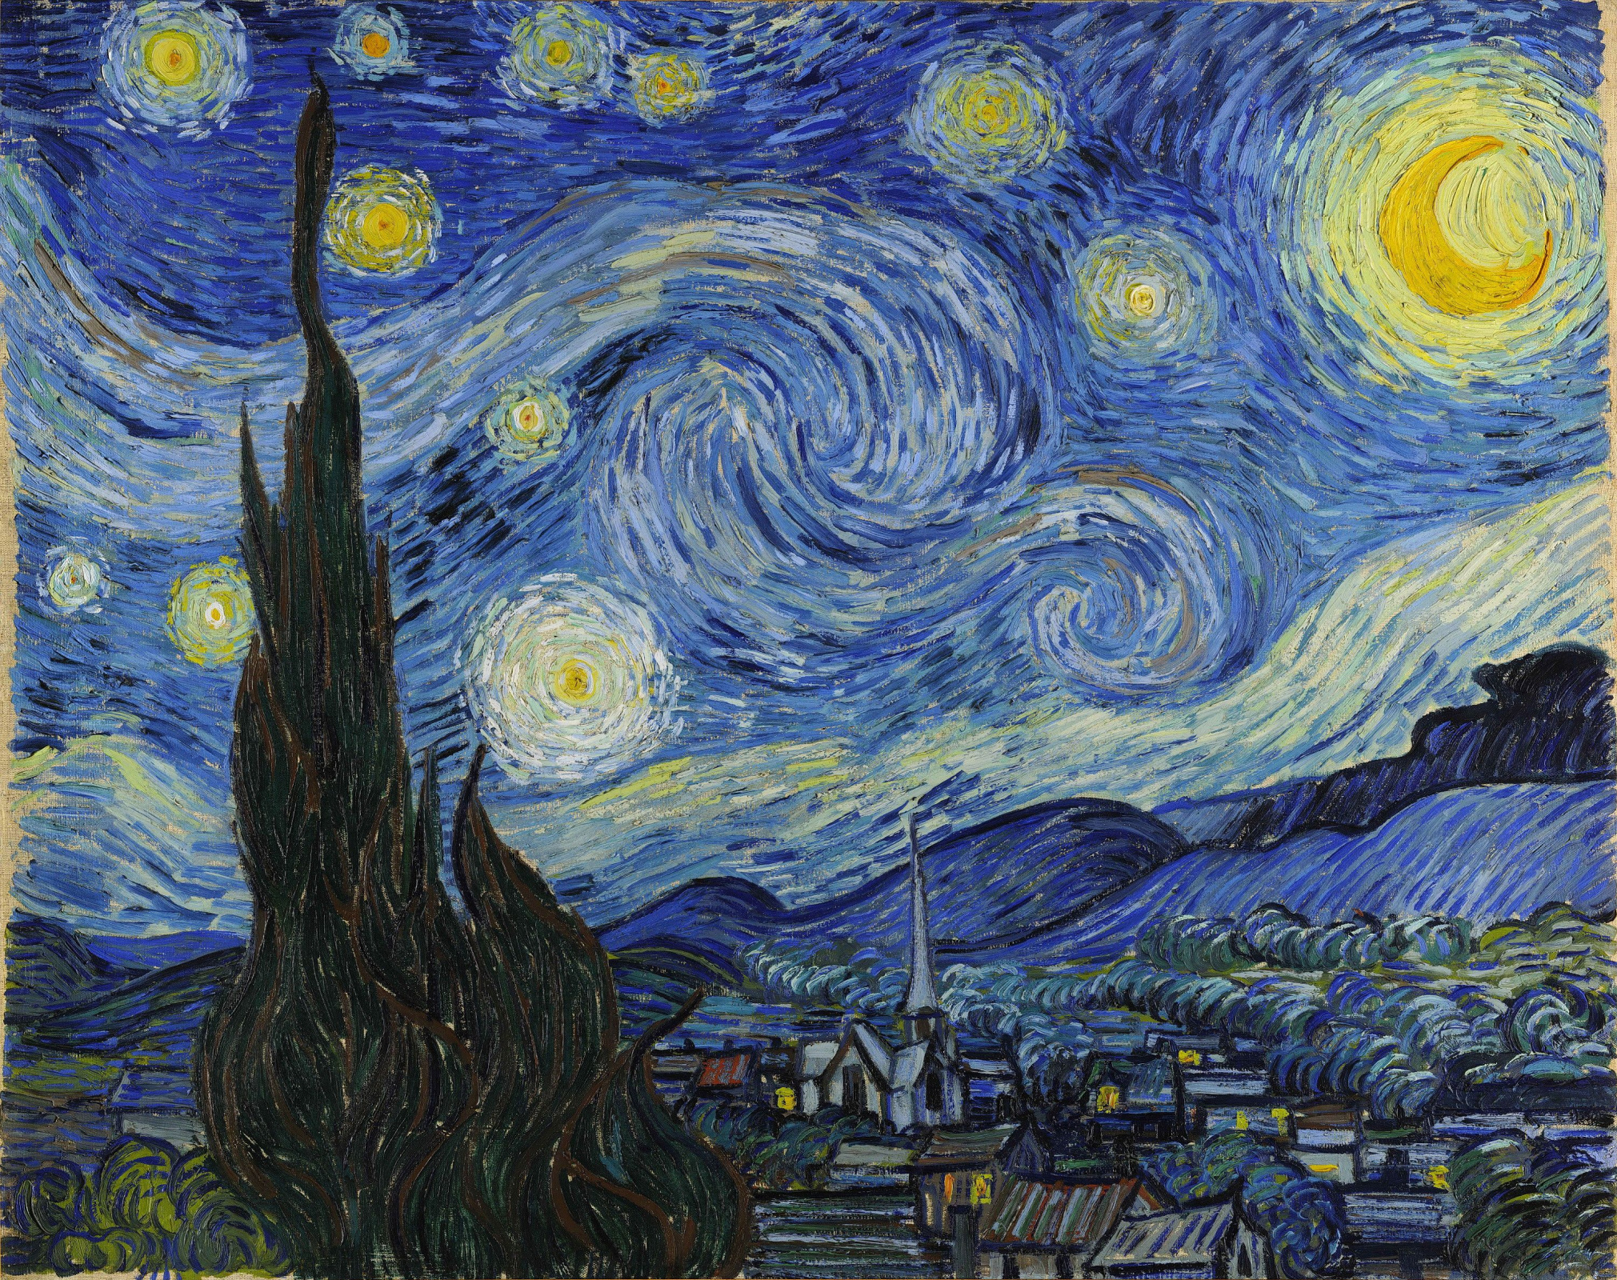
ART IN OUR LIFE

Slide 2
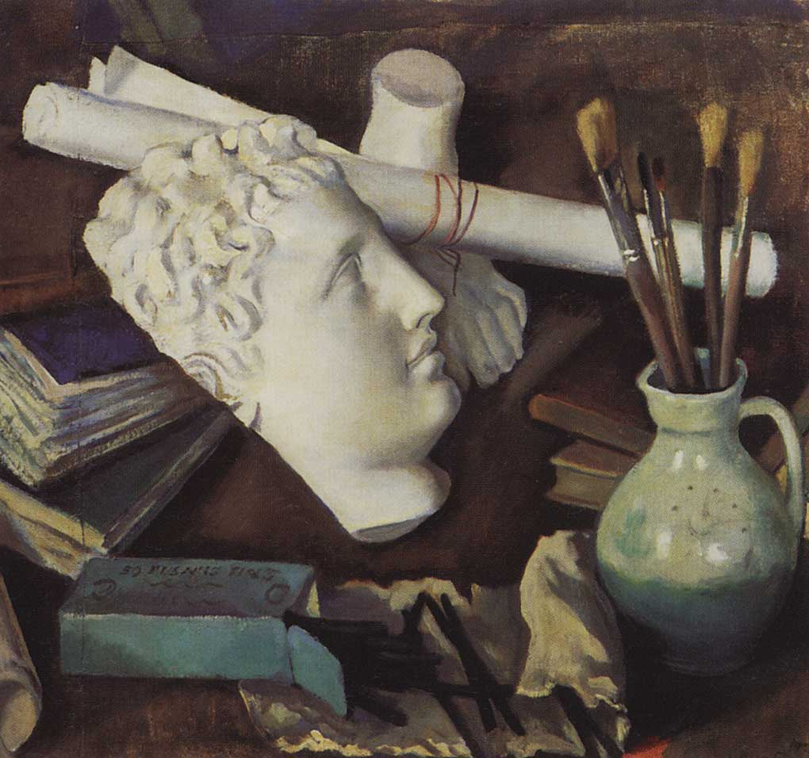
WHAT IS ART FOR YOU?
USE THESE WORDS AND PHRASES TO DESCRIBE YOUR THOUGHTS:
to serve as a means of self-expression – быть средством самовыражения.
an integral part of our lives – неотъемлемая часть нашей жизни.
significant — значительный.
to inspire — вдохновлять.
value — ценность.
to enrich - обогатить.
the ability to express emotions – способность выразить эмоции.

Slide 3
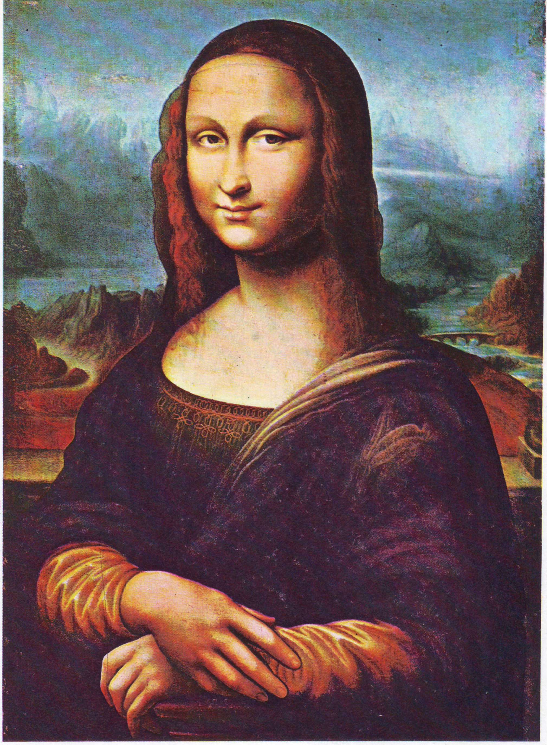
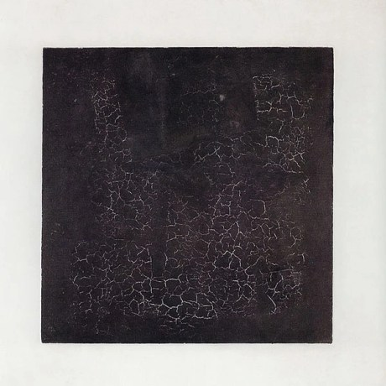
FAMOUS WORKS OF ART
Mona Lisa by Leonardo da Vinci
Black Square by Malevich
Starry Night by Van Gogh

Slide 4
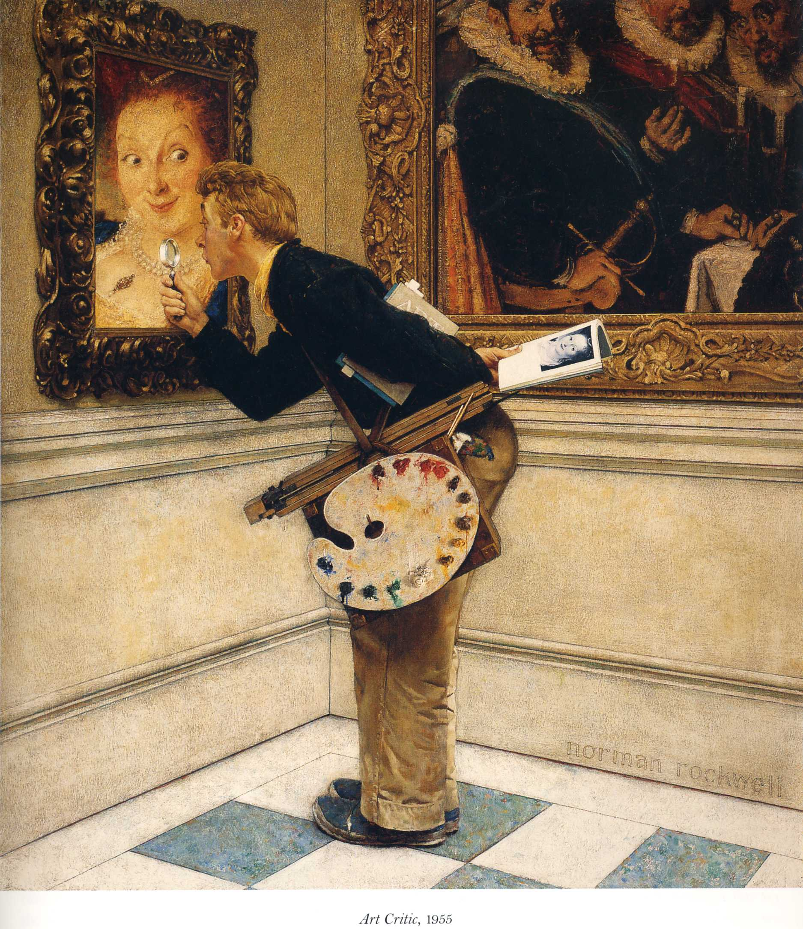
TRY TO BE ART-CRITIC!
How to describe art:
exquisite piece of painting - утонченное произведение искусства
obscure – мрачный
serene – спокойный
tender – нежный
heart-breaking – душераздирающий
impressive – впечатляющий
outstanding – выдающийся

Slide 5
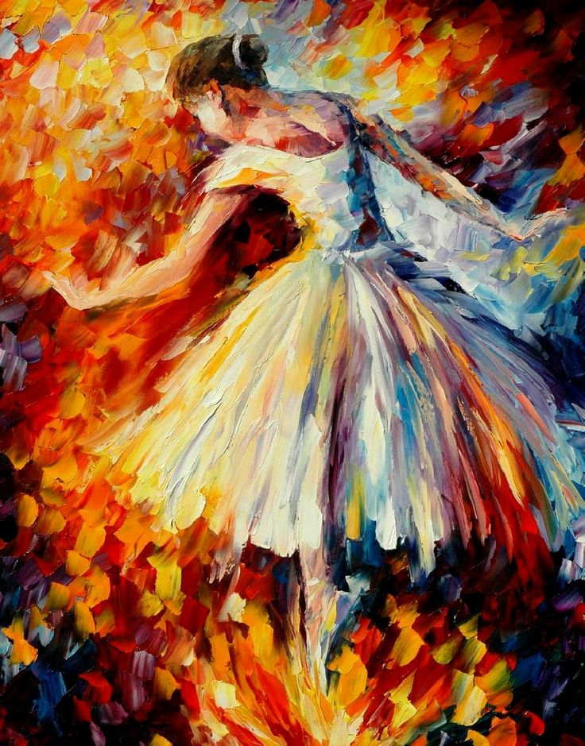
Genres styles of painting:
landscape – пейзаж
still life – натюрморт
portrait – портрет
symbolism – символизм
modern art – современное искусство
impressionism - импрессионизм
cubism – кубизм
suprematism - супрематизм
Painting techniques:
water-colour – акварель
gouache – гуашь
oil painting – масляная
acrylic - акриловая
Our thoughts:
I guess/expect... - Я полагаю...
I suppose it is... – Я предполагаю…
I imagine it is... – Я представляю себе, что …
It’s not very clear but, probably... - Это не очень понятно, но, возможно...
It might be a symbol of...- Это может быть символом...
It makes me think of...- Это заставляет меня задуматься о...

Slide 6
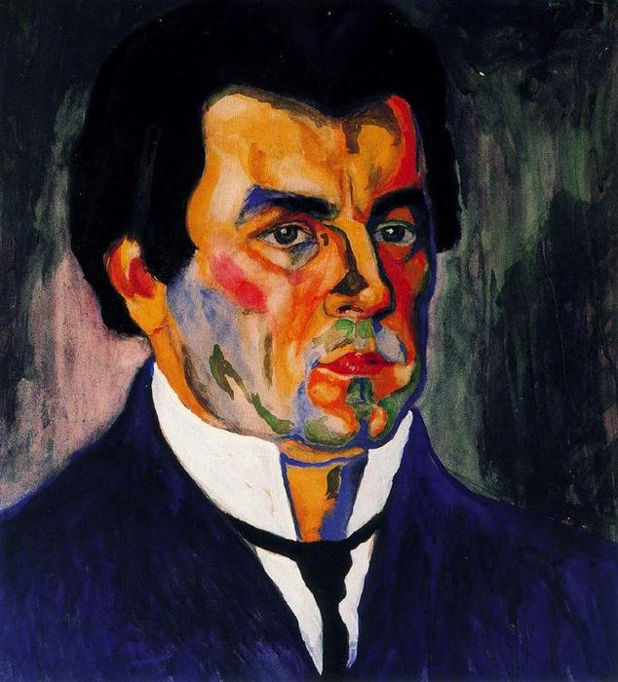
LET US DESCRIBE TOGETHER!
Kazimir Malevich (23 February [11 February] 1879 – 15 May 1935) was a Russian artist and art theorist.
Black Square by Malevich

Slide 7
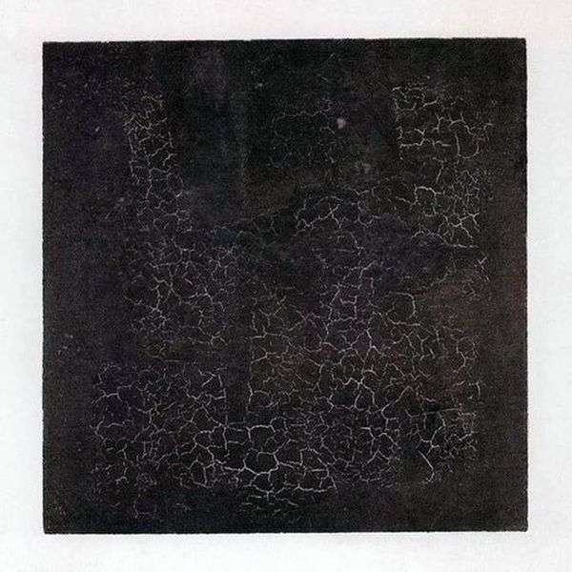
The black square is the most famous work of Kazimir Malevich, established in 1915.
It the most discussed and the most outstanding paintings in Russian art, which is kept in the State Tretyakov Gallery. It is really an impressive work of art.
The work was done with oil painting in the suprematism style (art movement focused on the fundamentals of geometry).
I suppose this kind of artwork might be symbol of simplicity (простоты), The simplicity of a square is the principle of any painting - the principle of light and shadow, black and white, good and evil.

Slide 8
We are surrounded (окружены) by art.
Everyone expresses himself using his creativity and the power of imagination to decorate the surrounding.
Art reflects (отражает) and enriches (обогащает) our inner (внутренний) world.

Slide 9
ИНТЕРНЕТ-ИСТОЧНИКИ:
1.https://upload.wikimedia.org/wikipedia/commons/thumb/d/d5/Mona_Lisa_%28copy%2C_Hermitage%29.jpg/894px-Mona_Lisa_%28copy%2C_Hermitage%29.jpg
2. https://gas-kvas.com/uploads/posts/2023-02/1675344318_gas-kvas-com-p-van-gog-art-risunok-37.jpg
3.https://s.poembook.ru/theme/50/43/8c/a0b83c848b698e239d5ffbde8535eb33c3424df6.jpeg
4. https://painting-planet.com/images3/image395_3.jpg
5. https://na-dostupnom.ru/wp-content/uploads/2021/07/ffaa641c4736f7cb5f2a16fadd9d8407-resize_crop_1Xquality_100Xallow_enlarge_0Xw_1200Xh_630-1024x538.jpg

