Slide 1
Time
Время в английском языке

Slide 2
second | секунда
minute | минута
hour | час
quarter | четверть
half | половина
clock | часы (настольные)
watch | часы ручные
by my watch | по моим часам
alarm-clock | будильник
time | время

Slide 3
Который час?
Сколько времени?
What is the time?
(What‘s the time?)
2. What time is it?
Ответ:
It is …

Slide 4
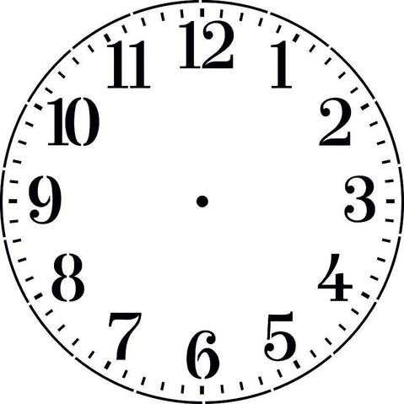
06:00
18:00
It is …
6 o‘clock.

Slide 5
03:00
15:00
It is 3 o’clock.

Slide 6
04:00
16:00
It is 4 o’clock.

Slide 7
05:00
17:00
It is 5 o’clock.

Slide 8
08:00
20:00
It is 8 o’clock.

Slide 9
10:00
22:00
It is 10 o’clock.

Slide 10
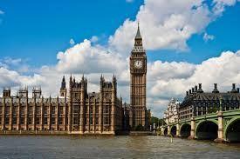
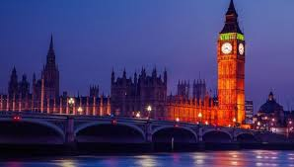
10:00
22:00
a.m.
p.m.
(до 12 часов дня)
(после 12 часов дня)

Slide 11
10:00
It is 10 o’clock a.m.

Slide 12
22:00
It is 10 o’clock р.m.

Slide 13
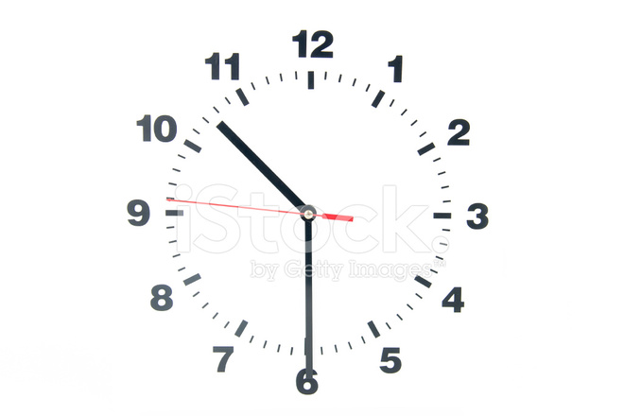
10:30
past
It is half past 10 a.m.

Slide 14
22:30
past
It is half past 10 p.m.

Slide 15
11:30
past
It is half past 11 a.m.

Slide 16
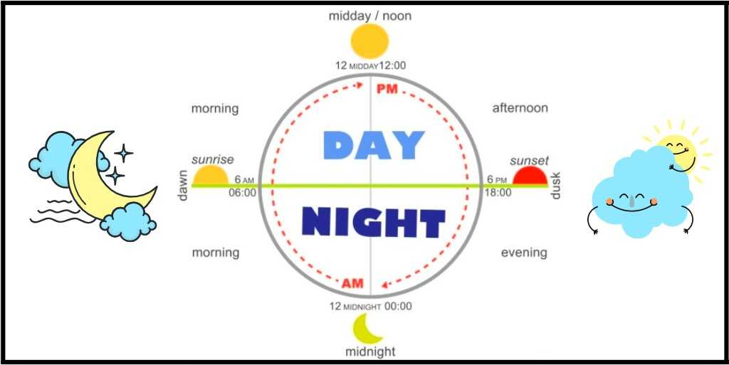
It is morning.
It is evening.
It is afternoon.

