Slide 1
Презентация на тему:,,УНИВЕРСТИТЕТ РОССИИ,,
Выполнила ученица 8''В'' класса
Грабенко Анастасия
Учитель Дружина М.В.

Slide 2
GOALS AND OBJECTIVES
Tell the class about the university that I'm going to enter in the future.

Slide 3
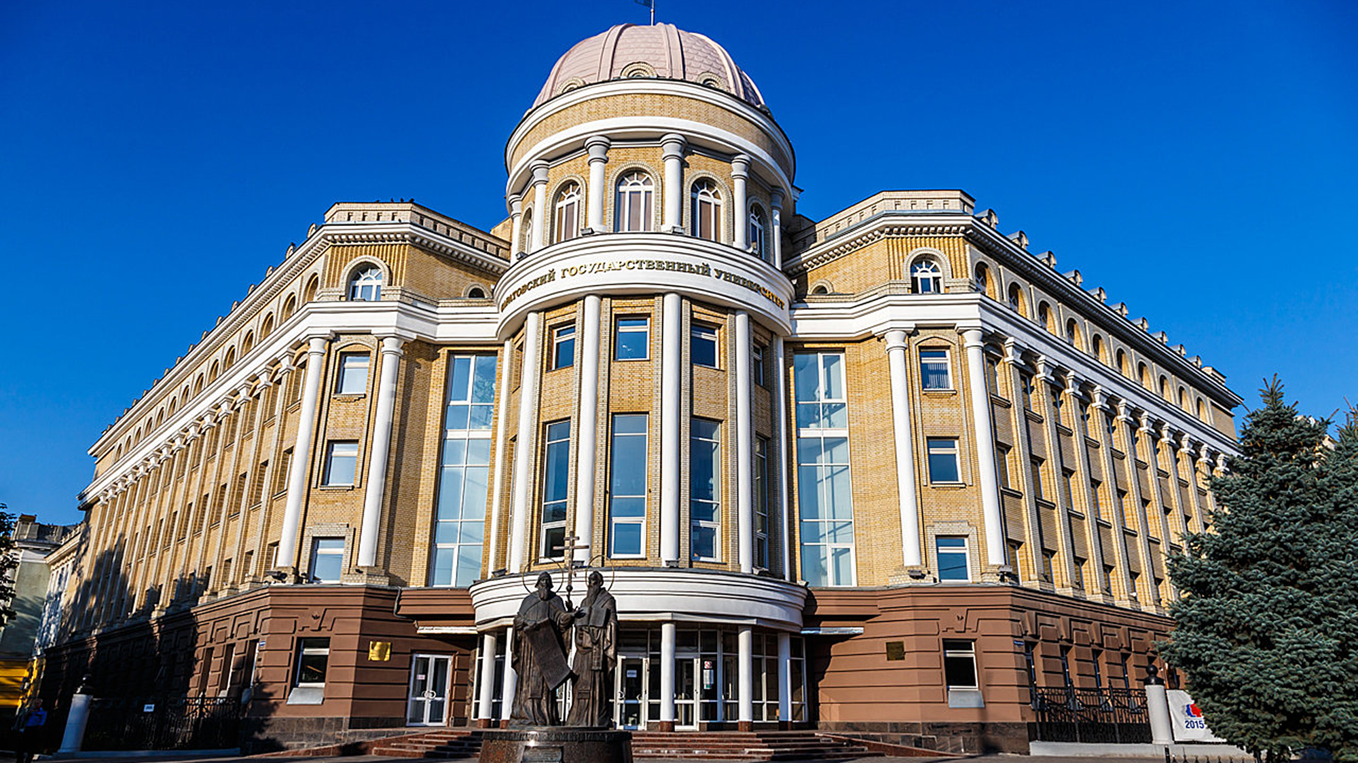
Saratov State University
Saratov State University named after N.G.Chernyshevsky is located in the city of Saratov.It’s the Russian higher education institution. It was founded in 1909. It has the status of a national research university.This is a very interesting place to enter the teaching field.

Slide 4
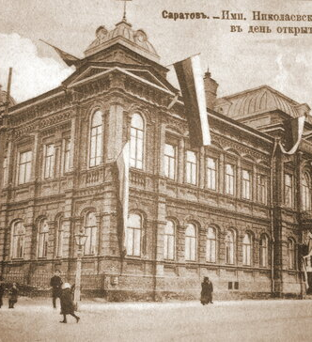
History of creation
The bill on the opening of the University in Saratov was approved by Nicholas II on June 10, 1909. This event was made possible thanks to the perseverance of the Saratov public, the administration and Prime Minister P. A. Stolypin. Saratov State University was opened on December 6, 1909 as the Imperial Nikolaevsky University.

Slide 5
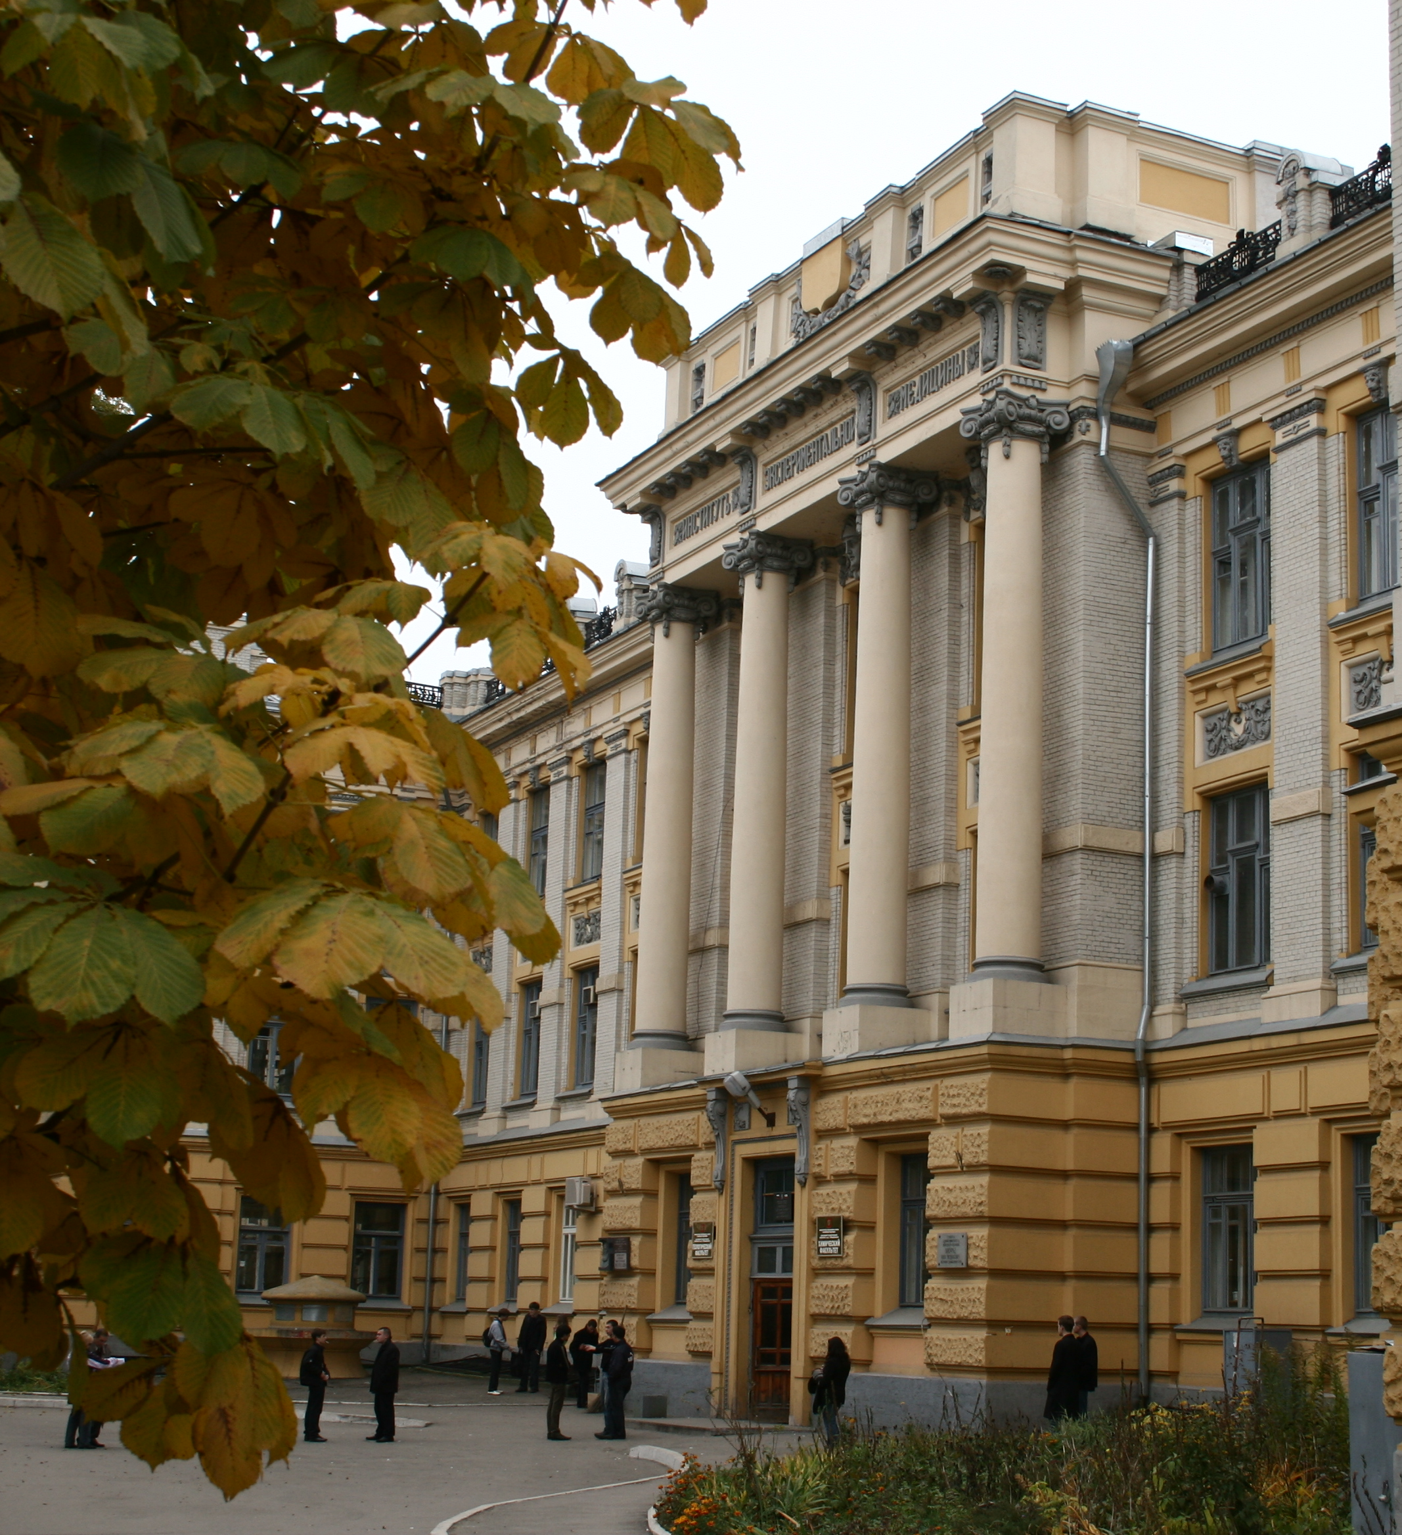
Top 5 facts about SSU
1) In 2014, SSU entered the rating of the British International Consulting Agency QS for the first time, taking 15th place among Russian universities and becoming the only university in Saratov included in this rating.

Slide 6
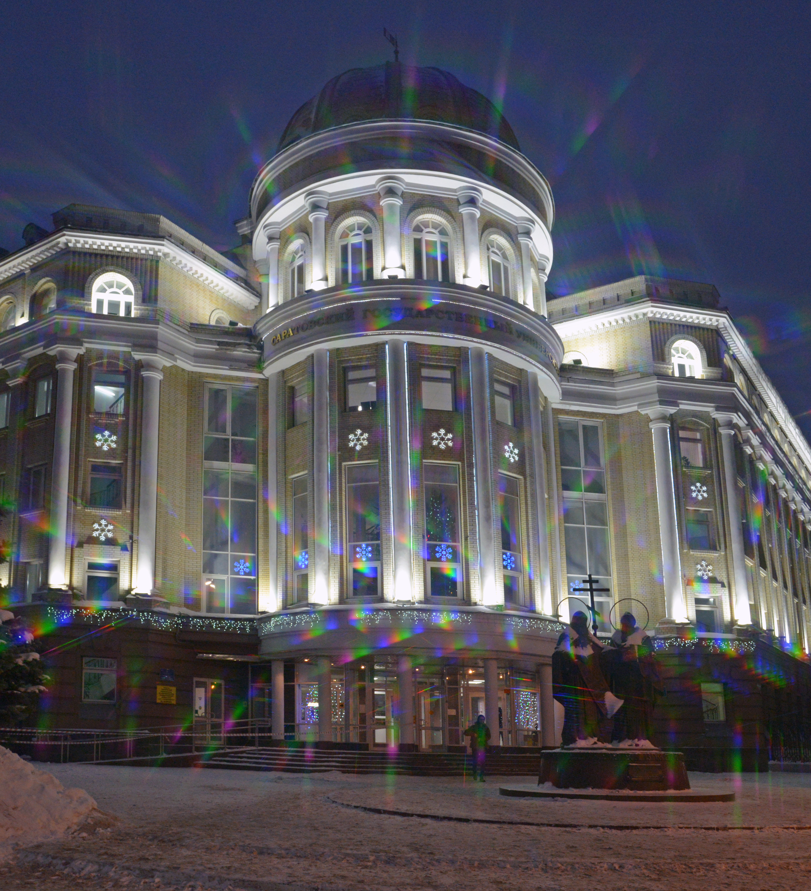
2) The level of training at SSU has received worldwide recognition. For example, teams of SSU students have repeatedly won prizes at the world and European programming championships for several years. So, in 2006, at the World Programming Championship held in the USA, where teams from 700 universities of the world participated, the SSU team won the title of absolute world champion.

Slide 7
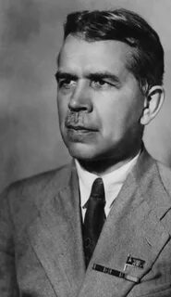
3) One of the outstanding humanitarians of the twentieth century, the philosopher S.L. Frank, became the dean of the Faculty of History and Philology. In the first post-revolutionary years, the founder of Russian genetics, Professor N.I. Vavilov, worked at the Faculty of Agronomy.

Slide 8
4) One of the priority areas for the university is teacher education. SSU is the only university in the Saratov region that conducts training in pedagogical specialties and areas of training.

Slide 9
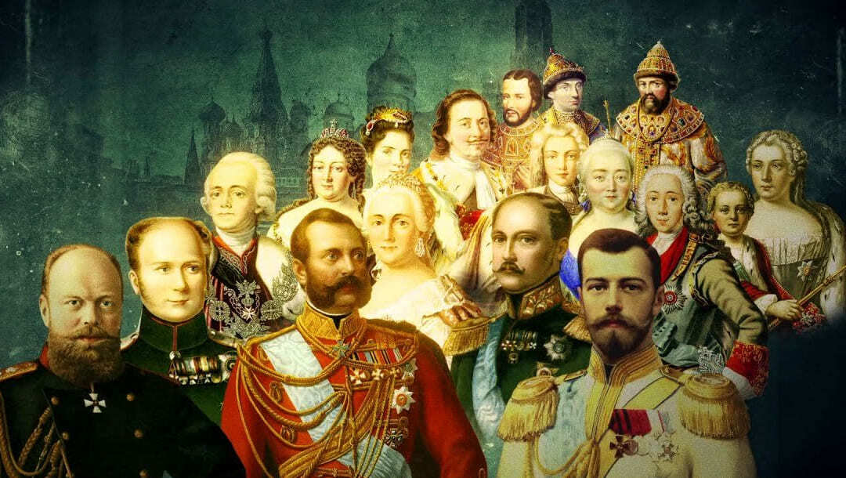
5) Saratov University, the fifth within its current borders and the last imperial university of Russia, was founded by the Highest Decree of Emperor Nicholas II in June 1909.

Slide 10
CONCLUSION ​
In this presentation, we have learned about the history of the university and some interesting facts about it.

Slide 11
ONLINE RESOURCES
https://vuzopedia.ru/vuz/3048
https://www.sgu.ru/gid-pervokursnika/kratkaya-istoriya-universiteta
https://национальныепроекты.рф/map/saratovskiy-natsionalnyy-issledovatelskiy-gosudarstvennyy-universitet-imeni-chernyshevskogo
https://glavportal.com/materials/saratovskij-universitet-sovremennoe-obrazovanie-s-vekovoj-istoriej

