Slide 1
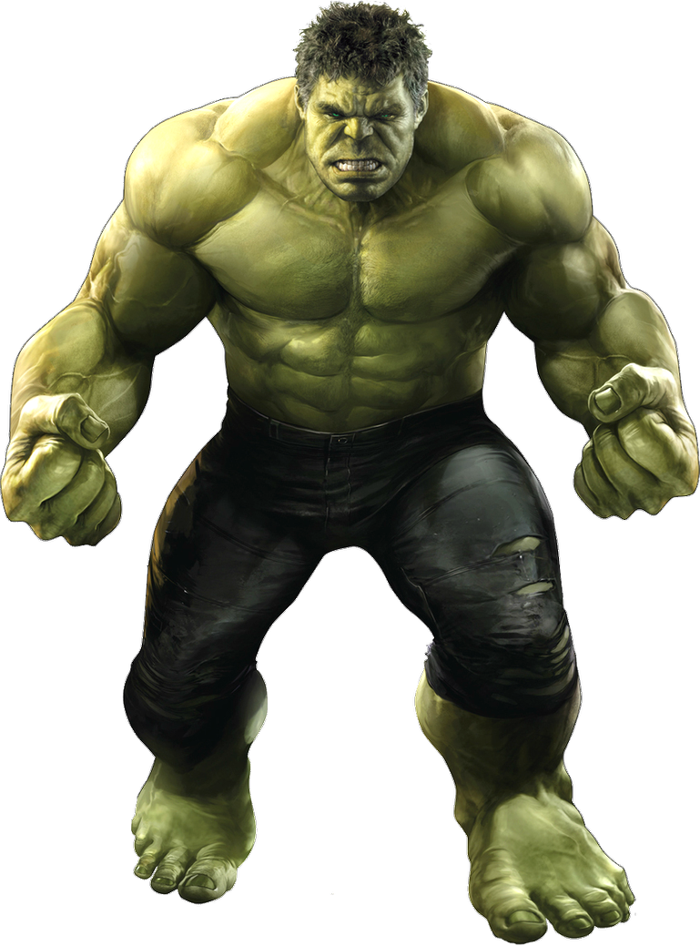
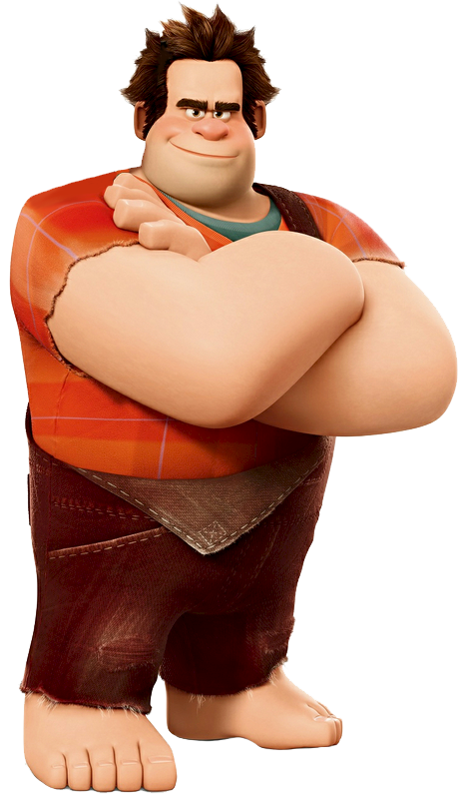
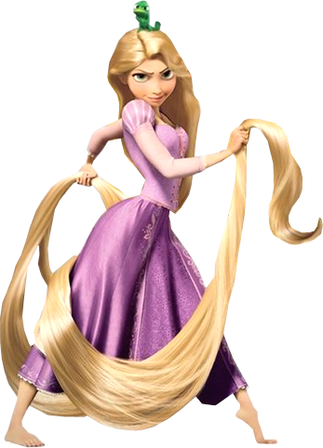
WHERE DO THEY LIVE?
By Artem Morozov
START
© Artem Morozov, 2022

Slide 2
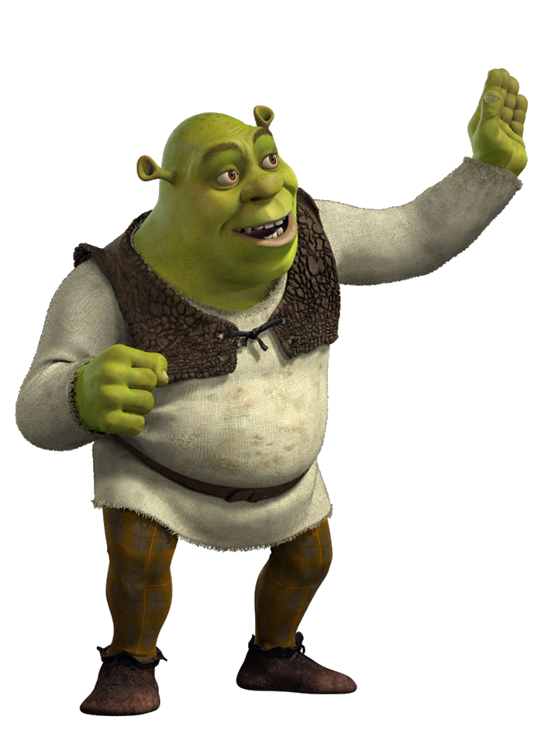
2+1
1
2
3
4
5
6
7
8
9

Slide 3
4-3
1
2
3
4
5
6
7
8
9

Slide 4
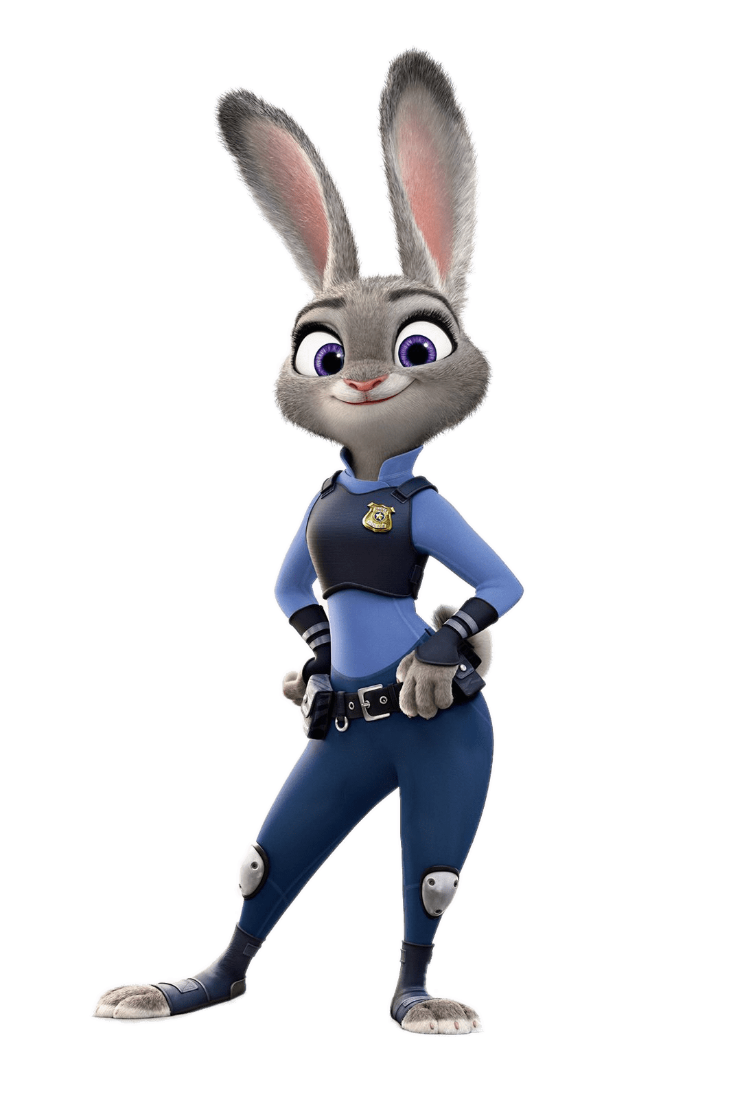
3+5
1
2
3
4
5
6
7
8
9

Slide 5
2+2
1
2
3
4
5
6
7
8
9

Slide 6
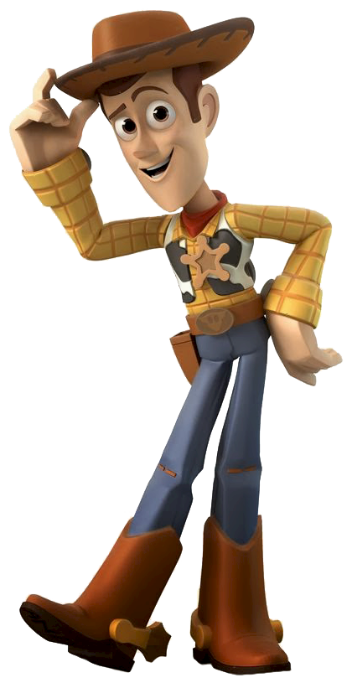
3+3
1
2
3
4
5
6
7
8
9

Slide 7
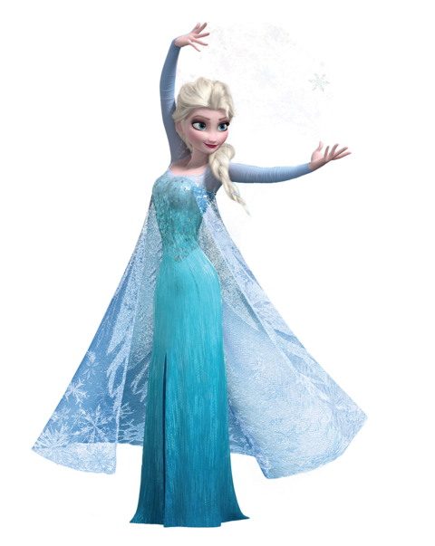
6-4
1
2
3
4
5
6
7
8
9

Slide 8
9-2
1
2
3
4
5
6
7
8
9

Slide 9
3+2
1
2
3
4
5
6
7
8
9

Slide 10
4+4
1
2
3
4
5
6
7
8
9

Slide 11
GOOD JOB!

