Slide 1
Presentation

Slide 2
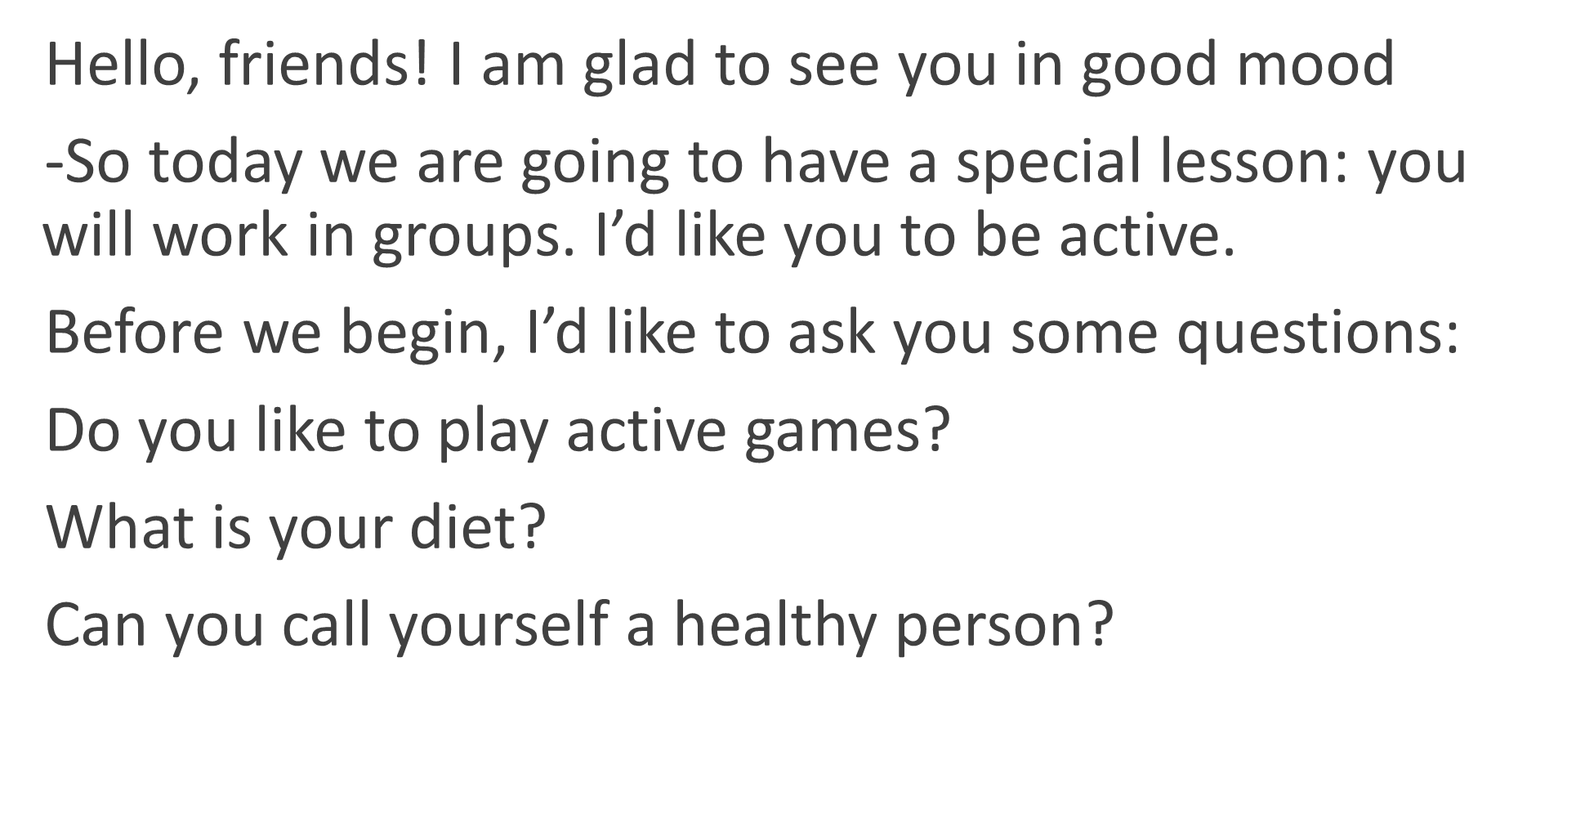

Slide 3
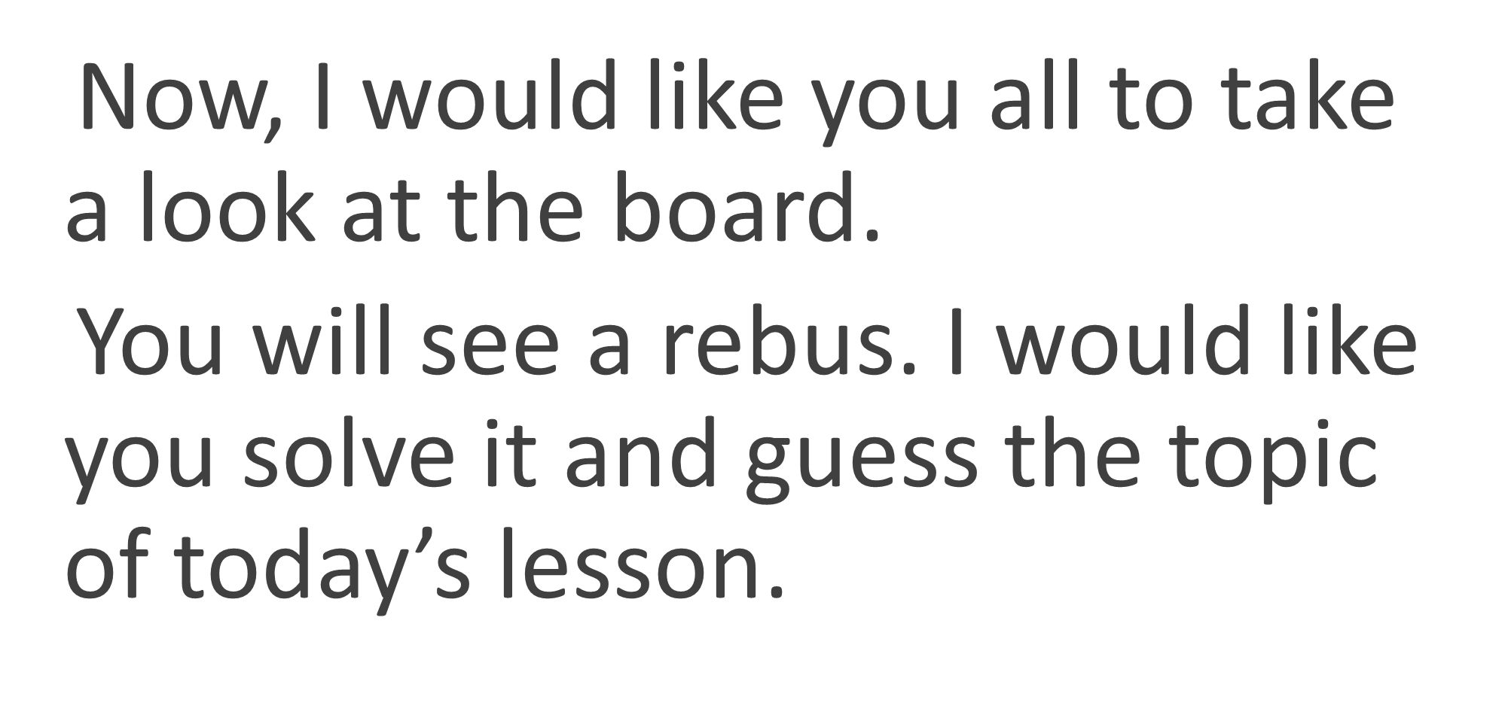

Slide 5
Health!

Slide 6
«A sound mind in a sound body»

Slide 7
Read these phrases with me

Slide 8
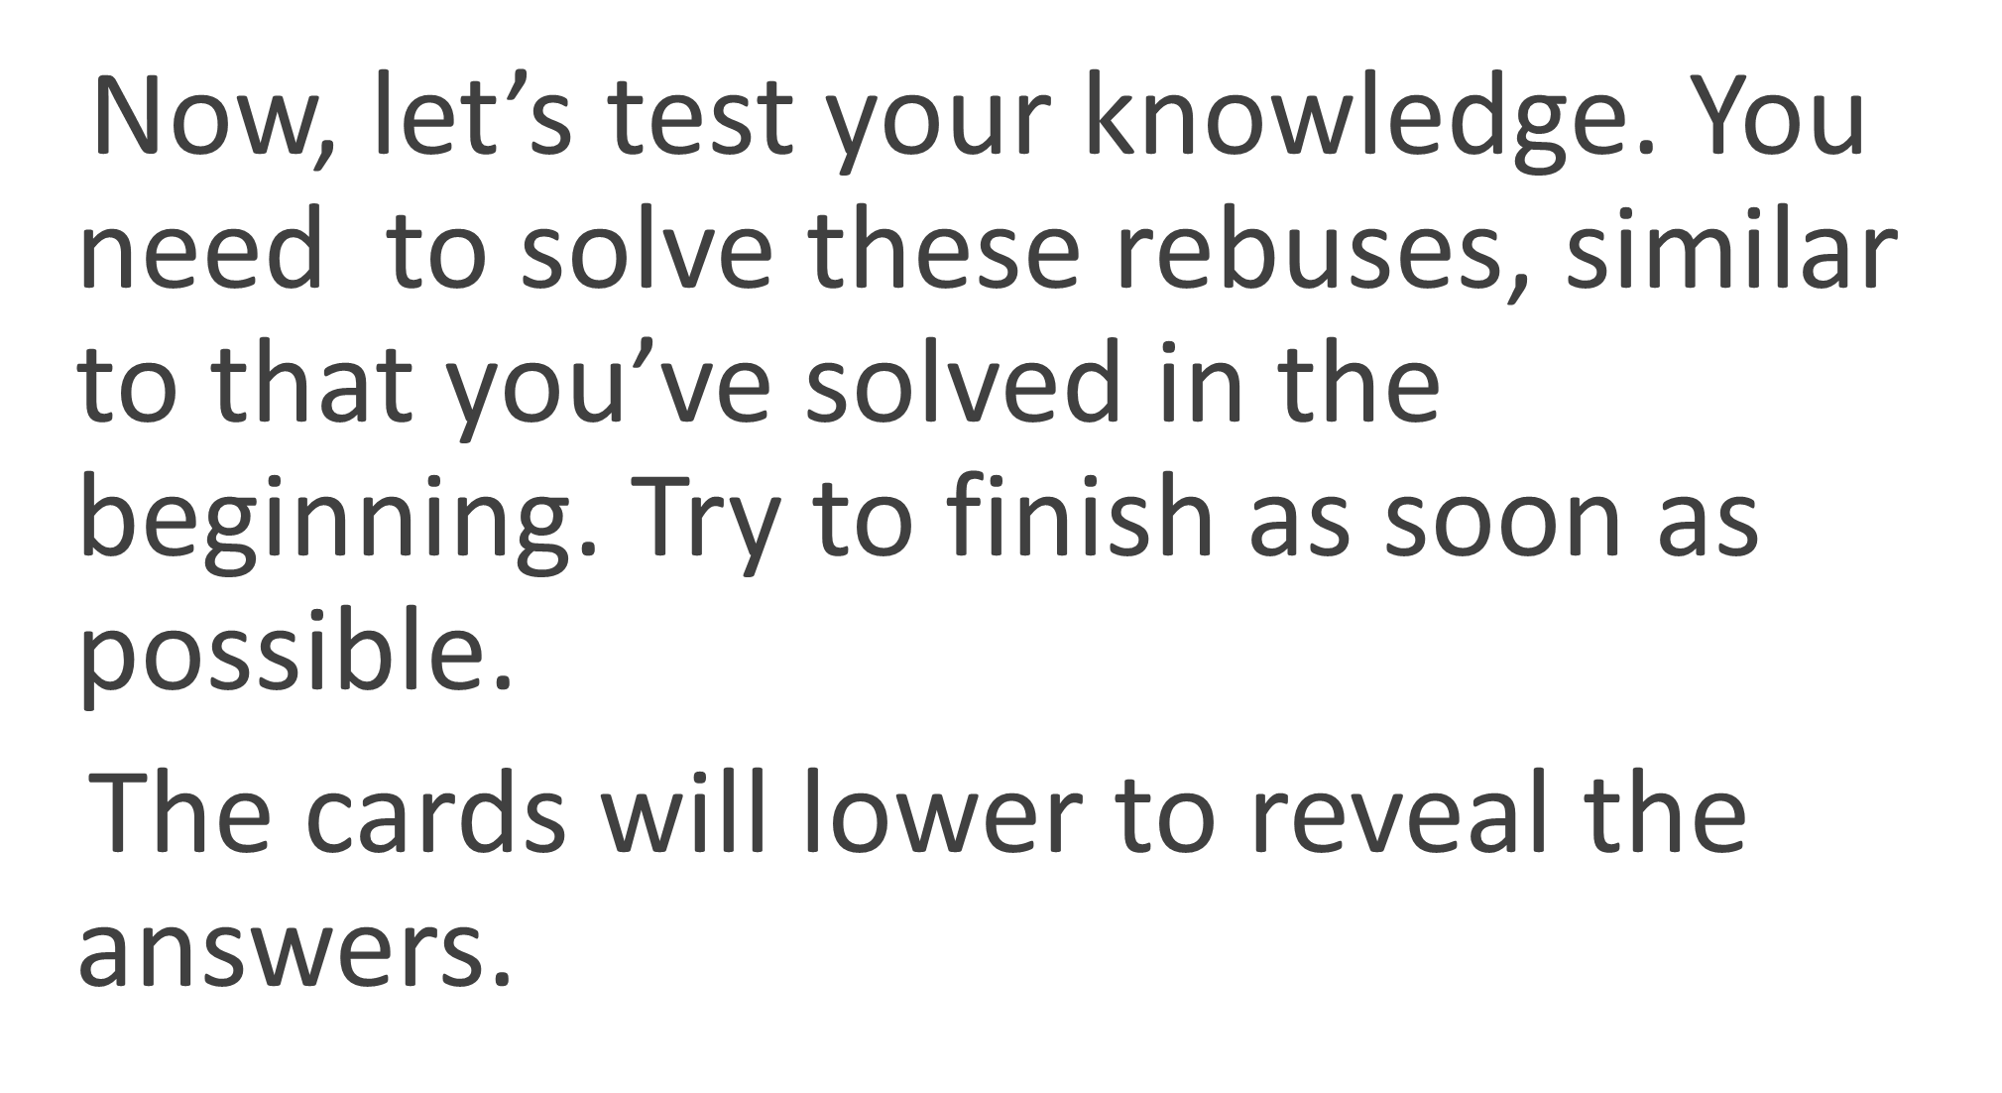

Slide 10
Sneeze
Cough

Slide 12
Thank you!

