Slide 1
RELATIVE PRONOUNS
Относительные местоимения

Slide 2
RELATIVE PRONOUNS
Относительные местоимения служат для связи придаточных предложений с главным.
Они являются союзными словами, которые отличаются от союзов тем, что они не только связывают придаточное предложение с главным, но и являются членами придаточного предложения.

Slide 3
WHO/THAT(который,…) указывают на одушевленный предмет
The woman who lives next door is a famous doctor.

Slide 4
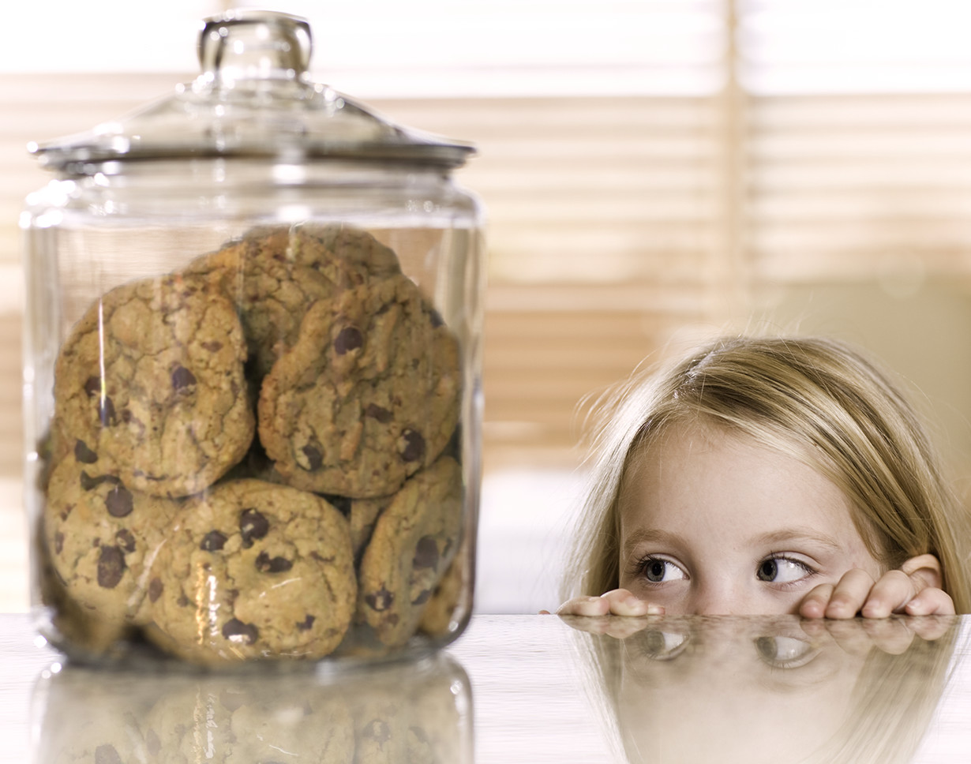
WHO/THAT(который,…) указывают на одушевленный предмет
Также можно использовать местоимение that, особенно в разговорном языке.
This is the girl that likes biscuits.

Slide 5
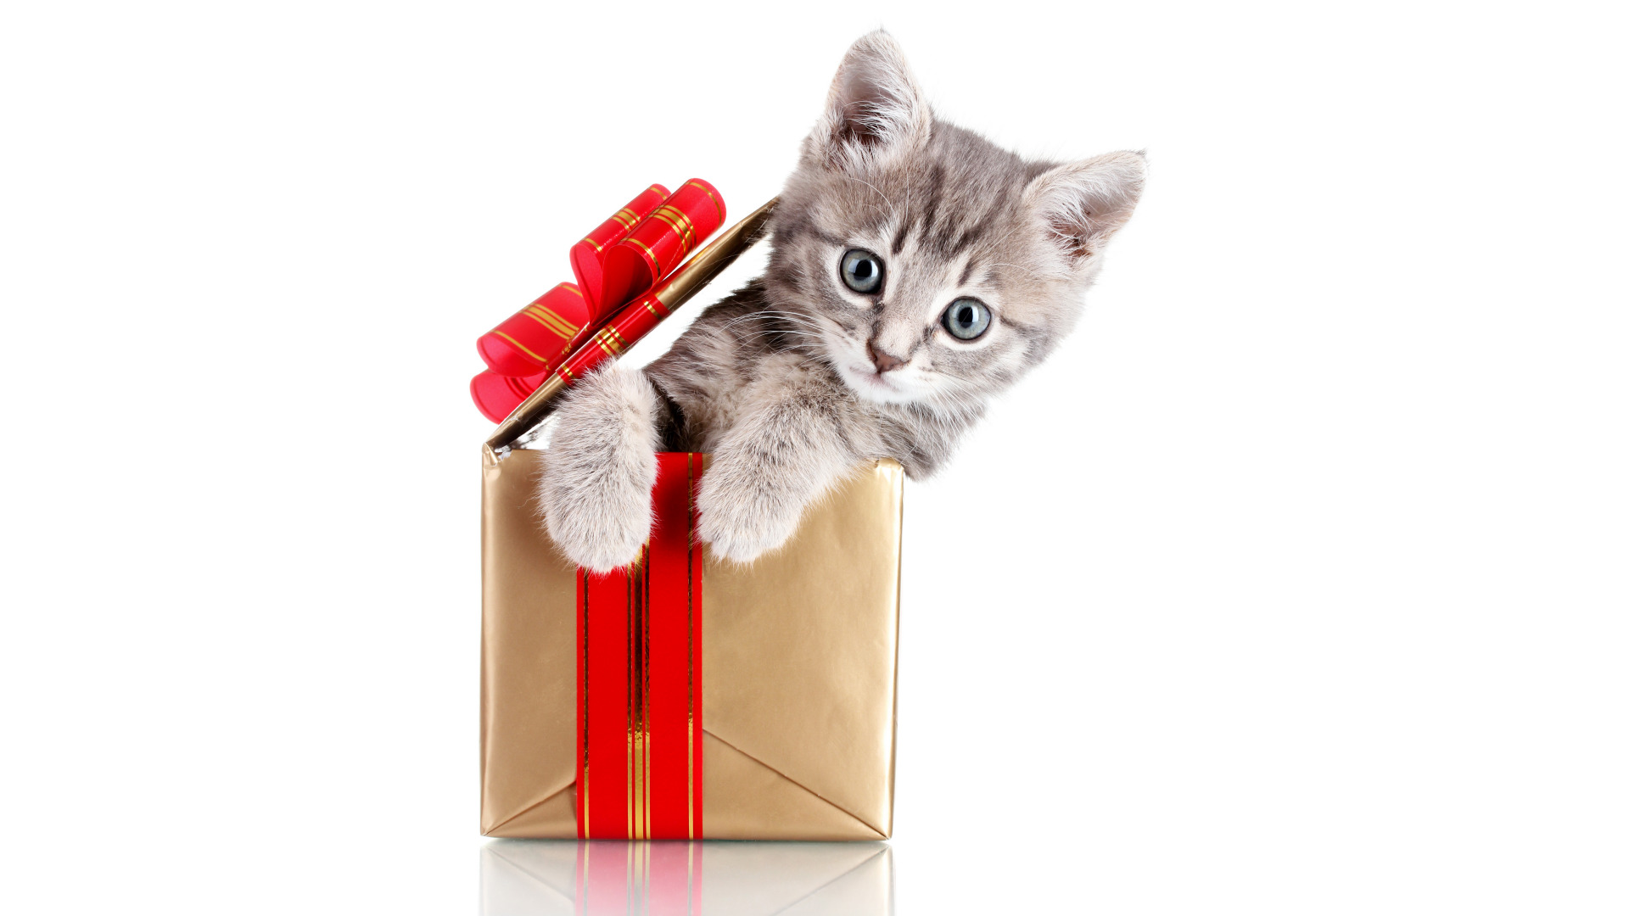
WHICH/THAT (который,…) относятся к неодушевленным предметам и животным
She gave me a cat which was very cute.

Slide 6
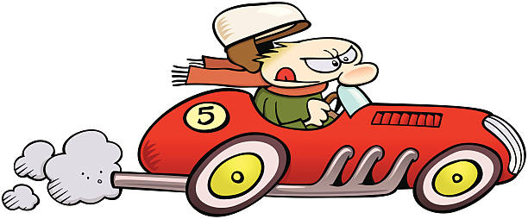
WHICH/THAT (который,…) относятся к неодушевленным предметам и животным
The car that won the race was wonderful.

Slide 7
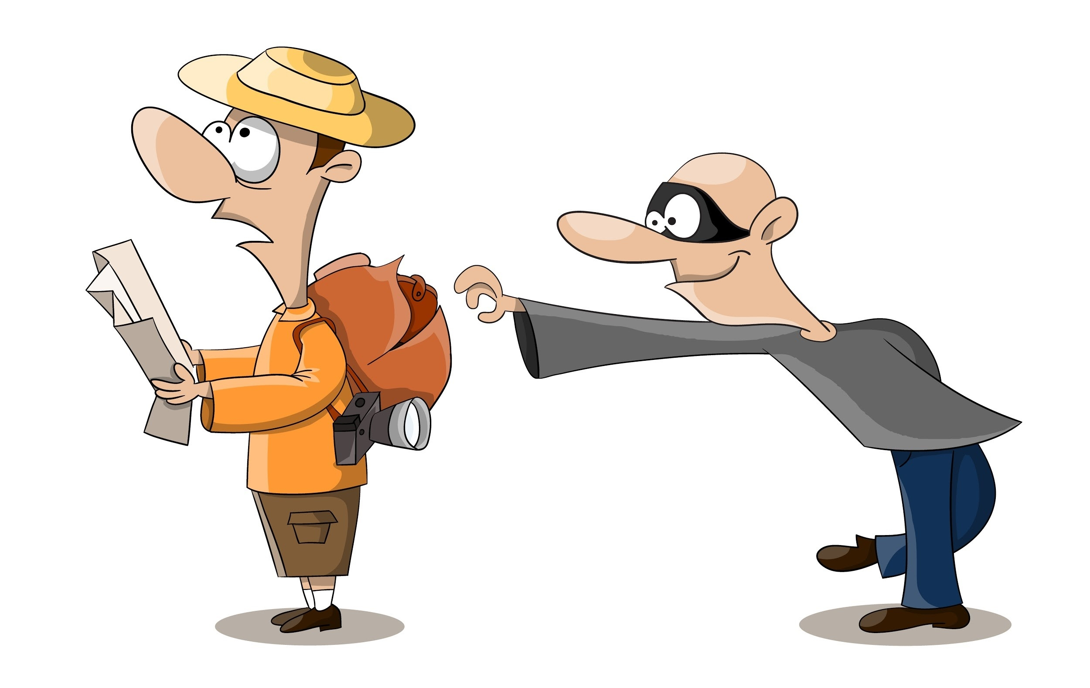
WHOSE (чей, чья, чьи,…) относится к предметам, принадлежащим людям
That was the man whose purse was stolen.

Slide 8
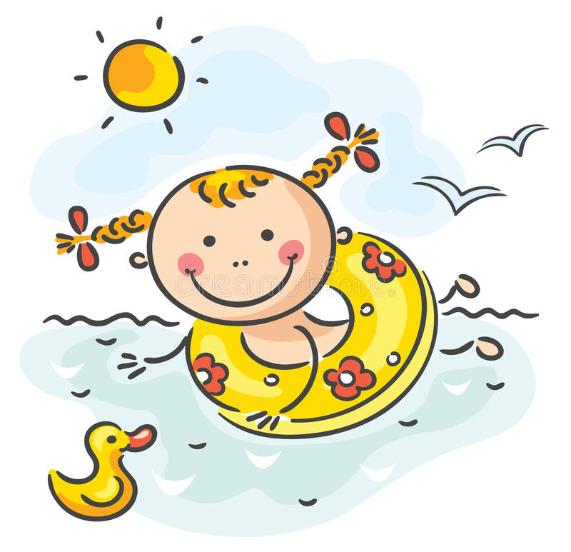
WHOSE (чей, чья, чьи,…) относится к предметам, принадлежащим людям
Jane, whose favourite hobby is running, also likes swimming.

Slide 9
Relative adverbs
Относительные наречия

Slide 10
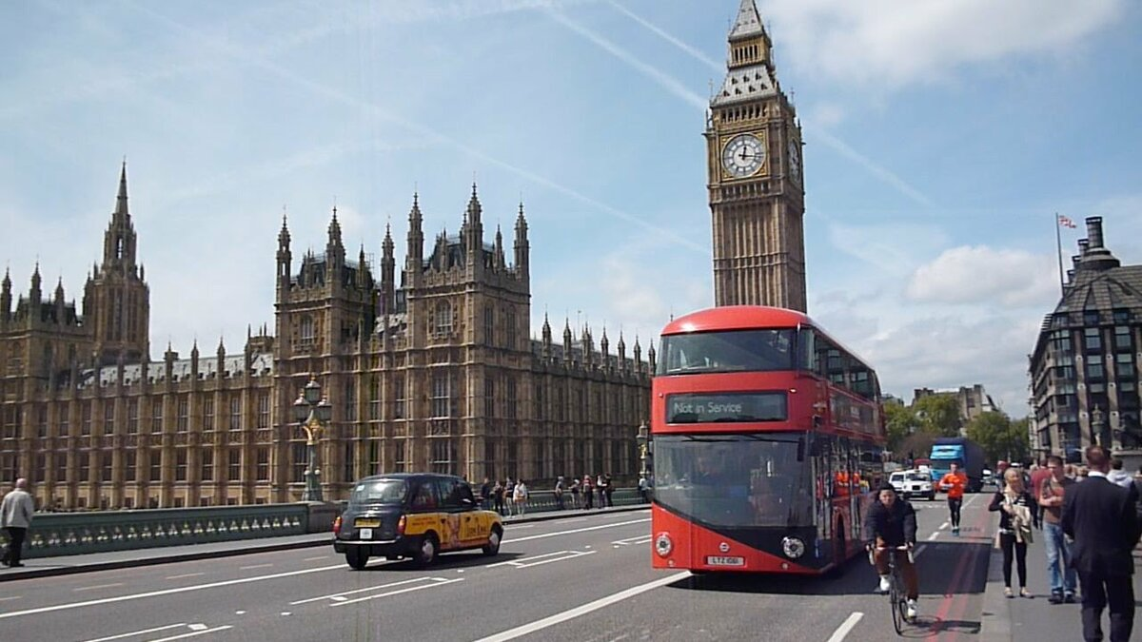
WHERE имеет прямое отношение к месту
London is the city where my mum was born.

Slide 11
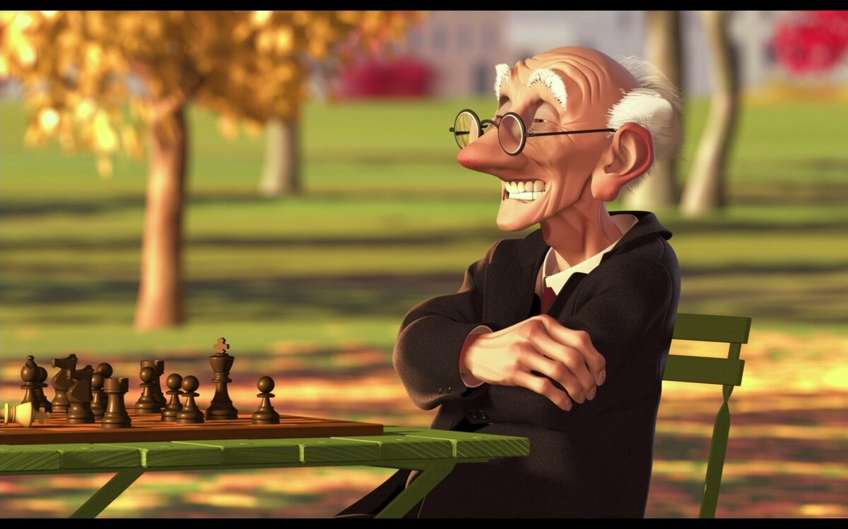
WHERE имеет прямое отношение к месту
This is the park where people come to play chess.

Slide 12
WHEN имеет отношение ко времени
2004 was the year when we bought this flat.

Slide 13
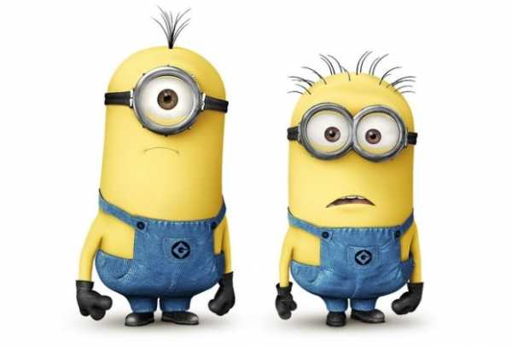
WHEN имеет отношение ко времени
I will never forget the day when I met you.

Slide 14
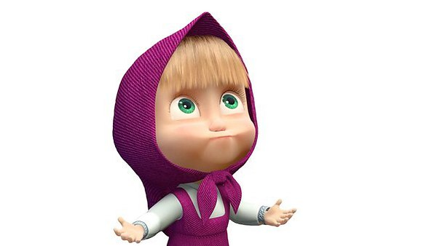
WHY почему (указание причины)
Tell me (the reason) why you came home late.

Slide 15
FILL IN THE CORRECT RELATIVE PRONOUN OR ADVERB
It was the year 2000__________ the Olympic Games take place in Sydney.
Is the artist ________ drew this picture French?
Can you tell me _________ you are driving so fast?
Oh! Is she a person _________ house is for sale?
This is a skate-park ___________ people come to skateboard.
Where is the cake _________ he cooked yesterday?
We are talking about the book _________ we bought a week ago.

Slide 16
Join two sentences using a relative pronoun
Example: I wrote to the friend. He had a birthday last week. – I wrote to the friend who/that had a birthday last week.
1. I bought a phone. It was nice.
2. Ann has got a friend. She sings well.
3. Max has become an actor. You met him last year.
4. I forgot to print the article. I wrote it yesterday.
5. The boy was sad. His motorcycle was broken.

