Slide 1
Презентация по английскому языку «Мой город»
Подготовил:
учитель английского языка
Грядунова О.Н.

Slide 2
Hello, my friends!

Slide 3
Phonetic drill. Repeat after me all together.
[b] bus stop, bus station;
[r] library, restaurant;
[t] town, top shop;
[u:] school, pool;
[h] hometown, hospital;
[p] people, pizza restaurant, pet shop.

Slide 4
План
Повторить лексику
Повторить грамматический материал there is/are
Развивать чтение/слушание с целью понимания содержания
Научиться составлять текст по образцу
Практиковаться в говорении

Slide 5
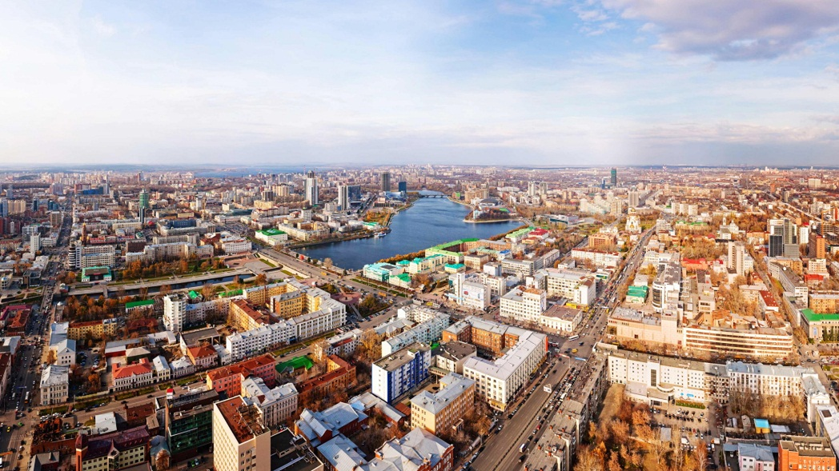
The topic of the lesson is ‘My hometown’

Slide 6
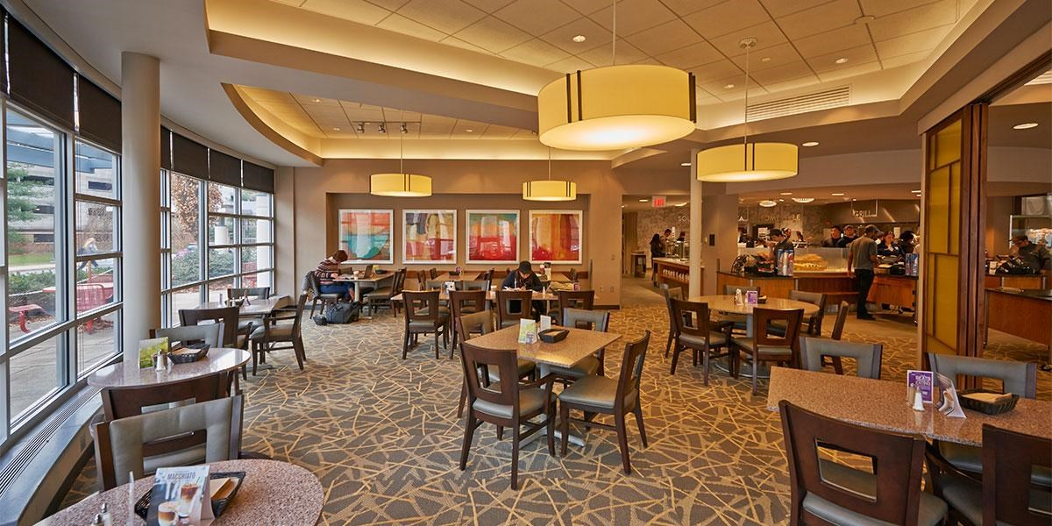
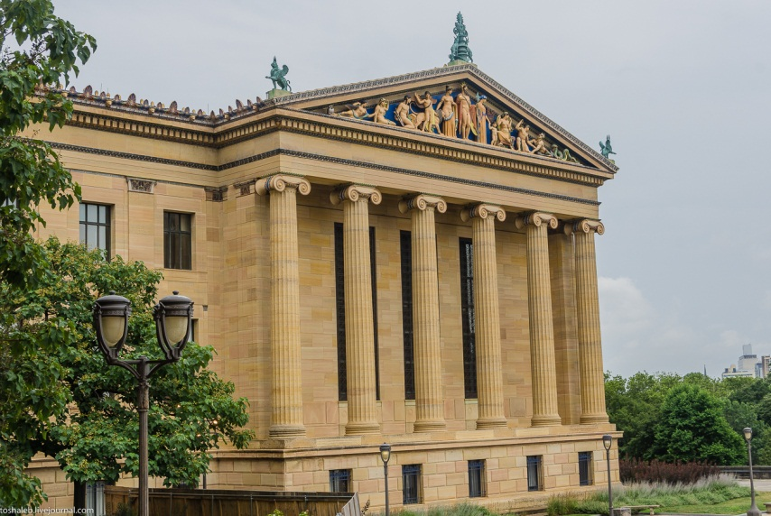
Make words from the letters.
smumeu
Railybr
Ncimea
Tpehpso
Efca
Karp
Trethae
Pishnopg trenec

Slide 7
Math 2 parts of the sentence
We can see many interesting things…
We can read books…
We can eat pizza…
We can buy food…
We can see a film…
We can buy food for pets…
We can walk and play different games…
We can have a meal…
In the park
At the supermarket, library, cafe , museum,, pizza restaurant, cinema, pet shop

Slide 8
Let’s check:
Smumeu - museum
Railybr - library
Ncimea - cinema
Tpehpso – pet shop
Efca - cafe
Karp – park
Trethae - theatre
Pishnopg trenec – shopping center

Slide 9
Let’s check:
We can see many interesting things at the museum
We can read books at the library
We can eat pizza at the pizza restaurant
We can buy food at the supermarket
We can see a film at the cinema
We can buy food for pets at the pet shop
We can walk and play different games in the park
We can have a meal at the cafe

Slide 10
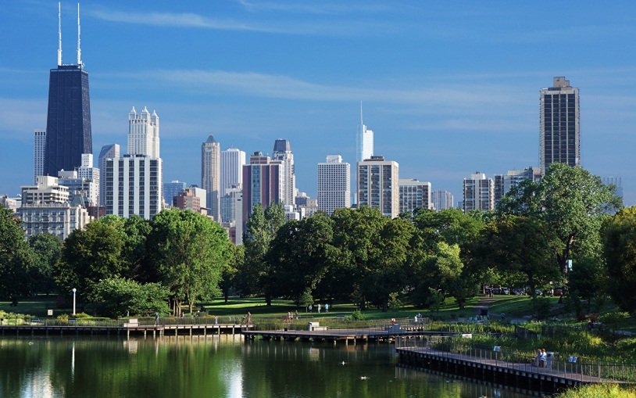
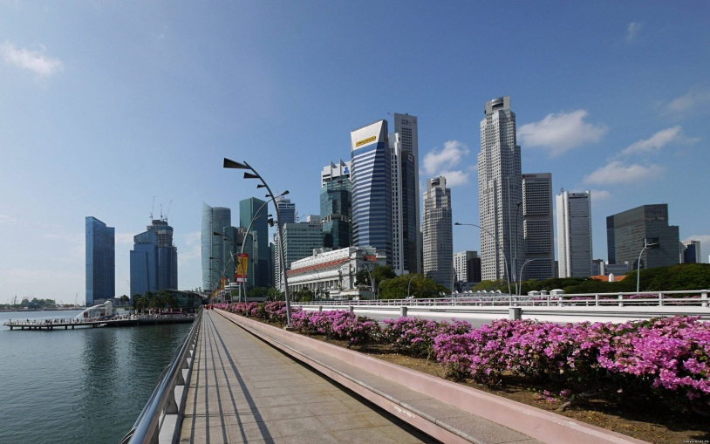
Let’s revise grammar…
There is a library in my town.
There is a beautiful lake.
There are many museums, hospitals, shops in my town.
There are five cinemas in my town.

Slide 11
Fill in the gaps is/are
There ... shops, schools, swimming pools, libraries in hometown
There ... a beautiful river
There ... 2 swimming pools and many hospitals in my town
There ... a large shopping center.
There … cafes and restaurants in my city.
There … a toy shop in my town.

Slide 12
Let’s check:
There are shops, schools, swimming pools, libraries in hometown
There is a beautiful river
There are 2 swimming pools and many hospitals in my town
There is a large shopping center.
There are cafes and restaurants in my city.
There is a toy shop in my town

Slide 13
Let’s move a little!
Move your body,
Move your heads,
Move your shoulders,
Move your legs,
Jump a little,
Run and go,
Sit, stand up,
And let’s go on.

Slide 14
Let’s make the story
Lipetsk is the best place to live.
Our zoo is nice.
Vika lives in …
She likes living there because …
There are a lot of …
You can…
Her favorite place is …
People are …
Her hometown is…
The places where people walk are wonderful.
You can visit the park.
My hometown is beautiful.

Slide 15
Lets check a story
Vika lives in Lipetsk.
She likes living there because Lipetsk is the best place to live.
There are a lot of interesting places.
You can visit the park.
Her favorite place is zoo.
People are kind and friendly
Her hometown is beautiful.

Slide 16
Are the sentences TRUE or FALSE
Vika lives in Voronezh.
There are a lot of interesting places
You can visit the park
Vika’s favorite place is a pizza restaurant
People are evil and silly
Her hometown is beautiful
F
T
T
F
F
T

Slide 17
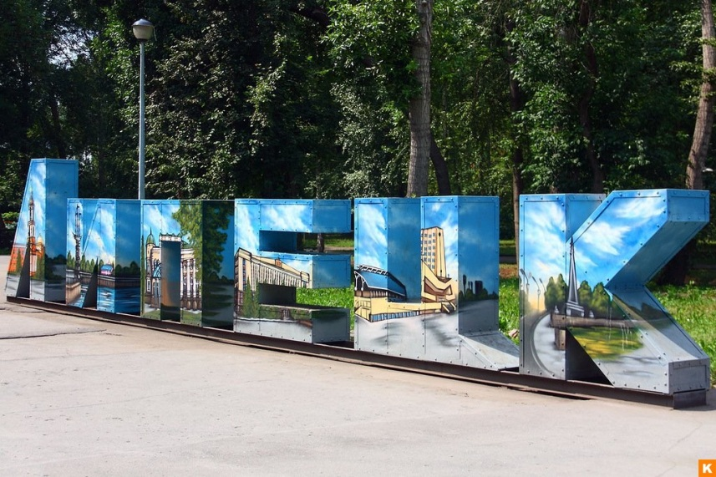
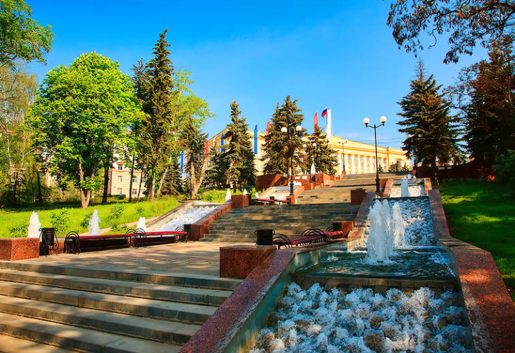
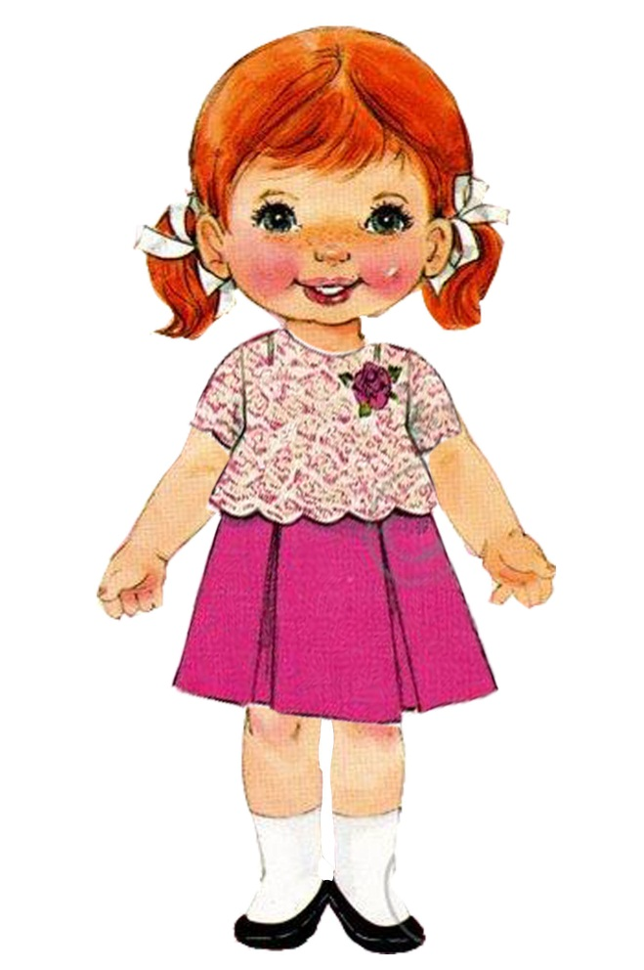
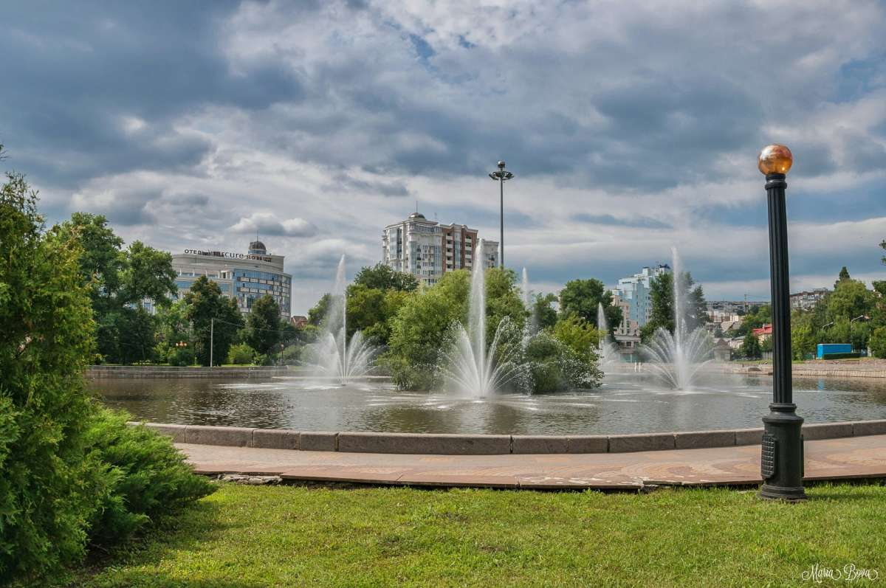
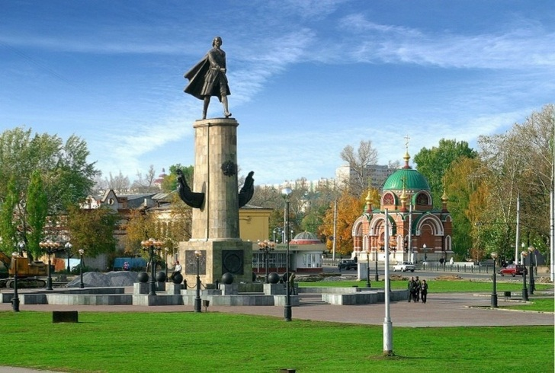

Slide 18
HOMEWORK:
Make the project “My hometown”
AB All about me № 10 p.121

Slide 19
You are smart!
You are brave!
You are nice!
Your marks are good!

Slide 20
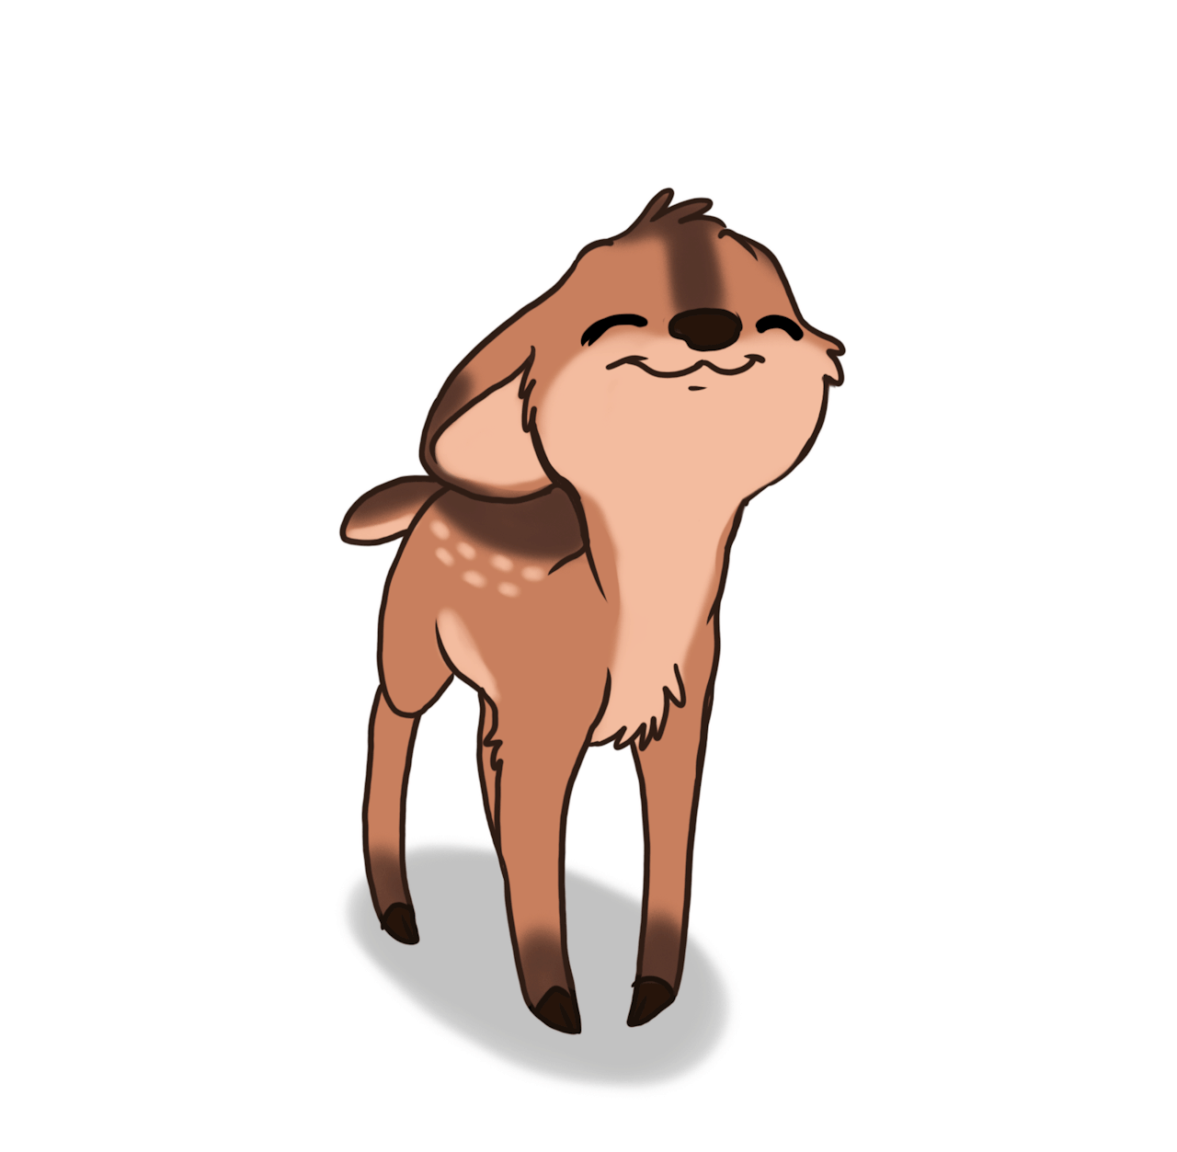
Thank you!

