Slide 1
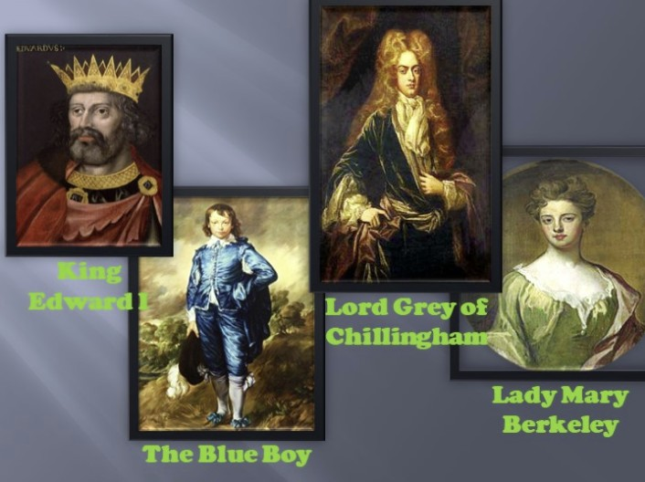
Famous ghosts
Broad-shouldered
Curly-haired
Gray-haired
Middle-aged
Ten-year-old
Red-haired
Long-haired
Well-known
Gray-eyed
Good-looking
Bad-looking
Bearded

Slide 3
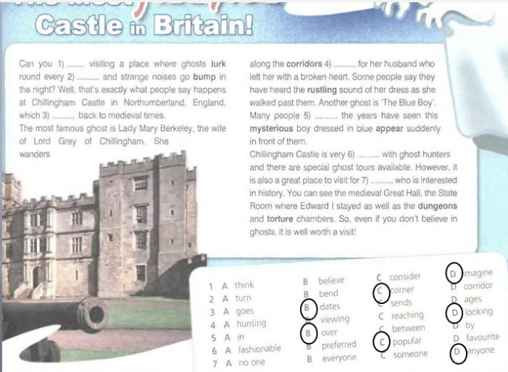

Slide 4
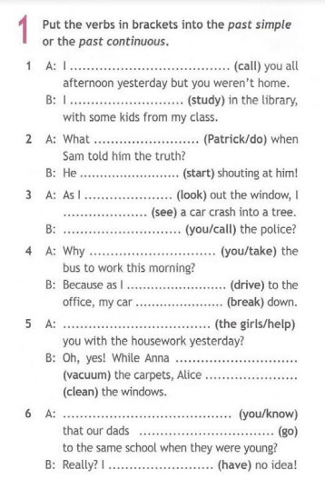
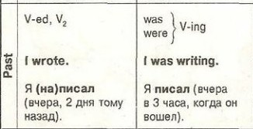

Slide 5
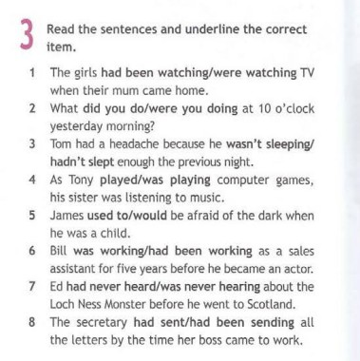

Slide 6
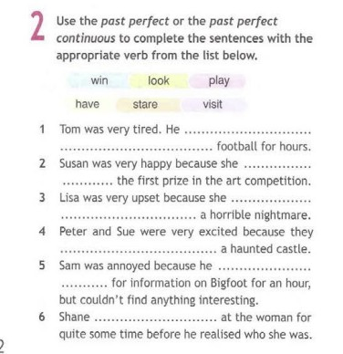
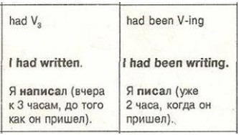

Slide 8
