Slide 1
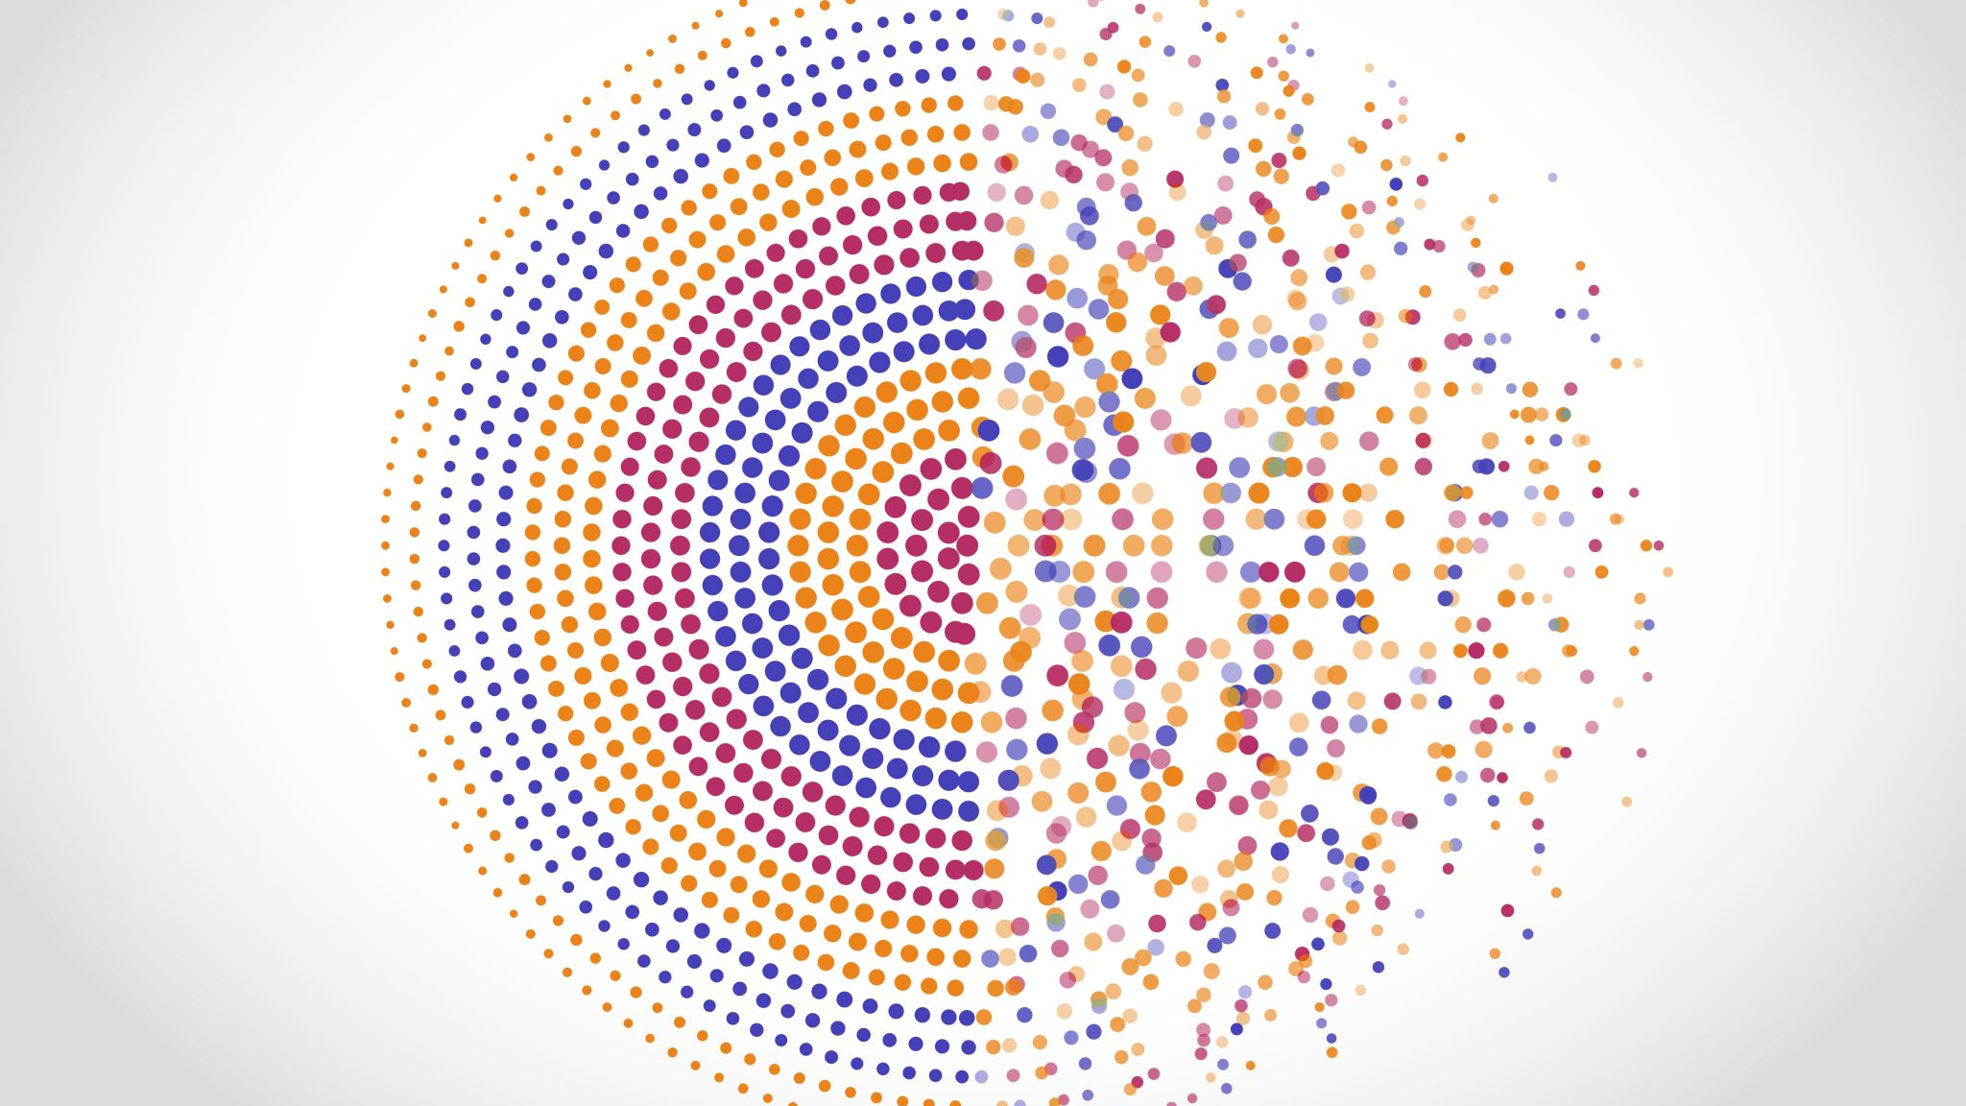
My town
Гусельников Лев школа лицей 21
4в

Slide 2
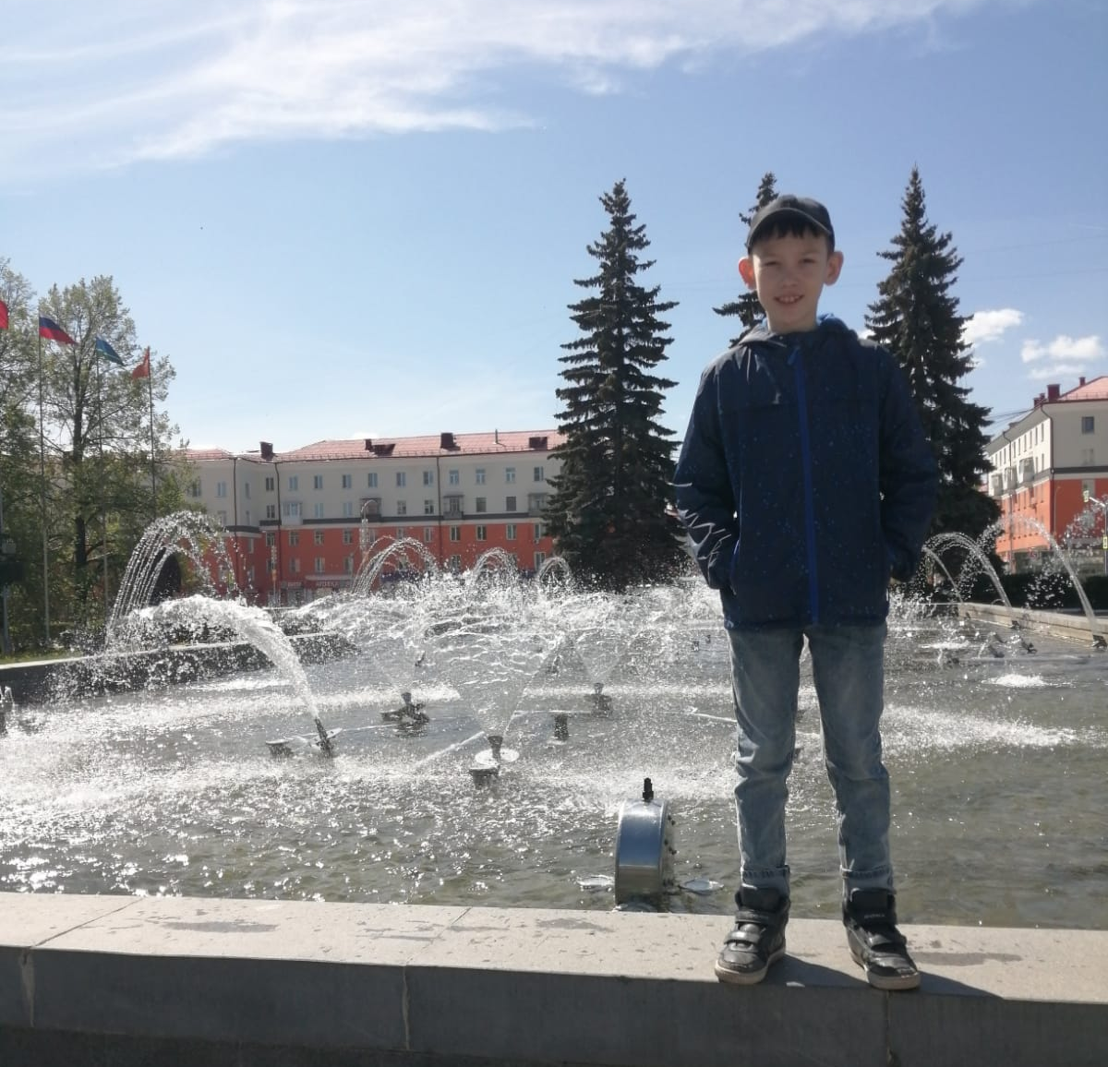
My name is Lev .I live in Pervouralsk .It is town. The center of our town is a Square of Victory. There are musical fountain, city administration, cafes and restaurants .

Slide 3
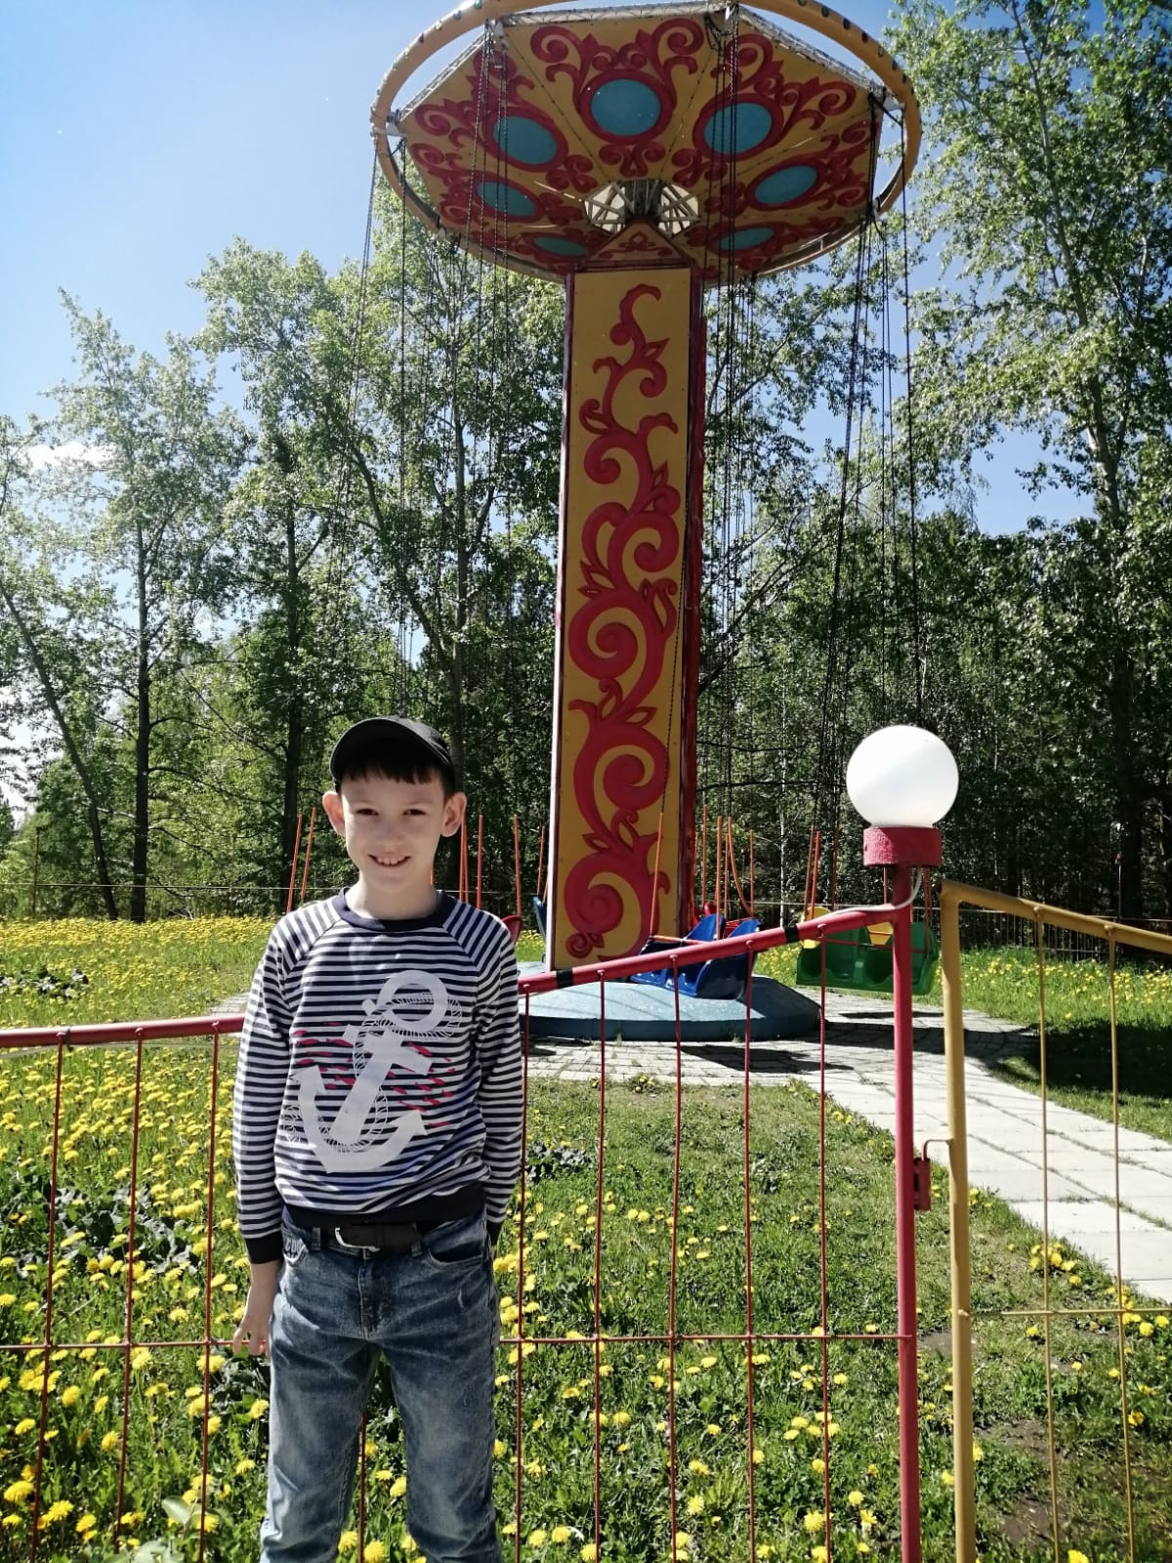
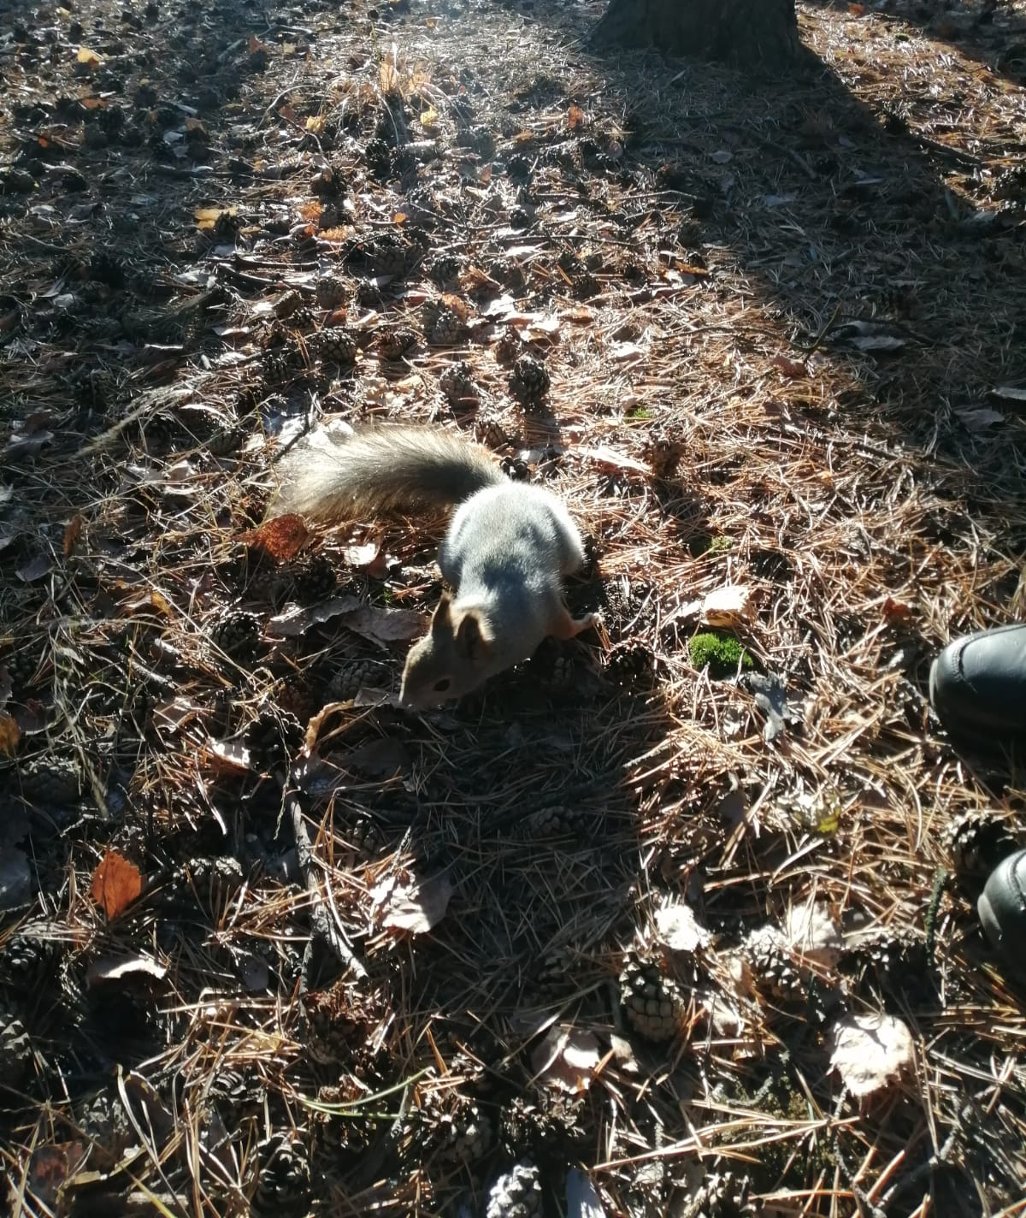
Not far from center is park. There are attractions and zoo. Our family likes to feed squirrels in the park .

Slide 4
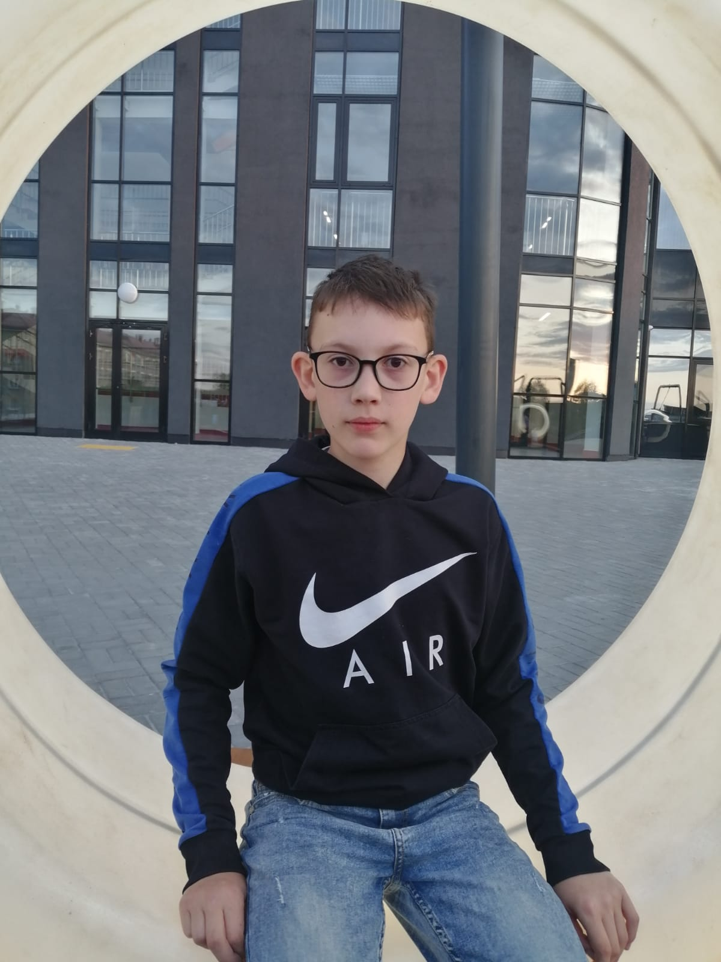
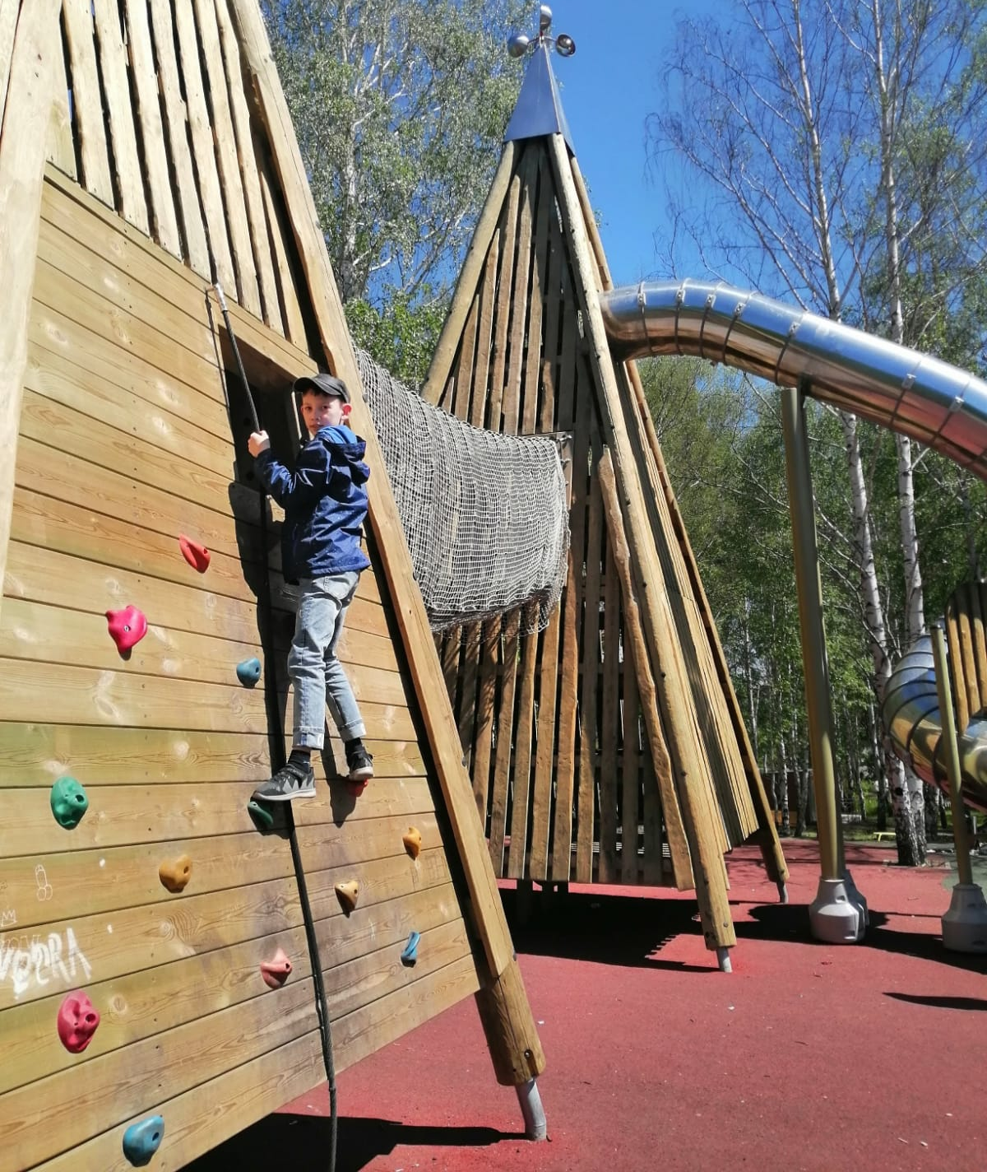
In our town are new swimming pool and new playground .It is big and nice. I like swim in swimming pool. I like play on the playground.

Slide 5
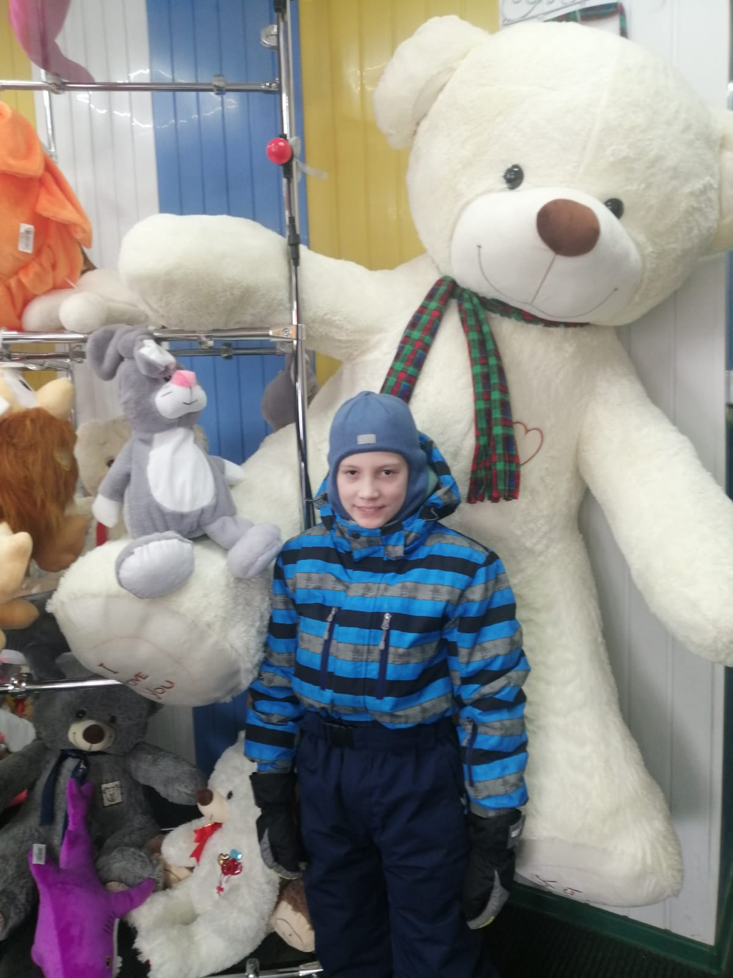
My town has got many supermarkets . In supermarket I shop fruit and vegetables .In town many toys shop too .

Slide 6
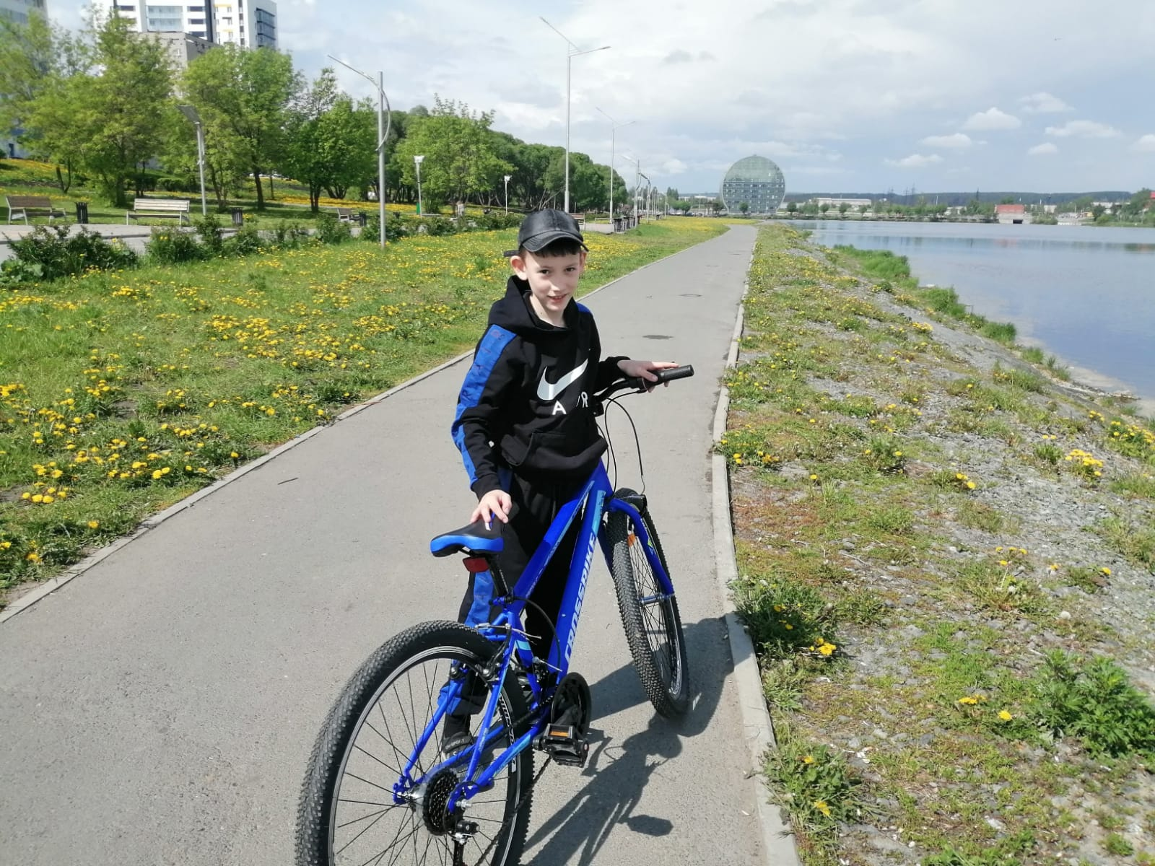
My town has got city pond with bike path, where I can ride bike.

Slide 7
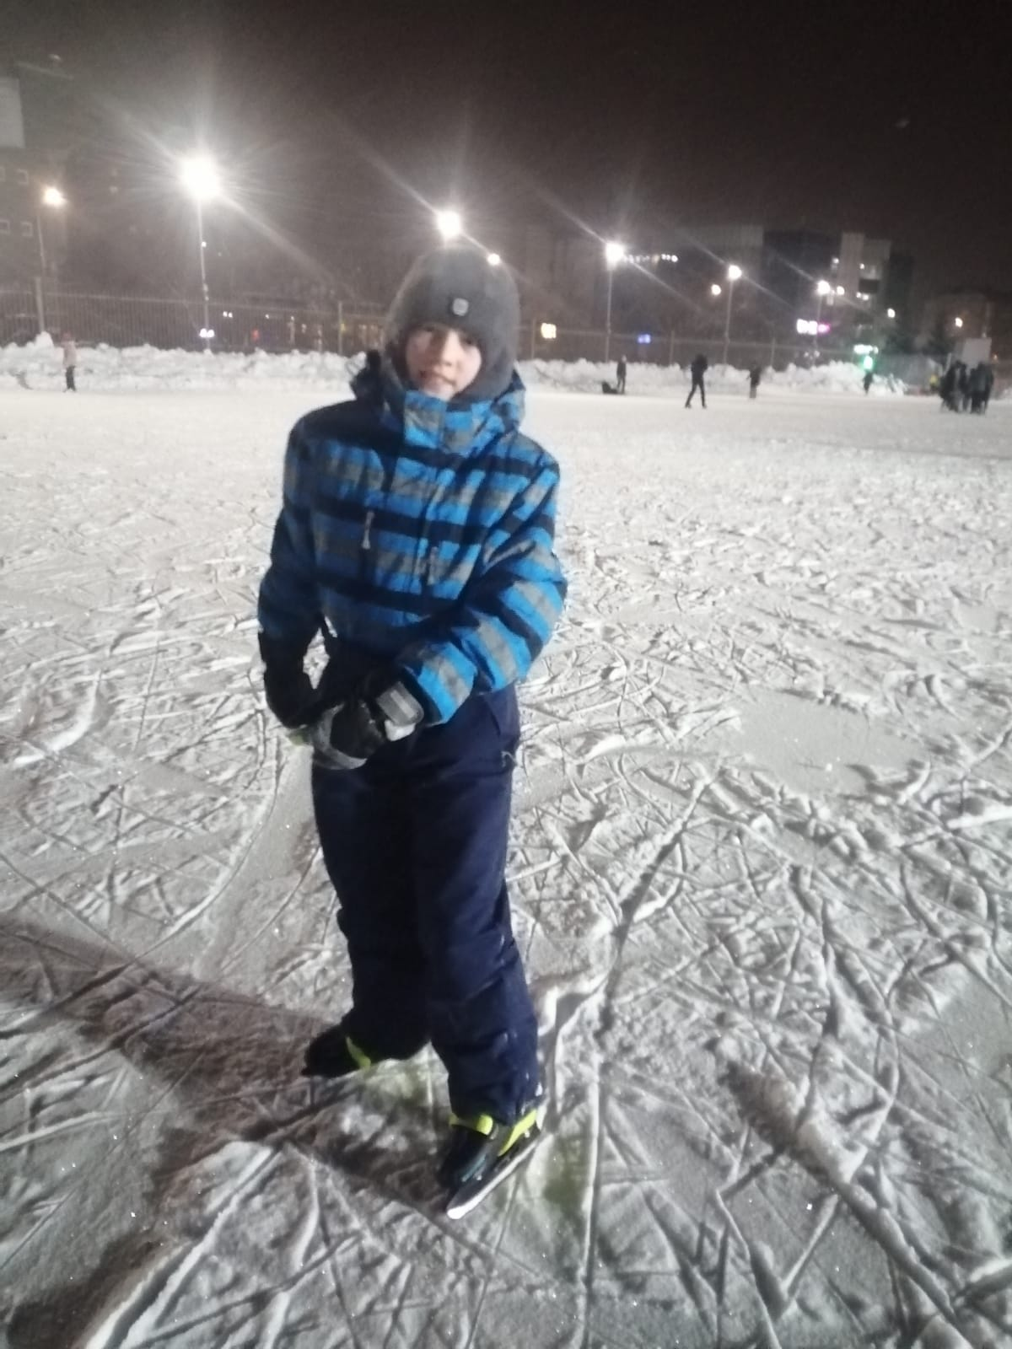
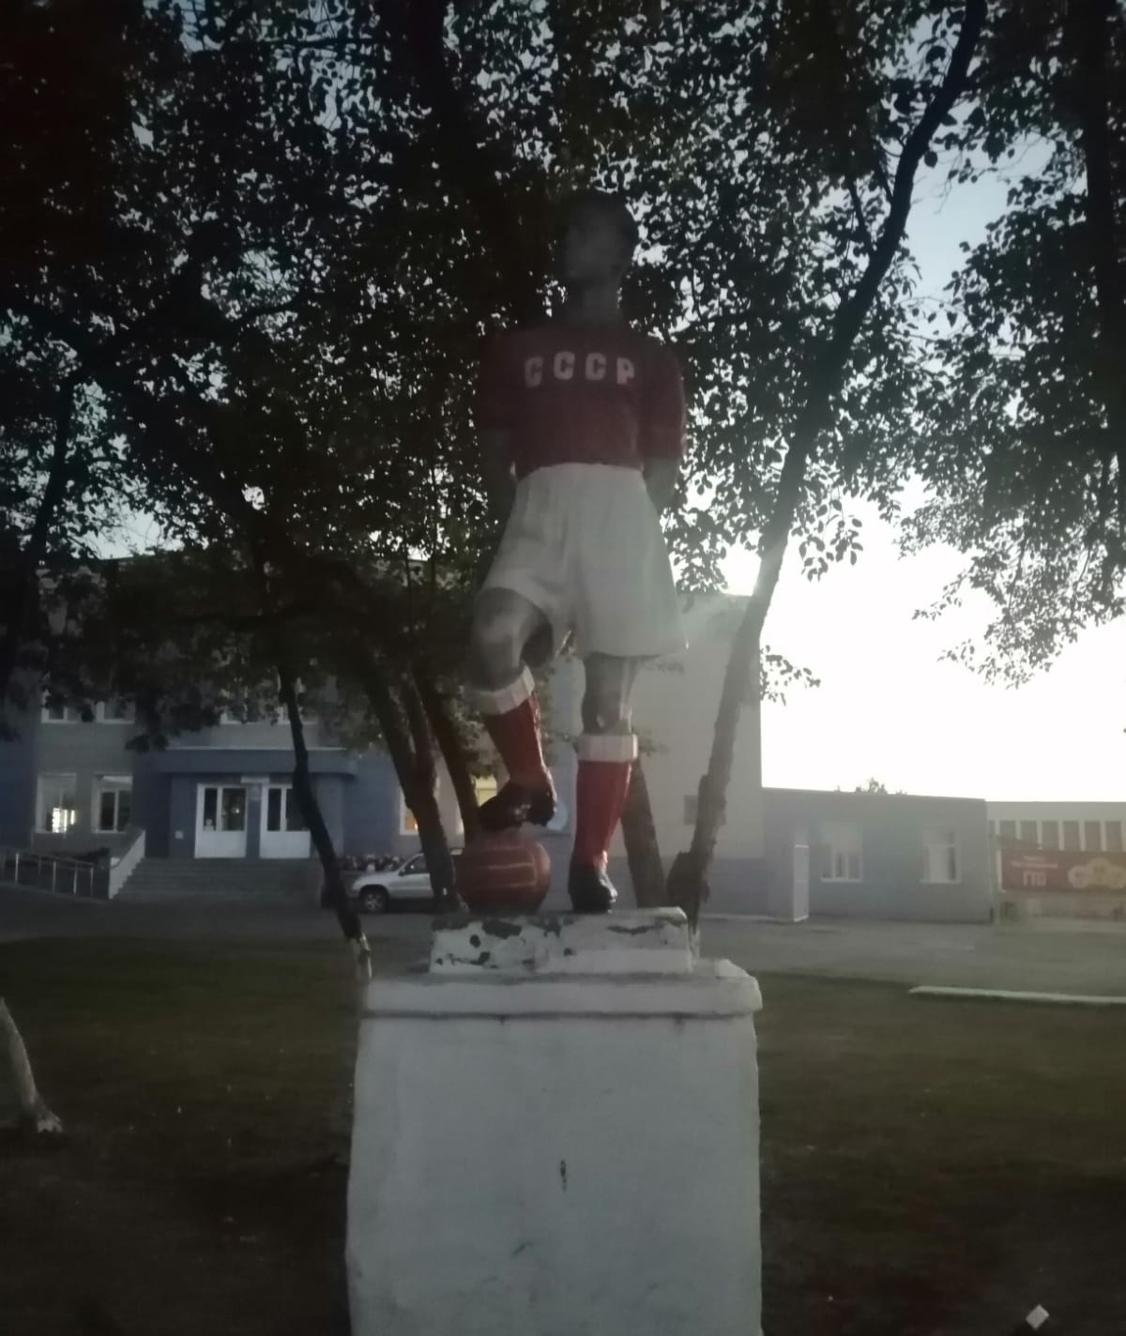
Near the square there is stadium. We can go in for sports every season.

Slide 8
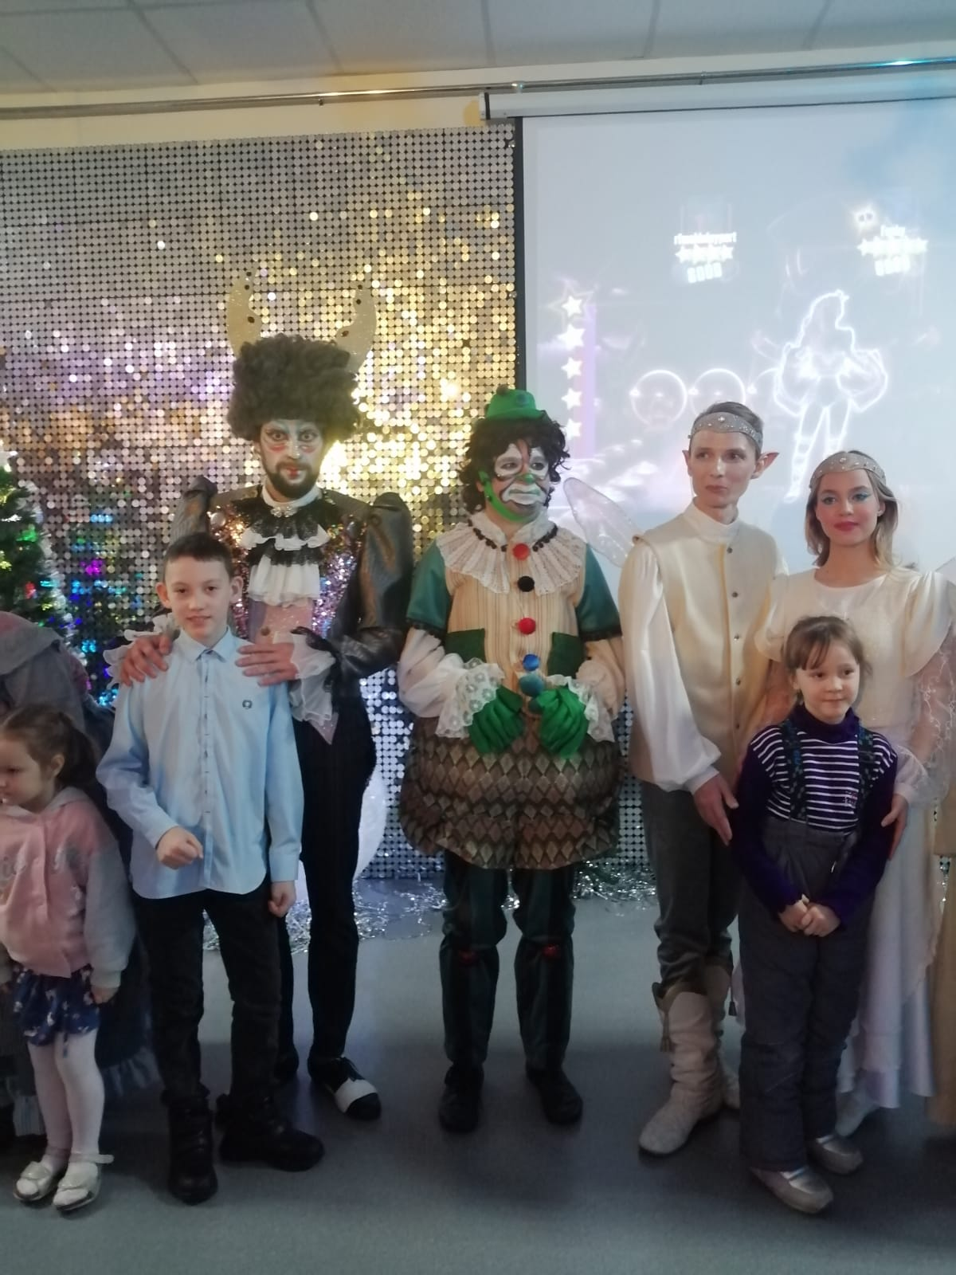
There are libraries, museum, theater in my town. I like visit theater Variant.

Slide 9
I like my town.

