Slide 1
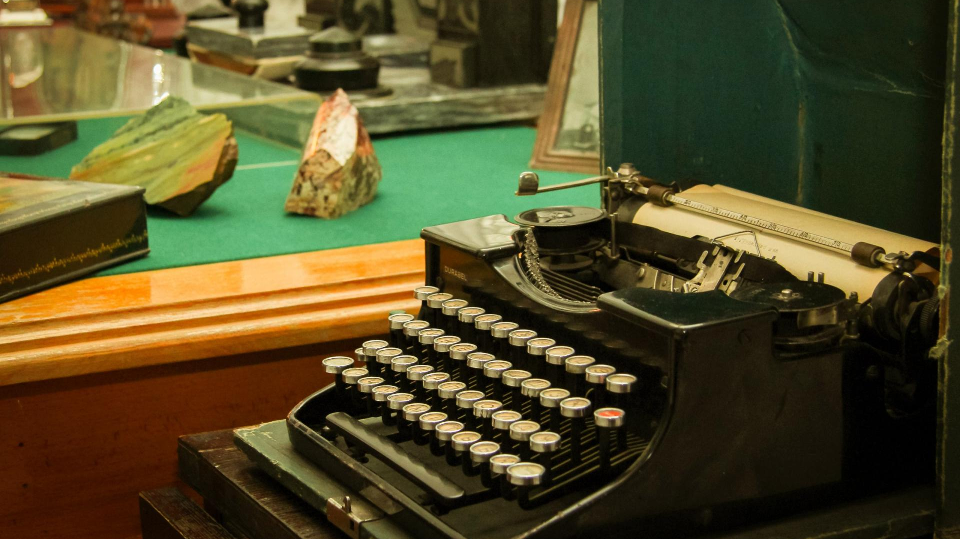
Museum – house named after Рavel Bazhov

Slide 2
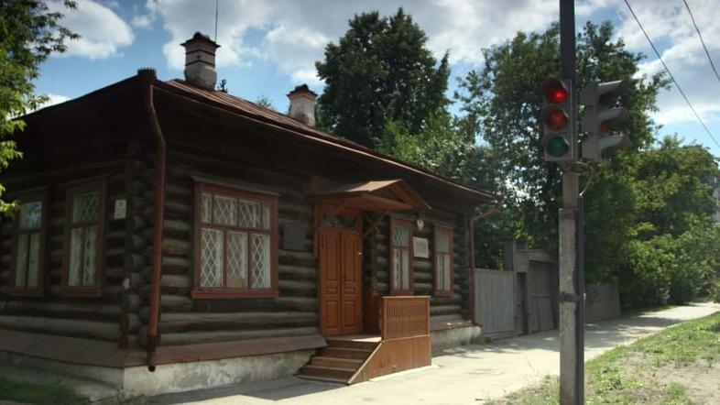
Pavel Bazov is Ural writer. It is house where he writed famous tales . It is in Ekaterinburg city ,Chapaev street 11.

Slide 3
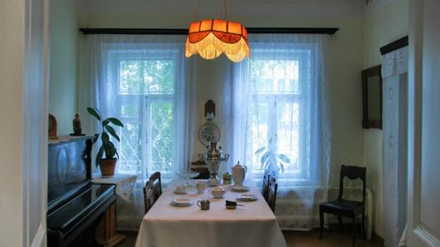
He lived and worked in this house. There is a daning room, cabinet and children room.

Slide 4
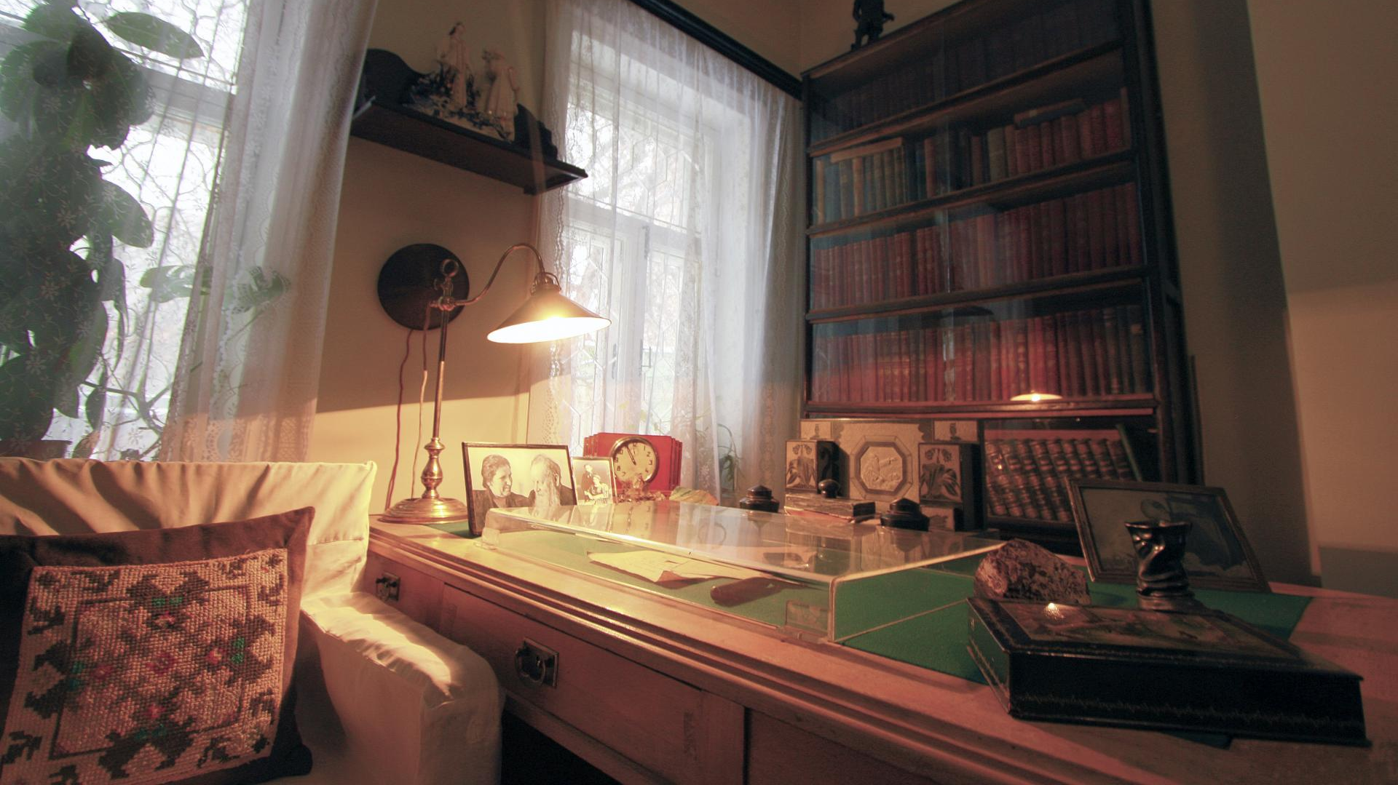
It is cabinet. There is table, tapewriter, armchair .School children go to excursion in this museum.

