Slide 1
ACADEMY OF SOCIAL MANAGEMENT DEPARTMENT OF PHYLOLOGY “The Mothers of Invention”
Karimova I. R.

Slide 2
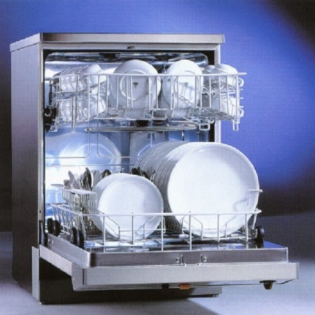
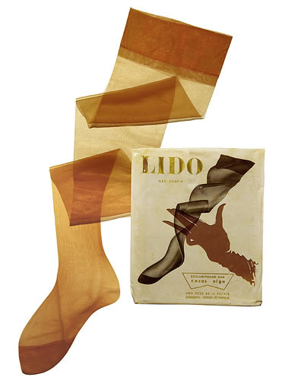
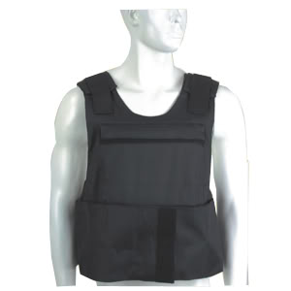
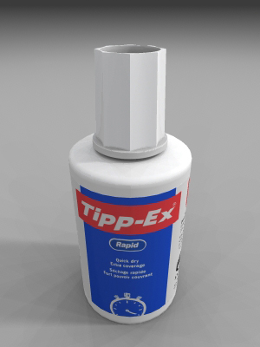
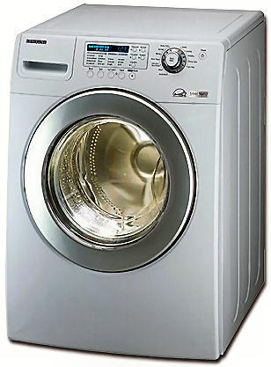
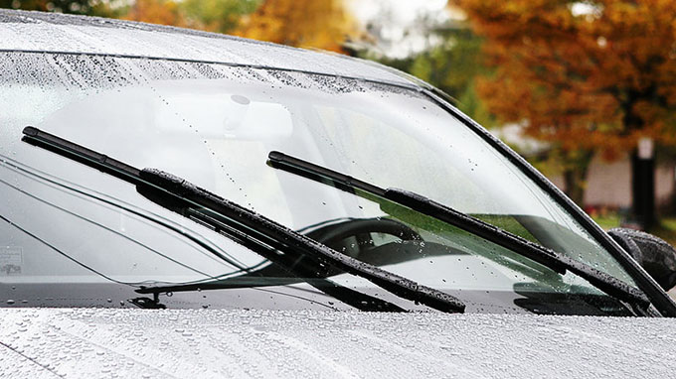
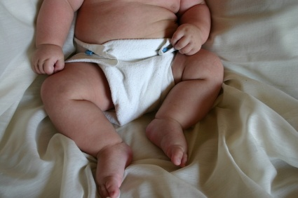
Look at these inventions. Five of them were invented by women. Decide which five you think they are.
Washing
machine
Dishwasher
Nylon stockings
Bullet - proof vest
Tipp -Ex
Windscreen wipers
Vacuum cleaner
Disposable nappies
Check your memory

Slide 3
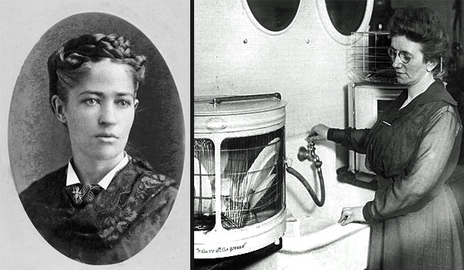
The dishwasher- this was invented by woman called Josephine Cochrane in 1886. She was a rich American who gave a lot of dinner parties. But she was annoyed that her servants used to break plates and glasses when they were washing them after the party. So, Josephine decided to try and invent a machine which could wash a lot of plates and glasses safely. Today the dishwasher is used by millions of people all over the world.
Start again

Slide 4
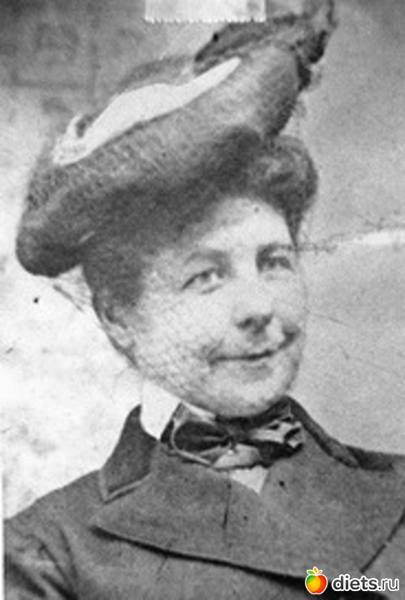
The car was invented by a man, but it was a woman, Mary Anderson, who in 1903 solved one of the biggest problems of driving. Until her invention, it was impossible for drivers to see where they were going when it was raining or snowing. The name of her invention? Windscreen wipers.
Start again

Slide 5
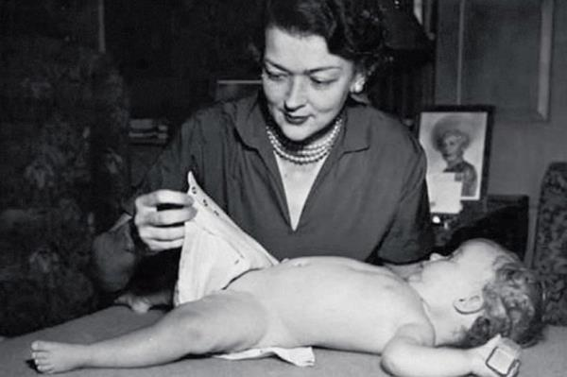
A fantastic invention that definitely improved the lives of millions people was disposable nappies. They were invented by a woman called Marion Donovan in 1950. Anybody who has a small baby will know what a big difference disposable nappies make to our lives. Today more than 55 million nappies are used every day in the world.
Start again

Slide 6
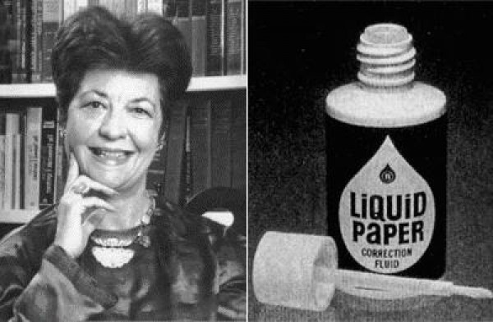
A few years later in 1956, Bette Nesmith Graham was working as a secretary. She used to get very frustrated and angry when she made typing mistakes. In those days if you made a mistake you had to get a new sheet of paper and start again from the beginning. She had a brilliant idea, which was to use a white liquid to paint over mistakes. Her invention is called Tipp-Ex today. Mrs Graham was a divorced mother and her invention made her a very rich woman.
Start again

Slide 7
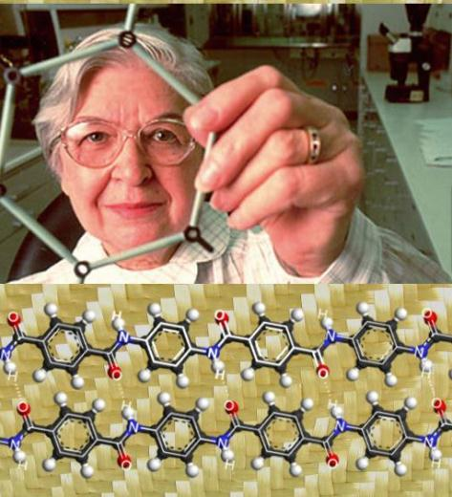
Policemen, soldiers, politicians all over the world are protected by something which was invented by a woman. In 1966 Stephanie Kwolek invented kevlar, a special material which was very light but incredibly strong, much stronger than metal. This material is used to make the bullet- proof vest. Her invention has probably saved thousands of lives.
Start again

Slide 8
Sorry, try again!
Start again

Slide 9
Check your memory
1) ___________ was invented by Josephine Cochrane in 1886.
2) ___________ was invented by Mary Anderson in 1903.
3) ___________ was invented by Marion Donovan in 1950.
4) ___________ was invented by Stephanie Kwolek in 1966.
5) __________ was invented by Bette Nesmith Graham in 1956.

Slide 10
Thanks very much. So… if you thought that everything was invented by men, think again.

