Slide 5
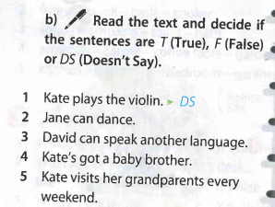

Slide 6
Cool [kuːl] классный
Kind [kaɪnd] добрый
Sweet [swiːt] милый
Clever [ˈklevə] умный
Friendly [ˈfrendlɪ] дружелюбный
Noisy [ˈnɔɪzɪ] шумный
Funny [funny] забавный
Naughty [ˈnɔːtɪ] непослушный
Caring [ˈkɛərɪŋ] заботливый

Slide 7
1)Her father is cool.
2)Her mum is ...............
3)Her brother is .............
4)Her grandma is ...........
5)Her grandpa is ...........
6)Her baby sister is .................

