Slide 1

General knowledge
quiz
All our life is a game.
William Shakespeare

Slide 2
First Round
Themes | Complexity of the questions
My family | 10 | 20 | 30 | 40 | 50
Holidays | 10 | 20 | 30 | 40 | 50
Daily routine | 10 | 20 | 30 | 40 | 50
Cartoons | 10 | 20 | 30 | 40 | 50

Slide 3
Second Round
Themes | Complexity of the questions
English speaking countries | 20 | 40 | 60 | 80 | 100
Road safety | 20 | 40 | 60 | 80 | 100
Movies | 20 | 40 | 60 | 80 | 100

Slide 4
10 points
Read the definition and guess
the word.
They are the parents of your
father or mother.
далее

Slide 5
20 points
Look at the picture
and choose the proper
word.
далее

Slide 6
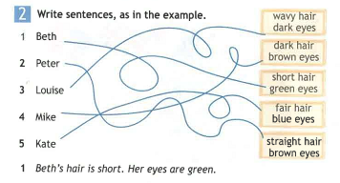
30 points
далее

Slide 7
Game
question
далее

Slide 8
40 points
Listen to the description of a person’s appearance
and find the man.
далее

Slide 9
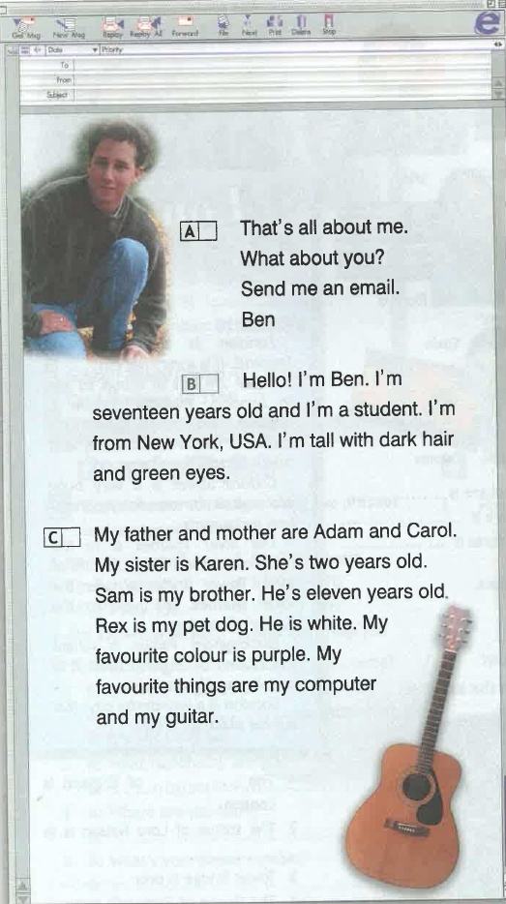
50 points
Read the text and put the paragraphs in the correct order.
далее

Slide 10
10 points
Think of 5 popular holidays
in the world.
далее

Slide 11
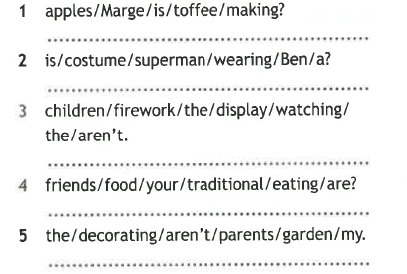
20 points
Put the words in the correct order to make sentences.
далее

Slide 12
Misfortune
question
далее

Slide 13
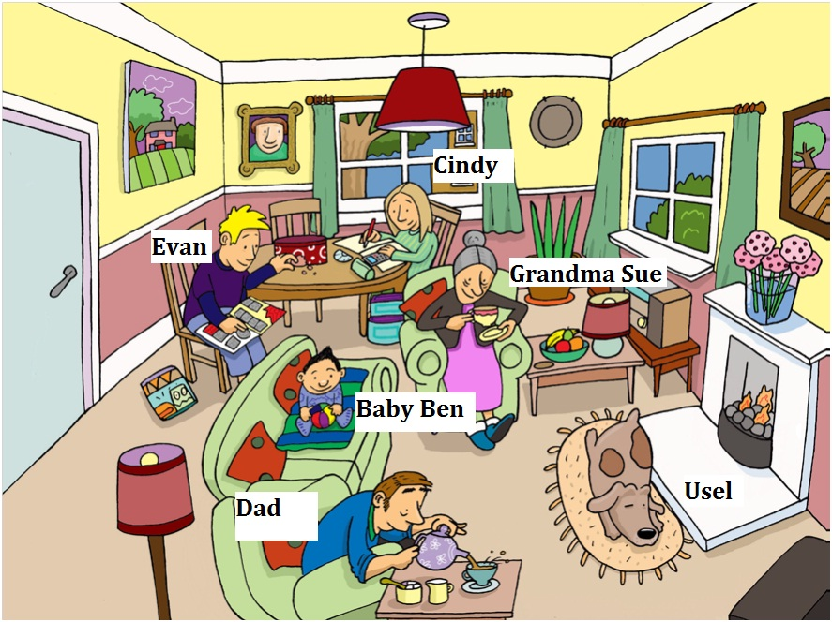
30 points
Describe the picture using the Present Continuous tense.
далее

Slide 14
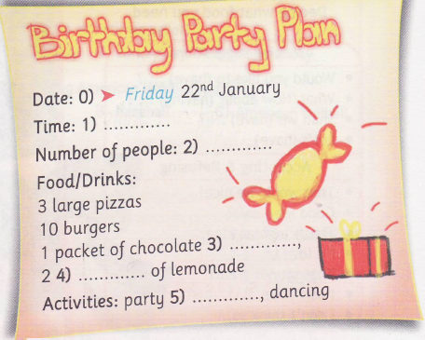

40 points
Listen and fill in the gaps.
далее

Slide 15
Game
question
далее

Slide 16

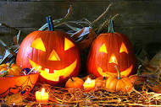
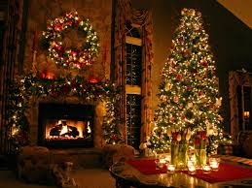
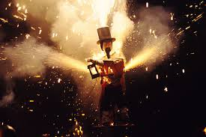
50 points
What holiday is it? Choose A, B, C, D.
Christmas
Guy Fawkes Night
St. Valentine’s Day
Halloween
They celebrate the birthday of Christ
They burn a lot of fires on this day.
The symbols of this holiday are roses, hearts and sweets.
Children like to go from house to house and say “Treat or trick!”
далее

Slide 17
Fortune
question
далее

Slide 18
10 points
далее
Name all the adverbs of frequency used in
the Present Simple Tense. Where do we use them
in a sentence?

Slide 19
20 points
Look at the pictures and say what Sally does
during the day.
далее

Slide 20
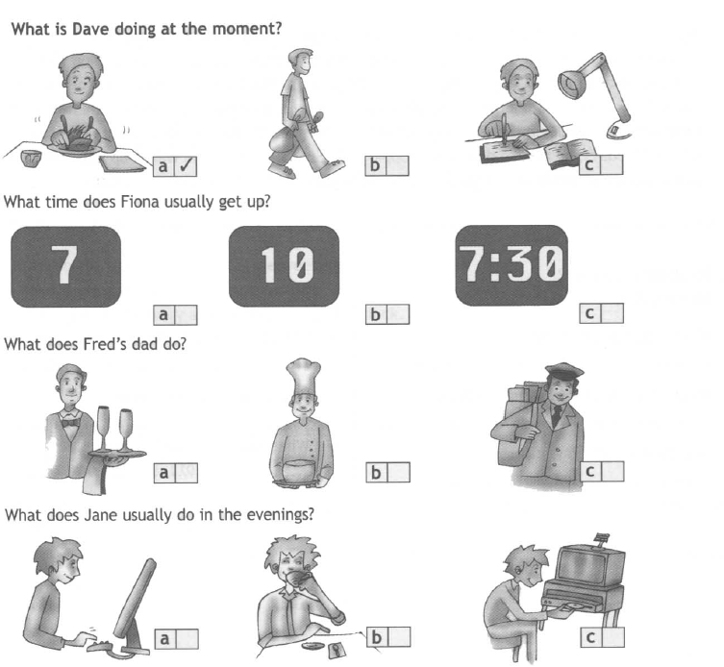
30 points
Listen and choose
далее

Slide 21
40 points
Use the watch and show the time.
It’s half past six.
It’s twenty five to nine.
It’s a quarter past eleven.
It’s seven o’clock.
далее

Slide 22
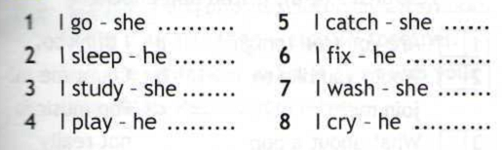
50 points
Write the third person singular.
далее

Slide 23
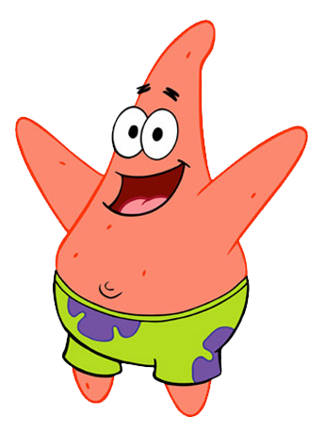
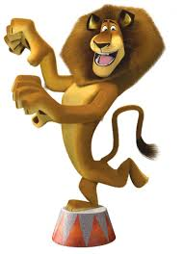
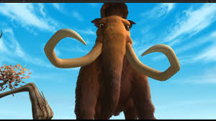
10 points
далее
Match the main characters to their friends
Marty
Sponge Bob
Sid

Slide 24
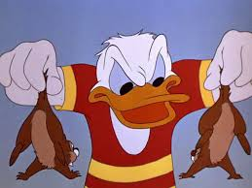
20 points
Look at the picture and guess the cartoon.
далее

Slide 25
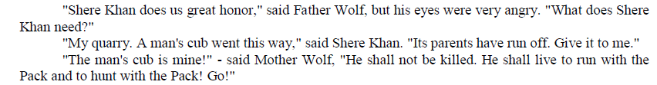
30 points
Read the extract and guess the cartoon.
Cinderella
Winnie the Poor
Snow White
Mowgli
далее

Slide 26

40 points
Listen to the song and say which
cartoon it is from.
далее

Slide 27
Misfortune
question
далее

Slide 28
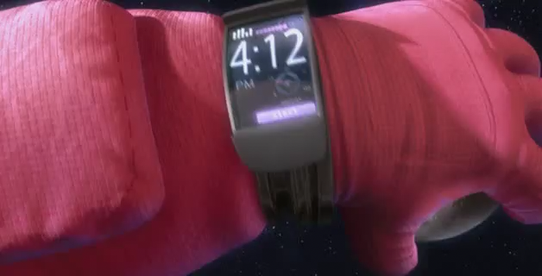
50 points
далее
Watch the cartoon and continue the story
(make 3-4 sentences using
the Past Simple Tense)

Slide 29




20 points
Which countries are these flags of ?
далее

Slide 30
40 points
Guess the missing countries.
далее

Slide 31
Fortune
question
далее

Slide 32
60 points
Choose the right
variant
далее

Slide 33
Misfortune
question
далее

Slide 34
80 points
Listen to the recorder and
answer the question.
What flags does the
Union Jack include?
далее

Slide 35
Fortune
question
далее

Slide 36
100 points
Match the countries to the nationalities.
далее

Slide 37
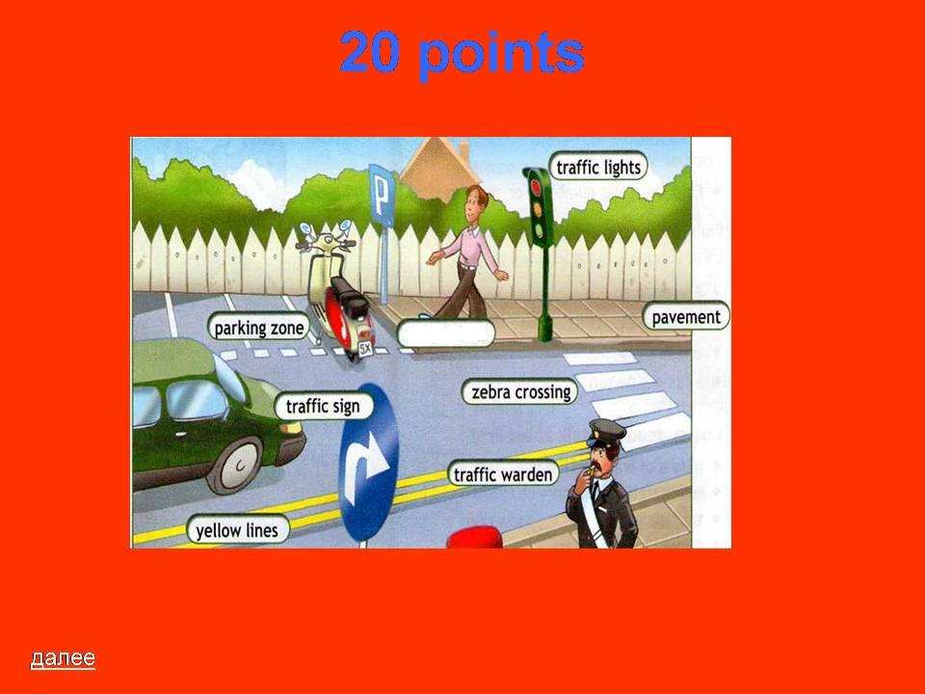
20 points
Name the missing word.
далее

Slide 38



40 points
What do these signs tell us?
далее

Slide 39
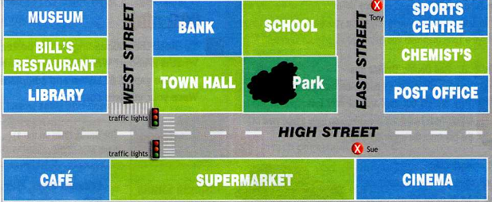
60 points
You are at school. Draw and say the route to
the museum.
далее

Slide 40
Game
question
далее

Slide 41
80 points
Give the instructions on
road safety
далее

Slide 42
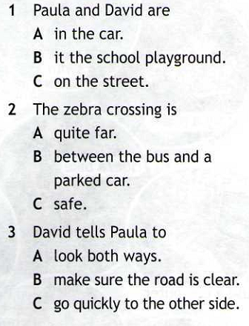
100 points
далее
Listen and choose.

Slide 43
20 points
Read the description and guess t
he movie character:
He is a teacher. He is bald and
has a scar on his face. He is very cool.
The students like him.
далее

Slide 44
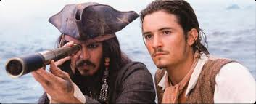
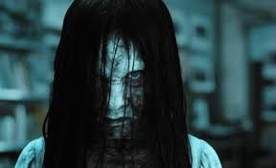
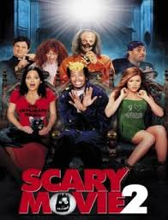

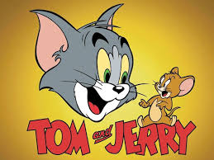
40 points
далее
1
3
2
4
5
Comedy
Adventure film
Cartoon
Melodrama
Horror film

Slide 45
60 points
Guess the words according
to their definitions
___________ images, often created by a computer.
___________ the music of a film.
___________ translation of the dialogue of a film
that appears at the bottom of the screen.
далее

Slide 46
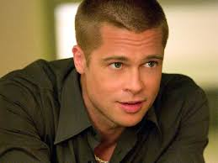
80 points
Pitt’s acting career began in 1987, with uncredited parts in the films NO Way Out, No Man’s Land and Less Than Zero. In 1988 he got the main role in The Dark Side of The Sun. After years of supporting roles in film and frequent television guest appearances, Pitt attracted wider recognition in his supporting role in the 1991 road film Thelma and Louise.
Now Brad is a very popular American actor and producer. Ye is well-known for his roles in Mr. and Mrs. Smith, The Mexican, World War Z, Ocean’s Eleven etc. He lives with his loving wife Angelina Jolie and their adopted children . Brad says that he is full of ideas about his career , that makes his fans happy.
William Bradley Pitt was born on December, 18 1963 in Oklahoma. His father, William Pitt, was a manager and his mother, Jane Hillhouse, was a teacher. He also has a brother Doug and sister Julia.
далее

Slide 47
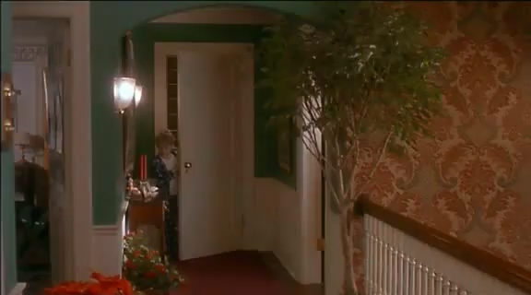
100 points
далее
Imitate the fragment of a film

Slide 48

Thank you
for your attention!
Good luck!
Best Wishes!!!
Thank you!

