Slide 1
Кафедра << … >>
Luigi Galvani

Slide 2
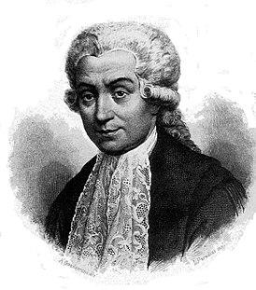
Luigi Galvani (ital. Luigi Galvani (September 9, 1737 — December 4, 1798) was an Italian physician, anatomist, physiologist and physicist, one of the founders of electrophysiology and the doctrine of electricity, the founder of experimental electrophysiology

Slide 3
The story of Luigi Galvani
Born in Bologna in 1759, he graduated from the University of Bologna, where he studied first theology, and then medicine, physiology and anatomy; in 1762 he received the degree of Doctor of Medicine. He taught medicine at the University of Bologna, from where shortly before his death he was dismissed for refusing to take the oath of the Cisalpine Republic, founded in 1797 by Napoleon Bonaparte.Galvani's experiments, which received the correct interpretation in the works of A. Volt, also contributed to the invention of a new current source – a galvanic cell. The phenomena discovered by Galvani were called "galvanism" for a long time in textbooks and scientific articles. Electrophysiology, the father of which can be considered Galvani, now occupies an important place in science and practice

Slide 4
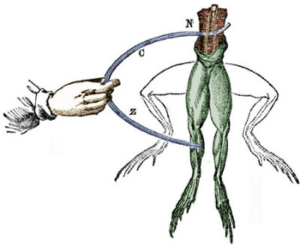
Galvani's first works are devoted to comparative anatomy. In 1771, he began experiments on animal electricity: he discovered and investigated the phenomenon of muscle contraction of a dissected frog under the influence of an electric current; observed muscle contraction when they were connected by metal with nerves or spinal cord, drew attention to the fact that the muscle contracts when two different metals touch it simultaneously. Galvani explained these phenomena by the existence of "animal electricity", thanks to which muscles are charged like a Leyden jar.
Zinc Wire
Copper wire

Slide 5
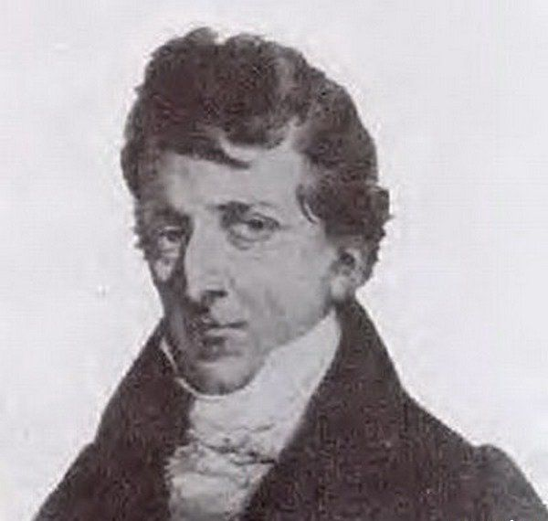
Nephew and follower of Luigi Galvani. He became famous for mixing serious research with a chilling spectacle. He practiced so-called electric dances, manifested
in the form of public experiments, which were designed to emphasize the effectiveness of electrical excitation to produce spasmodic muscle movements, to demonstrate this, the severed heads of executed criminals were used.
Giovanni Aldini (ital. Giovanni Aldini; April 10, 1762, Bologna — January 17, 1834, Milan)

Slide 6
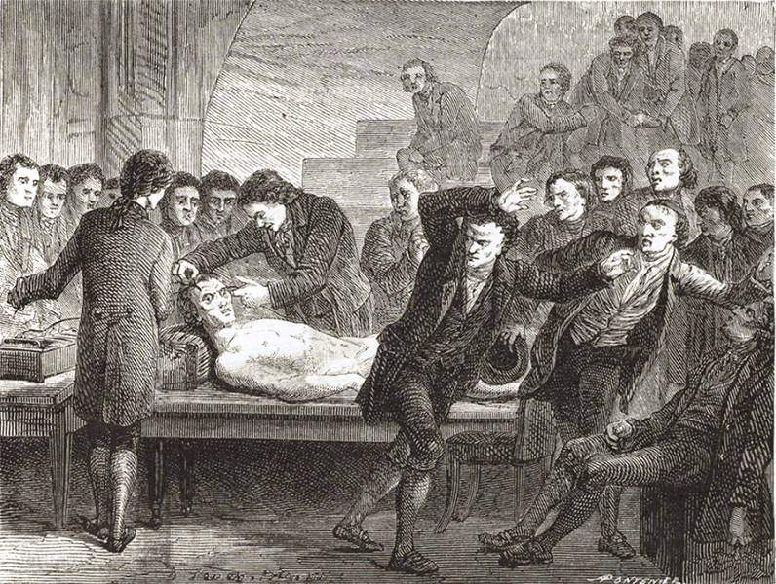
Other researchers have tried to apply electric current in the hope of resurrecting the dead, but to no avail. It is generally accepted in the scientific community that it was these experiments of Aldini that inspired Mary Shelley to write a novel about Frankenstein in 1818

Slide 7
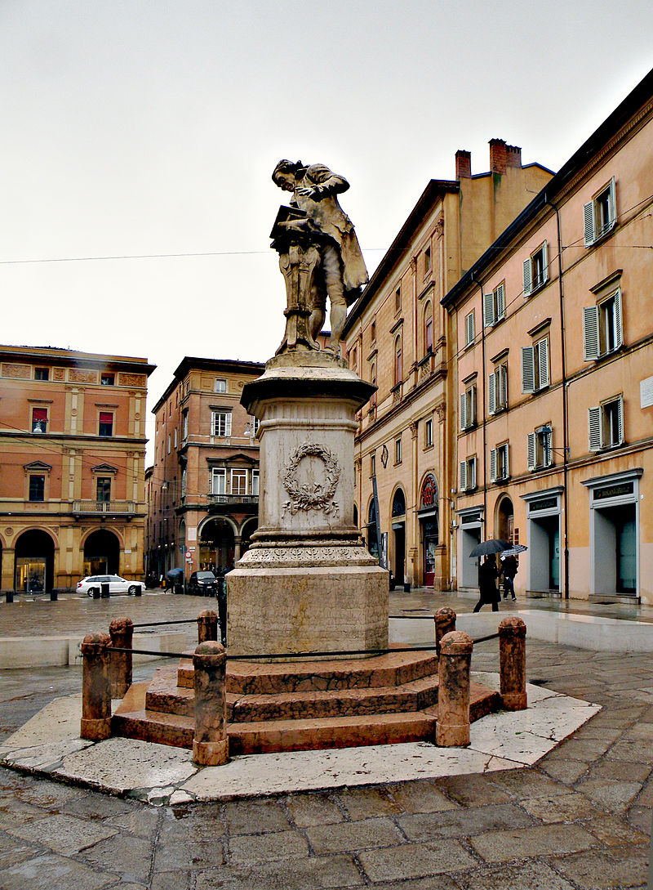
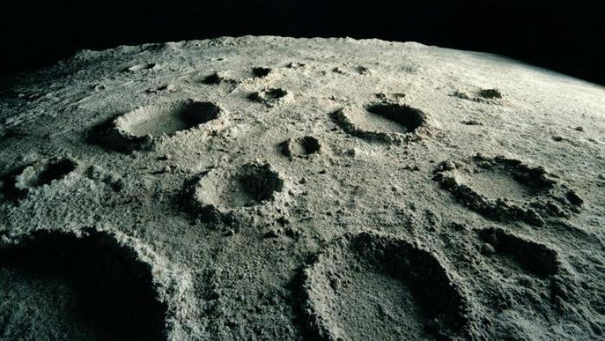
Galvani left behind several memorials, a monument was erected in his honor, a street was named after him on which the monument is located and a crater on the back side of the moon is named.

Slide 8
Thanks
for your attention

