Slide 1
How are you?
I’m good
I’m great
I’m wonderful
I’m tired
I’m hungry
I’m not so good

Slide 2
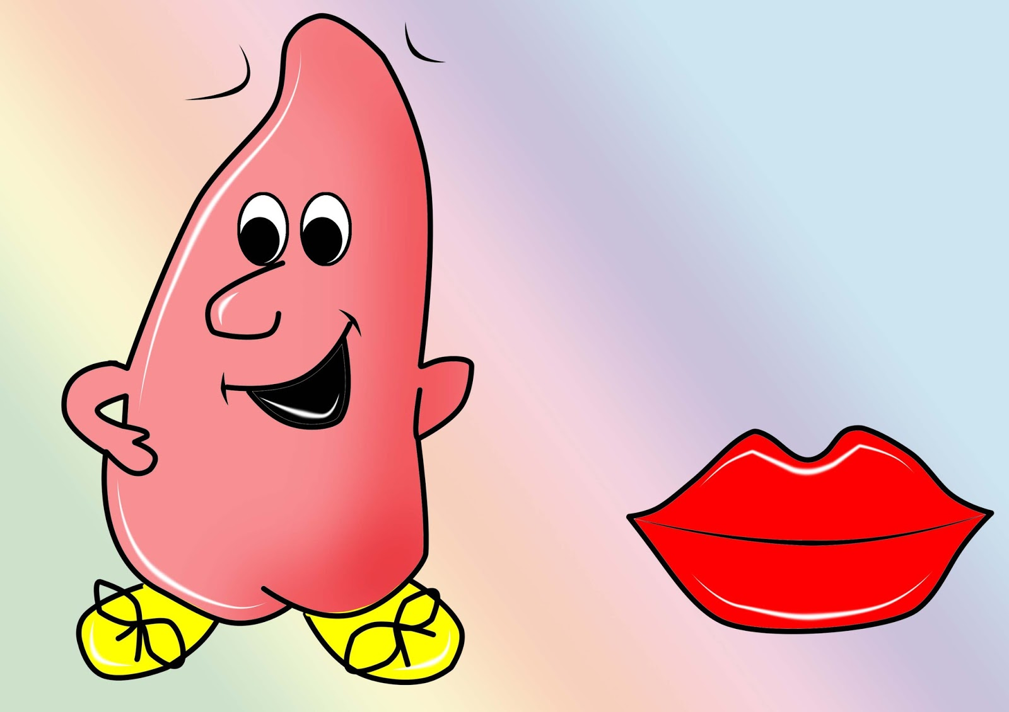

Slide 3
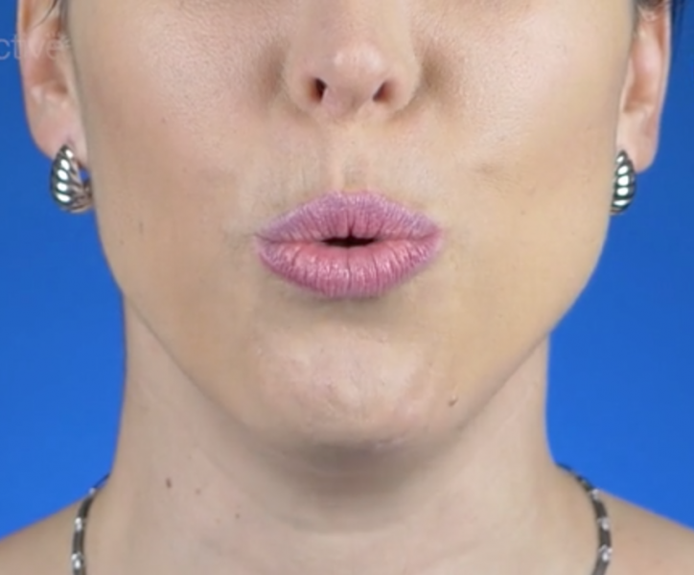

Slide 5
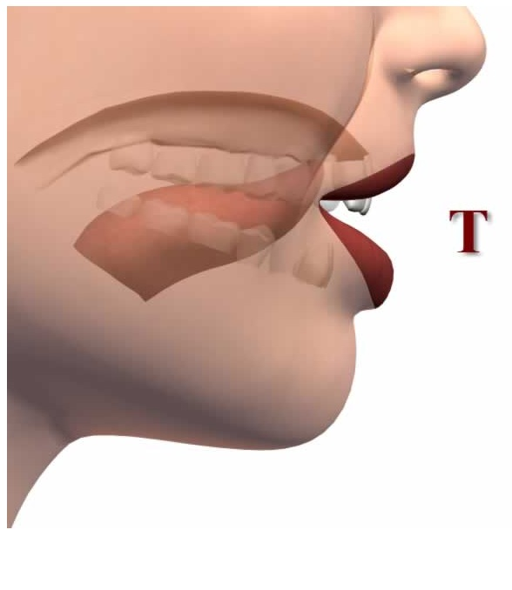

Slide 6
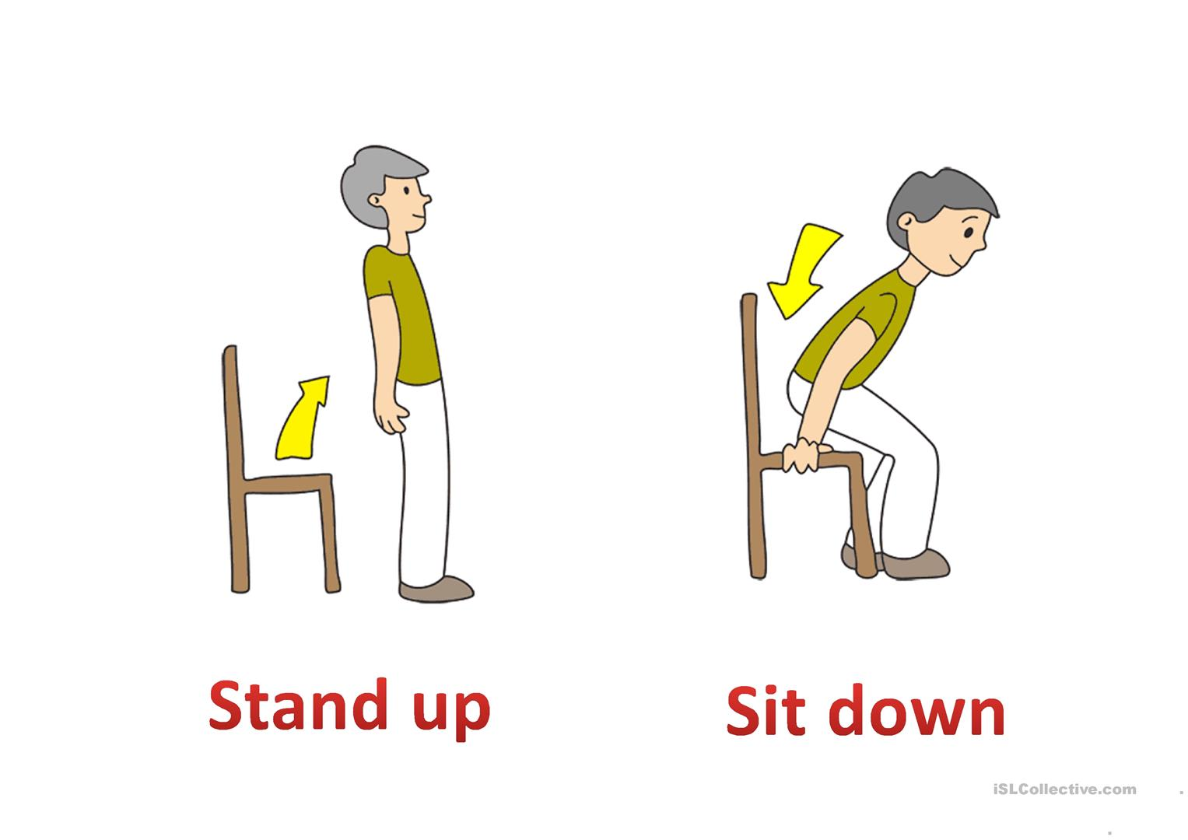

Slide 9
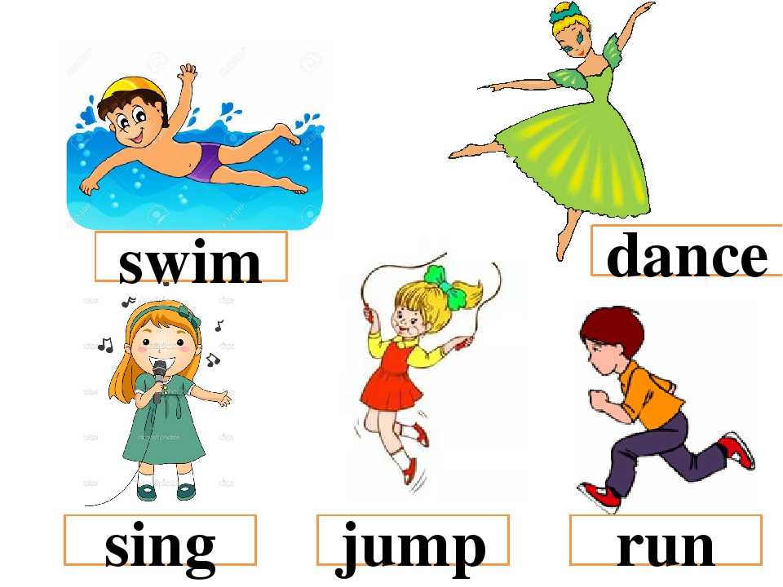

Slide 10
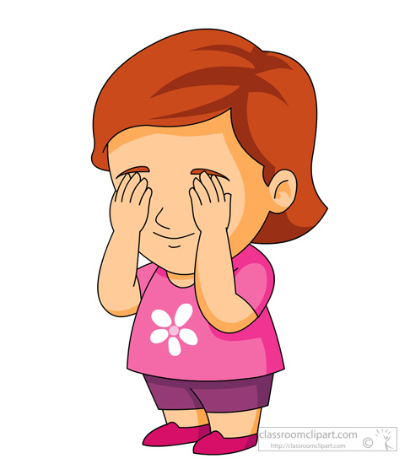
Open your eyes
Close your eyes

Slide 19
Open your eyes
Close your eyes

Slide 20
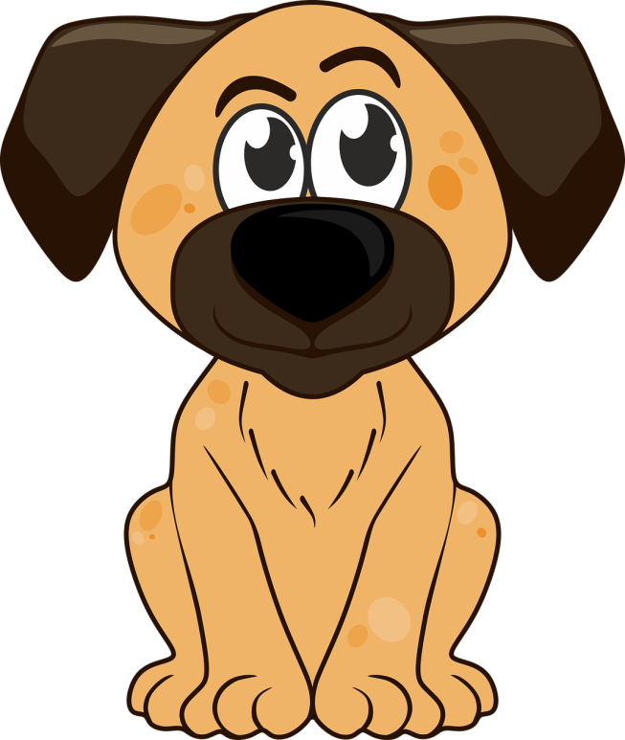
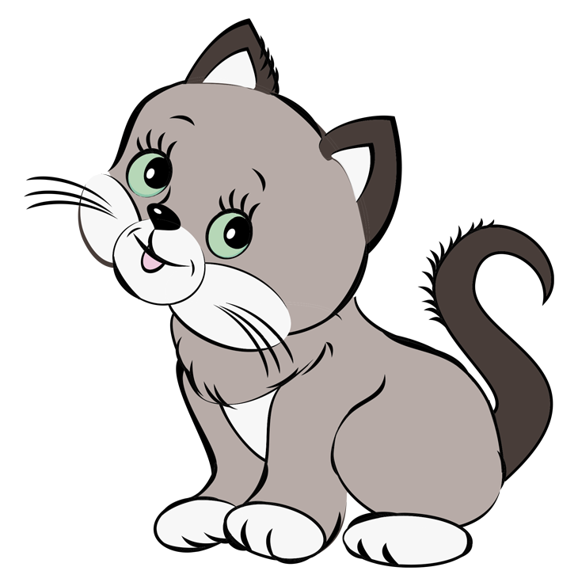
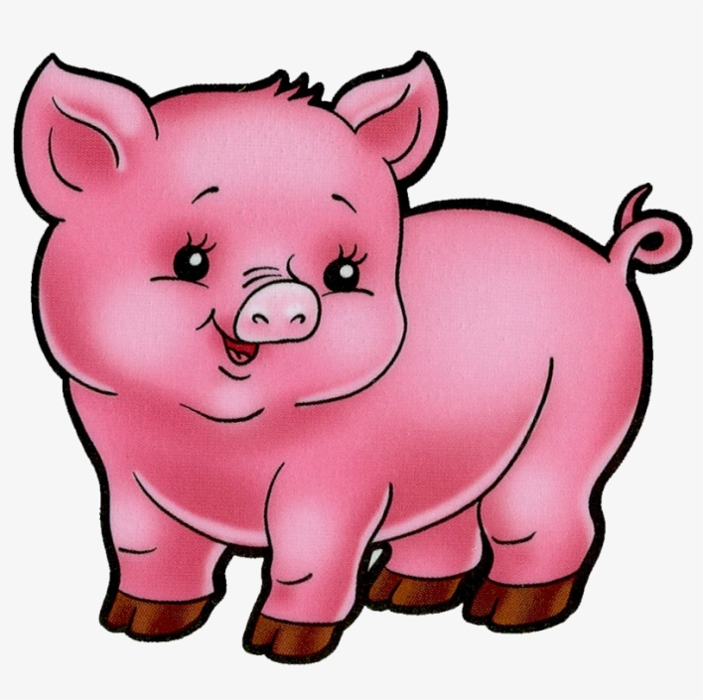
A pig
A cat
A dog

Slide 22
A dog
A pig

Slide 23
A pig
A cat

Slide 24
A cat
A dog

