Slide 1
What teen camps do you know?
Teen camps - подростковый лагерь
What shall we do there?

Slide 2
TEEEN CAMPS:

Slide 3

TECH CAMP
Make a video game
Make a robot
Make a webpage
Have IT classes

Slide 4
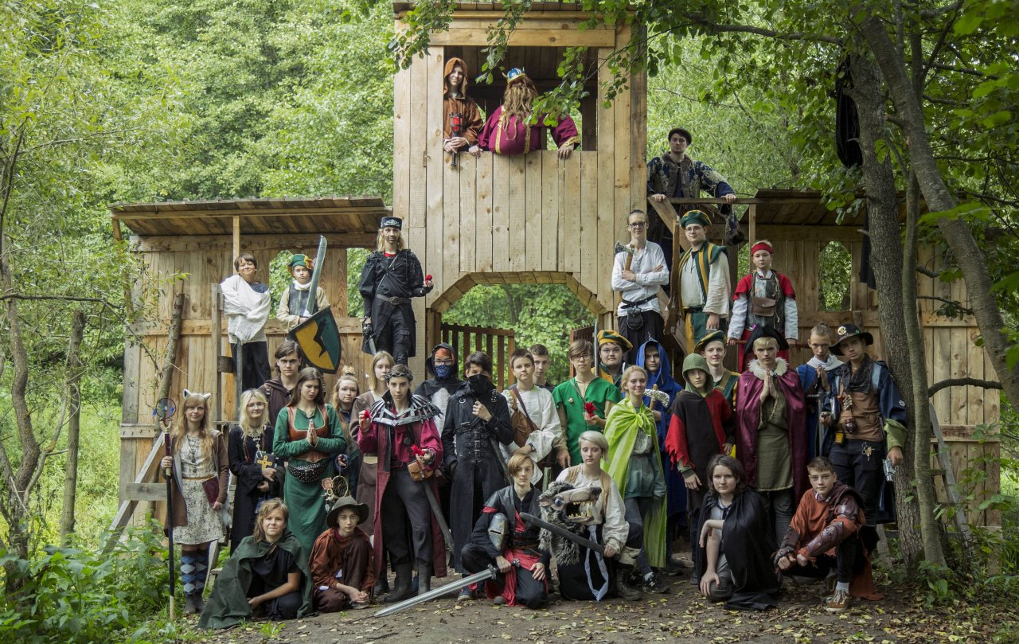
ADVENTURE CAMP
Go rafting
Go hiking
Make a tree house
Play sports

Slide 5
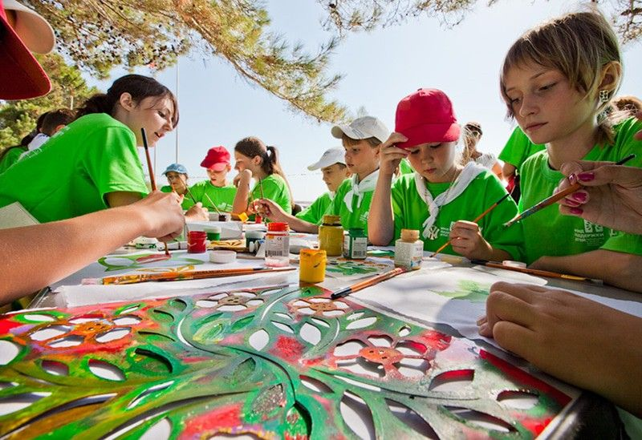
ART CAMP
Have dancing classes
Have acting classes
Have painting classes
Play an instrument

Slide 6
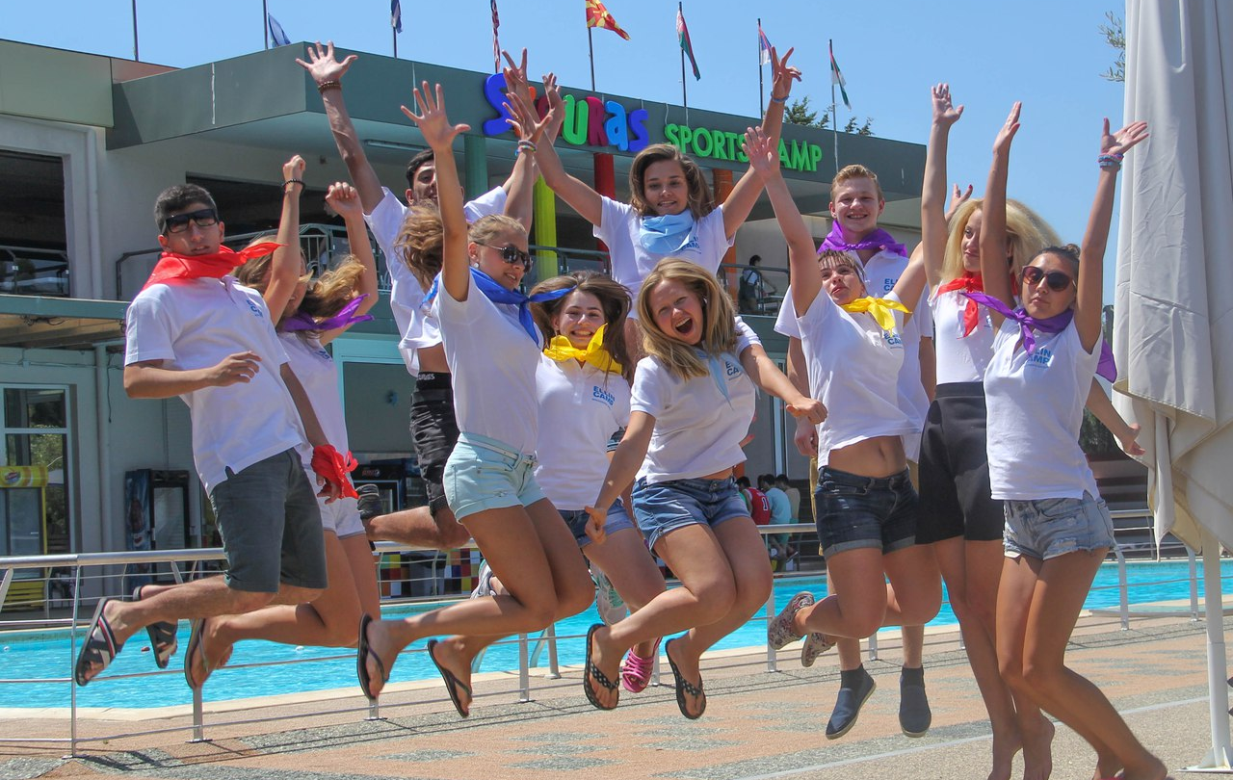
SPORTS CAMP
Play volleyball
Play basketball
Play football
Go swimming

Slide 7
Inviting
Would you like to go to an Art camp?
That would be lovely.
What will you do there?
I will….

Slide 8
Inviting
Would you like to go to a Sport camp?
Yes/ I’d love to// I’m afraid, I can’t.
What will you do there?
I will….

Slide 9
Inviting
Do you fancy going to an Adventure camp?
That sounds great!
What will you do there?
I will….

Slide 10
Inviting
How about going to a Tech camp?
Great idea!
What will you do there?
I will….

Slide 11
You can see exchanges. Read them and translate.
Then put them to the dialogue.
No, I haven’t.
Where are you going?
How?
Of course!
What’s that all about?
What time?
Thanks, but I’m afraid I can’t.
That’s a great idea!

Slide 12
Добавить заголовок слайда 2

Slide 13
Добавить заголовок слайда 2

Slide 14
Use already, just, before, ever, never, yet

Slide 16
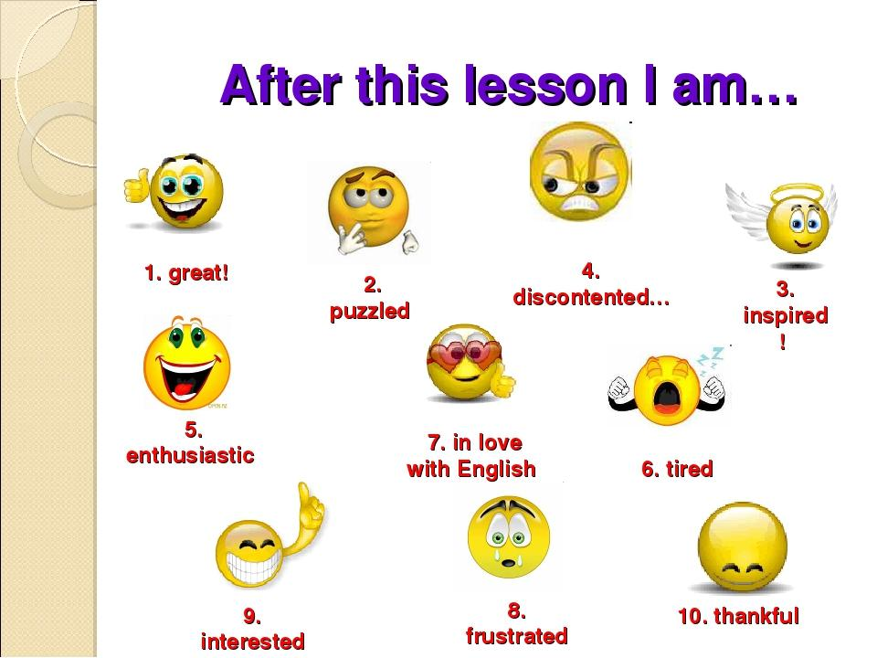


Slide 17



