Slide 1
Our Funny ABC

Slide 2
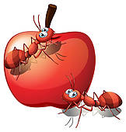
Аа
The ants attacked an apple

Slide 3
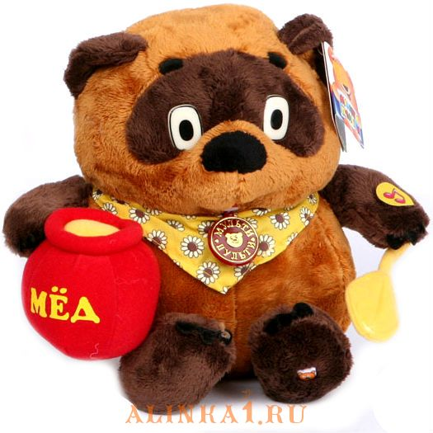
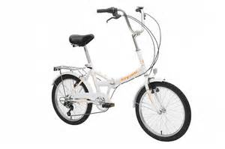
Bb
This bear bought a bike

Slide 4
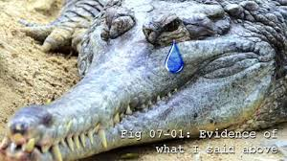
Cc
This crocodile can cry

Slide 5
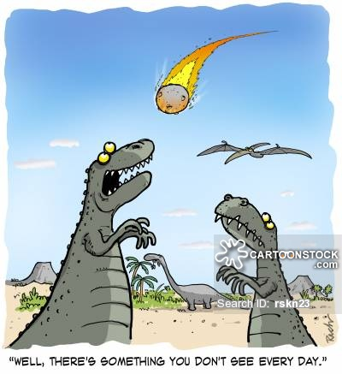
Dd
Dinosaurs dislike dangers

Slide 6
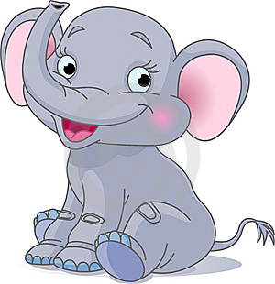
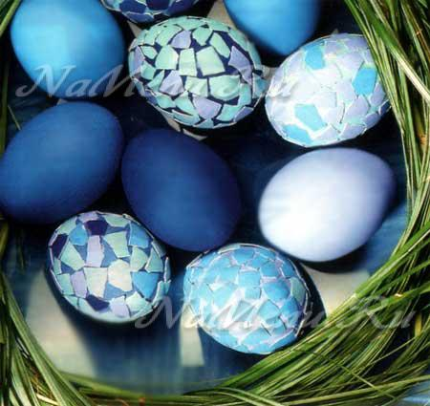
Ее
This elephant eats eight eggs every evening

Slide 7
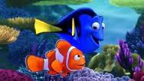
Ff
The fish finds friend

Slide 8
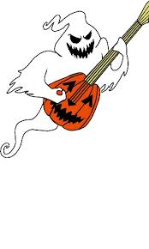
Gg
The ghost grab the guitar

Slide 9
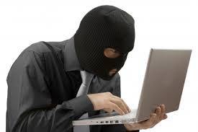
Hh
The hackers are hooligans

Slide 10
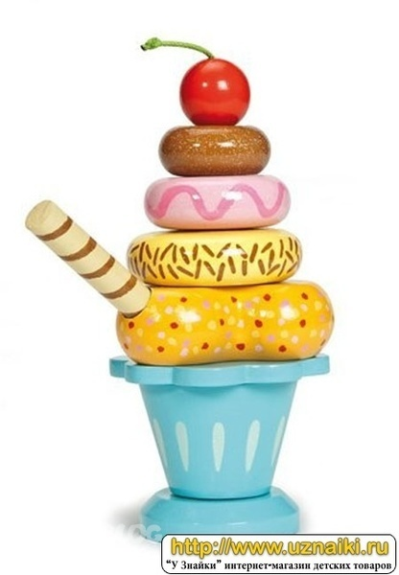
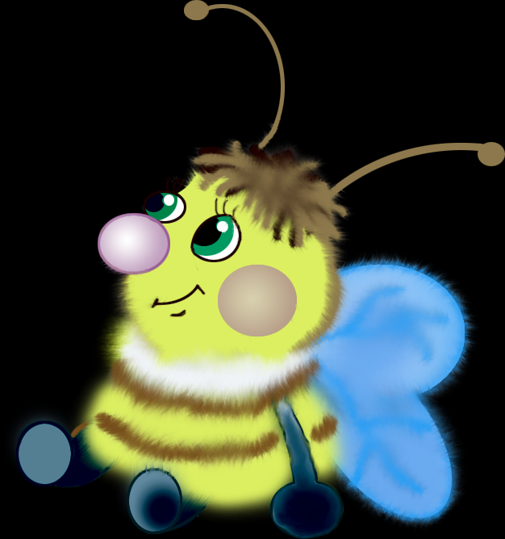

Ii
This insect is ill and it ignores ice cream

Slide 11
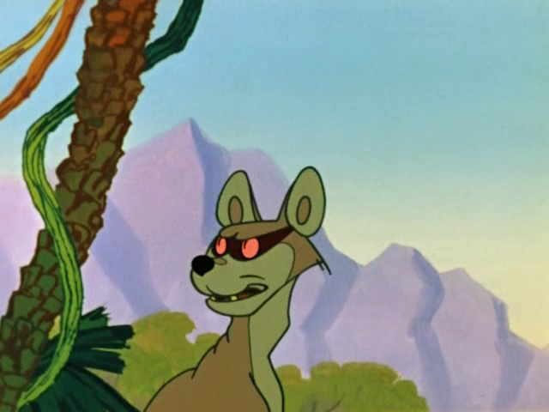
Jj
This jackal jumps in the jungle

Slide 12
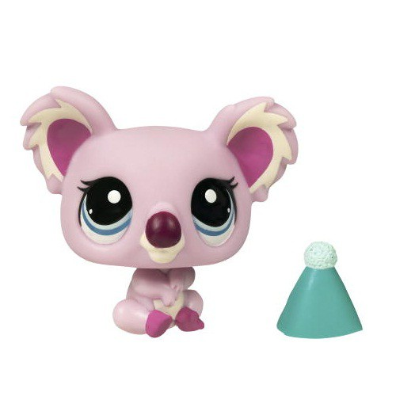
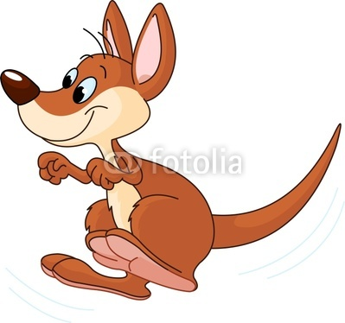

k
This kangaroo kisses koala in the kitchen

Slide 13
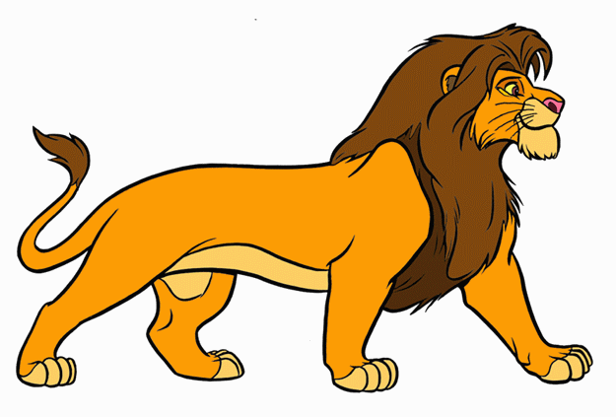

Ll
This lion looks for lunch.

Slide 14

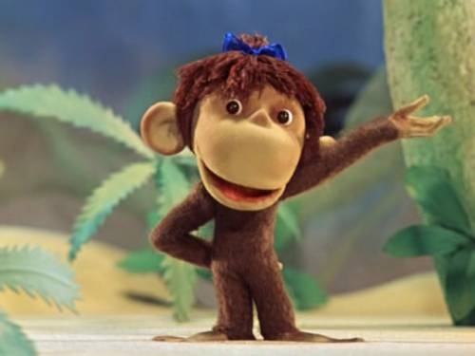
Mm
My merry monkey makes music for money

Slide 15
The moon melts in the morning

Slide 16
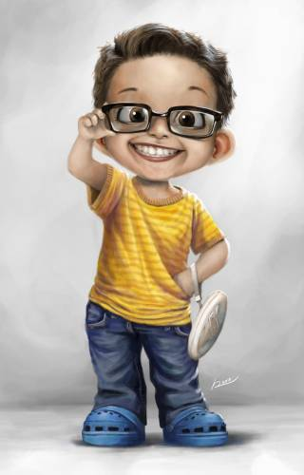
Nn
My noisy neighbour never nods his head.

Slide 17
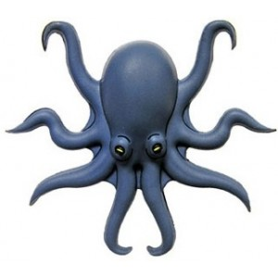
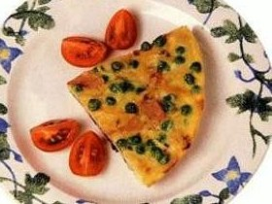
Oo
This octopus orders an omelette with olives.

Slide 18
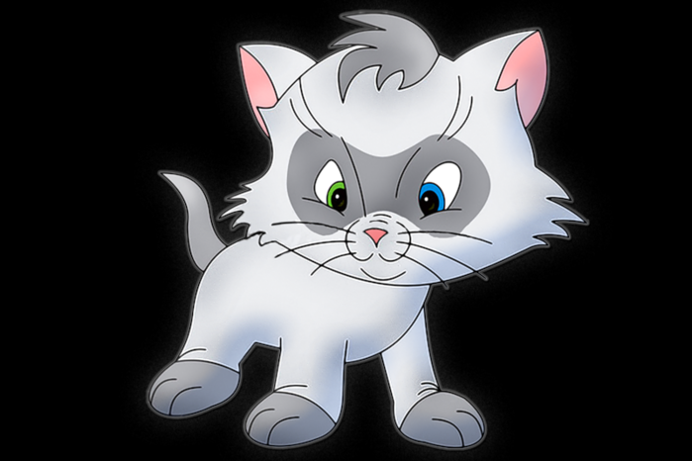
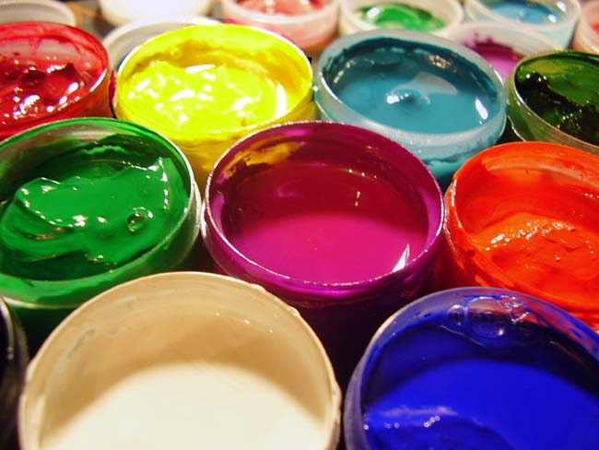
Pp
This pussy cat paints presents to panda.

Slide 19
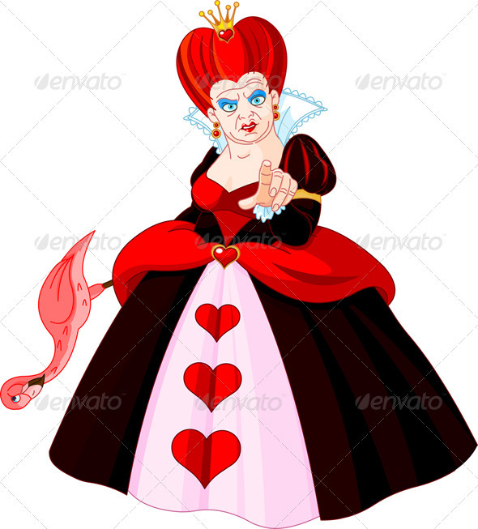
Qq
This queen of hearts quarrels quickly.

Slide 20
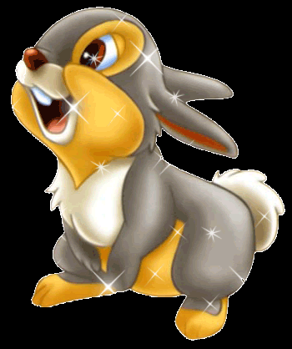
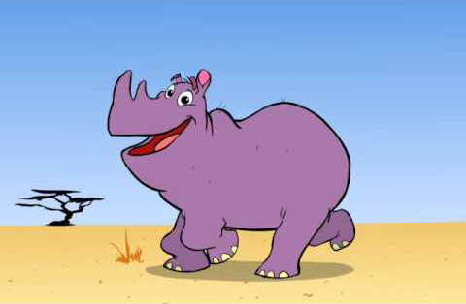
Rr
This rhino ran a race with a rabbit.

Slide 21
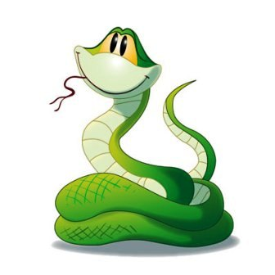
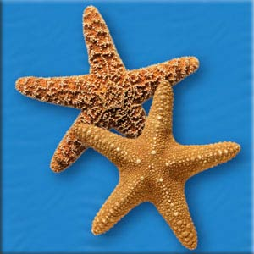
Ss
That snake saw some starfish in the sea.

Slide 22
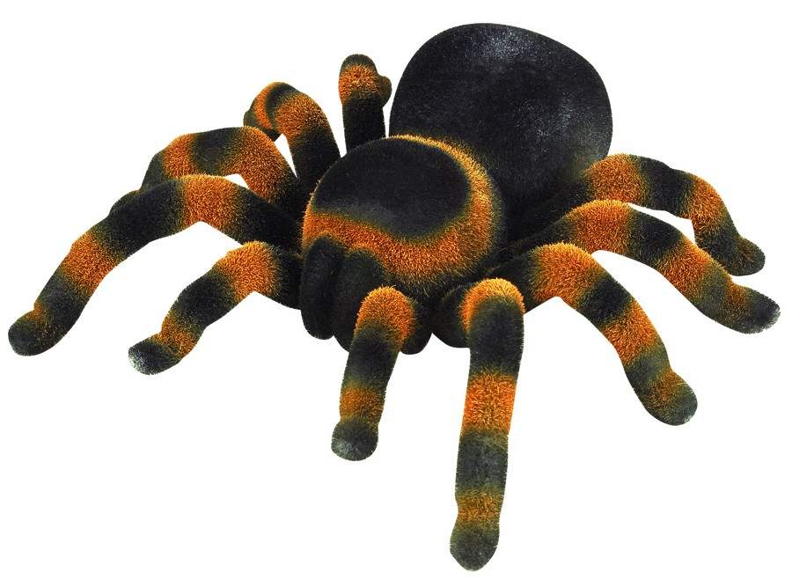
Tt
This tarantula is tired today.

Slide 23
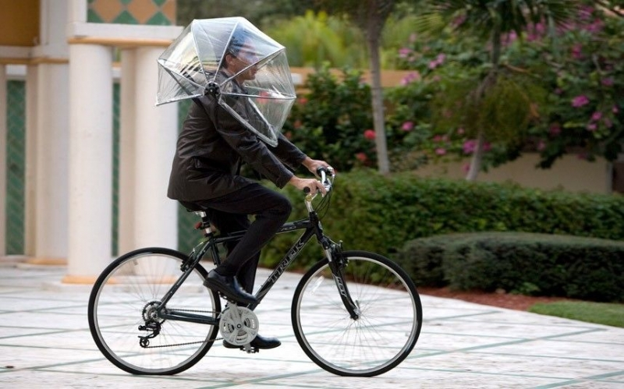
Uu
Uncle’s umbrella was unique

Slide 24
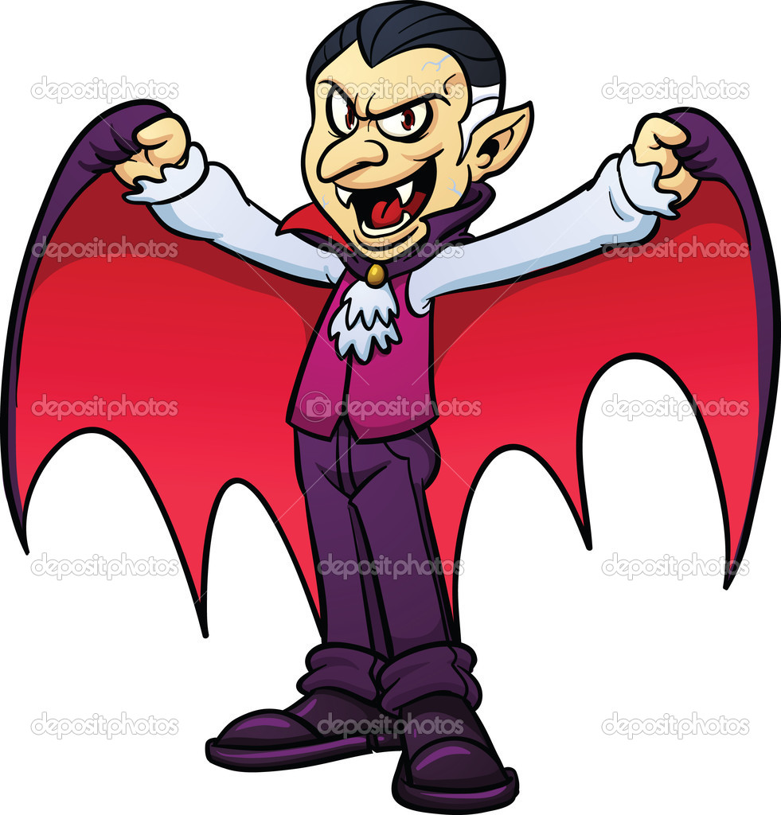
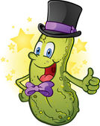
Vv
The Velvet vegetable visited a vampire.

Slide 25
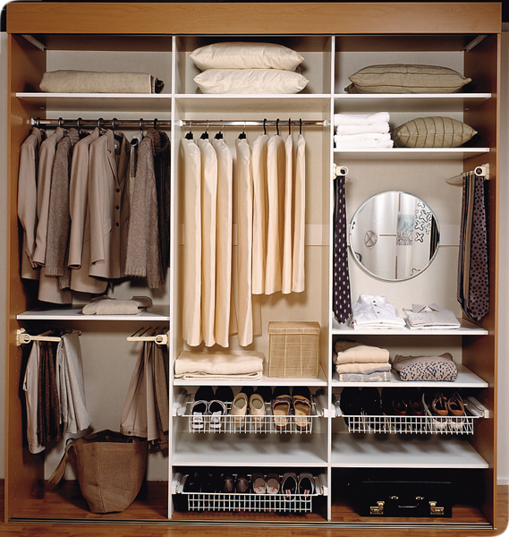
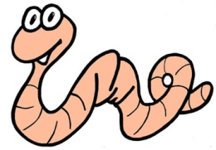
Ww
The wicked worm woke in the wardrobe.

Slide 26
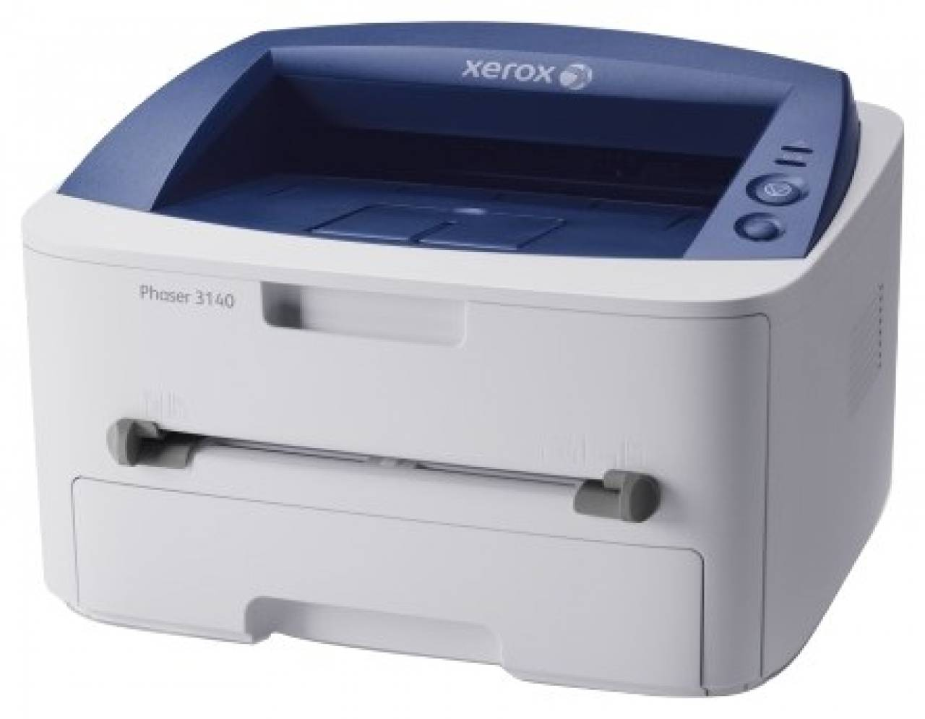
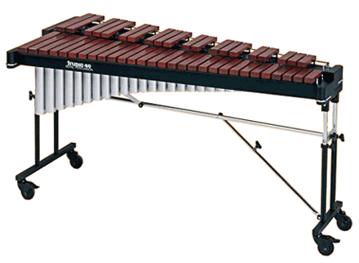
Xx
The xylophone and the xerox are X-mas presents

Slide 27
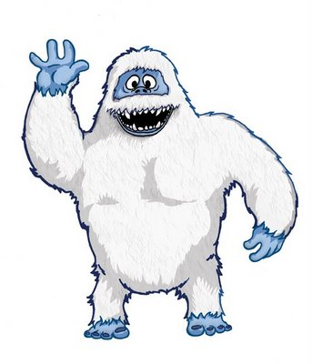
Yy
Young yeti yelled yesterday.

Slide 28
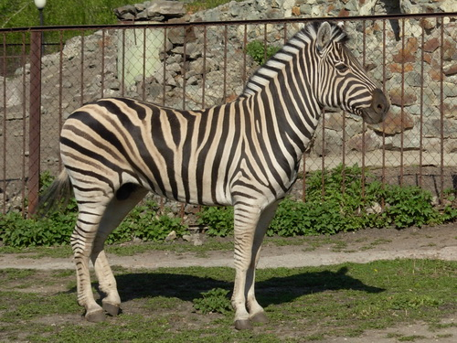
Zz
This zebra is at the zoo.

Slide 29
Sources:
1. http://www.multitran.ru/c/m.exe (online dictionary)
2. Little Golden Picture Dictionary by Diane Muldrow (Author), Bob Stake (Illustrator), June 11, 2002
3. Англо-русский словарь Мюллера
4. 1. Frid Boot, Diane (2001) Project English.
5. Hatchinson, Tom (2000) Project English.
6. Larsen-Freeman, Diane (1986) Techniques and Principles in Language Teaching. Oxford: Oxford University Press.

