Slide 1
Engineering and its directions

Slide 2
What is Engineering?
In general, engineering is a science that deals with design, construction and operation of structures, machines, engines and other devices. The term "engineering" is difficult to translate into Russian, because it has many meanings. Most often it is translated as engineering, technology, mechanical engineering, construction.

Slide 3
Engineer is a person who has received technical education and has a basic knowledge of other engineering fields, because most engineering problems are complex and interrelated.

Slide 4
Civil Engineering
Civil engineering deals with the design of large buildings, roads, bridges, dams, canals, railway lines, airports, tunnels and other constructions. A civil engineer must have a thorough knowledge of the properties and mechanics of construction materials, the mechanics of structures and soils, and of hydraulics and fluid mechanism.

Slide 5
Civil engineering divisions
construction design
transports engineering
hydraulic engineering

Slide 6
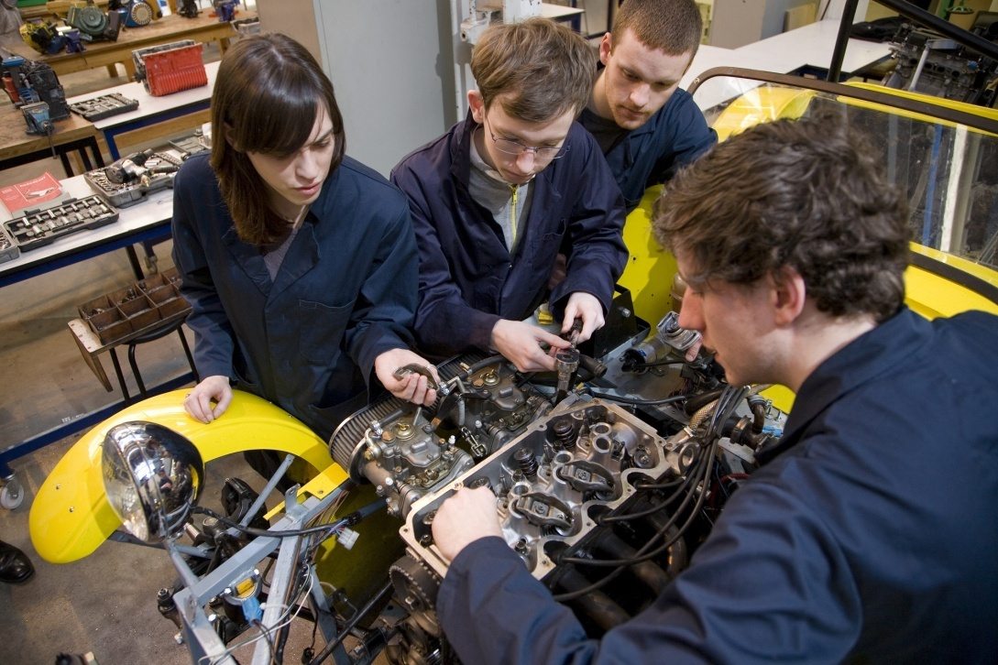
Mechanical Engineering
Engineers in this field design, test, build, and operate machinery of all types. The field is divided into: (1) machine - tools, mechanisms, materials, hydraulics and pneumatics. (2) heat as applied to engines, work and energy, heating, ventilation, and air conditioning. A mechanical engineer must be trained in mechanics and hydraulics, metallurgy and machine design. A mechanical engineer designs not only the machines that make products but the products themselves.

Slide 7
Electrical and Electronics Engineering
This is the widest field of engineering, concerned with systems and devices that use electric power find signals. Among the most important subjects in the field are electric power and machinery, electronic circuits, control systems, computer design, superconductors, solid - state electronics, robotics, lasers, radar, consumer electronics, and fibre optics.

Slide 8
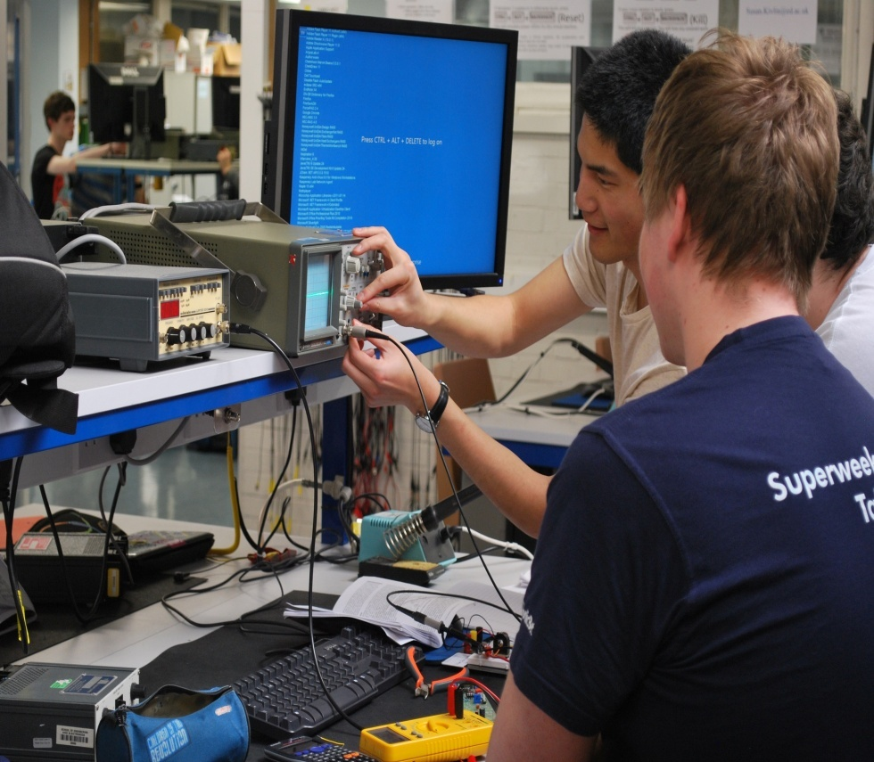
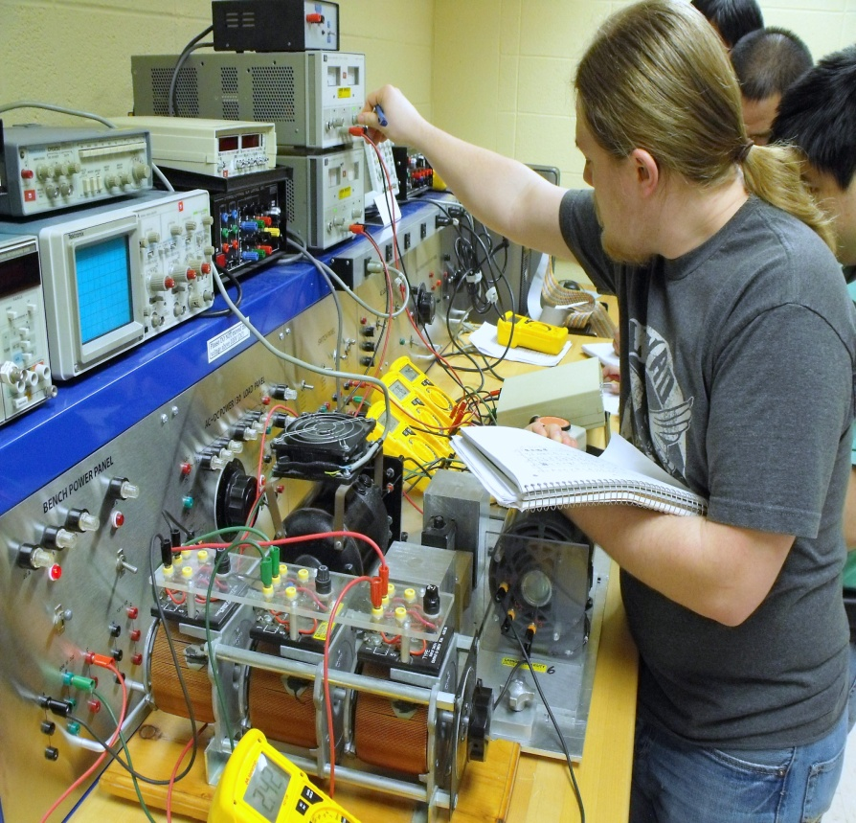
Electrical engineering can be divided into four main areas:
electric power and machinery;
еlectronics;
communications and control, and computers.

Slide 9
Electric Power and Machinery
Engineers working in this field design and operate systems for generating, transmitting, and distributing electric power. Several important developments appeared in this field. One of these is the ability to transmit power at extremely high voltages in both the direct current (DC) and alternating current (AC) modes, reducing power losses. Another is the real - time control of power generation, transmission and distribution, using computers.

Slide 10
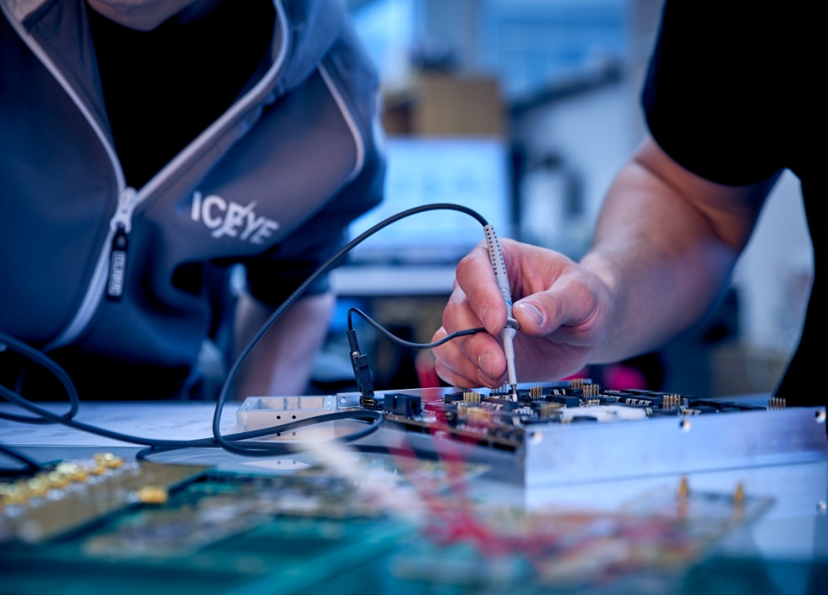
Electronics engineering
Electronic engineering deals with the research, design, integration, and application of circuits and devices used in the transmission and processing of information. The revolution in the trend towards integrating electronic devices on a single tiny chip of silicon or some other semiconductive material.

Slide 11
Much of the research in electronics is directed towards creating even smaller chips, faster switching of components, and three-dimensional integrated circuits.

Slide 12
Communications and Control
Engineers in this field work on control systems and communication systems that are used widely in aircraft and ships, in power transmission and distribution, in automated manufacturing and robotics.

Slide 13
Major developments in this field are the replacement of analogue systems with digital systems and copper cables with fibre optics (optical fibres). Digital systems lower electrical noise. Fibre optics lowers interference, has large carrying capacity, and is extremely light and inexpensive to manufacture

Slide 14
Computers Engineering
Computer engineering is now the most rapidly growing field. Computer engineers design and manufacture memory systems, central processing units and peripheral devices. Major developments in this field are microminiaturization (design of Very Large Scale Integration (VLSI) chips) and new computer architectures. Using VLSI, engineers try to place greater numbers of circuit elements onto smaller chips. Another trend is towards increasing the speed of computer operations through the use of parallel processors and superconducting materials.

Slide 15
Aeronautical and Aerospace Engineering
Aeronautics deals with the whole field of design, manufacture, maintenance, testing, and use of aircraft for both civil and military purposes. It involves the knowledge of aerodynamics, structural design, propulsion engines, navigation, communication, and other related areas.

Slide 16
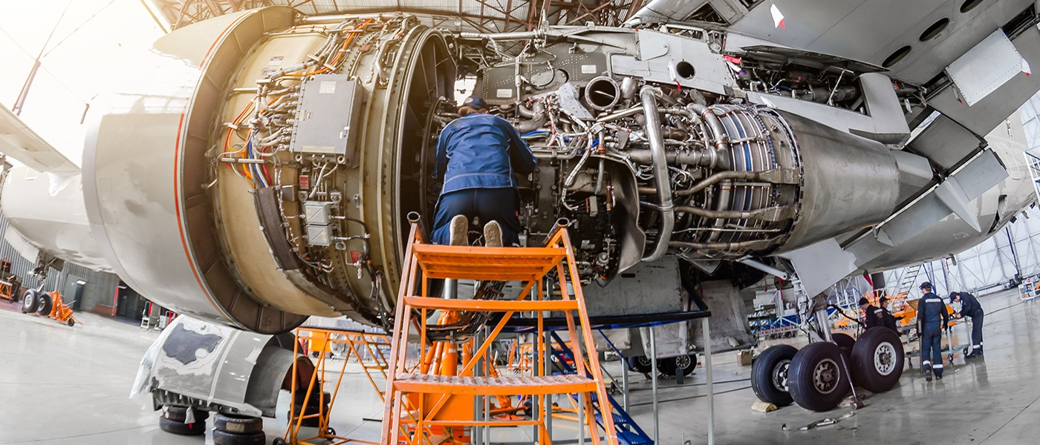
Aerospace engineering associates with aeronautics, but deals with the flight of vehicles in space outside the earth's atmosphere.
It includes the study and control of rocket engines, artificial and space vehicles for space exploration.

Slide 17
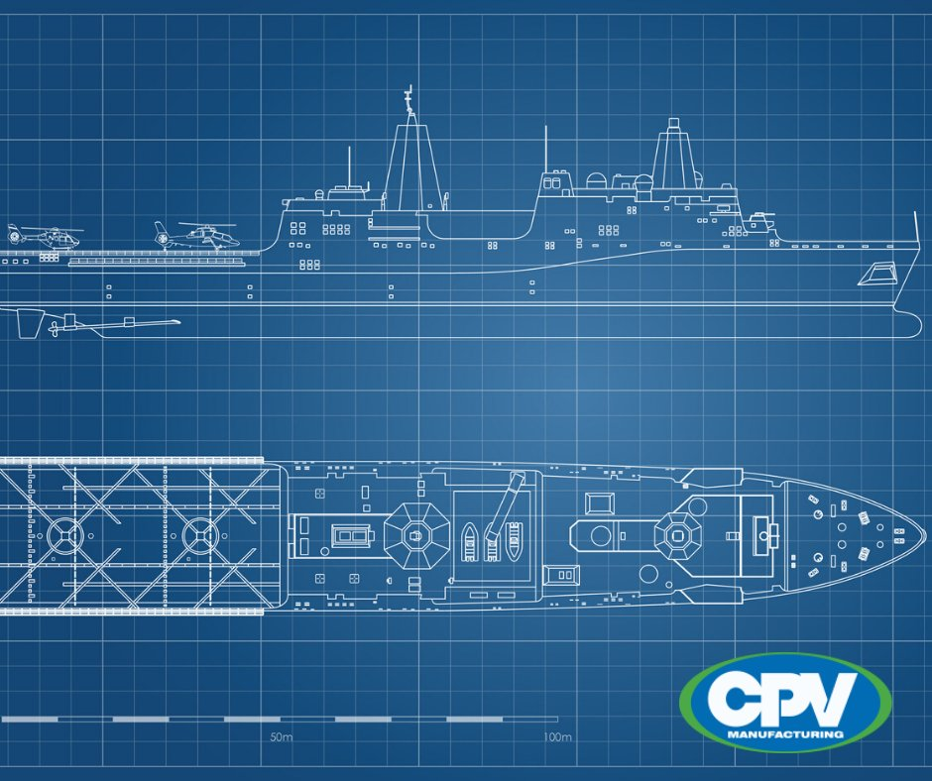
Naval Engineering
Naval architects are engineers who design and supervise construction of ships. Ships must be designed and built so that they are safe, stable, strong, and fast enough to perform the type of work intended for them. A naval architect must be familiar with the variety of techniques of modern shipbuilding.

Slide 18
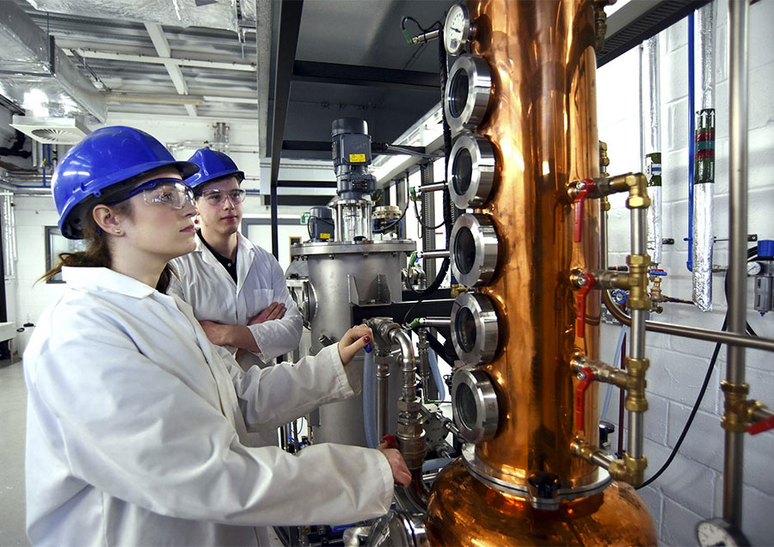
Chemical Engineering
This branch of engineering is concerned with the design, construction, and management of factories in which the essential processes consist of chemical reactions. The task of the chemical engineer is to select and specify the design that will best meet the particular requirements of production and the most appropriate equipment for the new applications.

Slide 19
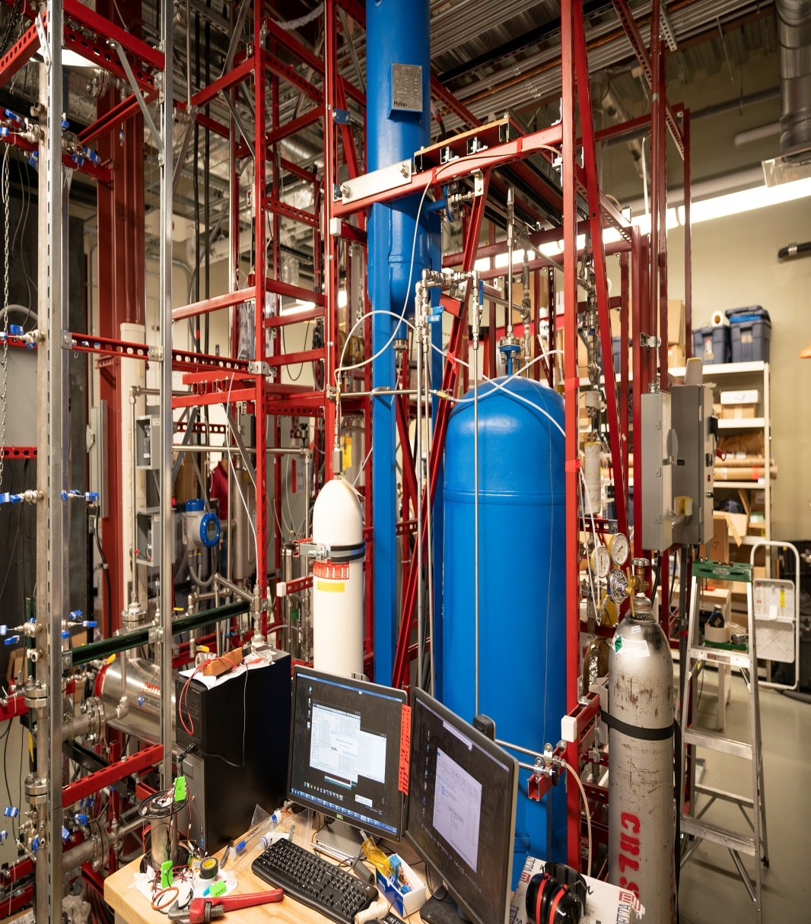
Nuclear Engineering
This branch of engineering is concerned with the design and construction of nuclear reactors. In addition to designing nuclear reactors that yield specified amounts of power, nuclear engineers develop the special materials necessary to withstand the high temperatures and radioactivity. Nuclear engineers also develop methods to shield people from the harmful radiation produced by nuclear reactors.

Slide 20
Safety Engineering
This field of engineering has as its object the prevention of accidents. Safety engineers develop methods and procedures to safeguard workers of hazardous occupations. They also assist in designing machinery, factories, ships, and roads, suggesting alterations and improvements to reduce accidents.

Slide 21
Questions:
1. Is engineering a science?
2.How can we translate the word “engineering”? What are the Russian equivalents for this term?
3. What do civil engineering deal with?
4. What are the main subdivisions in the field of civil engineering?
5. What do mechanical engineering deal with?

Slide 22
Questions:
6. What knowledge is necessary for a mechanical engineering?
7. What are the four main branches for a electrical engineering?
8. What are the major developments in the field of communications systems?
9. What are the major developments in the field of computer engineering?
10. What is aerospace engineering concerned with?

Slide 23
Questions:
11. What do naval architects design?
12. What is marine engineering devoted to?
13. What is the task of chemical engineers?
14. What is nuclear engineering concerned with?

