Slide 1
English in our life

Slide 2
The limits of my language mean the limits of my world.
Ludwig Wittgenstein

Slide 3
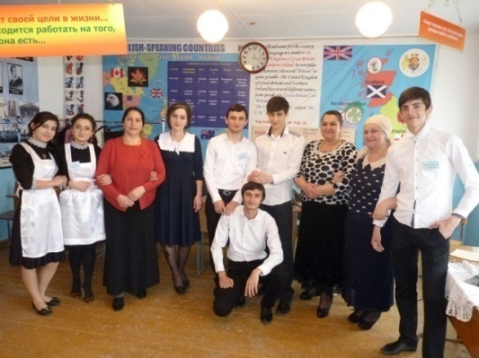
Цель проекта:
Показать значимость изучения языка и его влияние на жизнь человека.
Проблемные вопросы: Необходимо ли изучать иностранные языки? Изучение иностранного языка влияет на вашу жизнь?
Развитие речемыслительных навыков обучающихся ( умение принимать взвешенные решения, высказывать и аргументировать свою точку зрения, работать с информацией, анализировать различные мнения по спорным вопросам).

Slide 4
Задачи :
Изучить влияние владения английским языком на жизнь современного человека;
Показать преимущества человека, знающего английский язык;
Показать, какое место в жизни занимает английский язык.

Slide 5
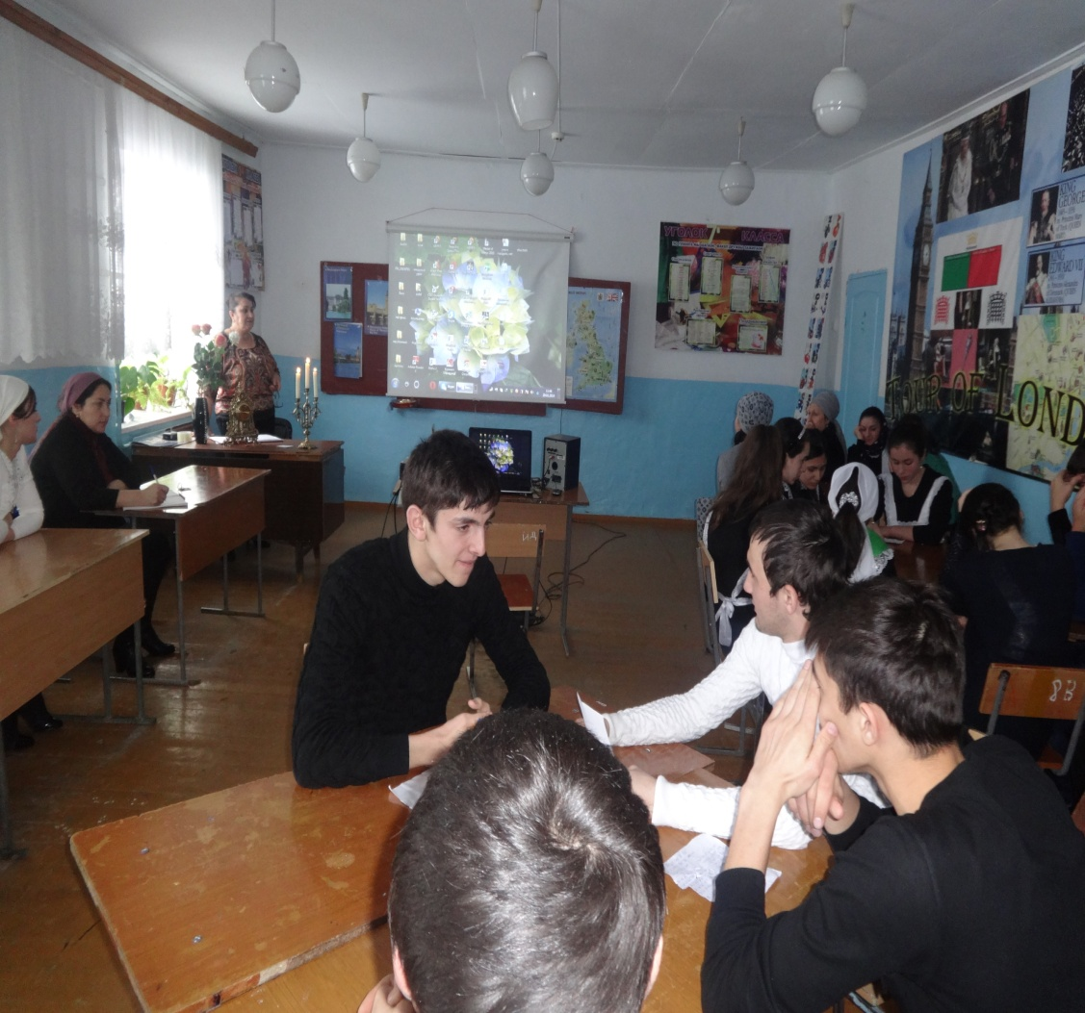
РОЛЬ АНГЛИЙСКОГО ЯЗЫКА В ЖИЗНИ СОВРЕМЕННЫХ
ШКОЛЬНИКОВ .
It is not a secret that now English is an indispensable and integral part of the life of any educated person.
And even playing in ordinary computer games, English, it is desirable to know, well, or at least its basics.
It is undeniable that English is necessary for managers, programmers, and students alike.
This language is so tightly embedded in our everyday life that sometimes we just do not notice it.

Slide 6
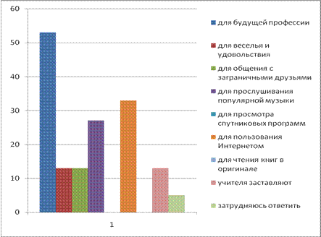

Slide 7
If you look around you can see that there are many signs, many names of different firms and enterprises in English.
Therefore, if you suddenly get lost in a foreign country, you can easily ask for help from foreigners in English.
There is no doubt that knowing the English language, you will not perish, in whatever country of the world you are.
Practically in any country, English is one of the main.
This language has become
international.
In addition, many warnings and inscriptions are duplicated on it.

Slide 8
I want to learn English because……
Significance for today.
Opens new perspectives.
Access to new information.
New business opportunities.
The hardness is more comfortable traveling.
Opportunity to make friends all over the world.

Slide 9
What does a Global Language mean? It means a common language for the world. Having such a status, the global language has to be of great importance, influencing all the domains of the human activity in the world. For example, English dominates every field such as the media, foreign language teaching, business, etc. English can be called an international language because of its simple and wide use already.

Slide 10
English is one of the most popular
languages of the word and in almost all
countries it is being studied.

Slide 11
English is the most important international language, which is a consequence of the colonial policy of the British Empire in the XIX century and world influence of the USA in the XX-XXI centuries.

Slide 13
To date, do not know the English language, then be not shod.

Slide 14
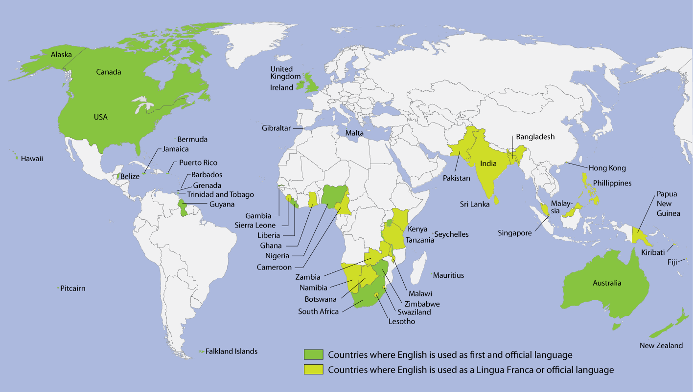
Countries where Englishis an
official language

Slide 15
Tips to help you to
Speak a little English every day.
Work on your pronunciation.
Expand your vocabulary and use idiomatic phrases.
Attend an English class or discussion group.
Carry a dictionary.
Listen to English radio or podcasts
Watch English movies and TV shows
Read an English book, newspaper or magazine.
Keep a diary in English
Find an English-speaking pen-pal.
Stay motivated.
English
Practice every day.

Slide 16
Daily English

