Slide 1
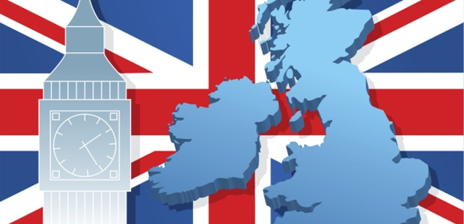
what ?
When ?
Where ?
Great Britain
Quiz

Slide 2



1
2
3
4
5
traditions
history
6
7
8
9
10
sights
poems
11
12
13
14
15
riddles
16
17
18
19
20
london
21
22
23
24
25
Geography

Slide 3
Rebus 1
,
,
,
,
a
giraffe

Slide 4
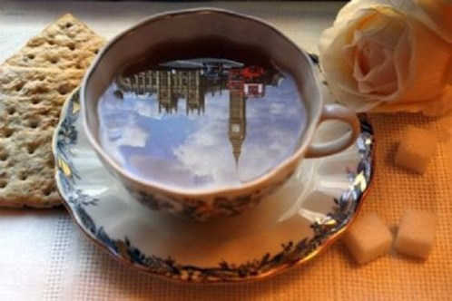
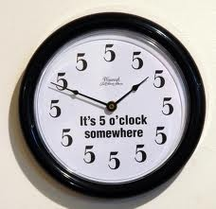

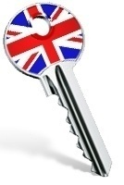
Traditions 2
What do some British people do at 5 o’clock?
Drink tea

Slide 5
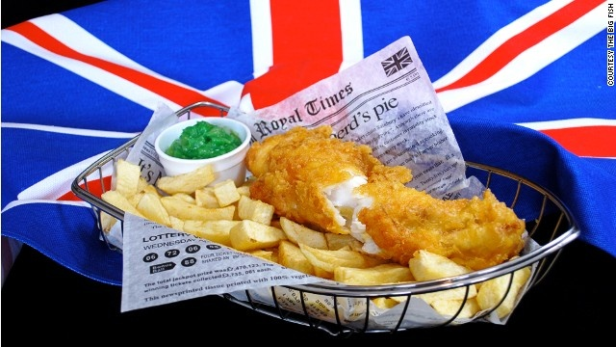
Traditions 3
What is British popular fast food?
Fish & chips

Slide 6
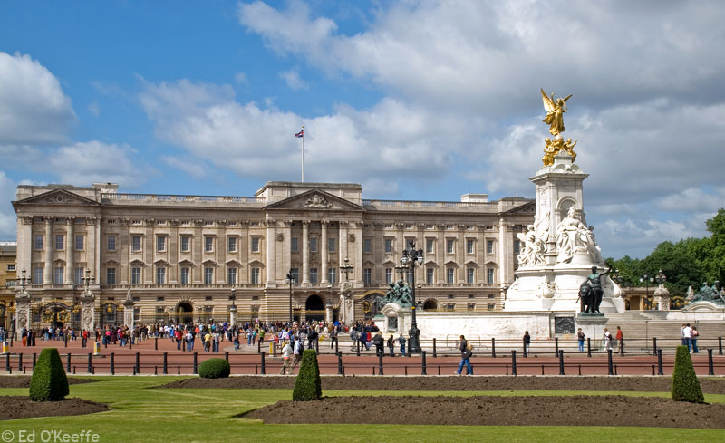
London 4
A home of the Royal Family is
Westminster Abbey
Buckingham Palace
The Tower of London
The White Tower
Buckingham Palace

Slide 7
Rebus 5
,
golf
G

Slide 8
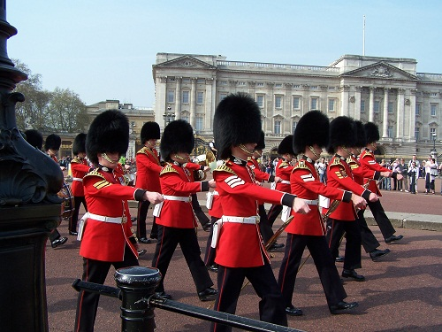
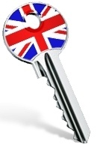
Traditions 6
The Changing of the Guard happens every day at…
12.30 a.m.
12 o’clock
11.30 a.m.
10 o’clock
11.30 a.m.

Slide 9

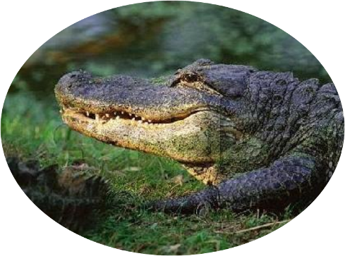
riddle 7
It is long and green. It lives in rivers and eats fish and birds. It has four legs and a long tail. This animal has a lot of teeth. What is it?
crocodile

Slide 10
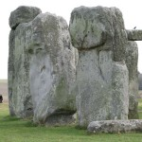
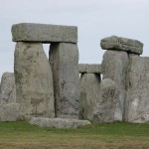
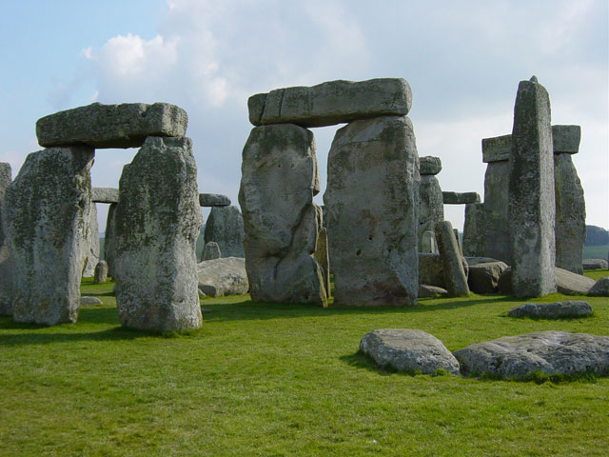

Sights 8
What is it?
Stonehenge

Slide 11
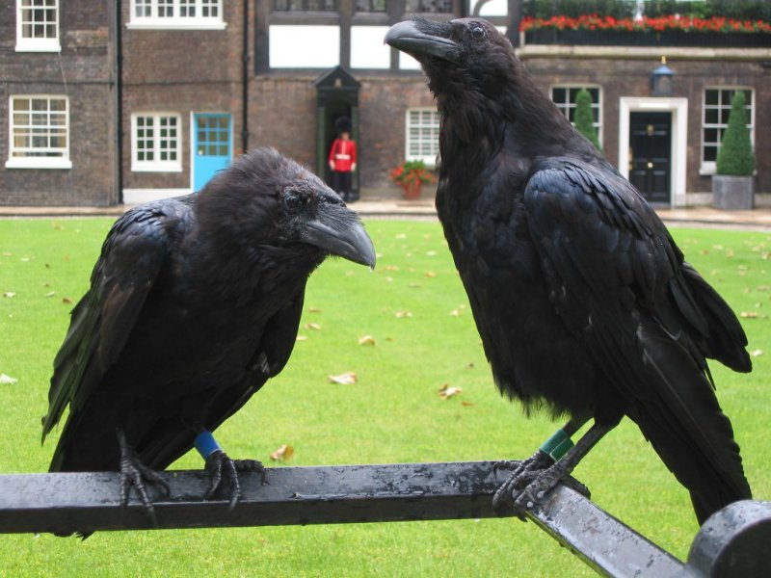
Traditions 9
The legend says that without them the Tower of London will fall.
The pigeons
The cats
The squirrels
The ravens
The ravens

Slide 12
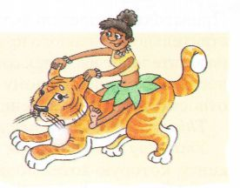
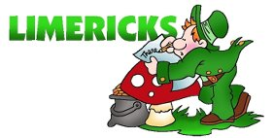
Limerics 10
What is a limerick?
An English holiday
A short funny poem
A town in England
A name of the animal
Edward Lear was a famous English poet. He made limericks popular in the 19th century. In fact Limerick got its name from the town Limerick in Ireland.
A short funny poem

Slide 13
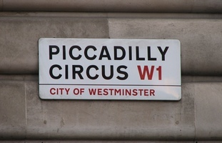
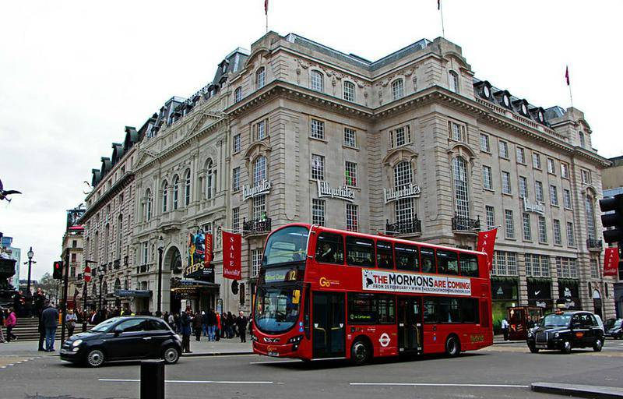
London 11
What is Picadilly Circus?
A circus
A square
A street
A house
A square

Slide 14
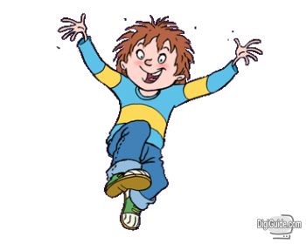
Let’s have a rest12

Slide 15
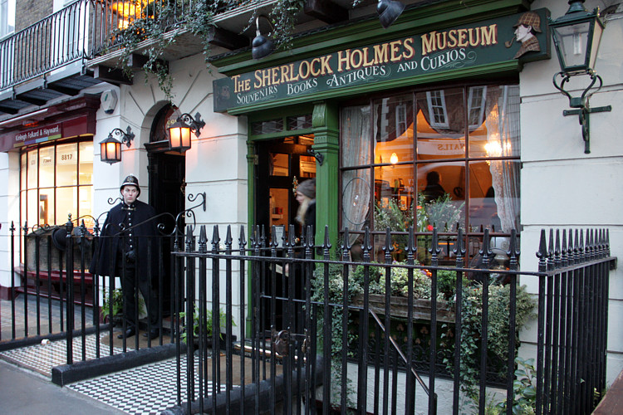
London 13
221b, Baker Street, London. Why is it a famous place ?
Sherlock Holmes museum

Slide 16
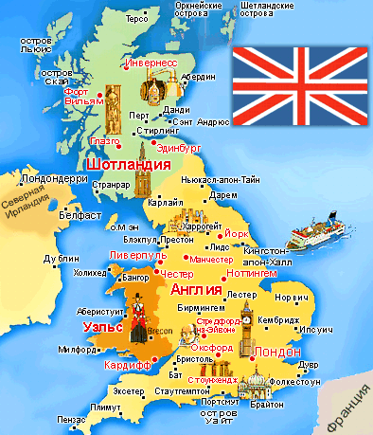
Geography 14
Great Britain is divided into …
Three parts
Five parts
Four parts
Two parts
Four parts

Slide 17
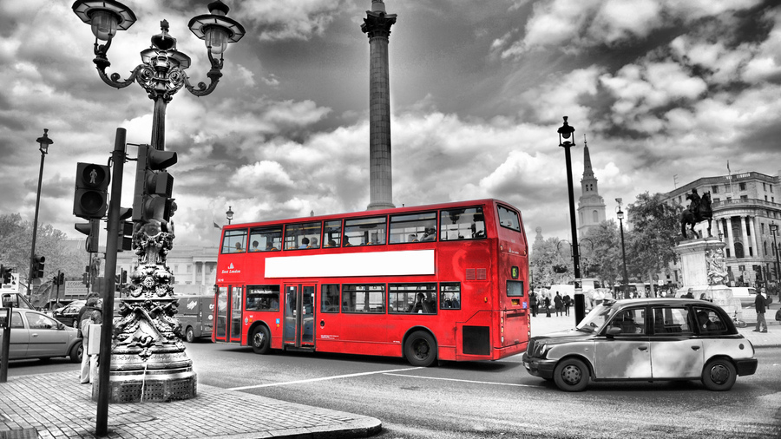
Traditions 15
London is more than …
One thousand years old
Two thousand years old
Three thousand years old
Four thousand years old
Two thousand years old

Slide 18
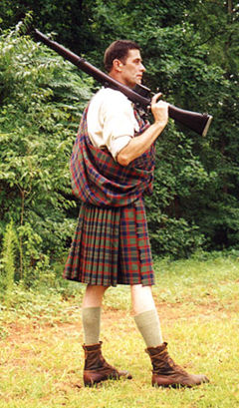
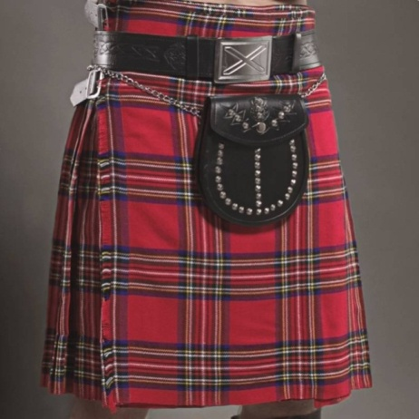
Traditions 16
In what country do men wear scirts?
France
England
Scotland
Norway
a) France
b) Ennd
d) Norway
scotland

Slide 19
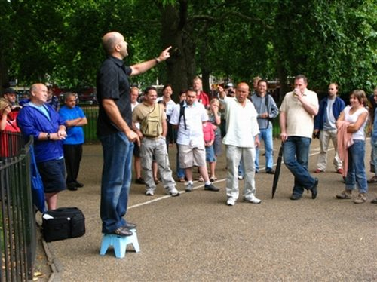
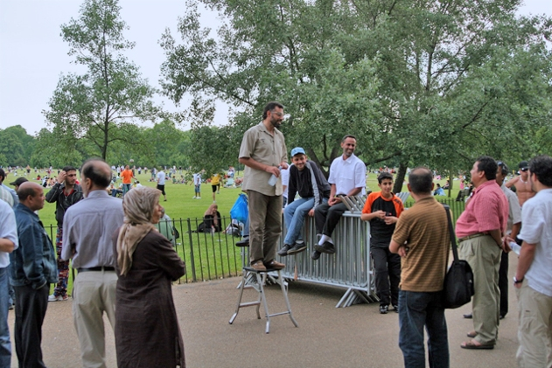
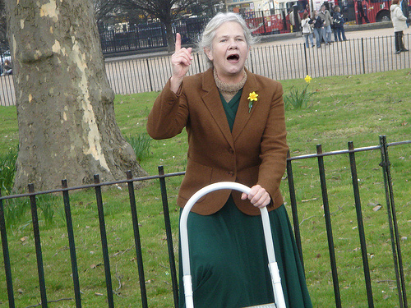

London 17
Where can you say everything you want?
in Regent’s park
in Hyde Park
in St. James’ Park
in Central Park
In Hyde Park

Slide 20
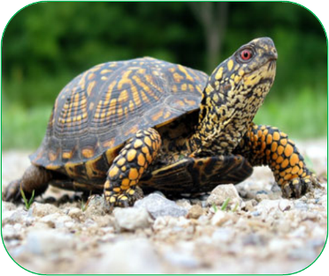
Riddle 18
I have four legs and a tail. I have no teeth. I can swim and dive. I carry my house around with me.
I am a …
tortoise

Slide 21

Traditions19
What is Union Jack?
the national flag of the UK
the name of the book by Mark Twain
the name of the museum
the dog’s name
the national flag of the UK

Slide 22
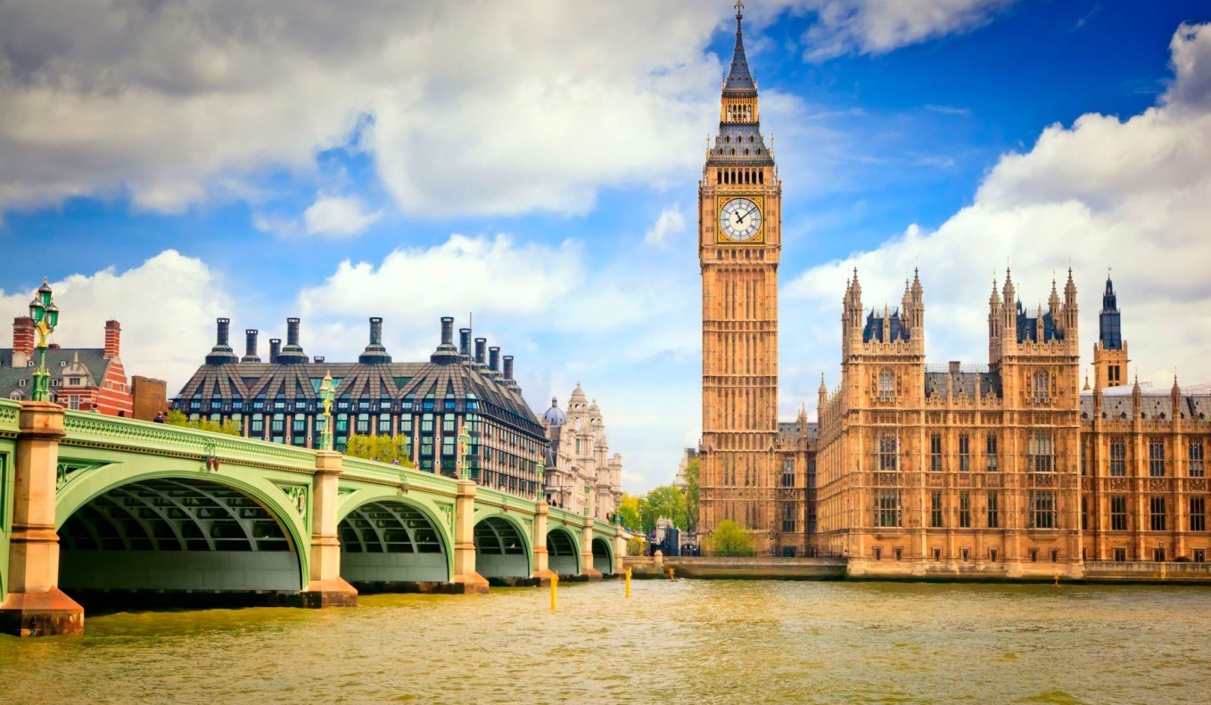
traditions 20
Where is Big Ben situated?
in the Tower of London
in Westminster Abbey
in the Houses of Parliament
in Buckingham Palace
in the Houses of Parliament

Slide 23
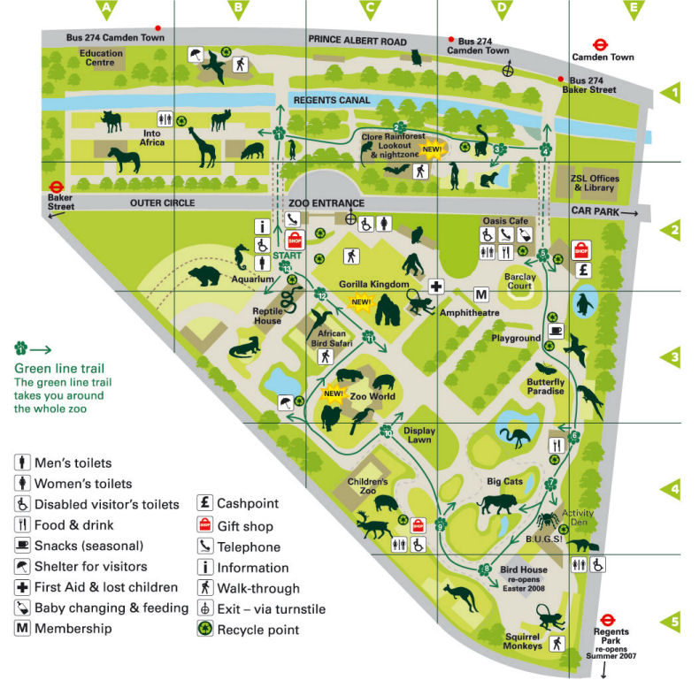
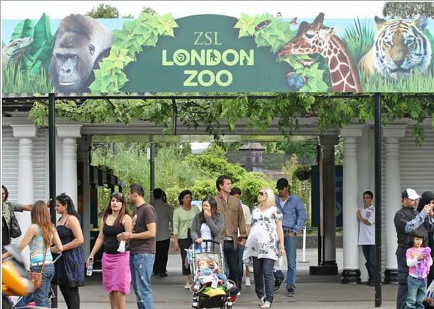
sights 21
Where is the London Zoo situated?
Regent’s park
Hyde Park
St. James’ Park
Central Park
in Regent’s Park

Slide 24
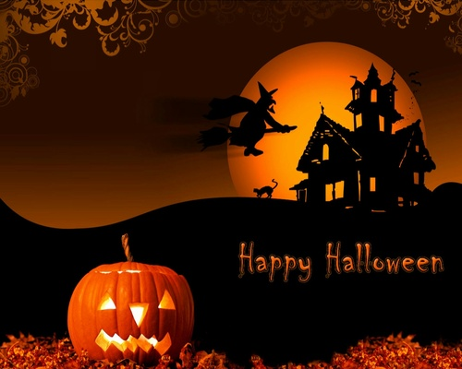
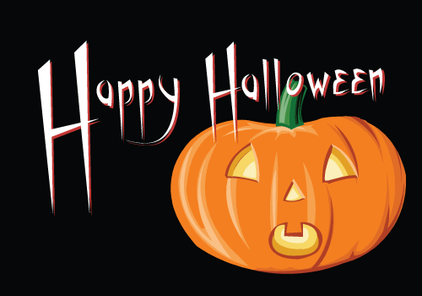
Holidays 22
When do children go “trick or treat”?
  October 31^{st (Halloween)}

Slide 25
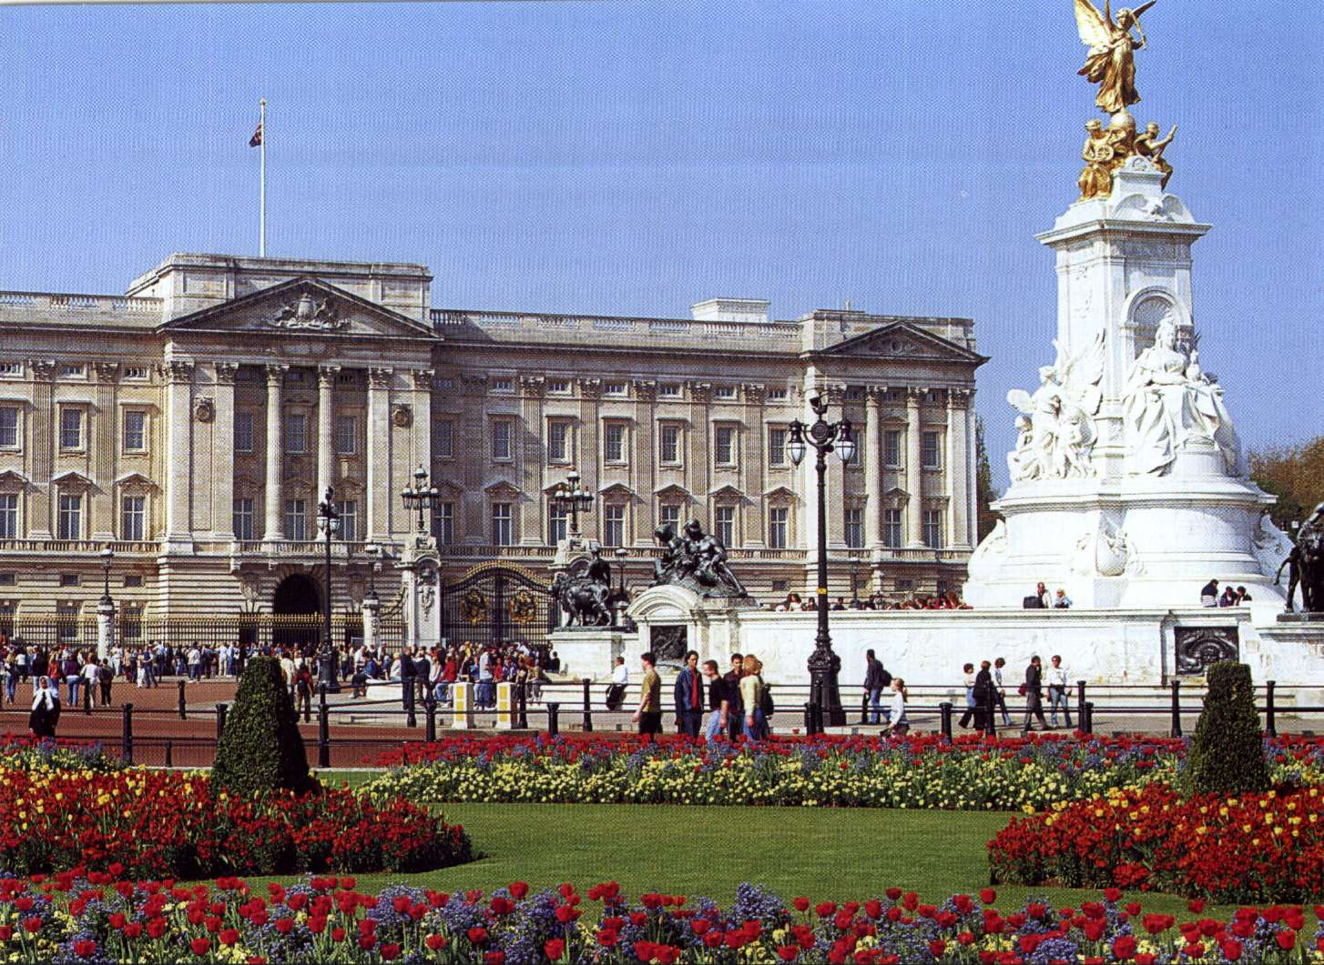
traditions 23
When can you see the flag over the Queen’s Palace?
When she is out
When she is abroad
When she has a party
When she is at home
When she is at home

Slide 26
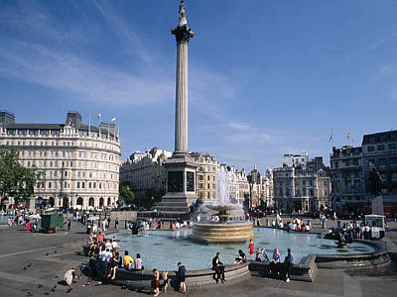
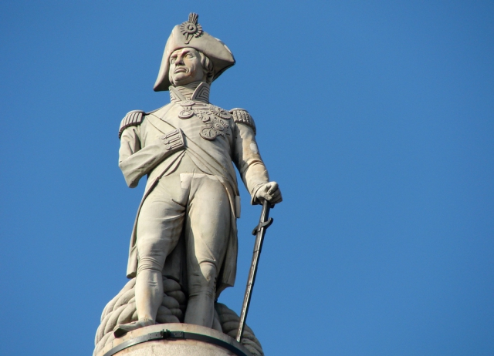
London 24
What can you see in Trafalgar square?
Nelson statue
King memorial
Queen memorial
Michael Gorbachev memorial
Nelson statue

Slide 27
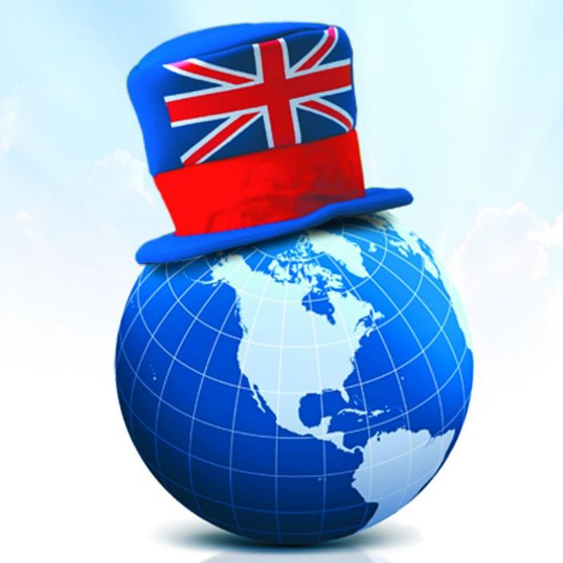
Tradition 25
What is the official language
in Great Britain?
French
Russian
English
Chinese
English

Slide 28


We have learned about …
I have already known about…
It was interesting for me to learn about…
The information about …. was new for me.

