Slide 1
Внеклассное мероприятие по английскому языку
Выполнила
учитель английского языка
МБОУ г.Мурманска СОШ № 53
Шарова Анастасия Андреевна

Slide 2
Правила
Участвуют 2 команды.
Команда выбирает категорию и количество очков. В случае неправильного ответа команда-соперник получает возможность ответить.
«Кот в мешке»( the riddle)- переход хода.
Выигрывает команда, набравшая наибольшее количество очков.

Slide 3
Country | 10 | 20 | 30 | 40 | 50
Grammar | 10 | 20 | 30 | 40 | 50
Famous people | 10 | 20 | 30 | 40 | 50
Culture | 10 | 20 | 30 | 40 | 50 0

Slide 4
Country 10
What is the capital of Great Britain?

Slide 5
Country 20
What is the capital of Scotland?

Slide 6
Country 30
What kind of state is Great Britain?
Parliamentary monarchy

Slide 7
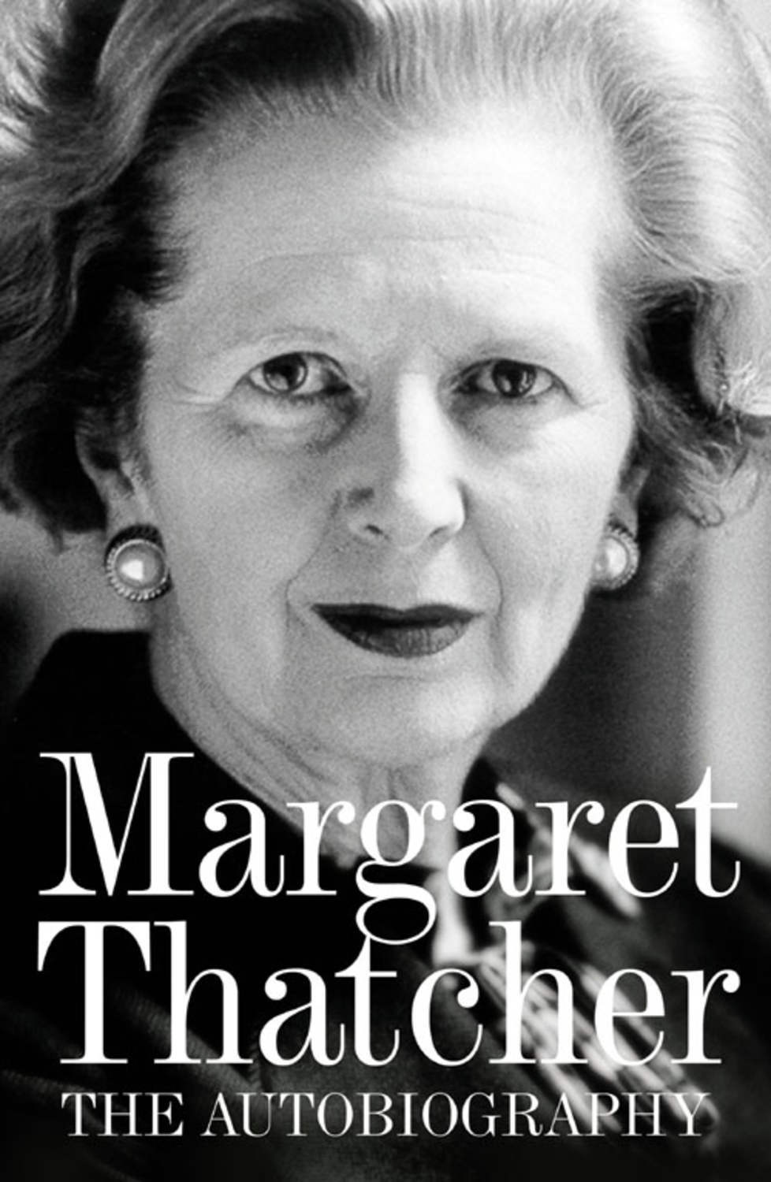
Country 40
Who was called “An Iron Lady”?
Margaret Thatcher

Slide 8
Country 50
What is the national emblem of Ireland?
Shamrock

Slide 9
Grammar 10
Name three forms of the verb “to be”.

Slide 10
The riddle
If you lose it once, you can never find it again.
Time

Slide 11
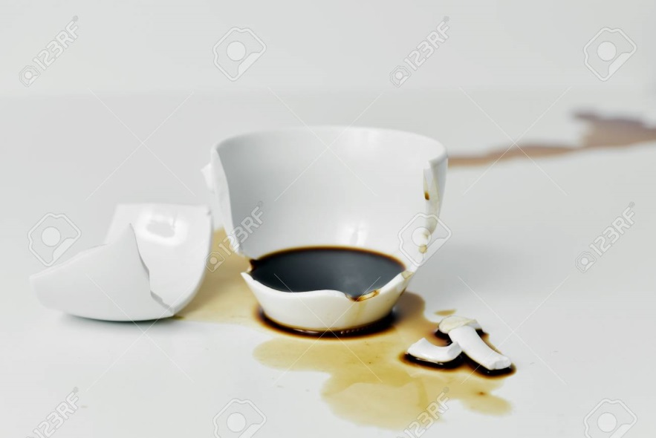
Grammar 30
Transform the sentence from active to passive voice.“ I broke a cup of coffee.”
A cup of coffee had been broken.

Slide 12
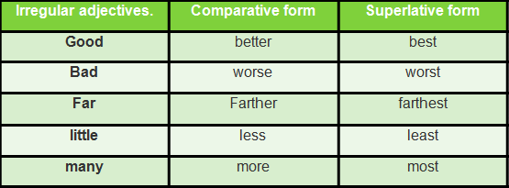
Grammar 40
Name four exceptions of Comparatives.

Slide 13
Grammar 50
Name 12 English tences.
Present Simple | Past Simple | Future Simple
Present Perfect | Past Perfect | Future Perfect
Present Continuous | Past Continuous | Future Continuous
Present Perfect Continuous | Past Perfect Continuous | Future Perfect Continuous

Slide 14
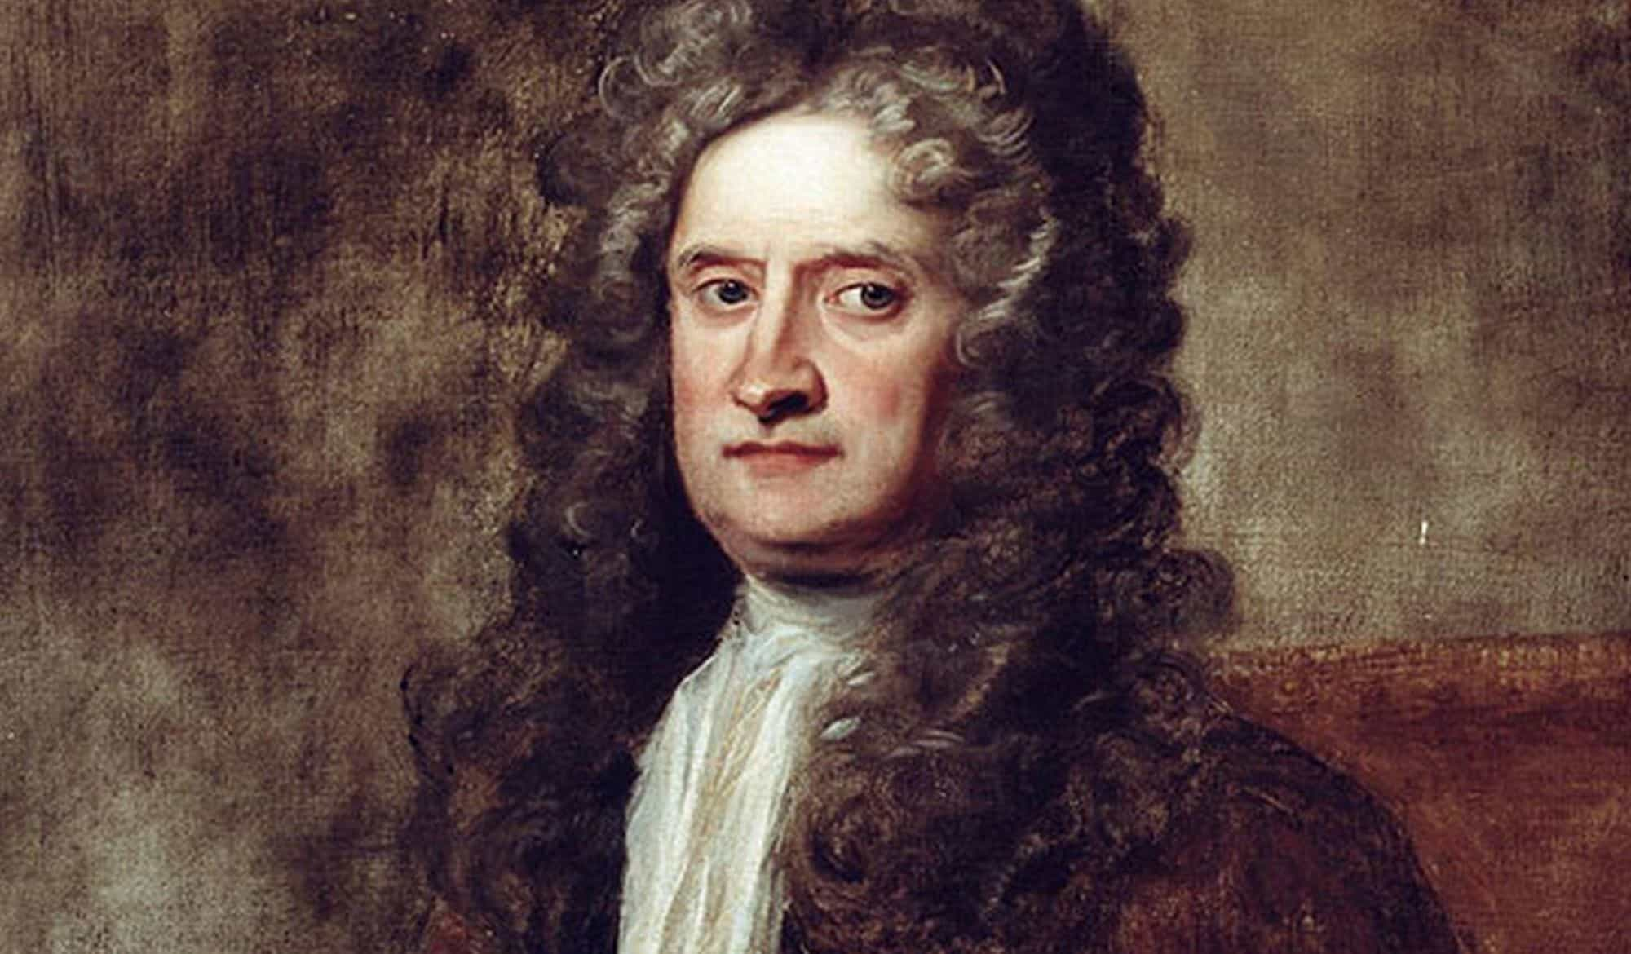
Famous people 10
He discovered the law of gravity when an apple fell on his head.
Isaac
Newton

Slide 15
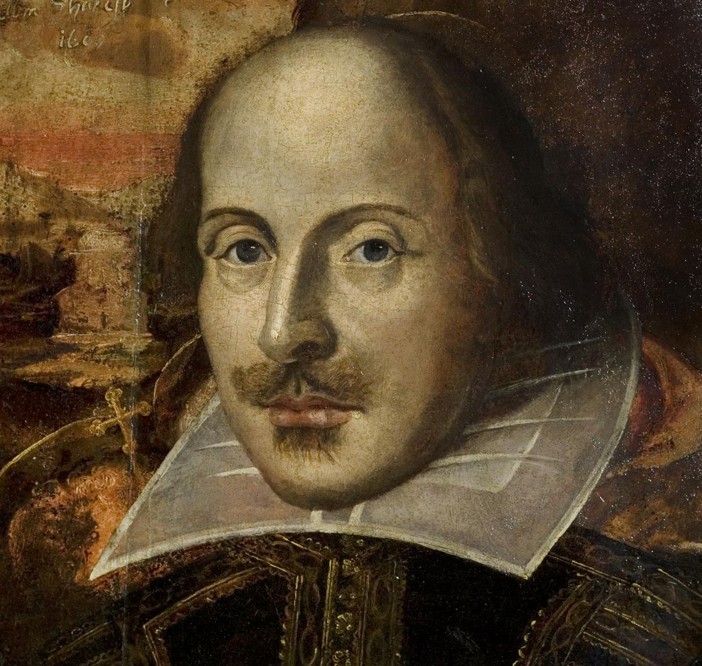
Famous people 20
The most famous playwright in the world.
William
Shakespeare

Slide 16
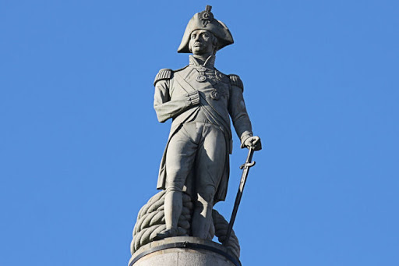
Famous people 30
The monument of this man stands in Trafalgar Square.
Admiral
Horatio
Nelson

Slide 17
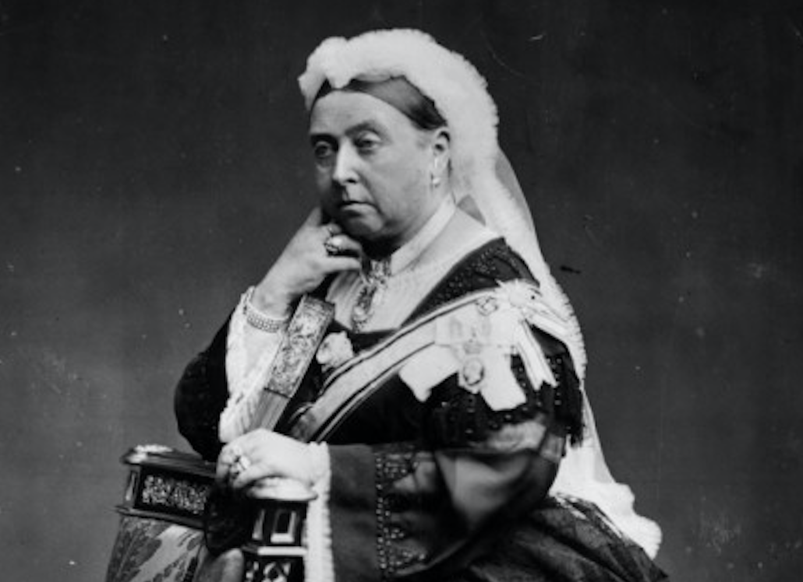
Famous people 40
This queen ruled for the longest period in British history.
Queen
Victoria

Slide 18
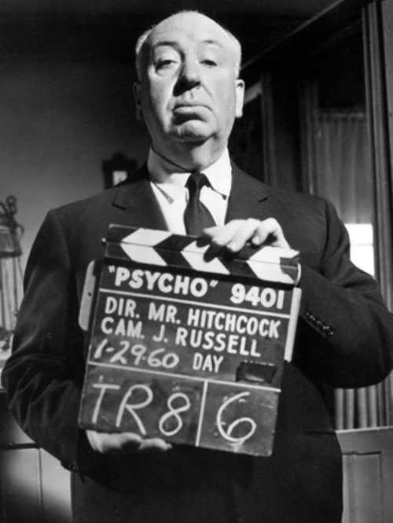
Famous people 50
A film director who is famous for his horror films.
Alfred
Hitchcock

Slide 19
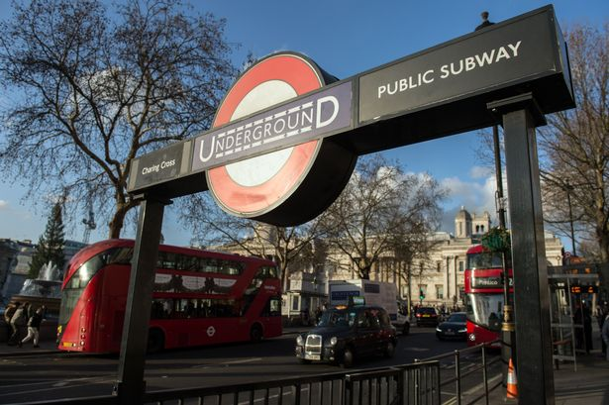
Culture 10
How do londoners call the underground?
The tube

Slide 20
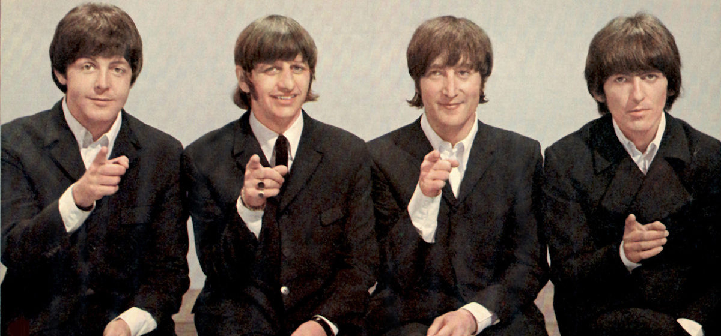
Culture 20
What is the most famous band in Great Britain?
The Beatles

Slide 21
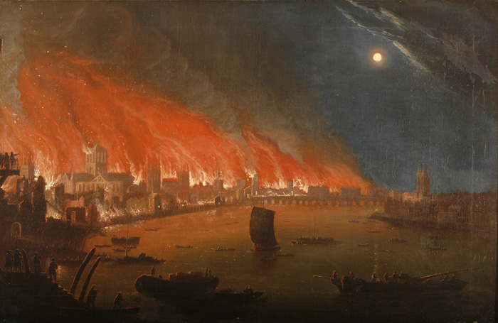
Culture 30
When was the Great Fire in London?
1666

Slide 22
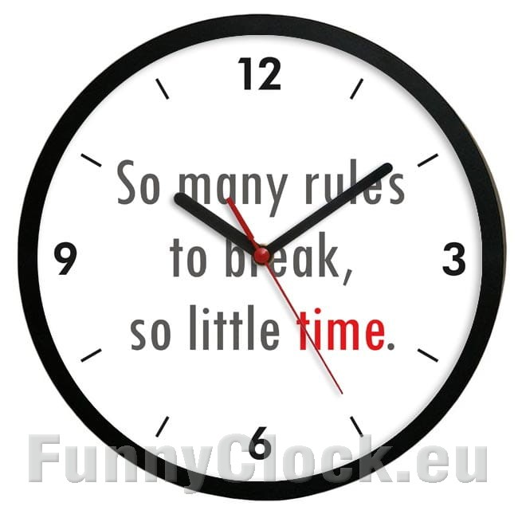
The riddle
I can tell you all the day: time to sleep and time to play!
A clock

Slide 23
Culture 50
Match holidays and dates.
1-h
2-d
3-j
4-g
5-f
6-c
7-e
8-a
9-k
10-l
11-i
12-b
1.Christmas | a.1st January
2.Women’s day | b.9th May
3.May day | c.31st October
4.Guy Fawkes Day | d.8th March
5.Valentine’s day | e.17th March
6.Halloween | f.14th February
7.St Patrick’s day | g.5th November
8.New Year’s day | h.25th December
9.April’s fool day | i.4th Thursday of November
10.Easter | j.1st May
11.Thanksgiving Day | k.1st April
12.Victory Day | l.March or April

