Slide 1
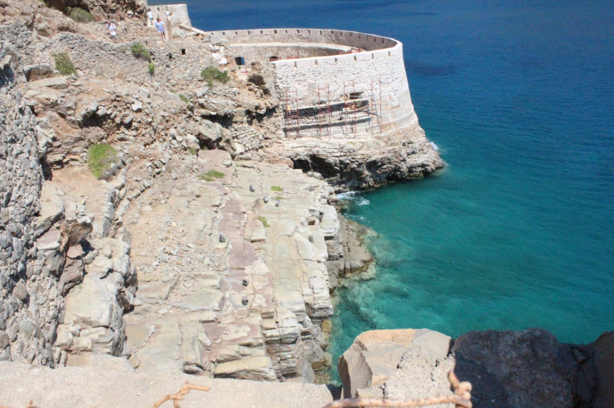
Wonderful island of Crete
Prepared by
Yakovenko Viktoriya
Class 8 «B»
School № 2
Teacher
Zinevich L.G.
2015

Slide 2
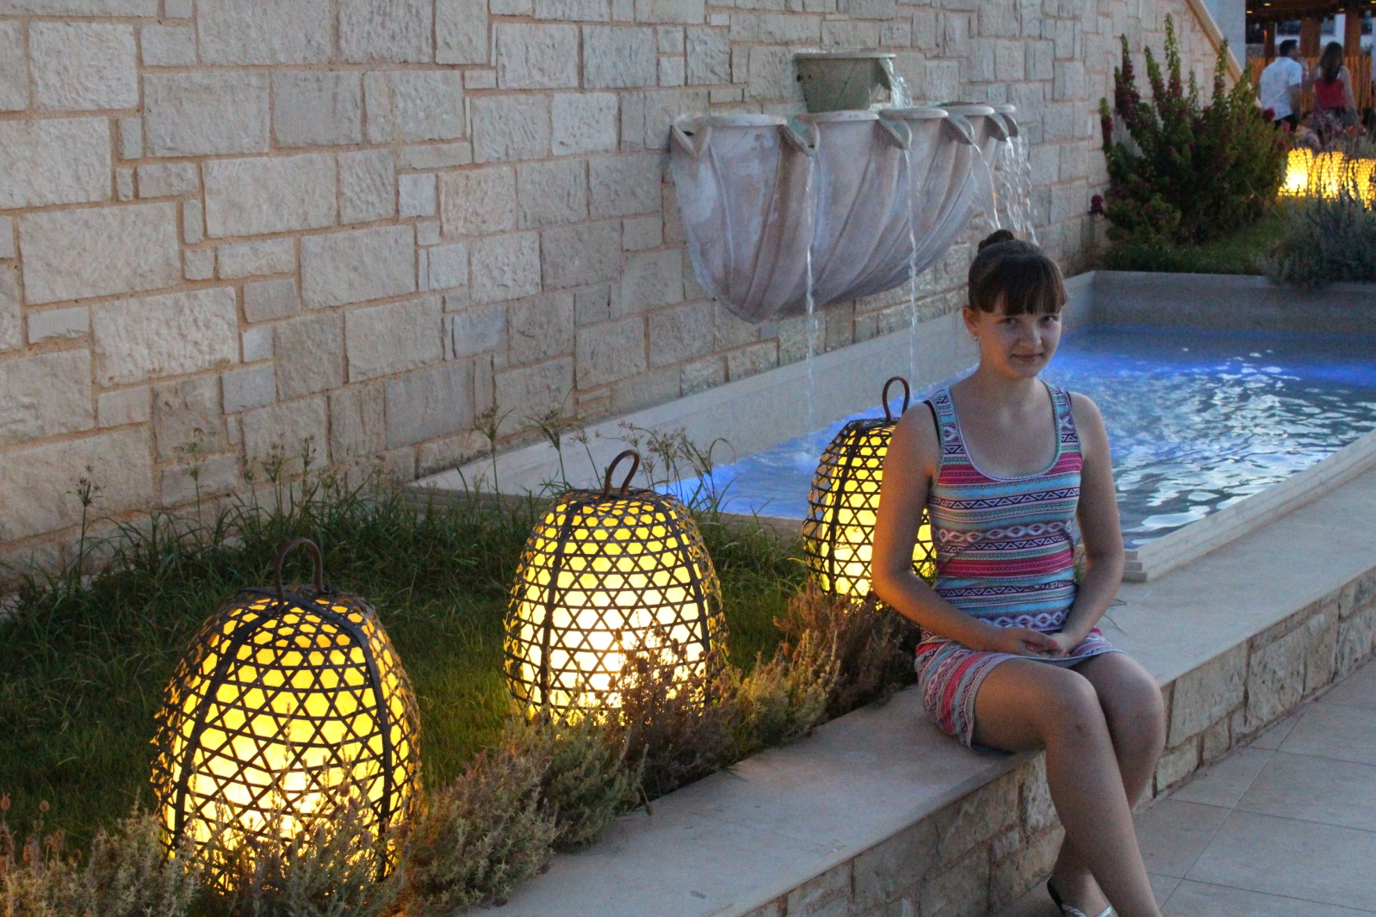
I am Vika .I am 14 years old .I study in class 8 in Kotelnikovo.
I play the piano and the guitar. But I also learn English language. Most of all I like reading and understanding texts .
I prefer working over the projects in English .

Slide 3
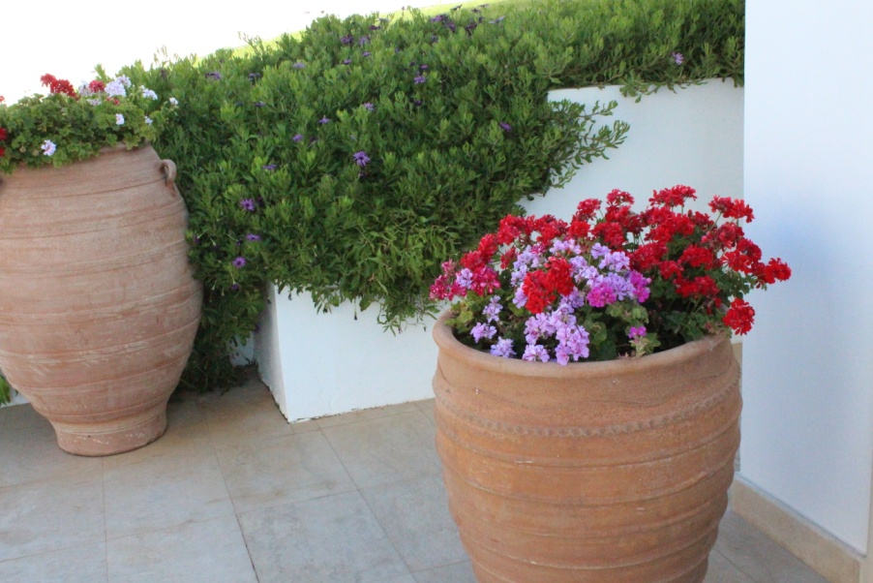
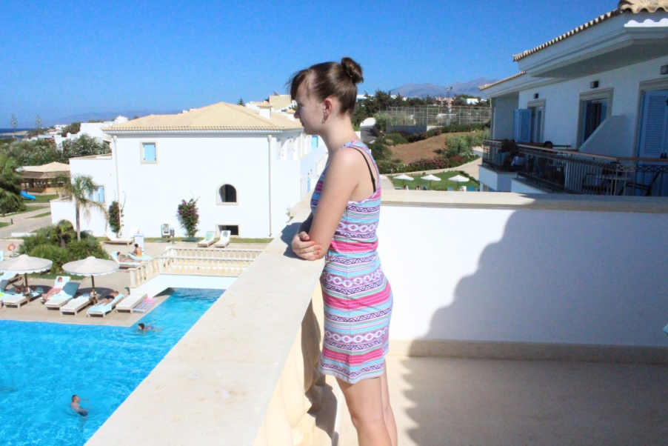
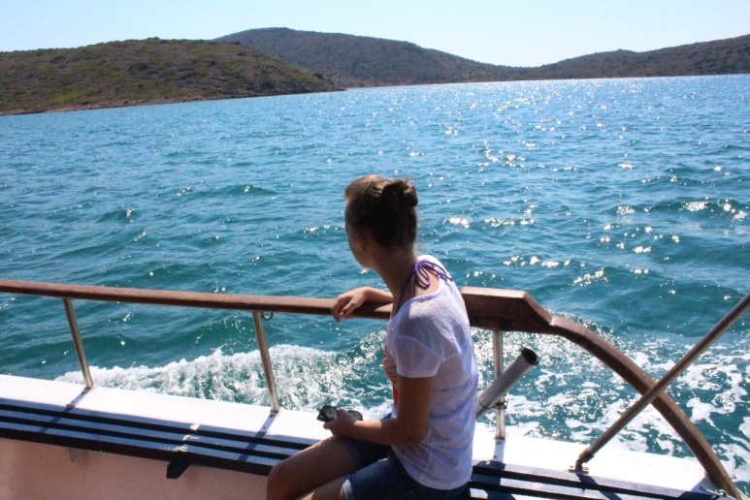
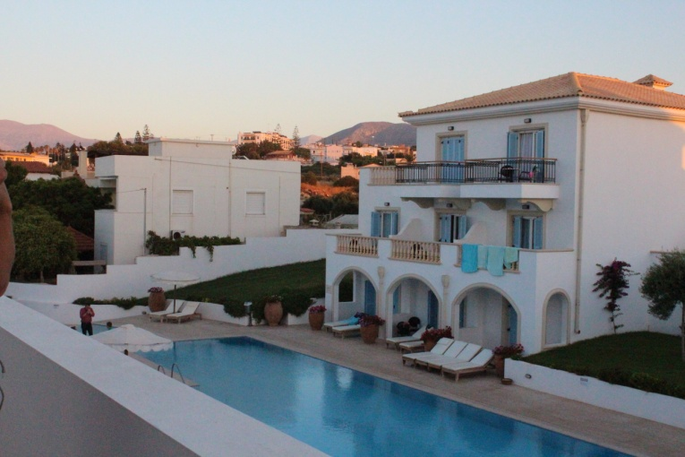
Pictures of Crete last year.

Slide 4
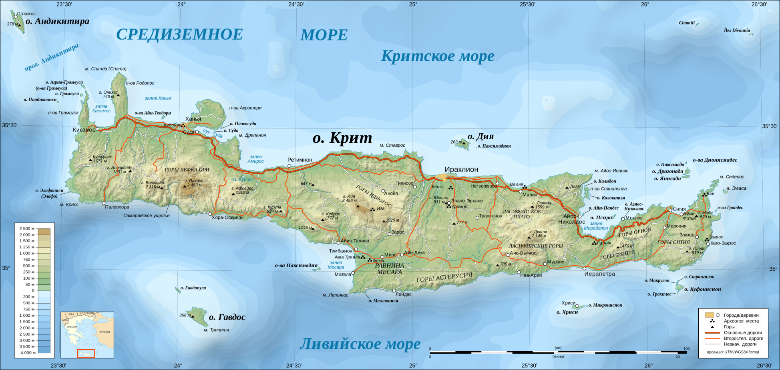
Where is the Island of Crete?
Crete is the largest Greek island, The fifth largest island in the Mediterranean Sea. Located 110 km from Europe. Geographically it belongs to Europe. Crete is washed by three seas :Cretan to the north, the Libyan to the south and the Ionian Sea in the west. Administrative center - the city of Heraklion.
The island covers 8261 square kilometers.

Slide 5
население,чем занимаются ,

Slide 6
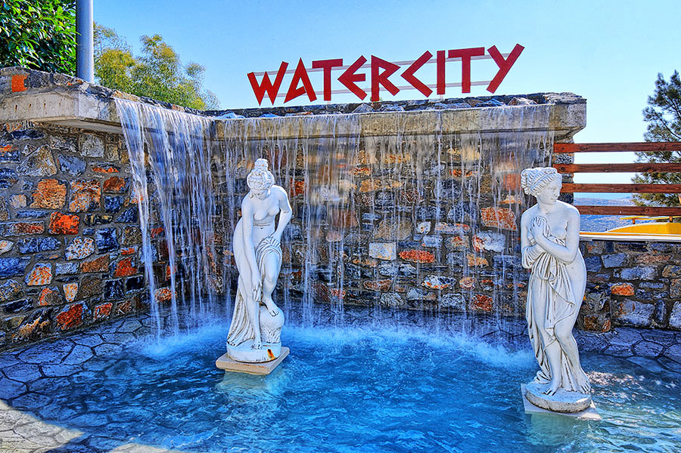
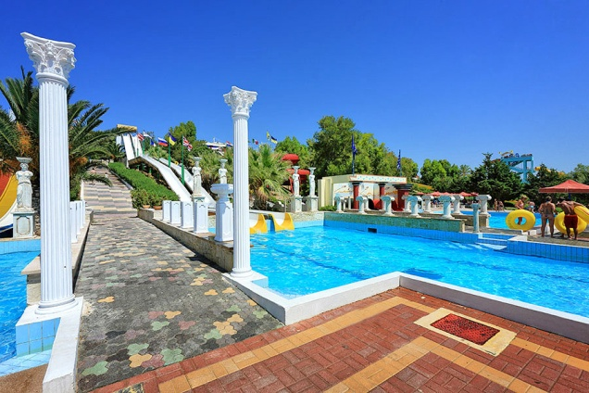
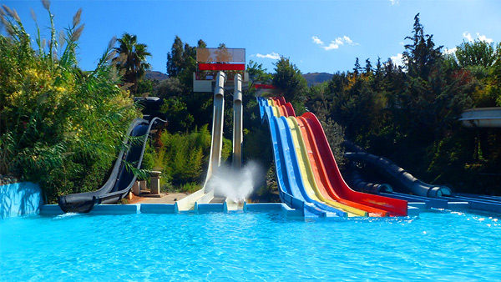
Water City Water Park in Heraklion
Water City Water Park is located in the open air and a rather high altitude. It is very popular not only among tourists but also among local youth. In addition Watercity in Crete there are several water parks, but it is this - the largest

Slide 7
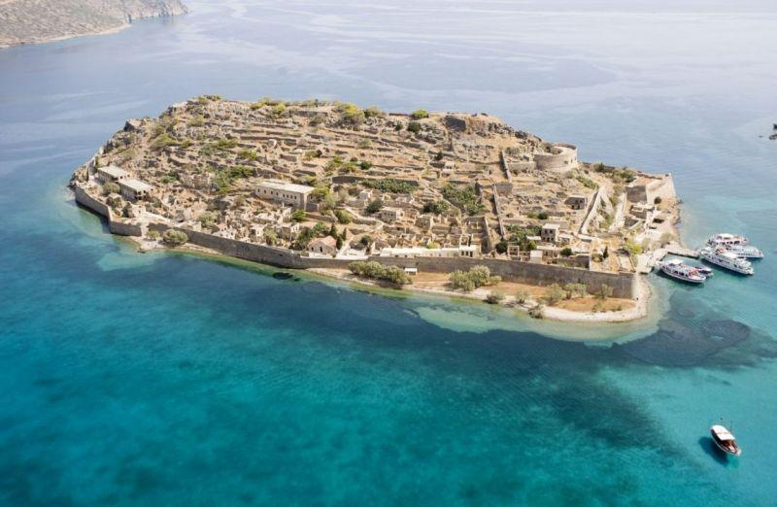
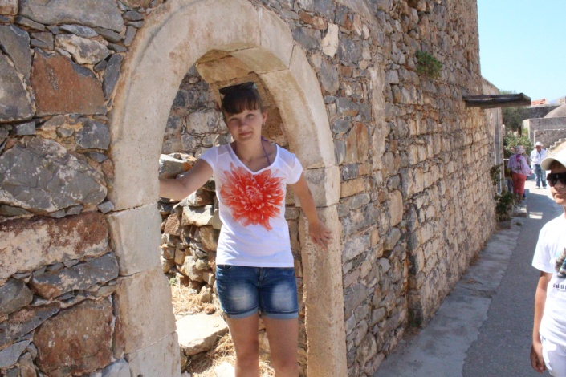
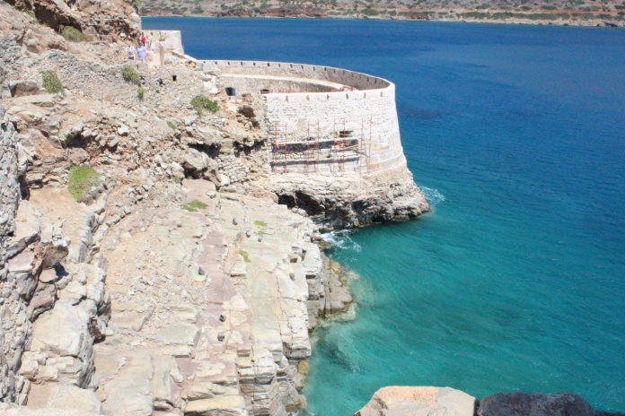
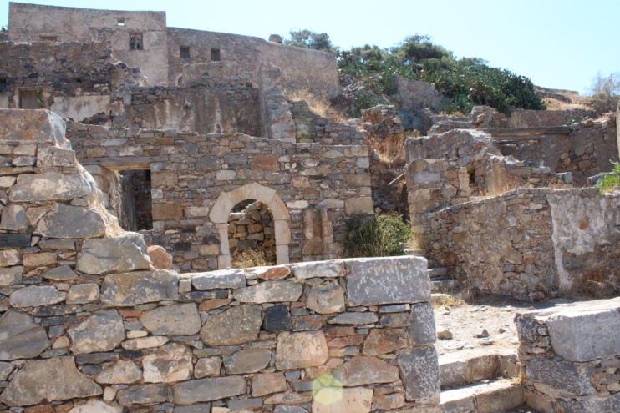
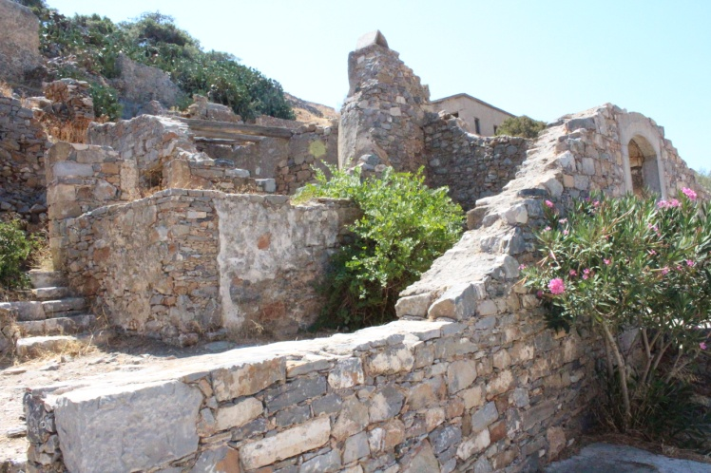
Spinalonga
Spinalonga - an island with a ragged outline, which is located at the coast in the eastern part of Crete, in the Gulf of Mirabell. Once the island was part of the mainland, but later was destroyed by a thin isthmus - according to some, is not a natural way, and the hands of the Venetians.

Slide 8
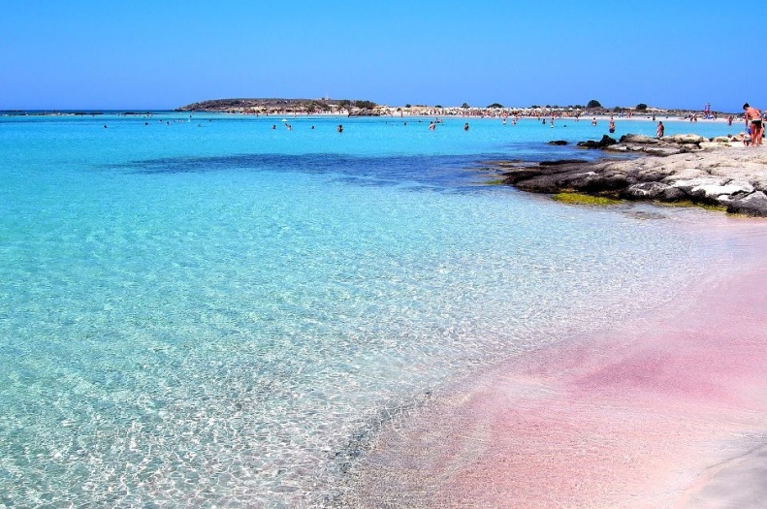
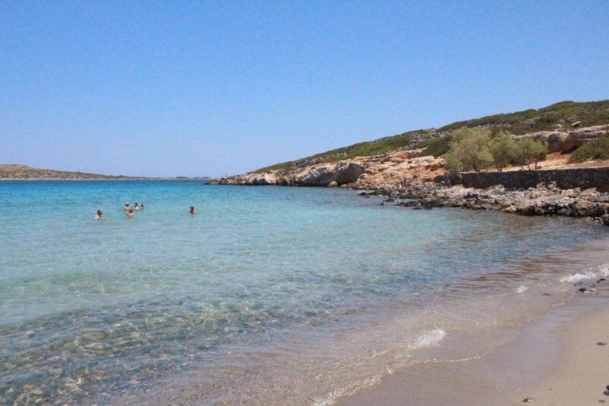
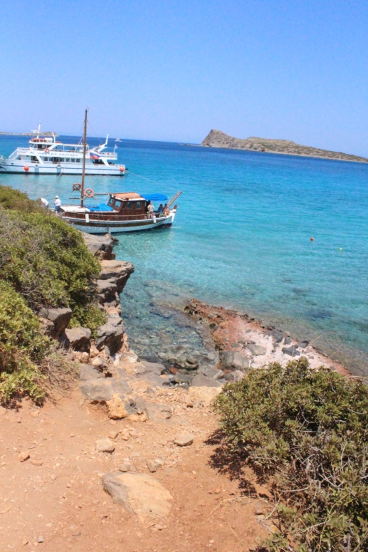
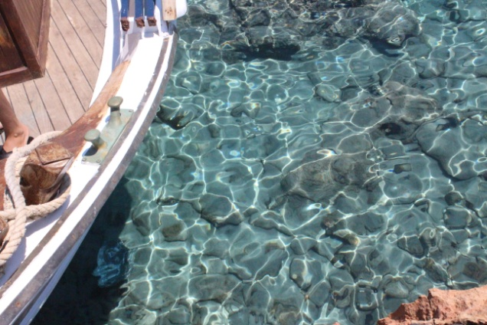
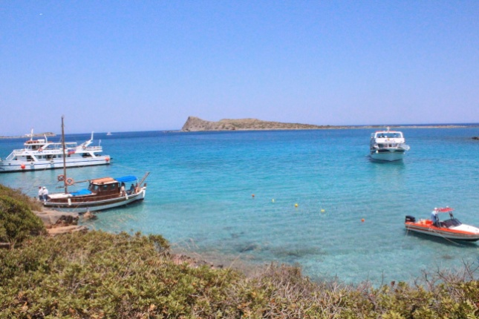
Lagoon and Beach Elafonisi
What is this place famous for? Firstly, unusual sand is white with pink highlights. When different lighting and color plays a fabulous shimmering shades. In conjunction with the play of color and highlights the crystal clear water is obtained an incredible spectacle. Shallow and therefore very warm sea gives his share of good feeling. Because of the shallow depth you can swim in any weather, even in a storm.

Slide 9
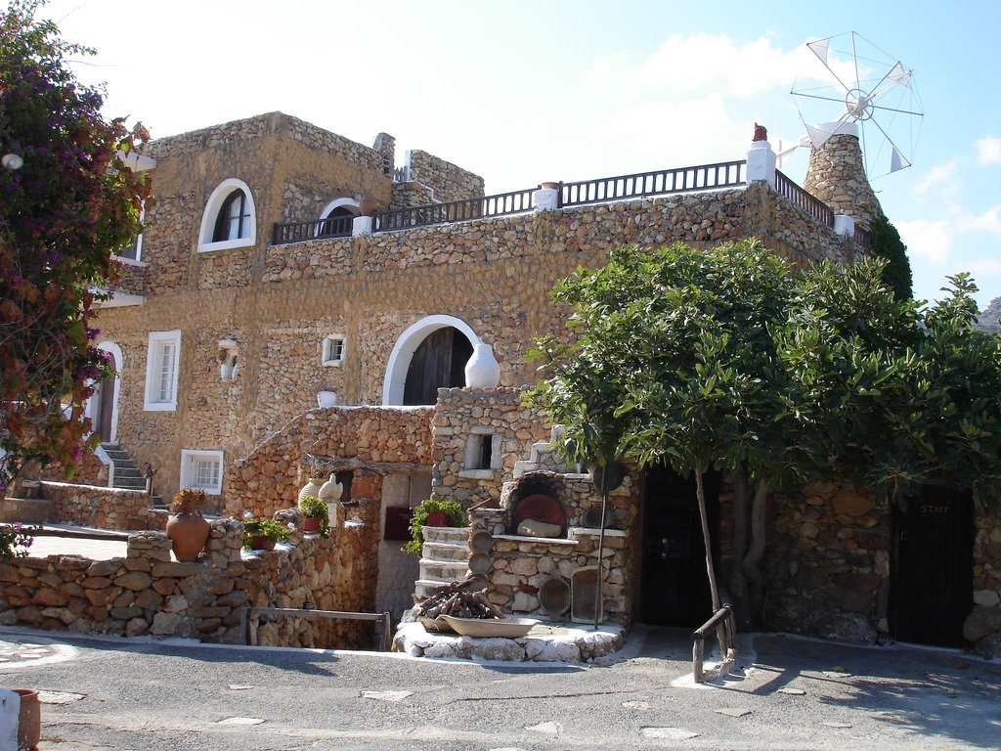
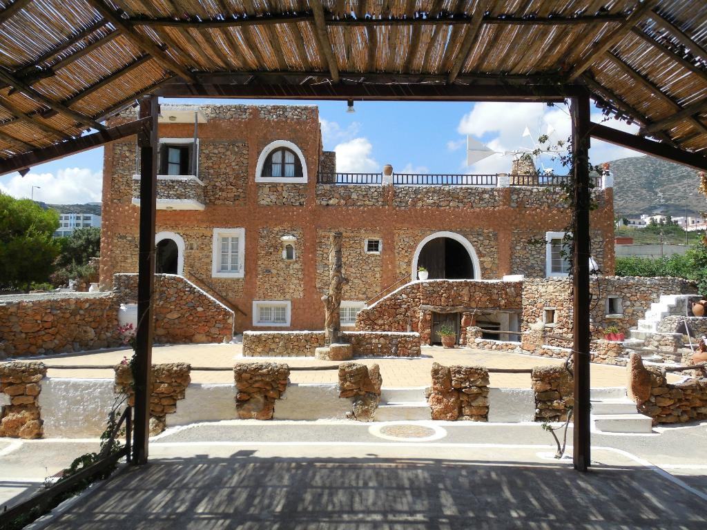
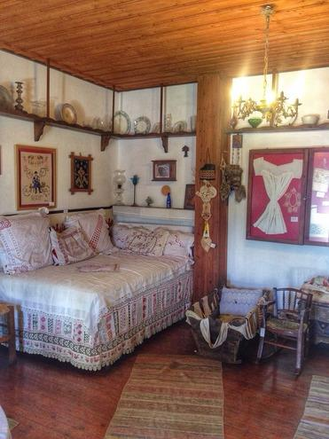
Open Air Museum "Lychnostatis"
The museum presents the life, life and popular culture of the inhabitants of Crete. It is noteworthy that this is a private museum. He gathered the usual Greek family exclusively at his own expense. You can get acquainted with the Greek crafts, with a life. The museum has a mill, a shepherd hut, an apiary, a weaving workshop, a winery. Also at the museum has a cafe where you can taste traditional Greek drinks, preparation of which you can also take part.

Slide 10
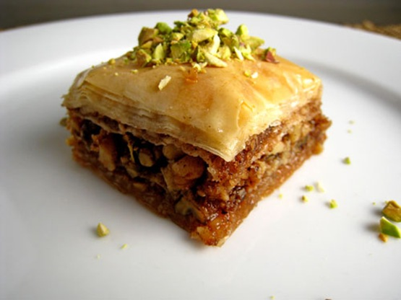
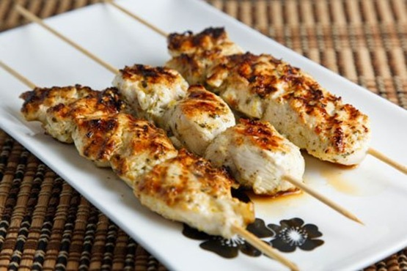
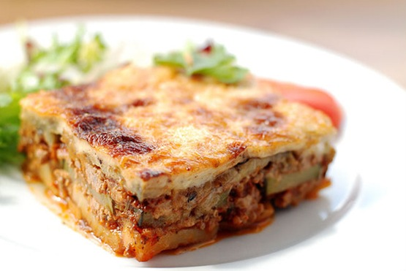
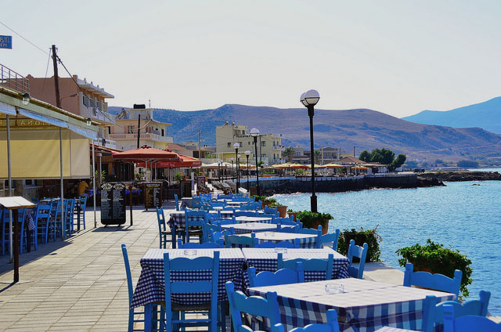
National dishes
baklava
souvlaki
Moussaka

