Slide 1
The origin of English words
Происхождение Английских слов

Slide 2
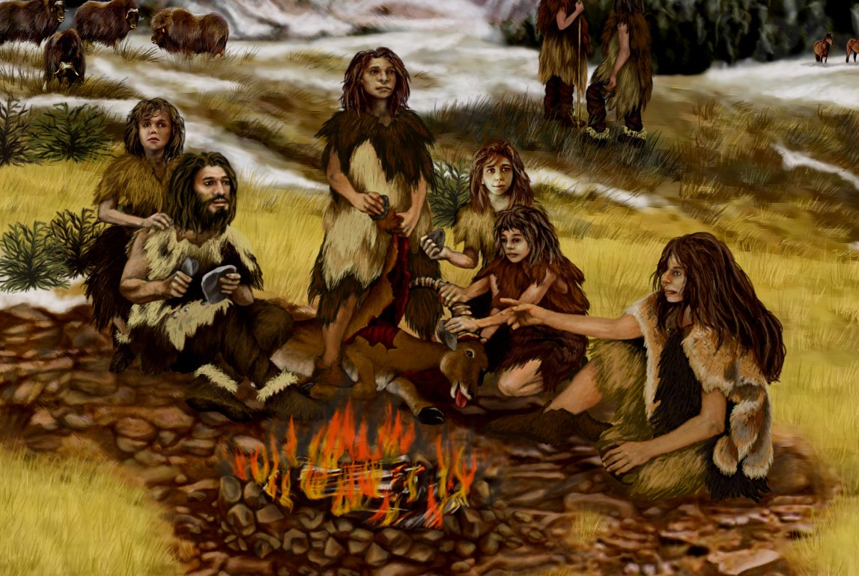
Pre-Roman time
Early people in Britain speak Celtic. (Древние люди в Британии говорили на Кельтском)

Slide 3
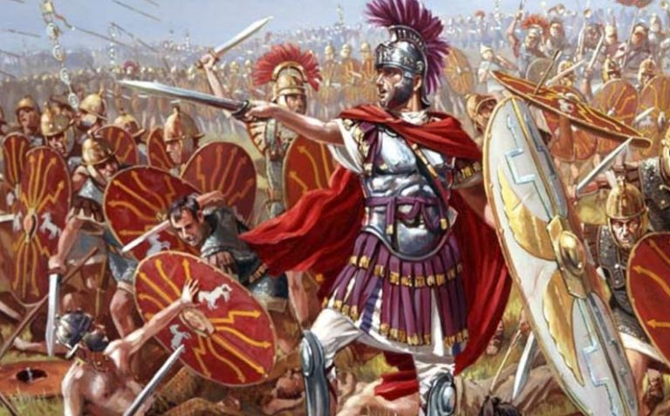
1st century AD
Romans invade Britain.Latin is the language of the Roman Empire(Римляне вторгаются в Британию.Латынь стала языком
Римской Империи)

Slide 4
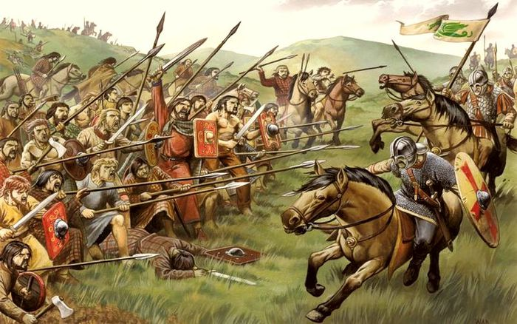
5th century AD
Germanic tribes invade from continental Europe and speak Old English. The word “English” comes from the Angles, the name of one of the tribes. Modern English words like “water” and “strong” come from Old English. The Vikings invade and introduce new words.

Slide 5
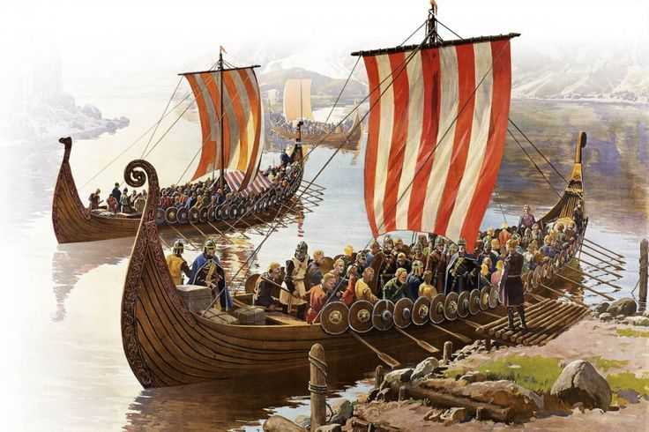
1066 AD
The Normans invade Britain and French becomes the official language. The English language changes and imports many words from French, for example “beef”

Slide 6
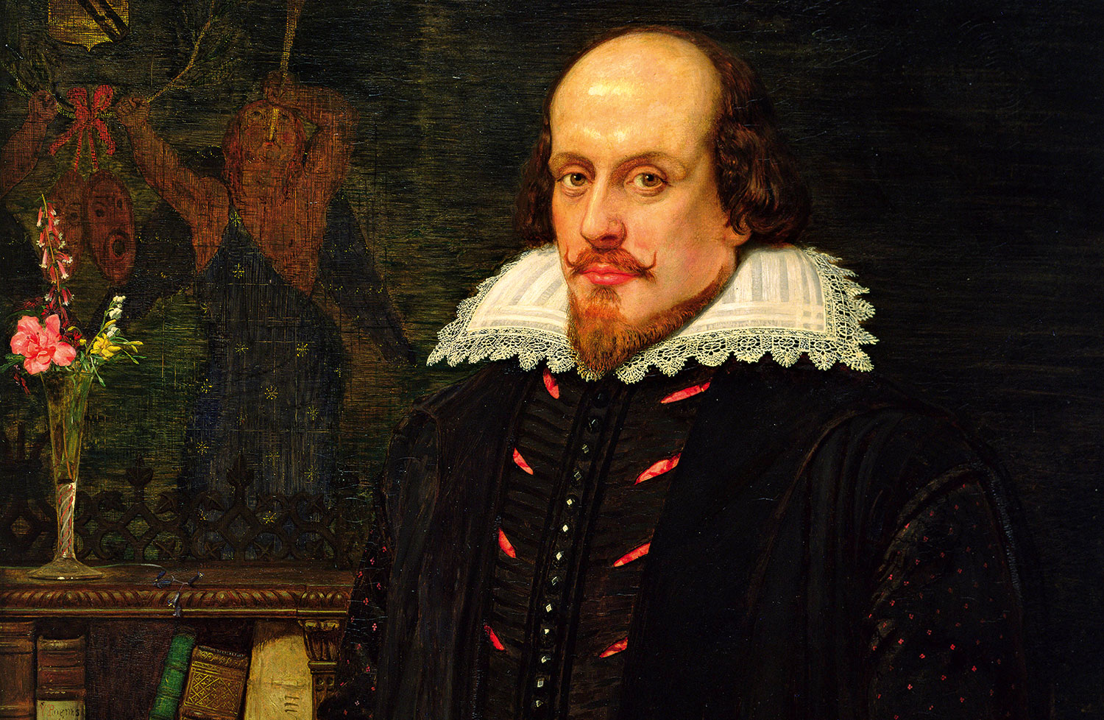
1600
Modern English has its roots in the time of Shakespeare. Latin and Greek have a big influence because they are the languages for scholars. English uses many Latin words ending in –us or –um, for example curriculum and circus. Words that end in –ology (the study of) and –phobia(the irrational fear of) originate from Greek words, for example biology and arachnophobia.

Slide 7

16th century to 19th century
Explorers and travellers bring many new words from around the world: words for animals (zebra from Kongo, an African language), food (chocolate from Nahuatl, the Aztec language), clothes (pyjamas from Hindi in India), drinks (tea from Chinese), mathematical terms (algebra from Arabic) and musical terms (piano from Italian)

Slide 8
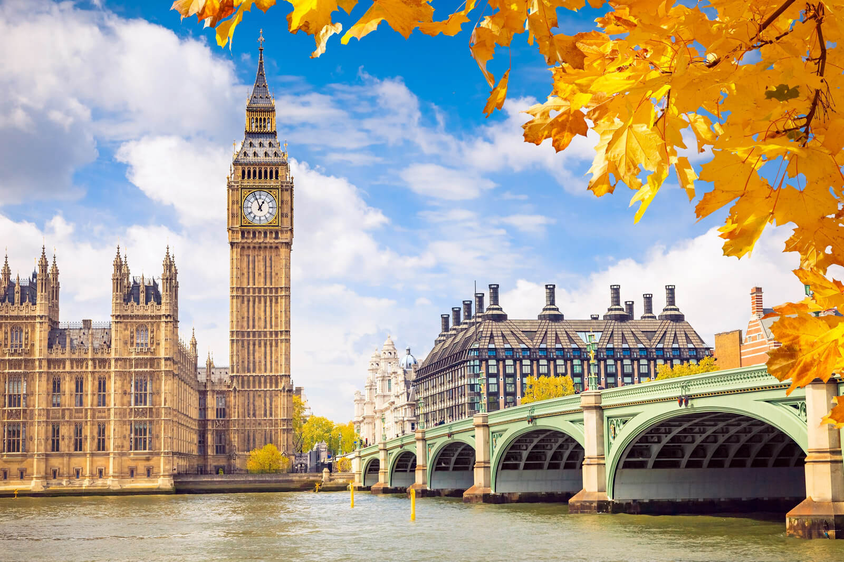
Today
The English language continues to grow, especially with new words in science and technology, for example “Microchip” and “Cyberspace” (Английский язык продолжает расти, особенно с новыми словами в науке и технике, например “микрочип” и “киберпространство”)

