Slide 2
When is Saint Patrick's day?

Slide 3
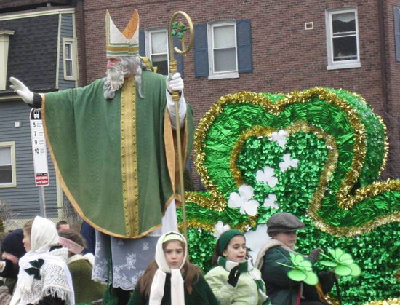
It is on March 17.
We say "Happy Saint Patrick's Day!"

Slide 4
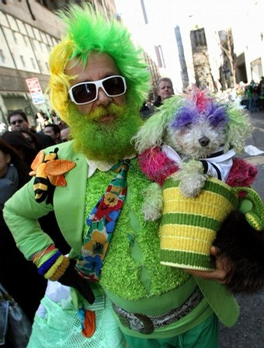
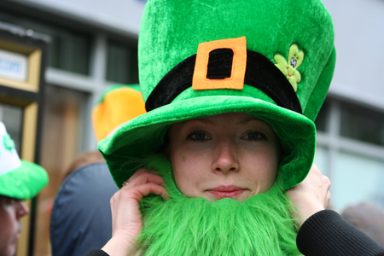
People celebrate it by wearing green clothes.

Slide 5
What are these?

Slide 6
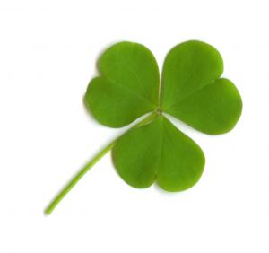
They are three leaf clovers.
Clovers are symbols of Saint Patrick's Day.

Slide 7
Who is this?

Slide 8
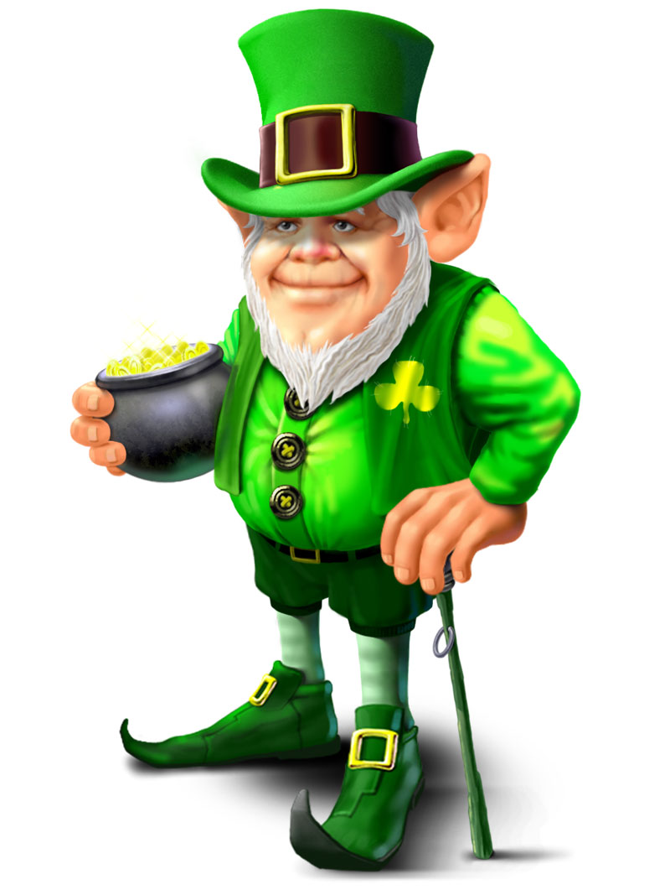
It is a leprechaun.
Leprechauns are little fairies who live in Ireland.
They play tricks on people.

Slide 9
Are there parades on Saint Patrick's Day?

