Slide 1




How Do You Treat
the Earth?

Slide 2

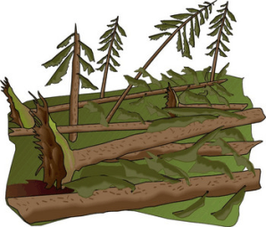
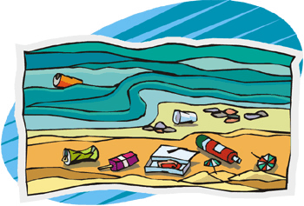
The Aim
To revise all the information on the theme “How Do You Treat the Earth?”– vocabulary, grammar (Present Passive Voice) and cultural notes.

Slide 3
Do You Know These Words?
a container
to damage
to destroy
to disturb
the environment
glass
grass
to keep off
nature
to plant
plastic
to pollute
pollution
to protect
to recycle
to reduce
to reuse
to throw away
wildlife
air
to disappear
the Earth
a (river) bank
a plant
wild
to spoil
in charge of
to be concerned
to find worrying
an aim
an alligator
to cover
a national park
a naturalist
a nature reserve

Slide 4
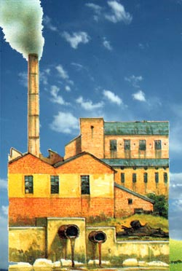
Inviromental Problems
LAND
WATER
AIR

Slide 5
Passive Voice
am
is
are
+ V3

Slide 6

Fill in is or are.
1. When the air … polluted, climate … changed.
2. When paper … not recycled, forests … cut down.
3. When the glass bottles … left in the forest, people and animals … hurt.

Slide 7
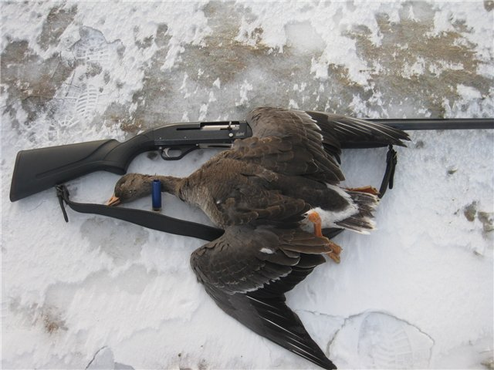

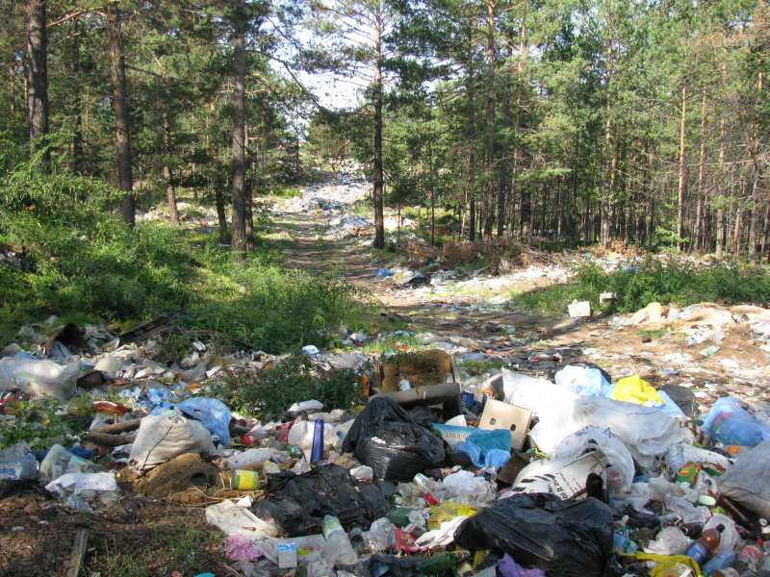
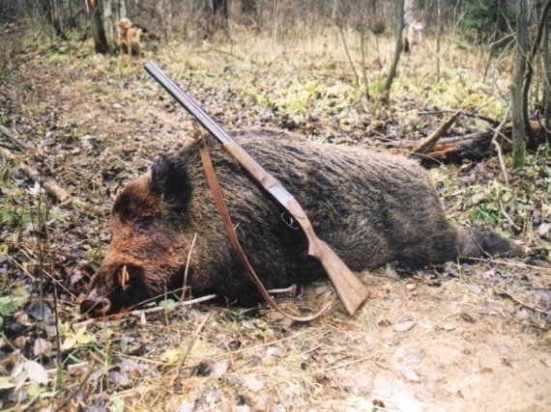
Transform the sentences into Passive Voice.
(We pollute nature. —> Nature is polluted.)
am/is/are +V3
1. We throw away litter.
2. We destroy wildlife.
3. We kill animals.

Slide 8

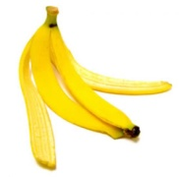

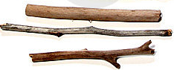
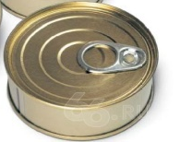
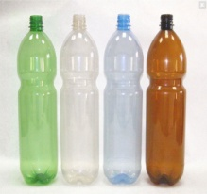
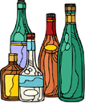
How long litter lasts
traffic ticket ..............1 month
banana peel..............up to 6 months
woolen sock..................1 year
wooden stake........... 4 years
can..........100years
plastic bottle…up to 500 years
glass containers ....forever

Slide 9
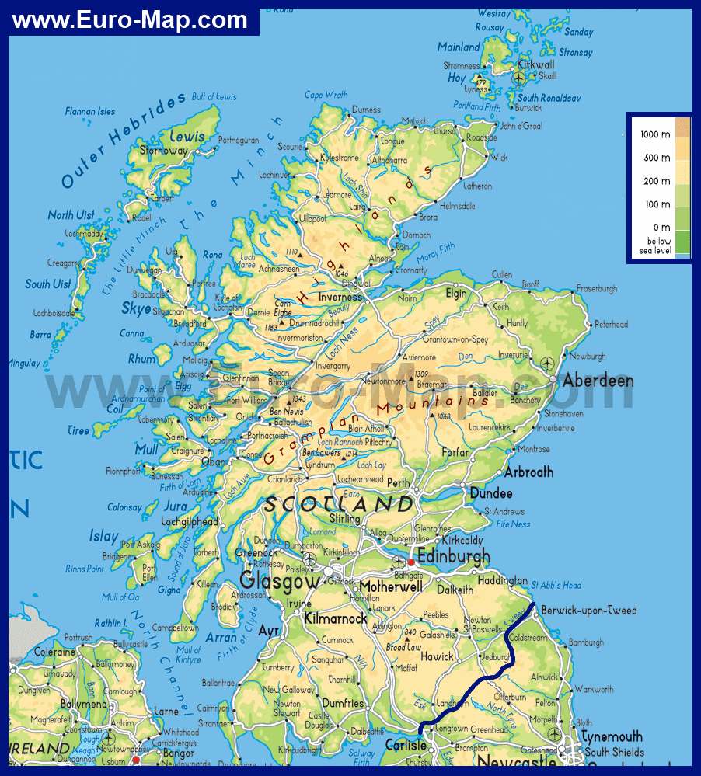
St.Kilda
Insh Marshes
Loch Lomond

Slide 10
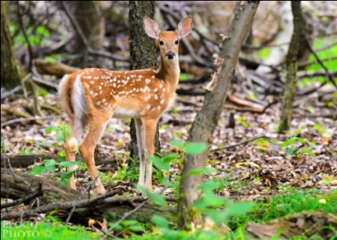
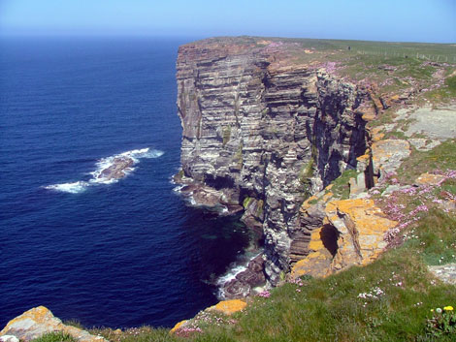
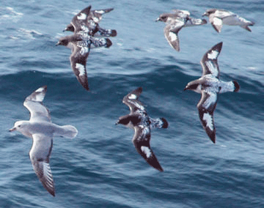
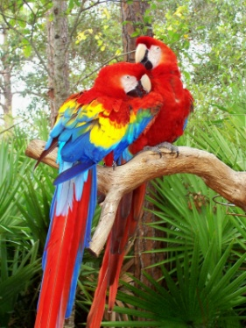
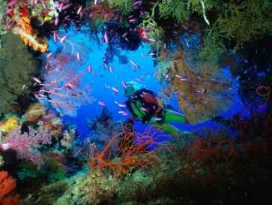
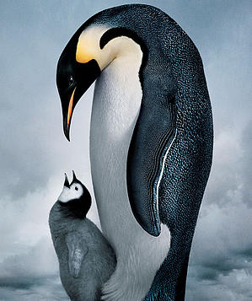
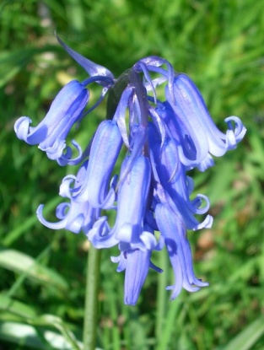
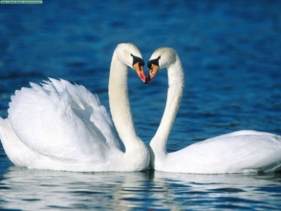
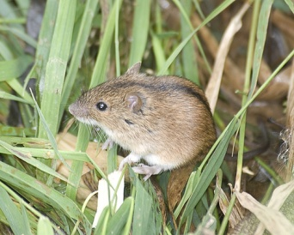
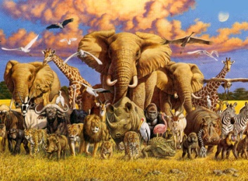
seabirds
parrots
deer
cliffs
underwater caves
Which of the following
do you think you can see
in Scotland's National
Nature Reserves?
penguins
bluebells
swans
field mice
wildlife

Slide 11
Explain these words:
not seen or found very often (не очень часто)
Protected (защищать) area with animals
Rare
Reserves
Cliffs
Unique
Wetland
Marshes
Hikes
Flocks
Trails
a large area of rock or a mountain with a very steep (крутой)side
an area of land that is partly (частично) covered with water
a group of animals
Unusual (необычный)
an area of low flat ground that is always wet and soft
a long walk in the mountains or countryside
Path (тропинка) through forests
Notes:
Which words are new for you?

Slide 12


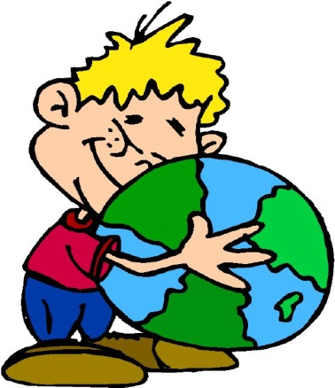
The Earth is a garden,
It’s a beautiful place.
For all living creatures,
For all the human race.
Helping Mother Earth
We can peacefully roam.
We all deserve a place
We can call our home.

Slide 13
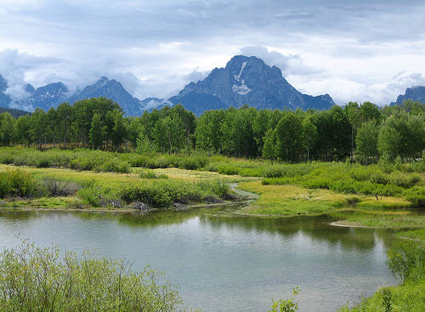
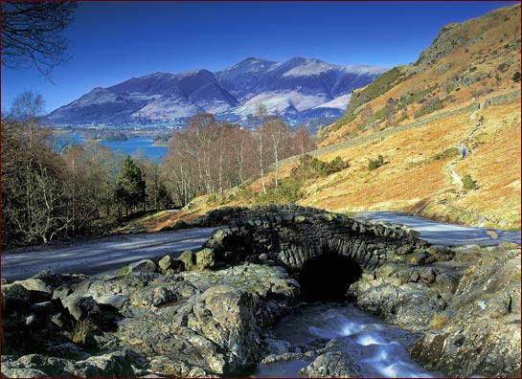

National Parks
Nature Reserves
Yellowstone
The Lake District
What was the first national park in the world?
What are the two aims of national parks?

Slide 14
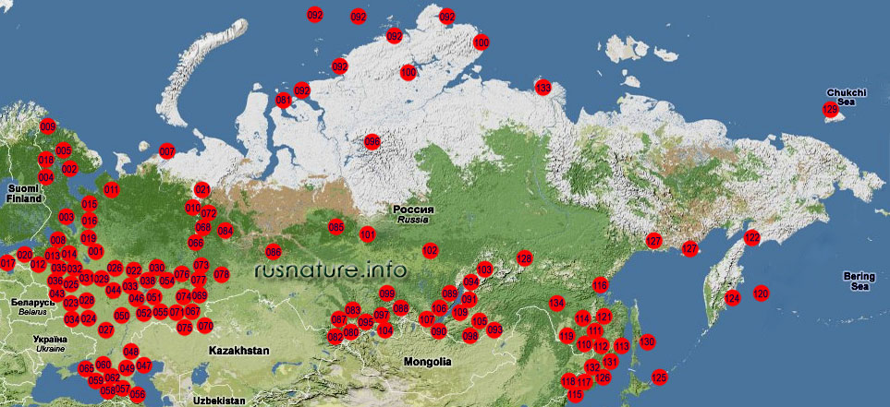

Slide 15
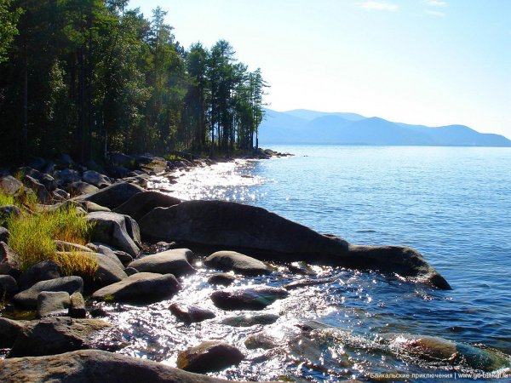
озеро байкал.flv

Slide 16
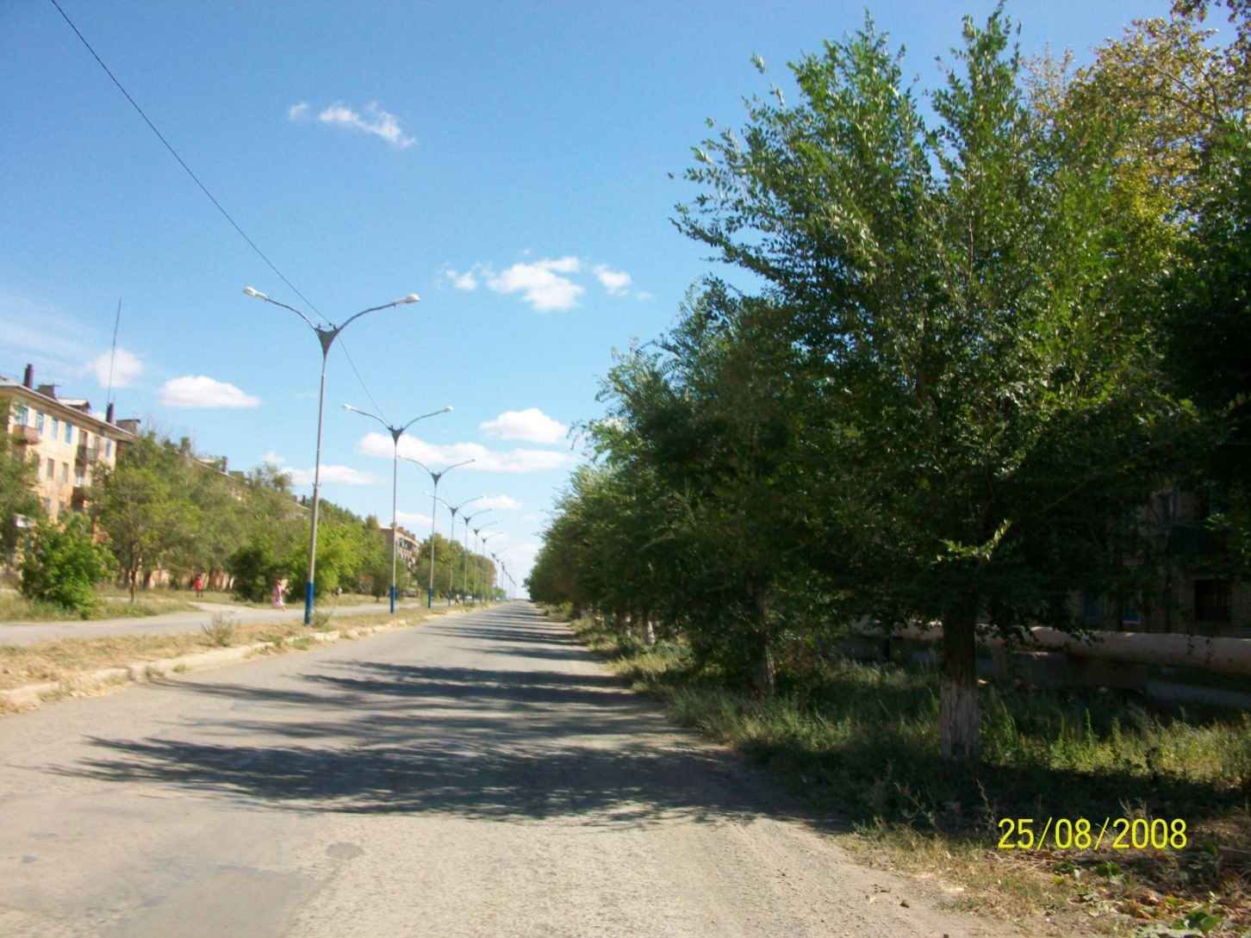

My Home Town

Slide 17
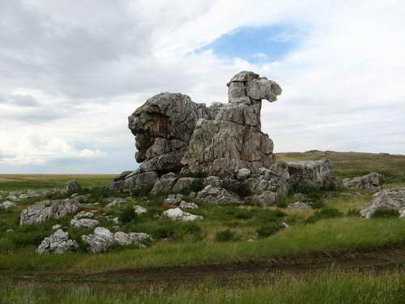

Slide 18
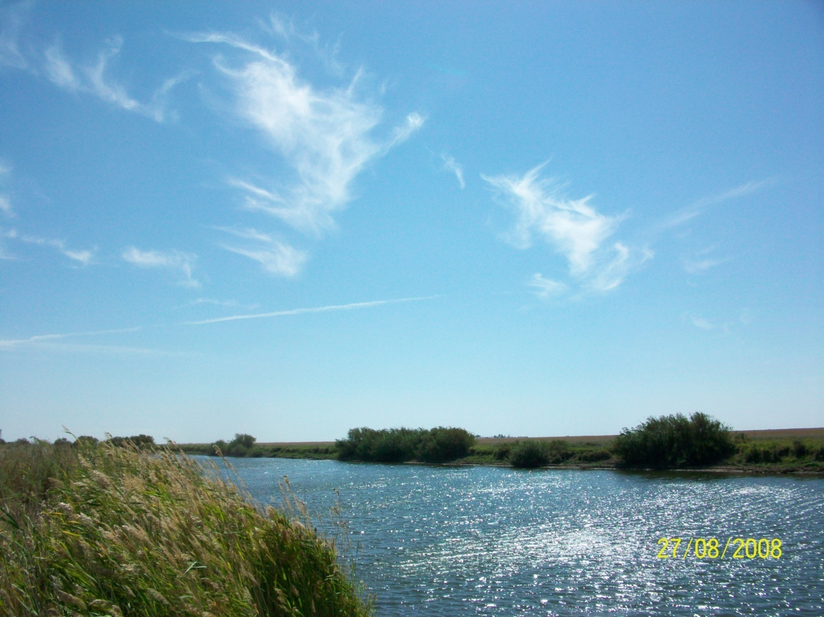

Slide 19
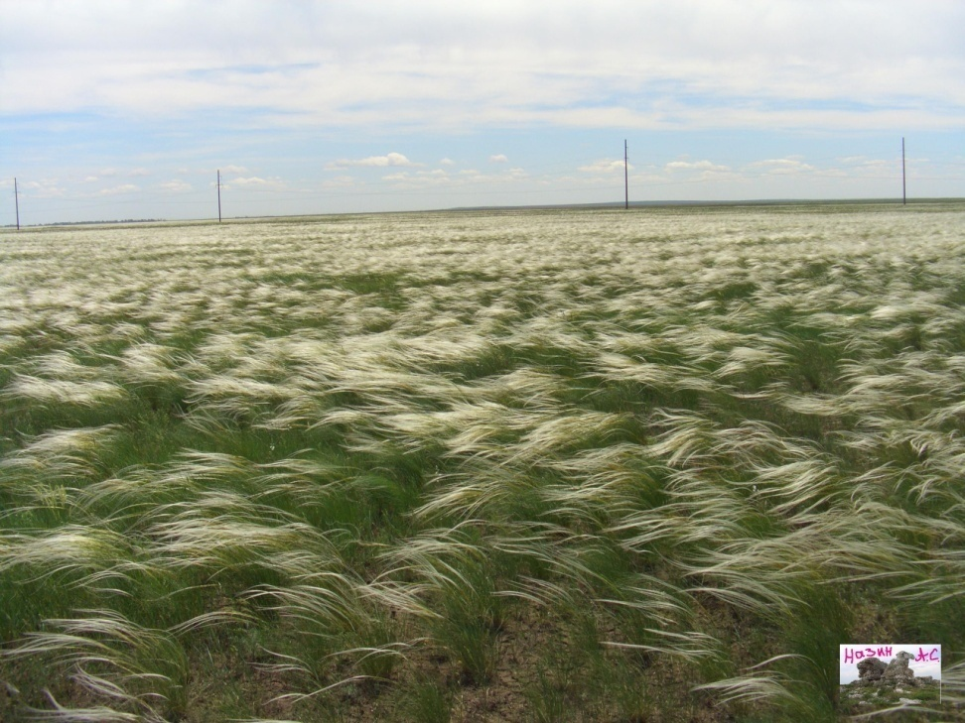
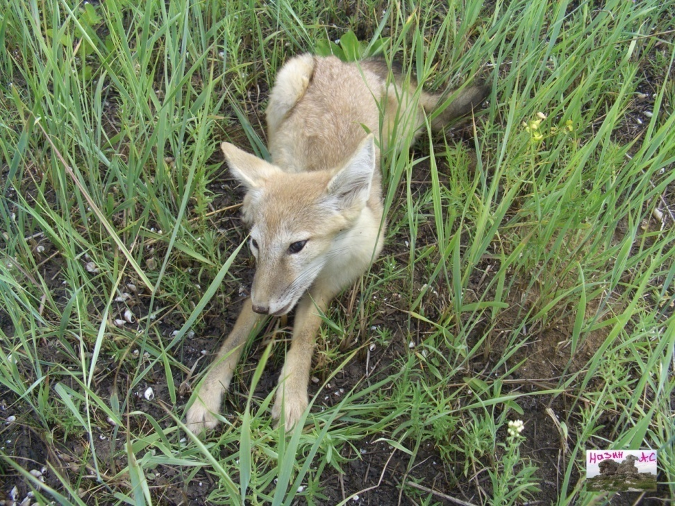

Slide 20
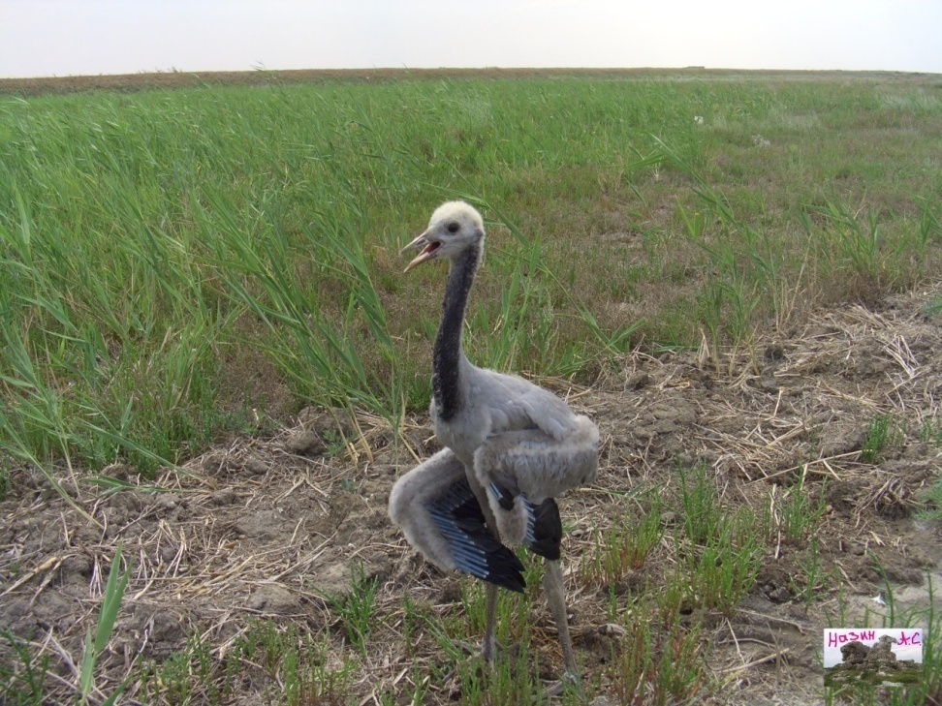
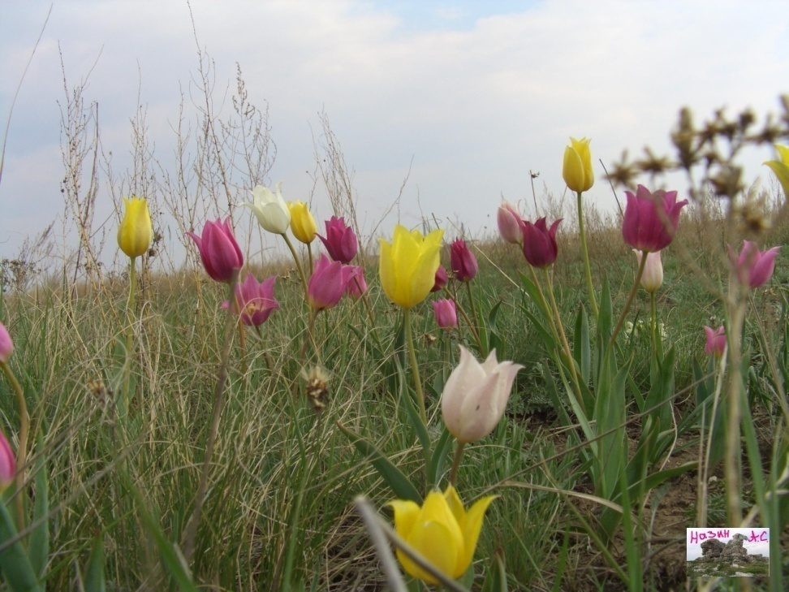

Slide 21
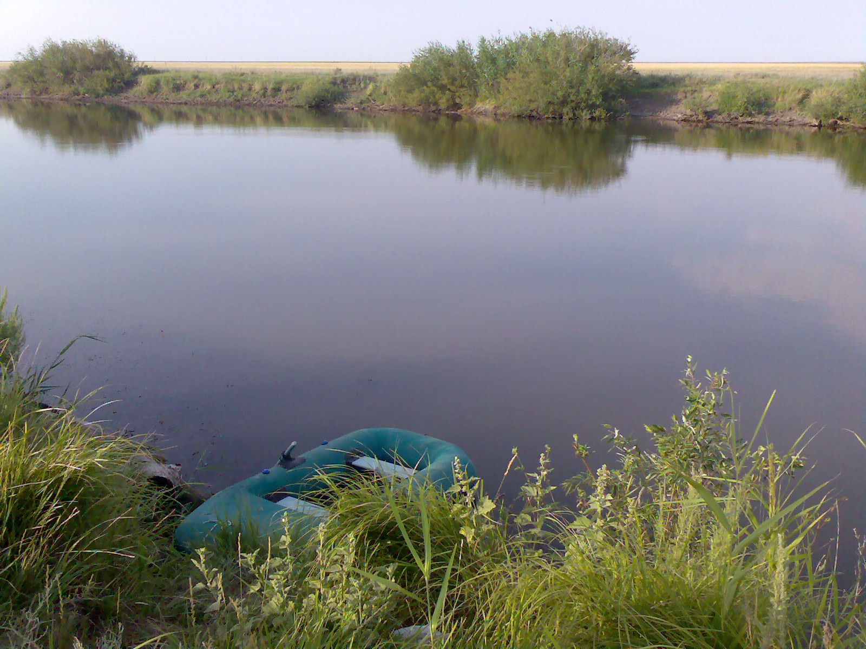
Eco problems
In My Native Town

Slide 22
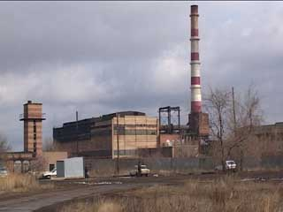

Slide 23
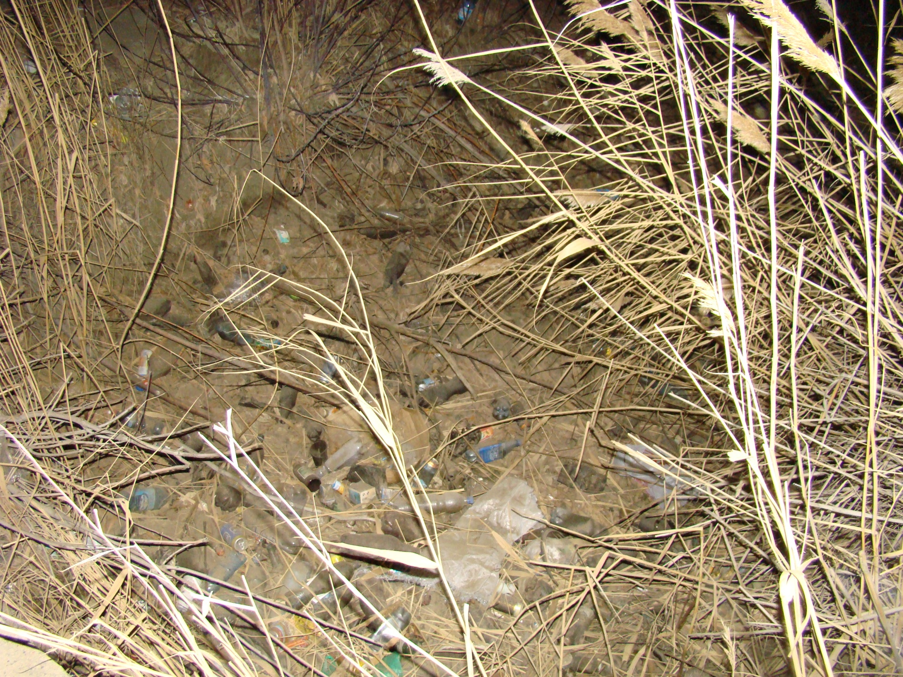

Slide 24
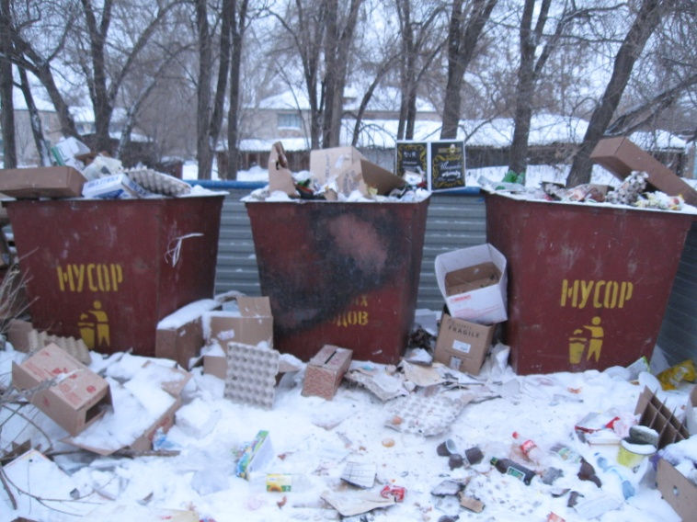

Slide 25
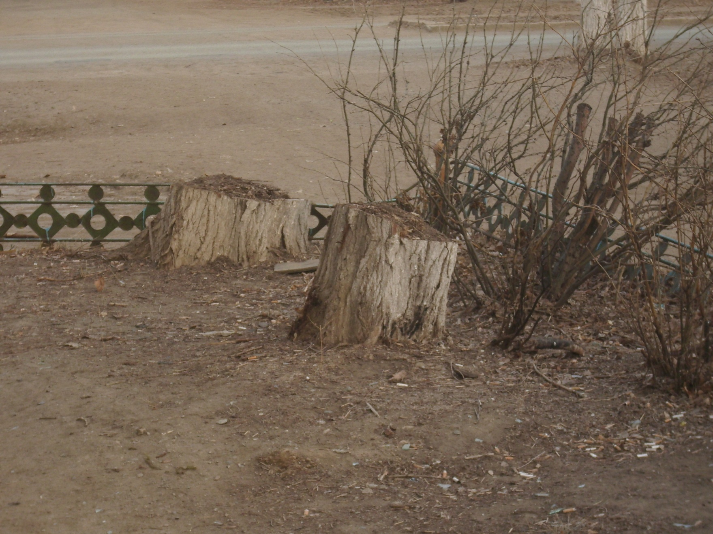

Slide 26
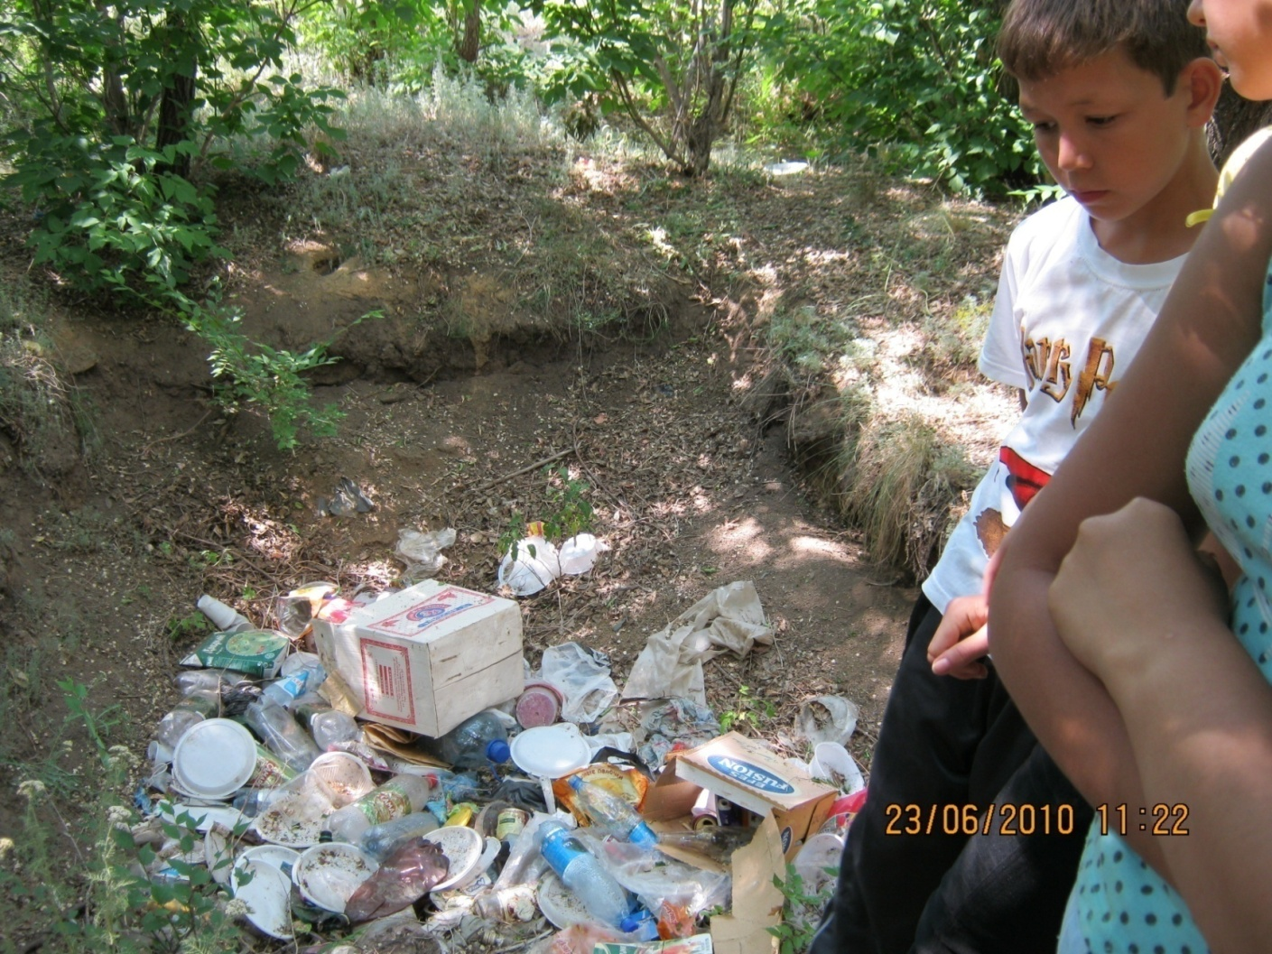

Slide 27
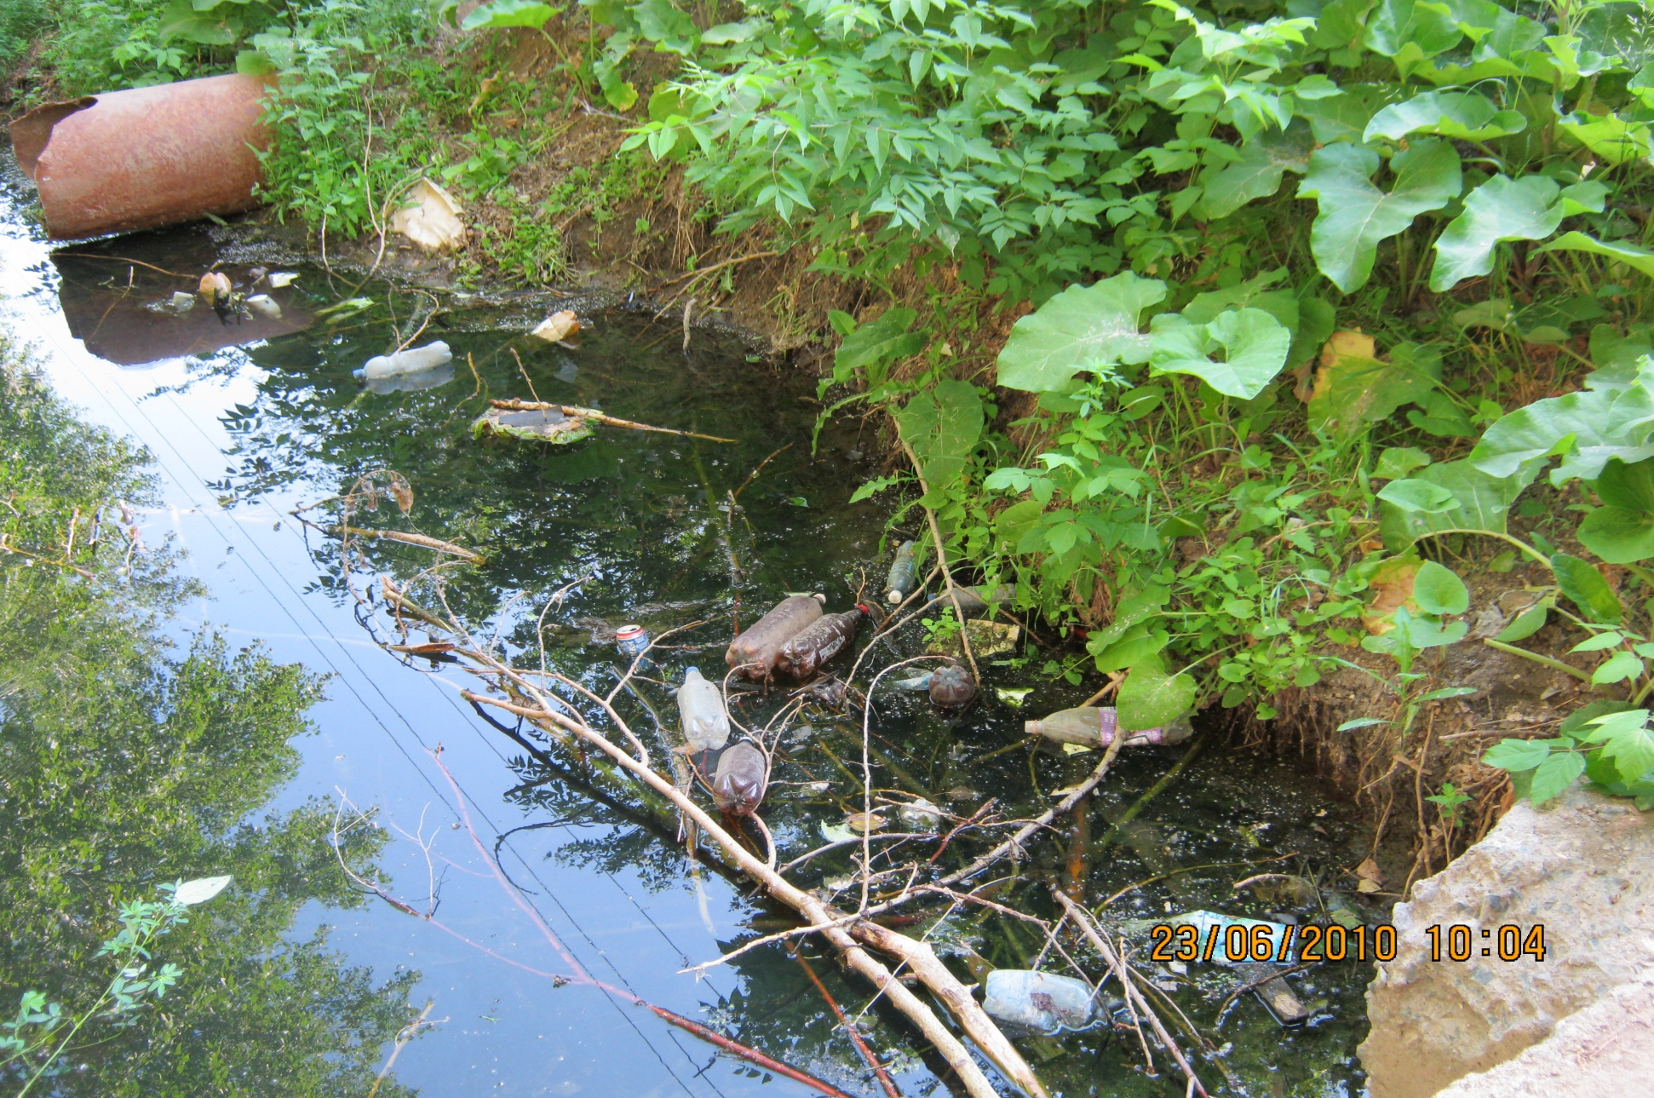

Slide 28
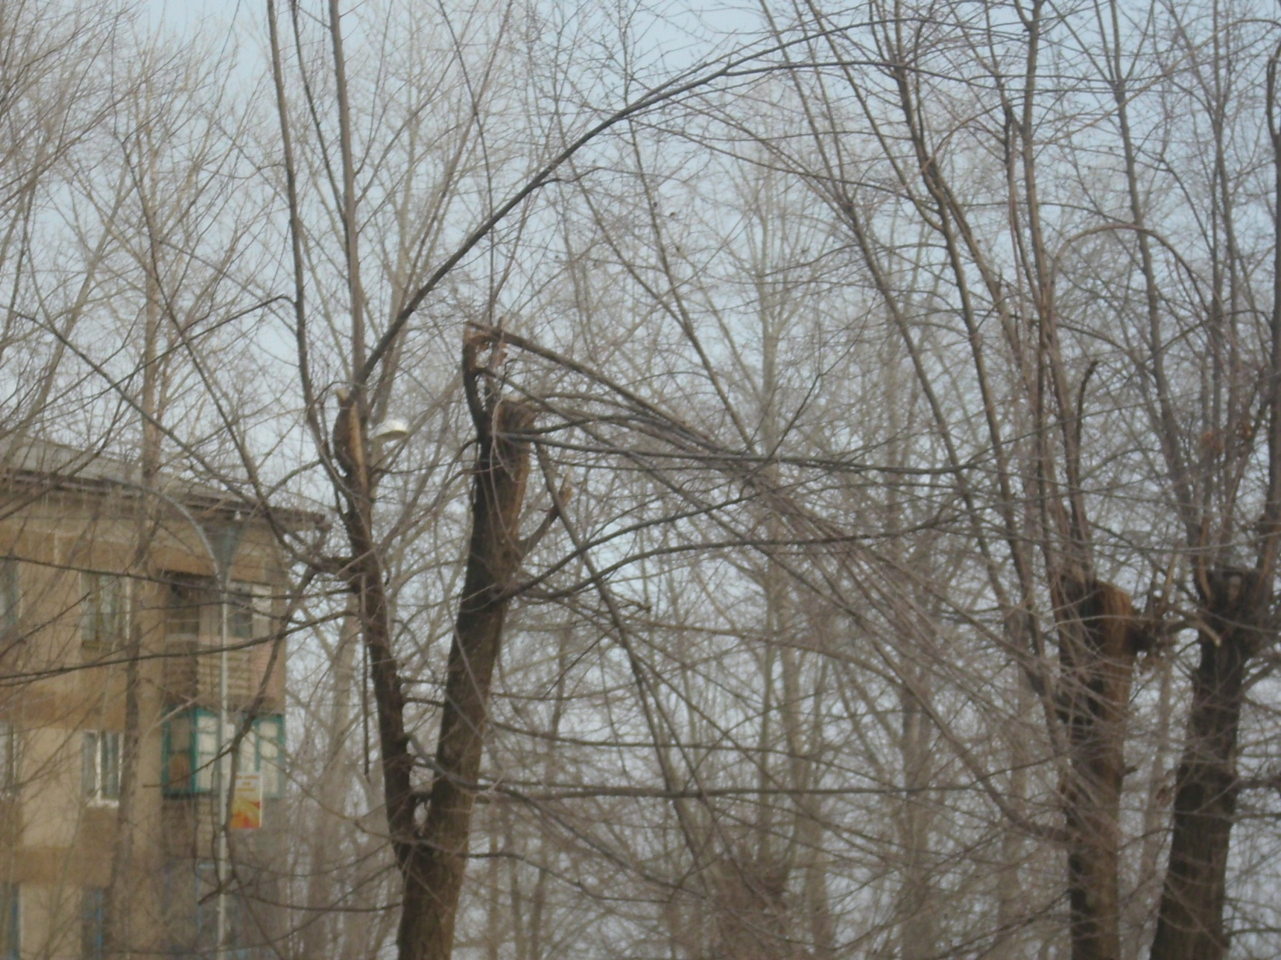

Slide 29
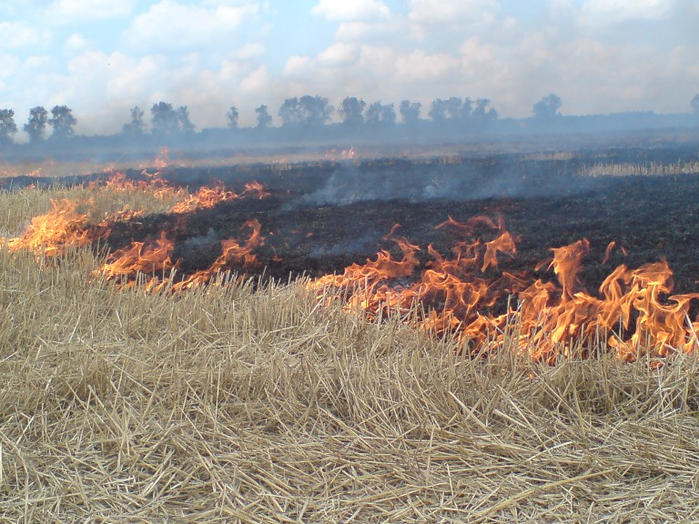

Slide 30
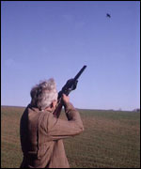

Slide 31
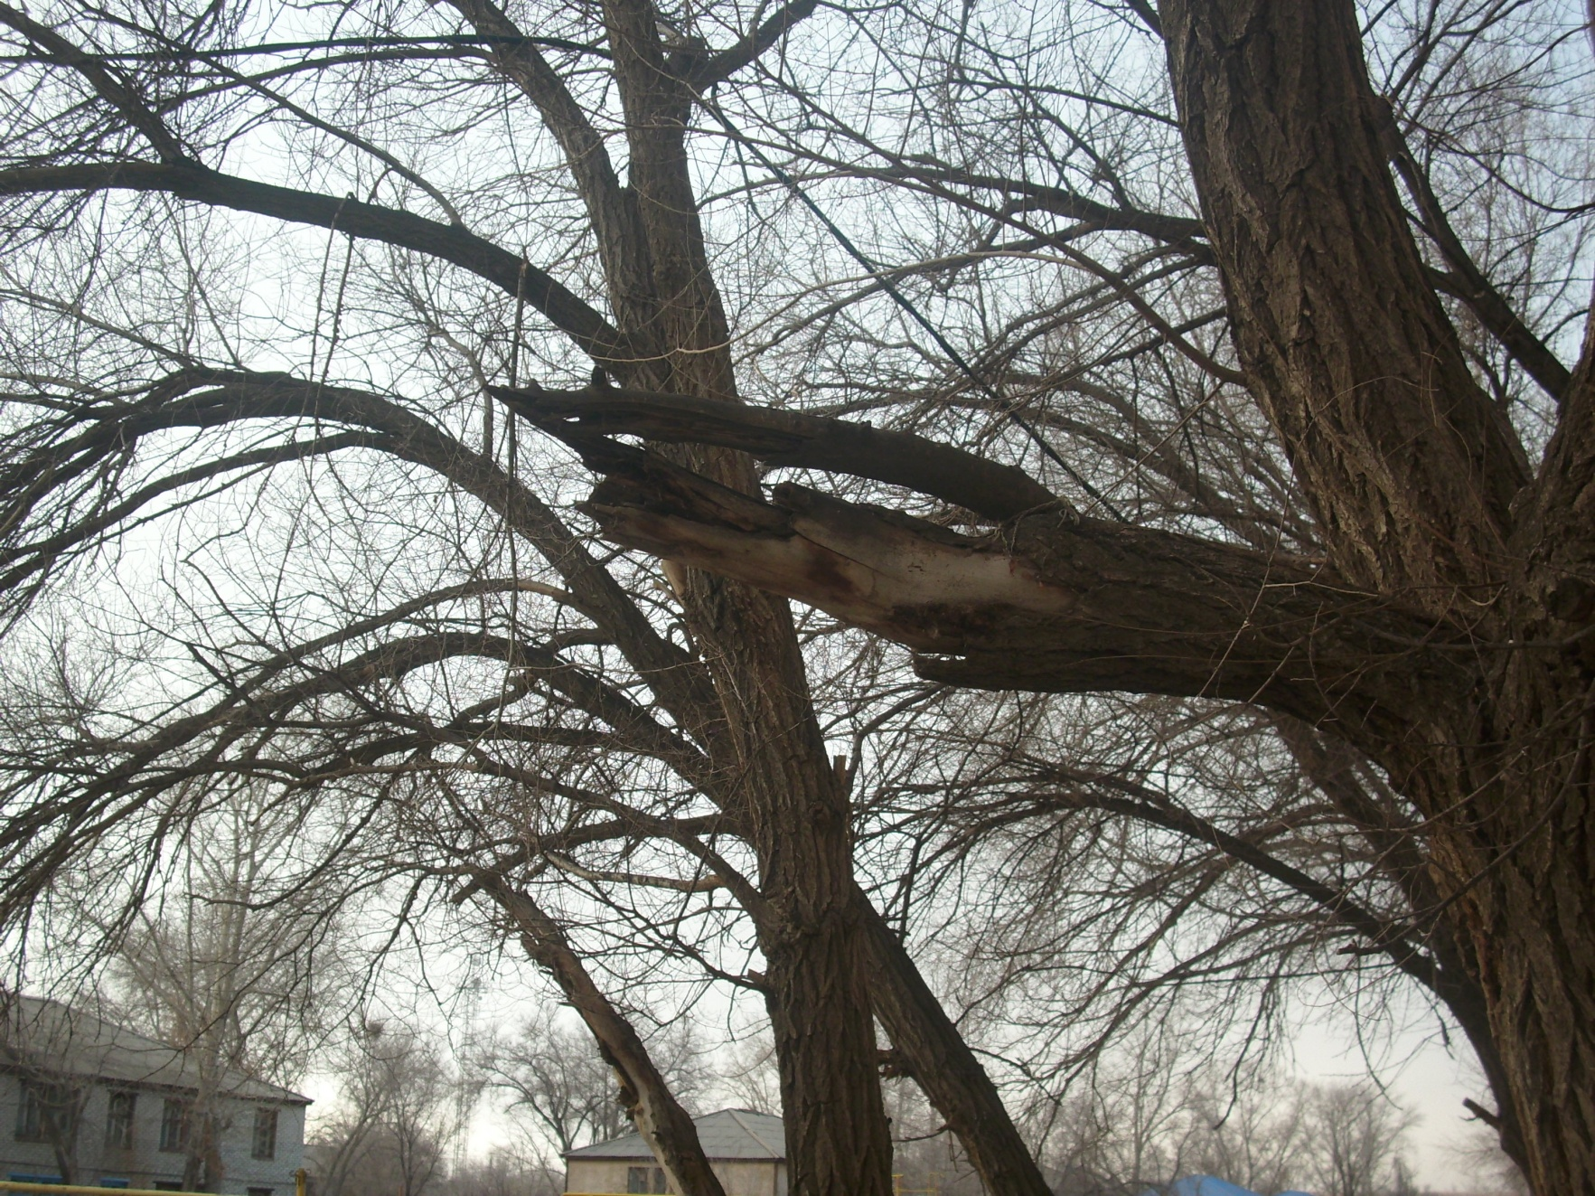

Slide 32
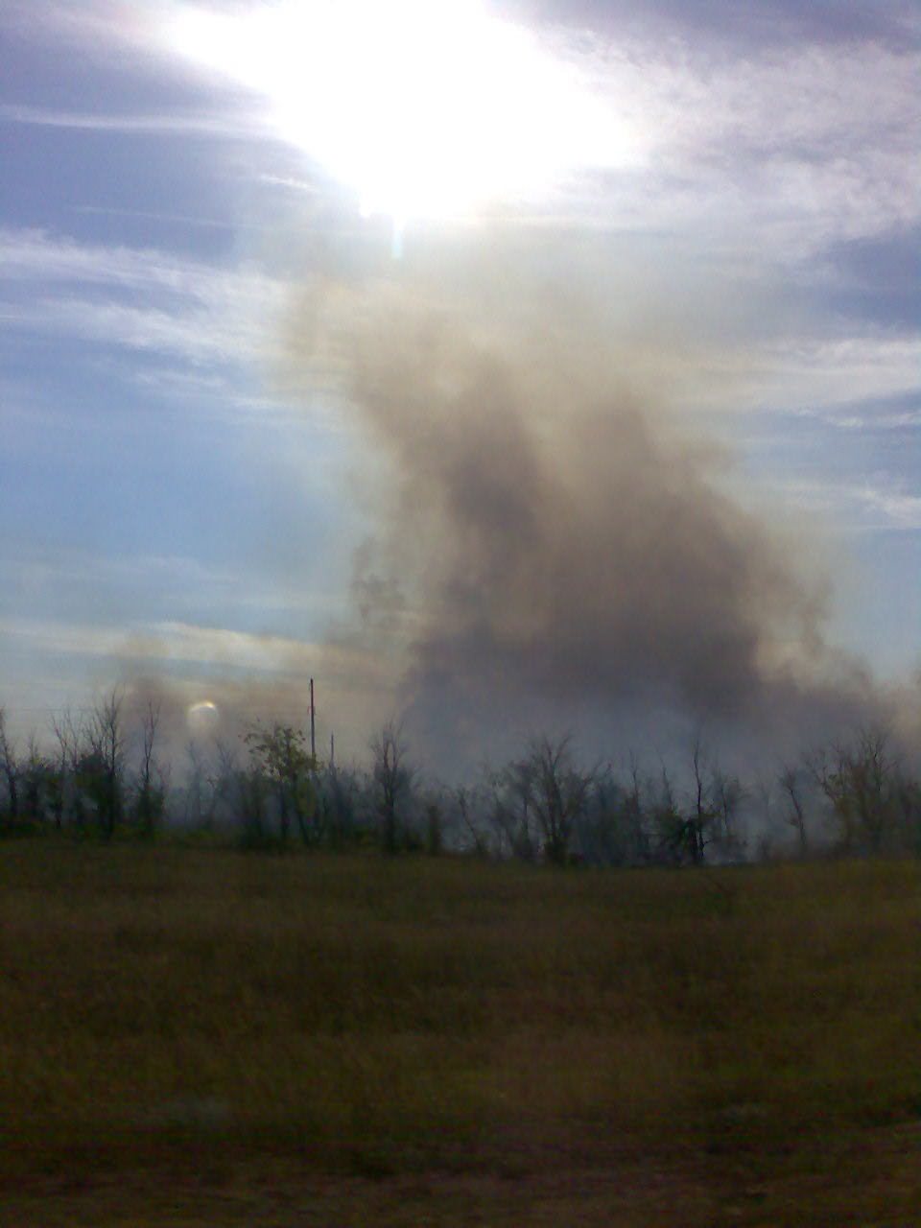

Slide 33
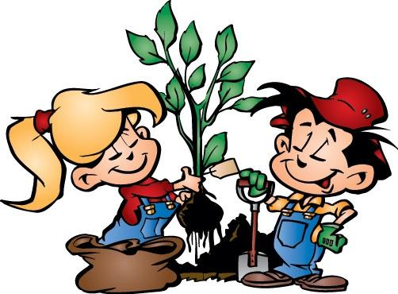
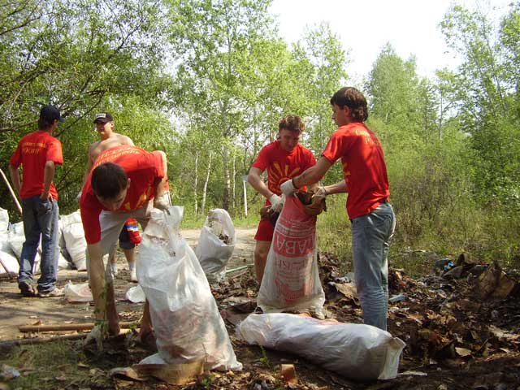
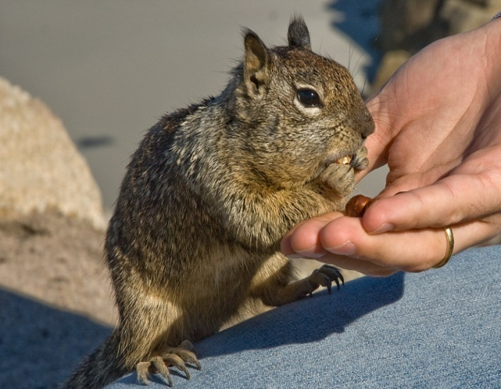

Are You Worried
About Nature?

Slide 34
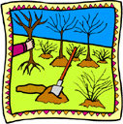

Ecology
suggests
activity!

Slide 35








The Three R’s
using electricity
glass bottles
paper
plastic containers
cartons
cans/tins
plastic bottles
using water

Slide 36

Leave wild flowers to enjoy.
Be a friend to fish. Don’t throw garbage into their homes.
Leave the place clean.
Use your head. Smart people recycle paper, cans and glass.
Plant trees and flowers.
Paint a picture, not a rock.
A mascot of the
Forest service

Slide 37

Homework :
Earth Day at your school

Slide 38

Save the Planet.flv

