Slide 1

To live healthy is cool!

Slide 2
What is the most important wealth for people ?
Car, gold, computer, school, health, money, friends, cottage, job.

Slide 3

“Health is the best wealth”
Health. A visit to the doctor

Slide 4
A letter. England , London
26/03/2019
Dear Russian friends!
I’ m Ben and I’m from London. I have some problems with my health and I need your advice.
I’m a bit lazy and never worried about my health. I like to eat sweets, drink coca-cola I think when your are a teenager, eating healthily isn’t cool. Fast food tastes so nice. I’m afraid but I always thought that people can do without doctors. But now I have stomachaches very often .What should I do?
Do you worry about your health? Do you often visit doctors ?
Please ,write me back soon.
With best wishes,
Ben
Benconor.com.@am

Slide 5

ache
heart
eye
ear
head
tooth
stomaСh
ache
BACK

Slide 6
Let’s watch a video.

Slide 7
Are you a healthy kid?
I think I’m a healthy kid,
because I often…
But I think, I should (must)….more.
And I shouldn’t…
I don’t think I’m a very healthy kid,
because I…
I think I shouldn’t…
I should (must)…to be healthier.

Slide 8
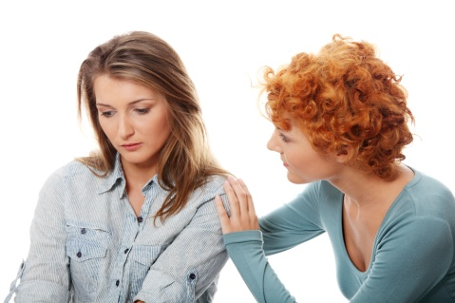
Our health depends on us.
We should care about our health

